Slide 1
The effect of race and sex on average (Median) income (Adjusted for inflation and in 2018 USD)
Project work: Our group’s github page, my section
https://github.com/rsandidge9/Team-2-Project/tree/master/Joe_Work
Data source: The center bureau of labor (CBL) statistics website
https://www.bls.gov/

Slide 2
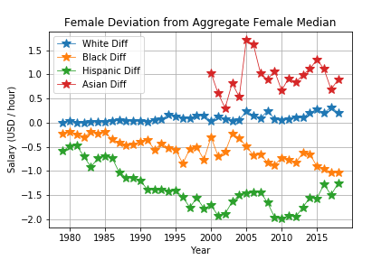
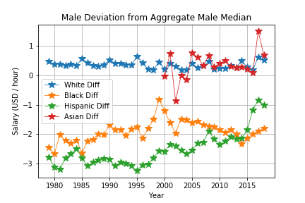
Non-white worker trends
Black and Hispanic workers are consistently beneath the median salary for each of their sex categories between 1979 and 2018. While not tabulated until 2000, Asian men consistently had a median salary above the median salaries across all racial categories. Asian women worker’s median salaries tended around the average white female worker’s median salaries with visible spikes either above (2017) or below (2002) the average salary for white female workers.
White Worker Trends
The data reflects a constant trend in which white workers, either male or female, were above the average salary and within 50¢ to $1/hr of the average salary of their respective sex category. This demonstrates how much the white workers’ salaries influences the average salary across all racial groups, and indicates that white workers for either category contribute largely to the total number of workers. The fact they have annual average salaries above the total averages implies that white workers also make more than the average salary across both sex categories.

Slide 3
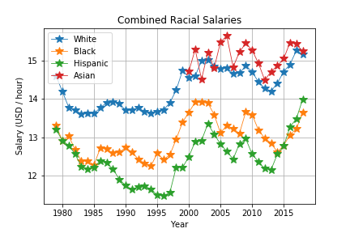
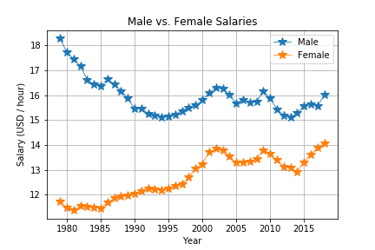
How race affects workers’ wages (Both Sexes)
The data shows us that white and Asian workers had the highest average wages while Hispanic and Black workers had the lowest wages. All race categories appear to exhibit similar rise- and fall-patterns between each other over time that reflect a shared impact from economic events (such as the recession following the 2008 financial crisis). White and Asian salaries stay above $14/hr post 1997 while Hispanic and Black workers have yet to pass $14/hr by 2018.
How sex category affects workers’ wages (All Races)
The two most noteworthy portions of the chart comparing annual average wages between the sexes are the periods of 1979-1995 and 1995-2018. In the chronologically first period of time, there was a drop in the male annual average salary and a rise in the female salary. This could reflect a rise of the female presence in the workforce that drives the medians of each category closer to the median between the two during this time. The second time period shows a mirror-like relationship between the two sexes’ average salaries. This indicates that both categories had similar reactions to market trends. It also indicates that the differences in the average salaries between the two sexes did not change as significantly as they did in the first time period.

Slide 4
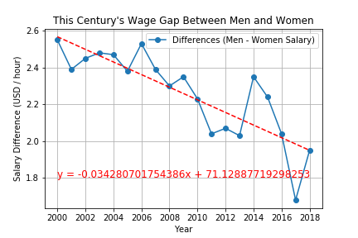
The chart on the right was created by taking the average men’s salary for each year post-1999 and subtracting the average women’s salary of each respective year. This was done to reflect the current trend in the differences bewteen men’s and women’s salaries for this century (21st). The slope and correlation coefficent imply that there is a clear decline in the differences between men’s and women’s annual average salaries as the years progress. However, the probability of recurrence (p-value) is less than 0.0001 which indicates that replicating this phenomenon would be unlikely should this data be collected for different time periods. The standard error being below 0.01 suggests that deviation from the estimated linear relationship would expected to be rather small.
Summary Statistics From This Chart
Rate of change: ~(-0.0343) Probability of Recurrence: ~1.0741*10⁻⁵ Estimate for Year 0: ~71.1289 Correlatin Coefficient:~( -0.8305)
Standard Error: ~0.0056

