Slide 1
Sudoku Web App
Team D: Jason, Robert, Nika

Slide 2
Project Overview
Goal: To create a web app for Sudoku puzzles whose features include: • Traditional 9x9 Sudoku Puzzles • Puzzles can be selected from a library or generated on demand • Selectable difficulty levels • Ability to make notes • Check solution as far as completed • Undo last move • Undo until all mistakes gone • Get a random or specific hint • Solution Timer

Slide 3
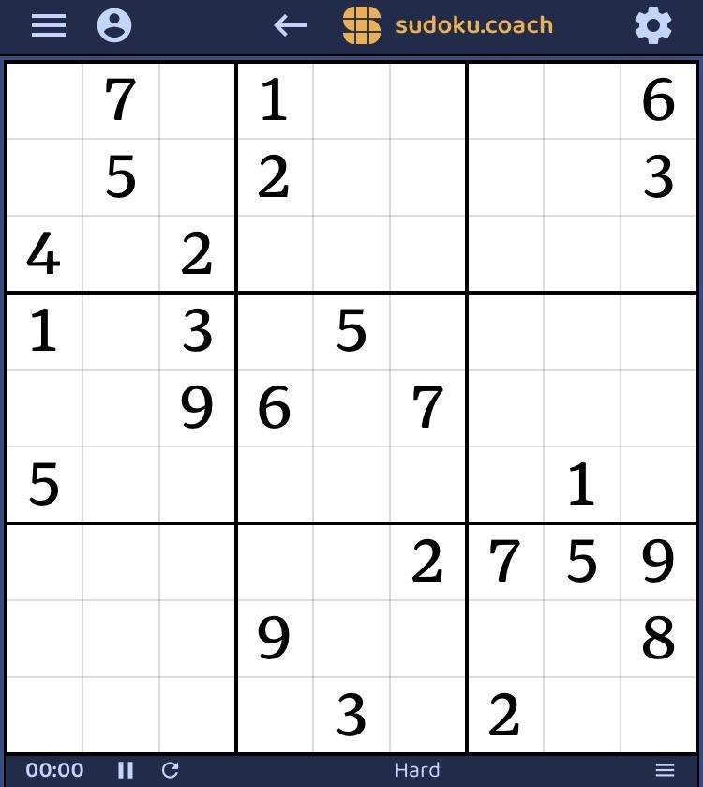

Storyboards
Home screen – appears when puzzle is instantiated:
A (random) 9x9 puzzle will be provided
The timer will be running
User will select between Easy, Medium, Hard
4
7
Gameplay:
Select a cell
Cell will be highlighted (border)
Enter a value 0-9 using keyboard
Value entered will fill entry location selected
Provided entries are shown in blue and user entries are shown in black
7
7
Notes: Off
Check Puzzle
Image source: sudoku.coach

Slide 4
Storyboards
New puzzle:
From the drop down menu choose difficulty: Easy, Medium, or Hard
4
Timer:
Toggle between a running and stopped puzzle timer
Timer will restart for a new game
Pause Timer:
Click the Pause Button
Resume timer:
Click the Resume Button
7
Check Puzzle:
All errors will be shown in red
7
7
Notes: Off
Check Puzzle
Image source: sudoku.coach

Slide 5
Storyboards
Notes mode:
Toggle notes mode
Select a cell
Cell will be highlighted (border)
Player can make notes of potential entries values 1-9
Value selected will be entered by keyboard input
Notes will override user entered values and vice-versa
1
4
7
Undo (two types):
Undo last entry (value or note)
Undo all entries (including notes) until puzzle is correct
Can be repeated until there is no user input left
7
7
Notes: On
Check Puzzle
Image source: sudoku.coach

Slide 6
Storyboards
Hint (two types):
Choose location to get hint for
Get hint at a random location
Correction of an error
Hint at an empty location
Get a hint at a specific location
Select Location
Correction of an error
Hint at an empty location
Hint appears in blue and is now permanent
4
7
7
7
Notes: On
Check Puzzle
Image source: sudoku.coach

Slide 7
Our Plan
Development Process: Incremental Approach
Allows us to implement requirements with minimal planning
We can begin using, experiencing, and testing some features earlier
Framework: Python/Django
Python programming language as a base, SQLite database for persistent data storing. Expanded upon with HTML, CSS, JavaScript (React.js), MaterialUI for expanded features.
Why??? Good for web apps. Allows us to focus on implementing the game logic and user interface and gives us access to REST API’s. Plus all of us were familiar with Python, HTML, CSS, JavaScript and SQL

Slide 8
Framework
Database
MySQL
json
Browser
HTML, CSS, JavaScript (React)
Server
Python Django
Internet
json
File
System

Slide 9
Demonstration!

Slide 10
Database Schema
SudokuBoard
Columns:
board_id: AutoField (Primary Key)
board: CharField (Max Length: 81)
solution: CharField (Max Length: 81)
userBoard: CharField (Max Length: 81, Nullable, Blank)
creation_time: DateField (Default: Current Date)
ActionHistory
Columns:
id: AutoField (Primary Key)
sudoku_board_id: ForeignKey (SudokuBoard, On Delete: Cascade)
row: PositiveBigIntegerField
col: PositiveBigIntegerField
previous_value: IntegerField
new_value: IntegerField
timestamp: DateTimeField (Auto-set to Current)
undone: BooleanField (Default: False)
NoteHistory
Columns:
id: AutoField (Primary Key)
sudoku_board_id: ForeignKey (SudokuBoard, On Delete: Cascade)
row: PositiveBigIntegerField
col: PositiveBigIntegerField
value: IntegerField
Unique Constraint (Optional):
Unique combination of row and col per note
SudokuBoard → ActionHistory: One-to-Many
SudokuBoard → NoteHistory: One-to-Many

Slide 11
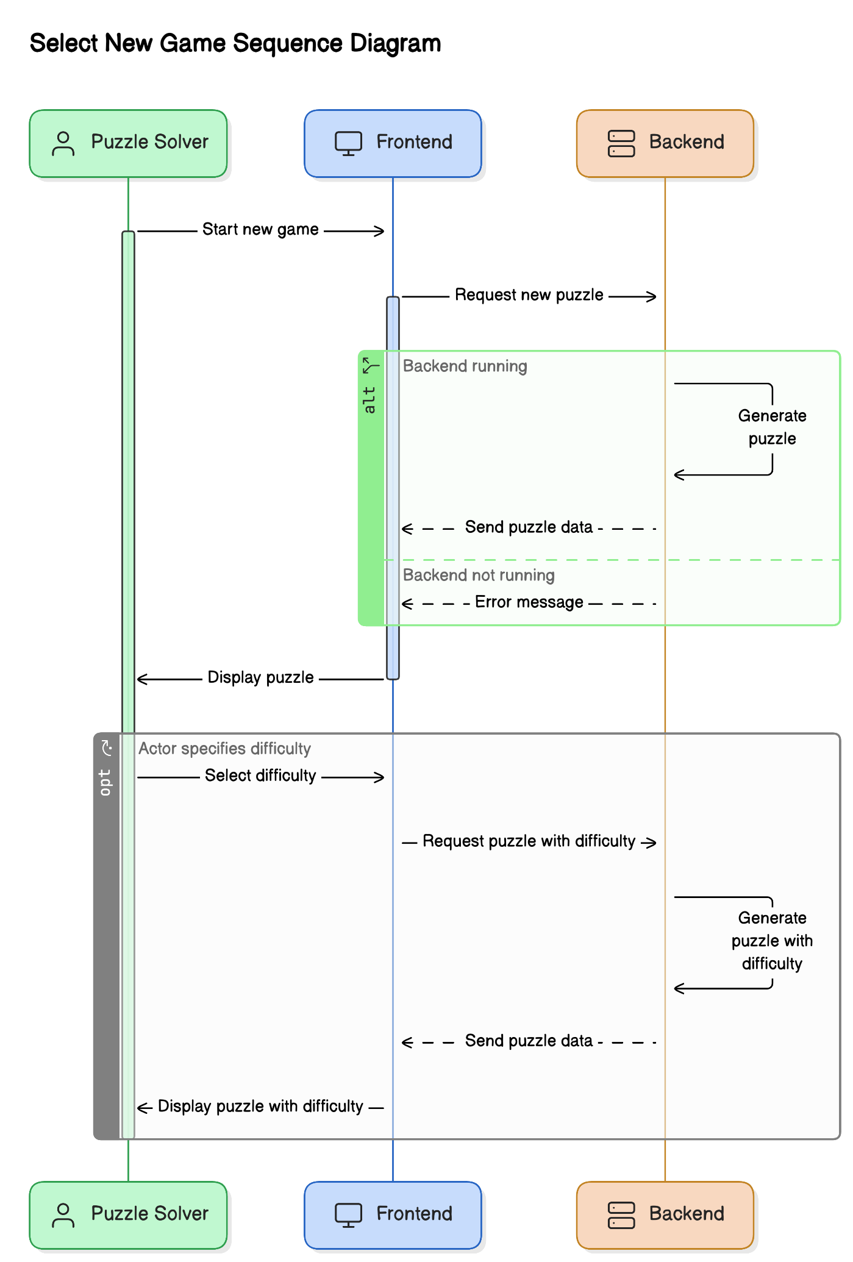
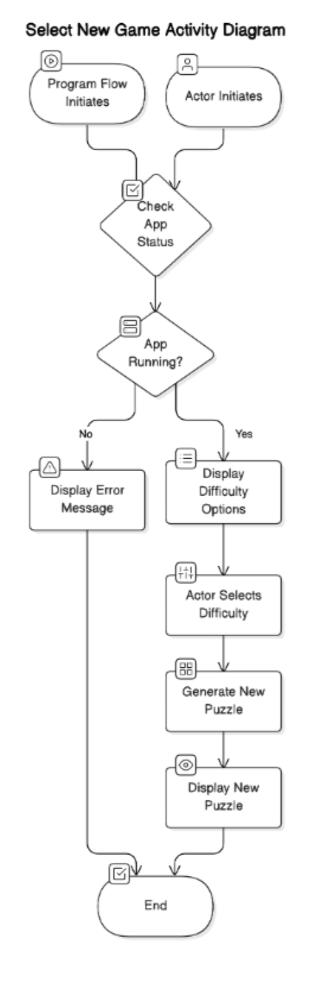
Select New Game
Scenario Title: Select New Game
Actor: Puzzle solver
Stakeholder: Group D
Preconditions:
Backend and Frontend are both running
App is running and actor wants to start a new game
Triggers:
Program flow initiates
Actor initiates
Success scenarios: [Basic Flow] Actor specifies games size and difficulty and new puzzle appears and is ready for use

Slide 12
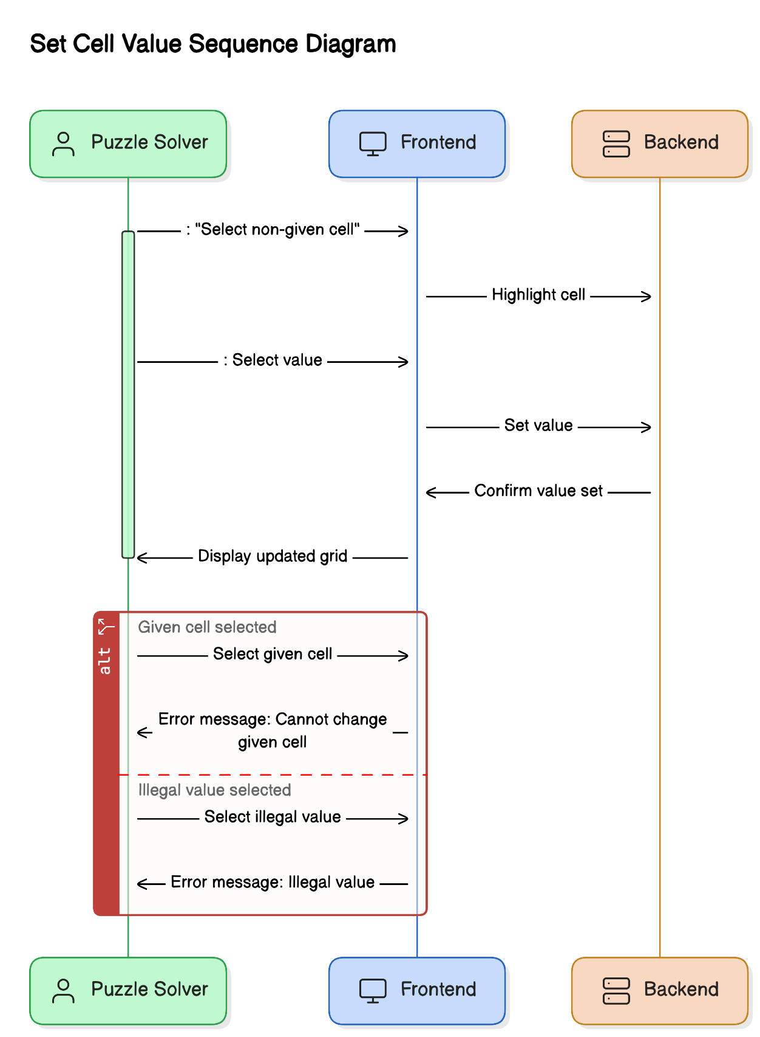
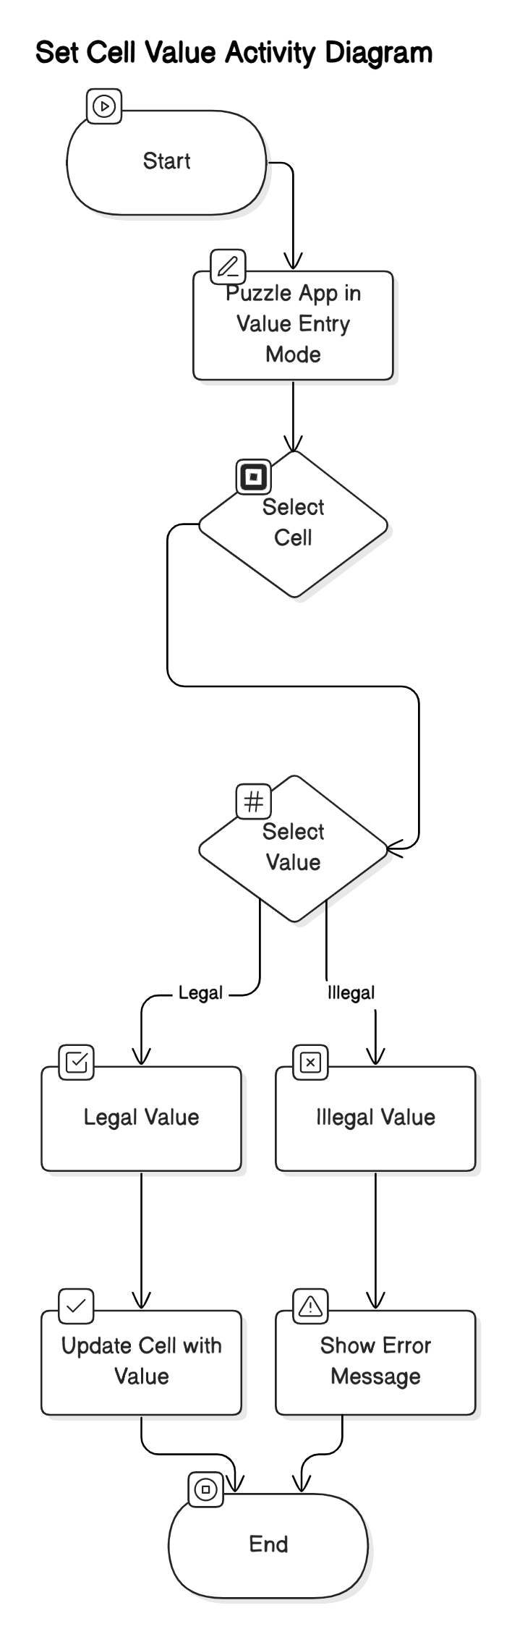
Set Cell Value
Scenario Title: Set Cell Value
Actor: Puzzle solver
Stakeholder: Company hosting puzzle app
Preconditions:
Actor has started an unfinished puzzle
Triggers:
Puzzle app is in value entry mode
Main success scenarios: [Basic Flow]
Actor selects a non-given cell to fill in (including overriding)
Actor selects a value to be put in chosen cell
Alternative paths: [Alternative Flow]
Actor selects a ‘given’ cell
Actor selects an illegal value

Slide 13
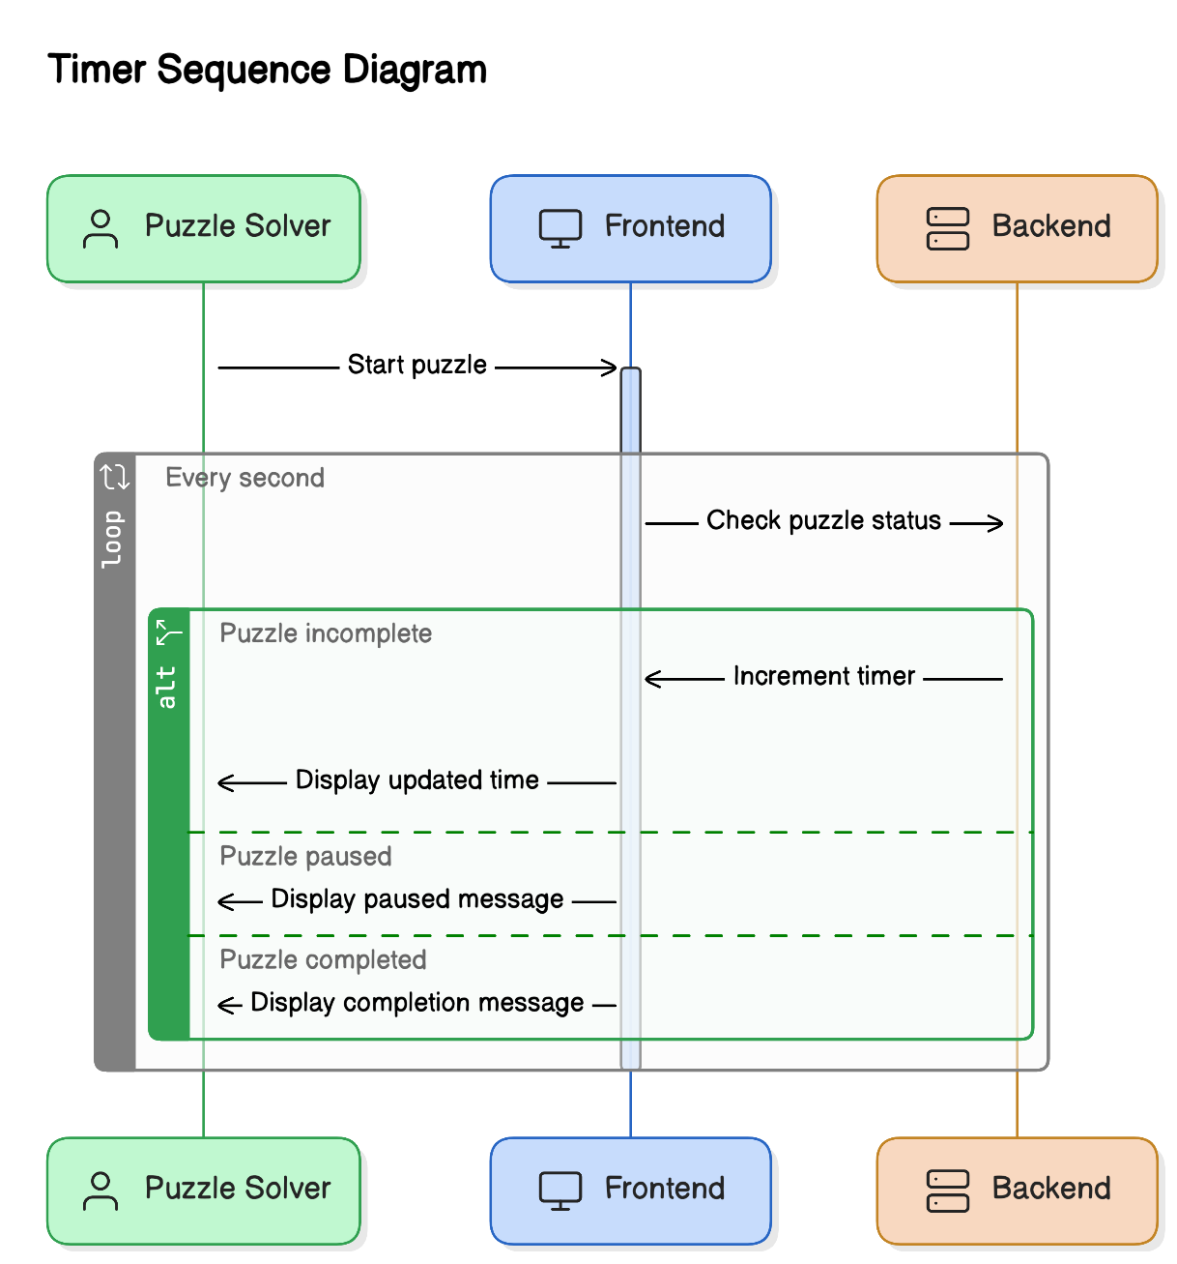
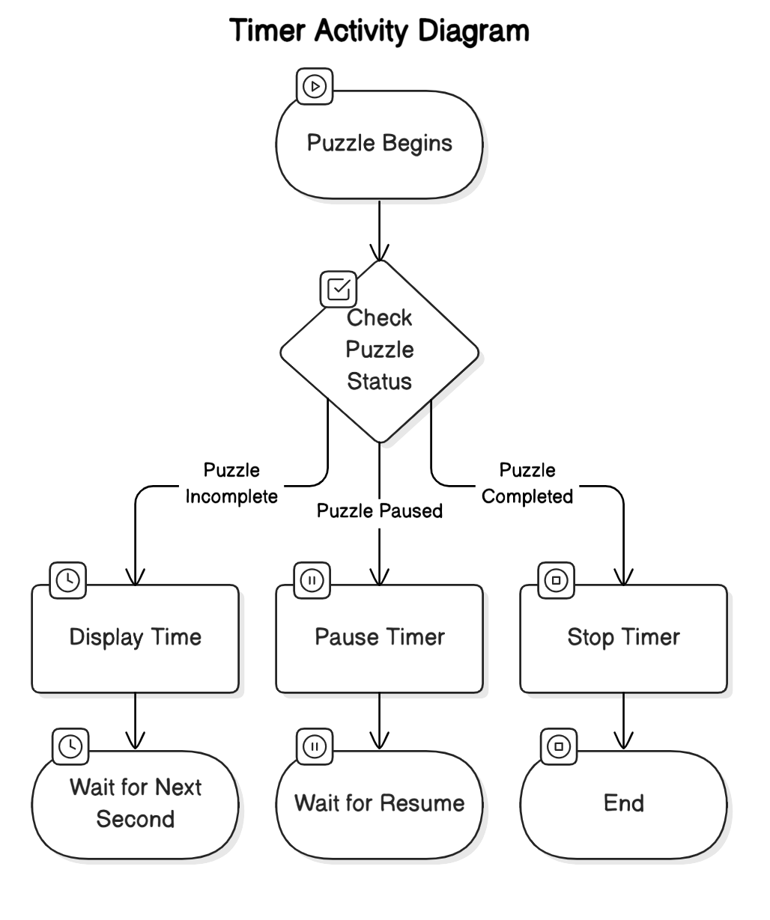
Timer
Scenario Title: Timer
Actor: Application time event handler
Stakeholder: Group D
Preconditions:
App user is actively solving an unfinished puzzle
Triggers:
Puzzle begins
One second has elapsed since last increment
Main success scenarios: [Basic Flow]
Amount of time taken so far to solve an incomplete puzzle is displayed
Amount of time taken so far to solve an incomplete puzzle is displayed
Actor can pause the timer
Time count and display are resumed
Alternative paths: [Alternative Flow]
Puzzle has been completed

Slide 14
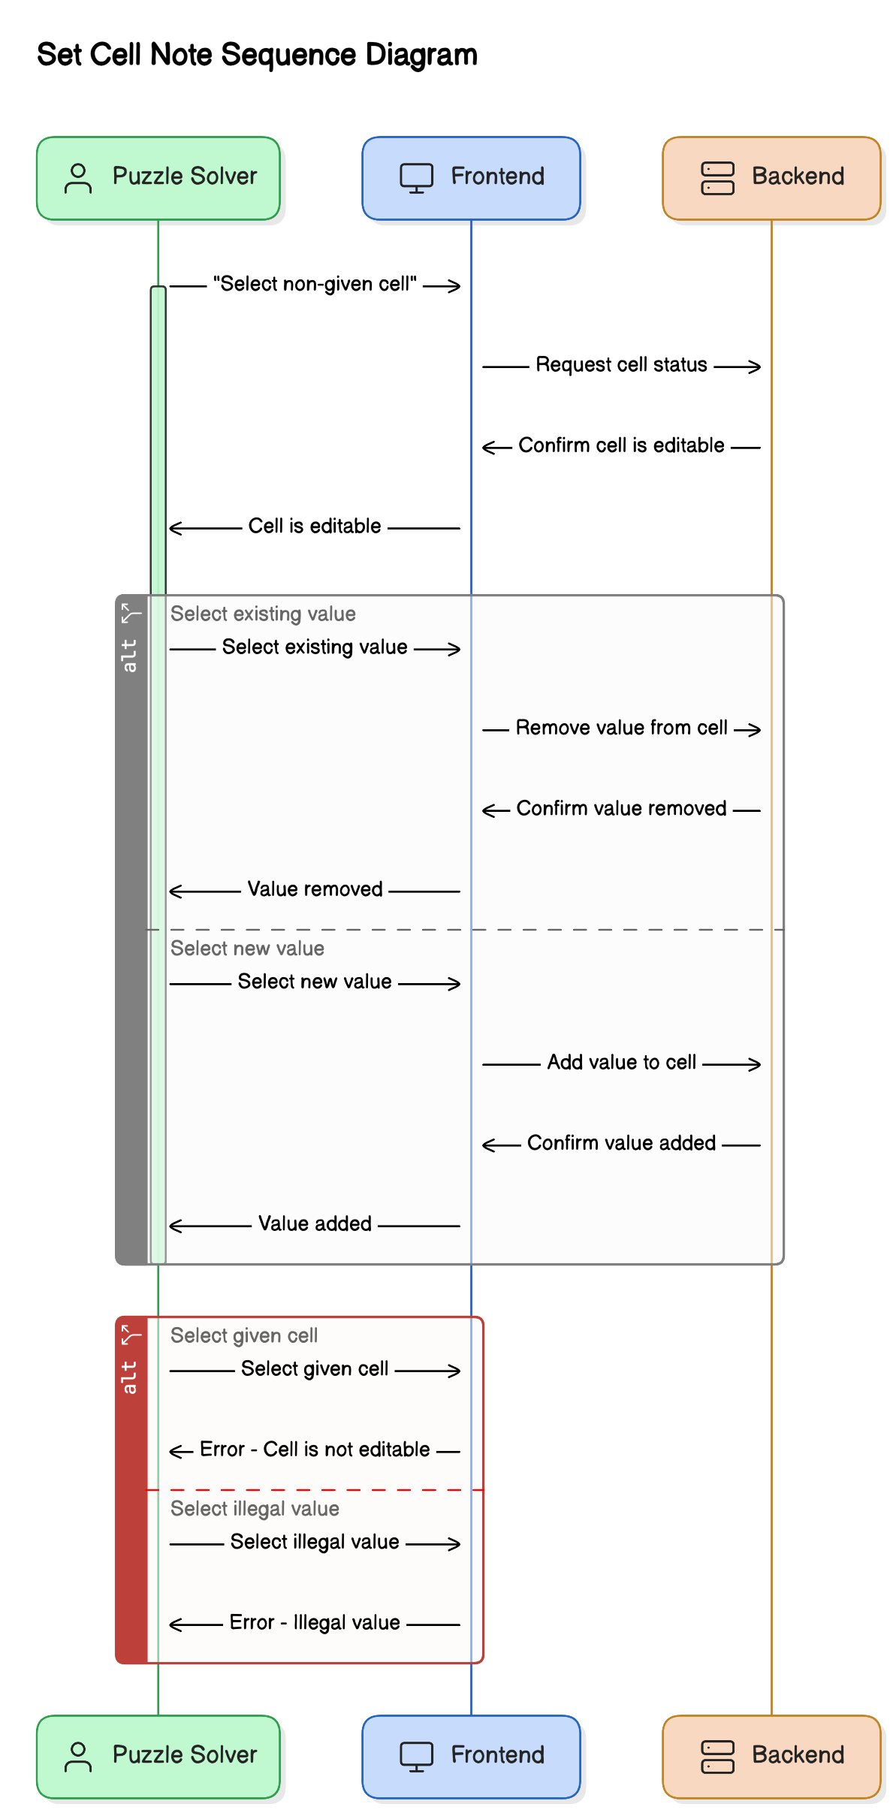
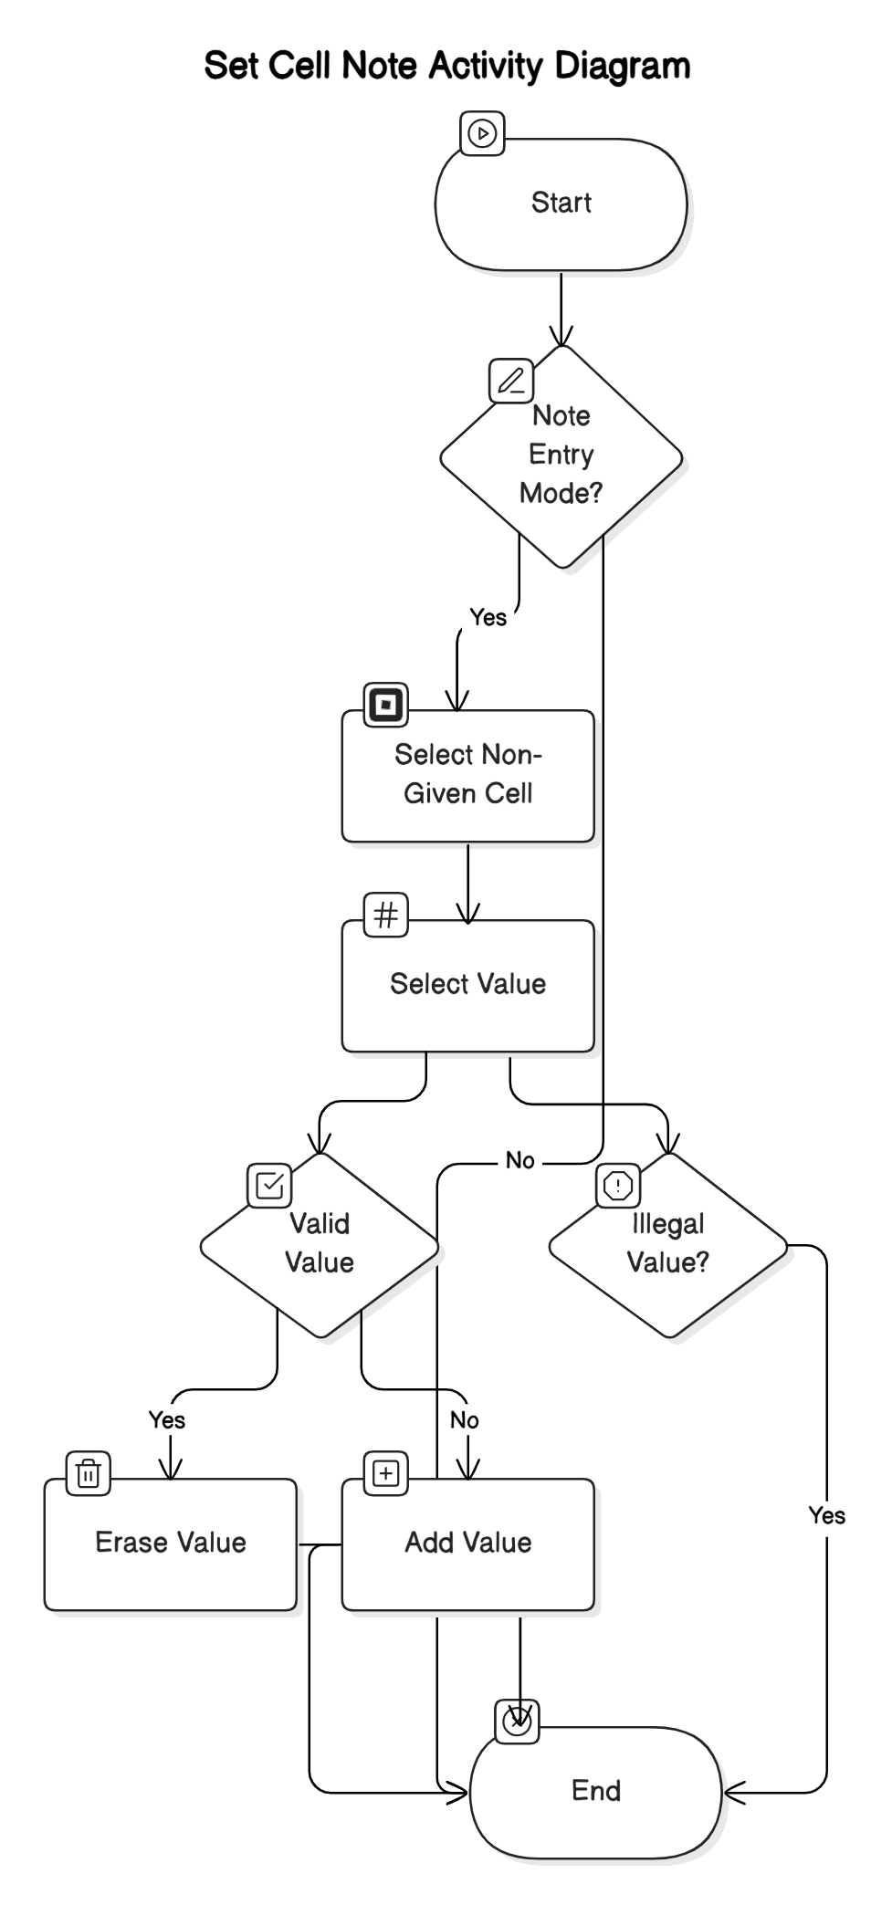
Set Note
Scenario Title: Set Cell Note
Actor: Puzzle solver
Stakeholder: Group D
Preconditions:
Actor has started an unfinished puzzle
Triggers:
Puzzle app is in note entry mode
Main success scenarios: [Basic Flow]
Actor selects a non-given cell to fill in
Actor selects a value to be put in chosen cell
Selecting an existing value will erase it
Selecting a new value will add it
Alternative paths: [Alternative Flow]
Actor selects a ‘given’ cell
Actor selects an illegal value

Slide 15
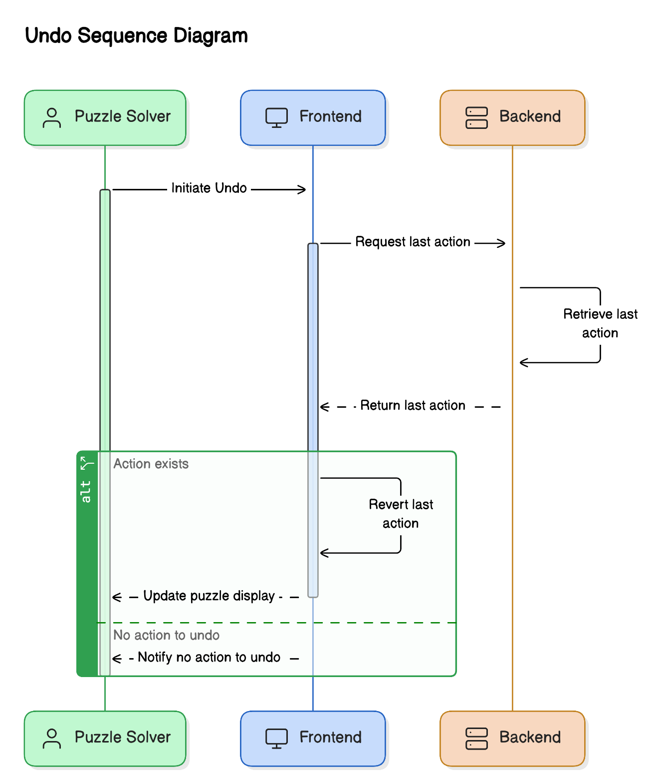
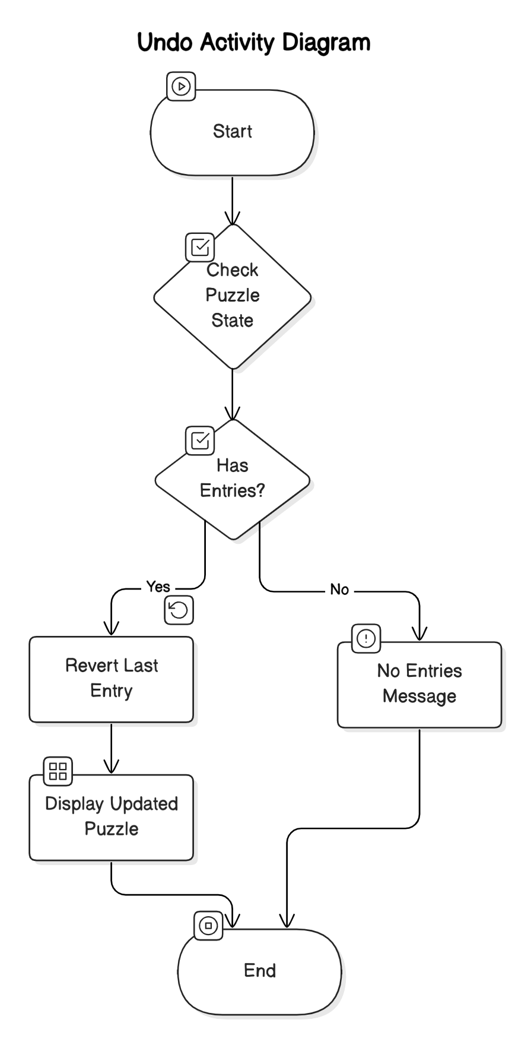
Undo
Scenario Title: Undo
Actor: Puzzle solver
Stakeholder: Group D
Preconditions:
Actor has started an unfinished puzzle
Triggers:
Actor initiates
Main success scenarios: [Basic Flow]
Puzzle is re-displayed with cell last filled in put back to it’s previous value
Works for both value and note entries
Alternative paths: [Alternative Flow]
Puzzle has no actor entered values or notes

Slide 16
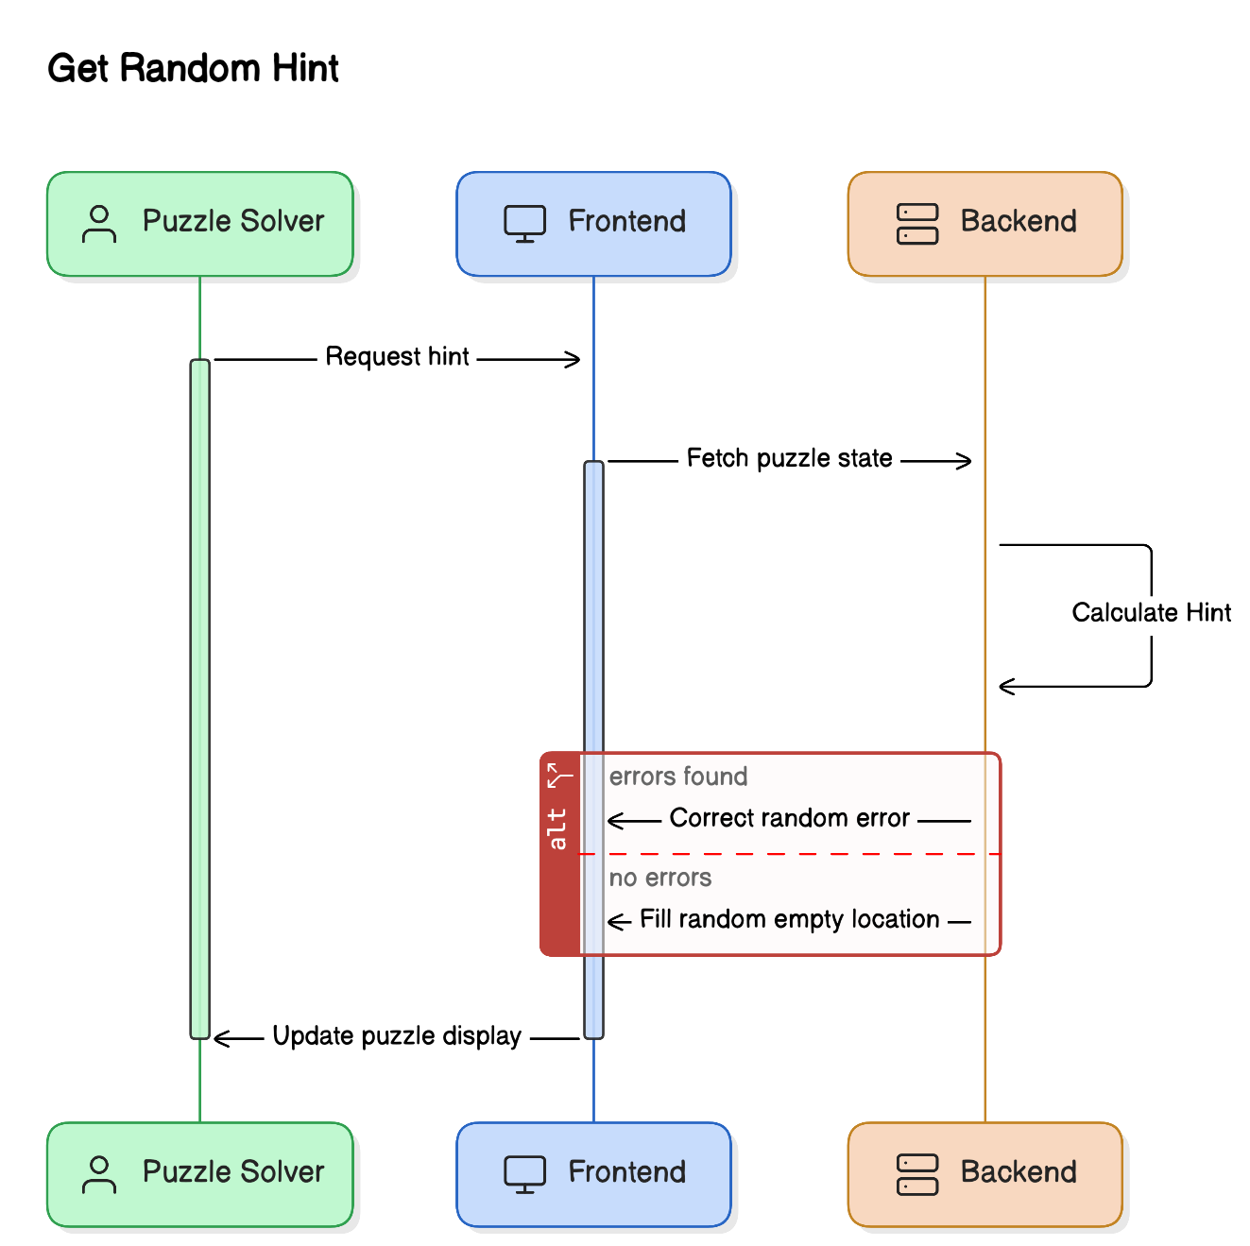
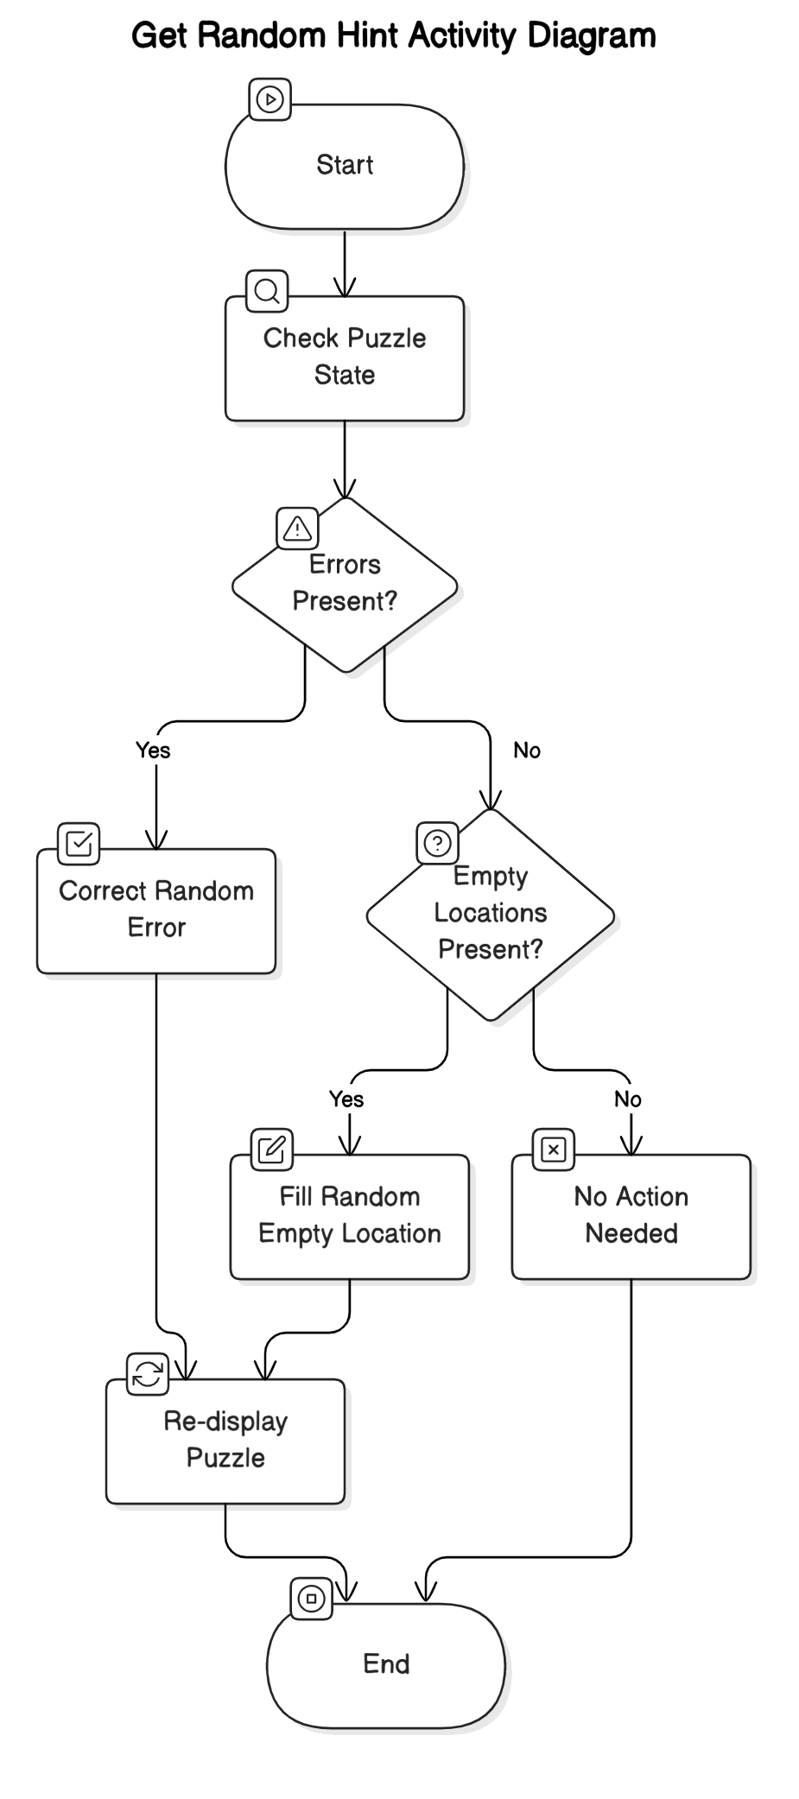
Random Hint
Scenario Title: Get Random Hint
Actor: Puzzle solver
Stakeholder: Group D
Preconditions:
Actor has started an unfinished puzzle
Triggers:
Actor initiates
Main success scenarios: [Basic Flow]
Puzzle is re-displayed with a randomly chosen error corrected, or (if no errors)
Puzzle is re-displayed with a randomly chosen empty location filled in

Slide 17
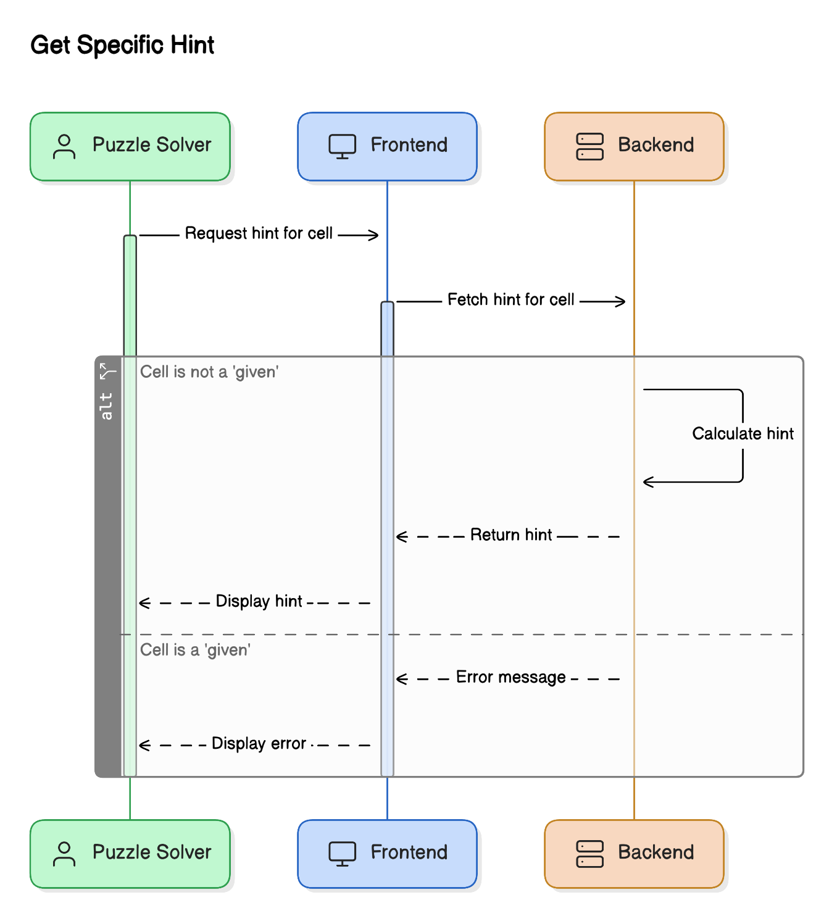
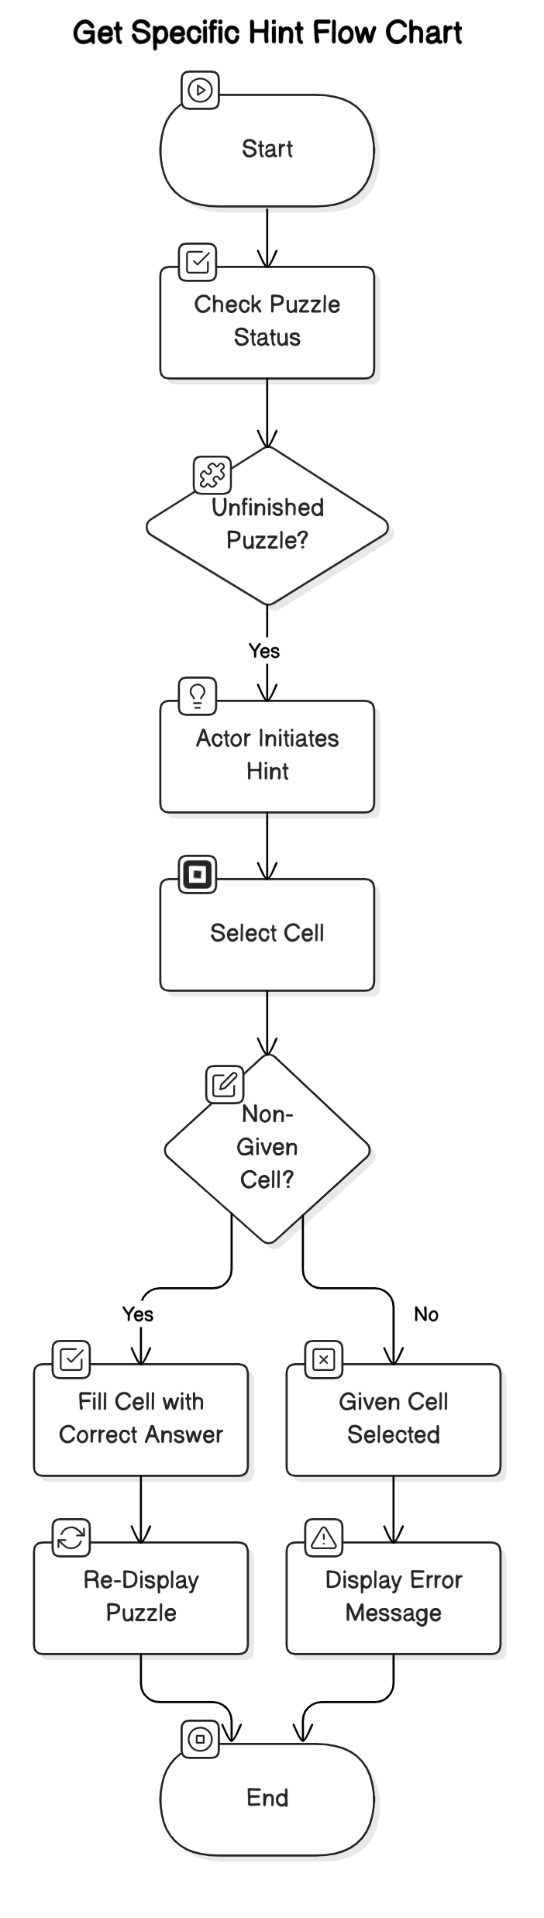
Specific Hint
Scenario Title: Get Specific Hint
Actor: Puzzle solver
Stakeholder: Group D
Preconditions:
Actor has started an unfinished puzzle
Triggers:
Actor initiates
Main success scenarios: [Basic Flow]
Actor selects a non-given cell to be filled in with a correct answer
Puzzle is re-displayed with cell indicated correctly filled in
Alternative paths: [Alternative Flow]
Actor selects a ‘given’ cell

Slide 18
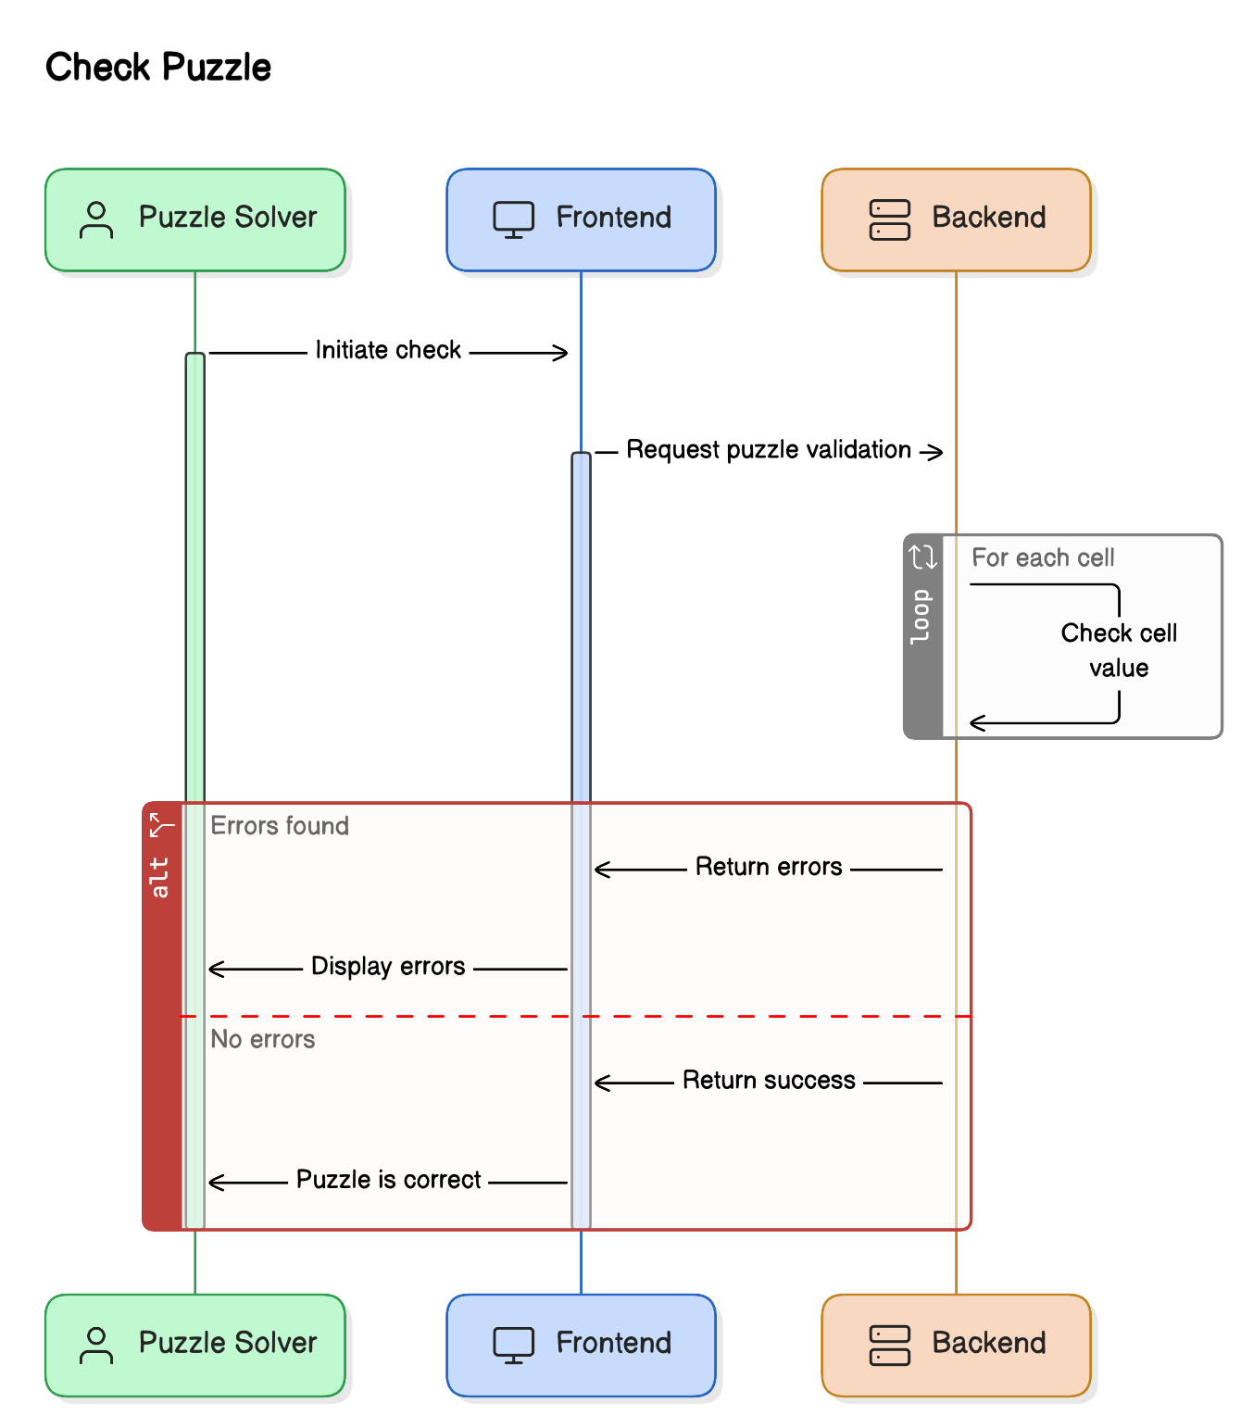
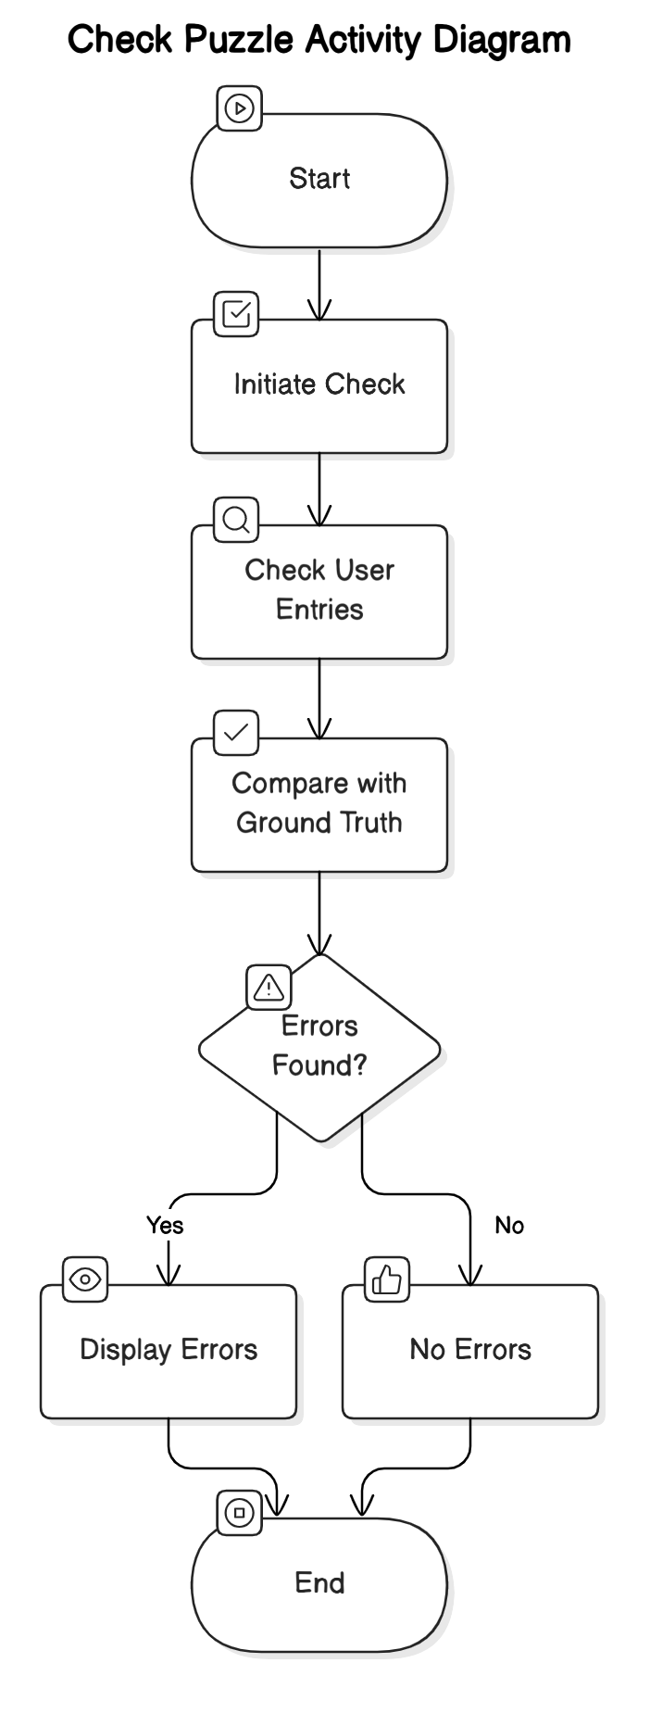
Check Puzzle
Scenario Title: Check Sudoku Puzzle for Correctness
Actor: Puzzle solver
Stakeholder: Group D
Preconditions:
Actor has started an unfinished puzzle
Triggers:
Actor initiates
Main success scenarios: [Basic Flow]
Puzzle is re-displayed with any errors indicated
Only works for value entries, not note entries
All user entered cell values are checked against the ‘ground truth’
Alternative paths: [Alternative Flow]
There are no errors

Slide 19
Testing
Unit Testing
Algorithms
Integration Testing
API Testing: Postman
Usability Testing
User Interface (UI)
User Testing

