Slide 1
Marketing Analytics MSDS 450 Section 55
Solo 3 Sync Session
August 8, 2018

Slide 2
Agenda – Part 3
Course is divided into 3 Application parts:
Part 1 - Market Segmentation analysis – Solo 1 Project (3 weeks)
Understanding the market – Clustering techniques
Part 2 - Discrete Choice experimentation – Solo 2 Project (3 weeks)
Understanding the market’s preferences – Conjoint (DOE), Multinomial Logistic Models (Bayesian methodology)
Part 3 - Customer campaign response modeling
- Solo 3 Project (3 weeks)
Understand customers’ behavior & their responses – Classification Models - Tree Based, Logistic Regression, SVM,…

Slide 3
Part 3 – Customer Campaign Response Modeling
Overview
Customer Data (Raw data): Sales transactional data, & other data from customers exist. Based on customer zip codes, zipcode-specific information can be purchased.
Note that the different data sources are at different atomic levels.
Customer Profile Data (Processed data): Based on sales & other data, customer profile data is created. (ie) Each row is has a unique customer name. Other attributes are customer past sales, demographics, zip code-level demographics, etc.
Campaign Response Model - Predictive Model: Based on customer profile data, we can use tree-based models such as CART to predict the customer response; Note that we are using ‘supervised learning’ techniques since we have the customer response;
We can also build a Logistic Regression model for respond/no respond. This will also provide us the probability that a person will respond in the future. Hence, we would be able to create a ‘targeted’ list of customers who have high probabilities of buying.
You can use different ‘cut-off’ probabilities to construct different ‘targeting’ scenarios
Financial Modeling: Calculate the financial impact of the marketing campaign, for different ‘target marketing’ scenarios . Watch Dr. Tom Miller’s video.

Slide 4
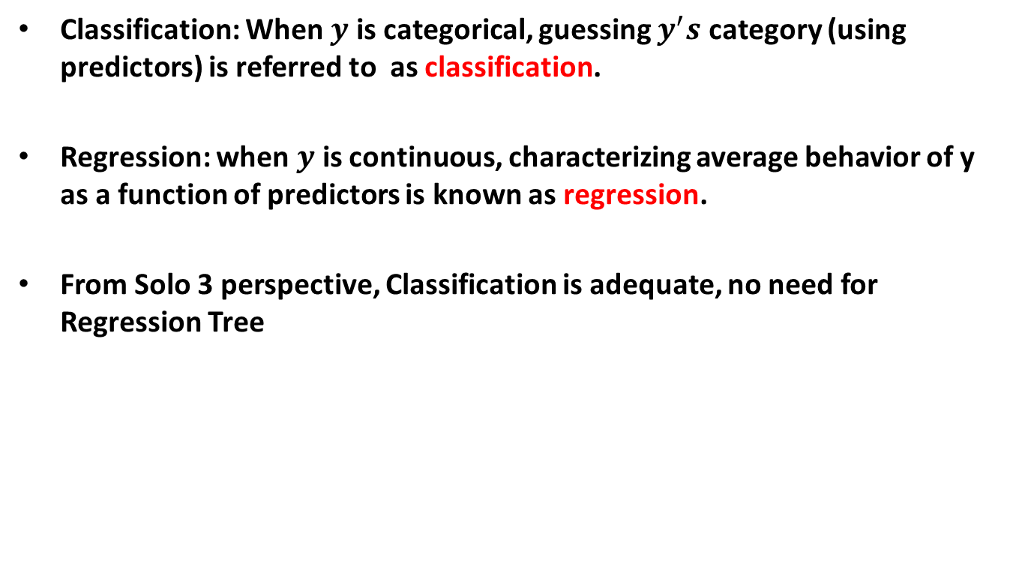
CART
Classification: When $y$ is categorical, guessing $y^{′}s$ category (using predictors) is referred to as classification.
Regression: when $y$ is continuous, characterizing average behavior of y as a function of predictors is known as regression.
From Solo 3 perspective, Classification is adequate, no need for Regression Tree

Slide 5
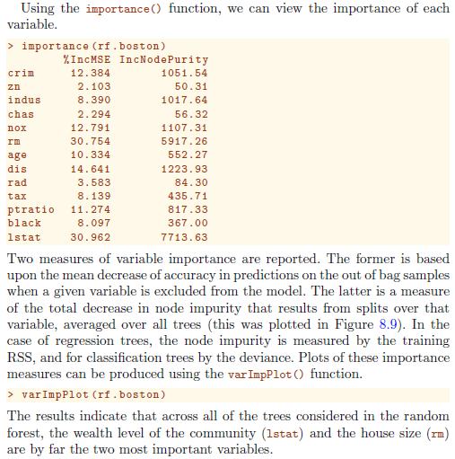

Slide 6
References
The Elements of Statistical Learning: Data Mining, Inference, and Prediction. Hastie T, Tibshirani R, Friedman J. Second Edition 2009.
http://stats.stackexchange.com/questions/6581/what-is-deviance-specifically-in-cart-rpart
Hand DJ, Daly F, McConway K, Lunn D, Ostrowski E. A Handbook of Small Data Sets, Chapman and Hall 1996.

Slide 7
Logistic Regression (410/411)
Similar to Multinomial Logistic Regression but with binary response
Modeling the log(odds ratio)
E(y) = log(p/(1-p)) = β0 + β1x1 + β2x2 + …..
p = exp(β0 + β1x1 + β2x2 ) / {1+ exp(β0 + β1x1 + β2x2 )}
Note that we use the exponential function to do this in Solo 2
Use the ‘predict’ function in R to compute the probabilities
Model performance – AIC, Deviance, Confusion Matrix, etc.

Slide 8
Goodness of Fit Statistics for Logistic Regression
Deviance is a measure of goodness of fit of a generalized linear model.
Similar to ‘residuals’ in OLS, ‘deviance’ is used for MLE method
It is a measure of badness of fit–higher numbers indicate worse fit.
The null deviance shows how well the response variable is predicted by a model
that includes only the intercept (grand mean) – similar to overall RM in MLR
The residual deviance is for the model with other predictors – similar to FM in
MLR.
Chi-square test is used for hypothesis testing of FM vs RM
AIC is based on the Deviance, but penalizes for making the model more
complicated, but does not have a practical interpretation.
Much like adjusted R-squared, it’s intent is to prevent including irrelevant
predictors.
Smaller AIC, the better model is.

Slide 9
Solo 3 Assignment – Data files you would need
Project Description File: Solo-3-project description.pdf
2) Data Dictionary: Experian Data Dictionary.pdf
3) Data Dictionary: XYZ_Data Dictionaries.xls
Data file: XYZ_complete_customer_data_frame.Rdata
(This is the Customer profile data, which is already processed, hence
you start from here, no need to start with the raw data)
5) ‘Read’ data file: XYZ_read_data.r

Slide 10
Solo 3 Data description – ‘Customer Profile Data’
XYZ_complete_customer_data_frame.Rdata
Summarized sales data from retail industry on 30,779 customers
Data on actual transactions - $ as well as number of units of different products
Dr. Tom Miller wrote R code to summarize the transactions at the customer level
from raw data (watch his video, if you want to know the details)
Each customer’s zip code was gathered & zip code level aggregate data merged
In the summarized data set, each row is a unique customer
Some columns provide actual sales information of the customer
Other columns are zip-code related data which was purchased

Slide 11
Solo 3 Problem description
Use XYZ's data to develop a model-based method for targeting customers that XYZ can use to make its upcoming mail campaign profitable.
This campaign will consist of one mailing to XYZ customers who are selected based on your analytic results and your recommendations.

Slide 12
Solo 3 Modeling Steps
Data Frame: 30,779 observations & of 554 variables
Most of the variables are categorical variables
First do EDA, to get insights about the data
You may build tree-based models to predict response
Goodness of fit statistics & validation
You may build a logistic regression or other models to predict response
Goodness of fit statistics & validation
Use different cutoff points on the probabilities to develop multiple campaign scenarios
Do financial analysis to compare different campaigns & make a recommendation

Slide 13
Solo 3 Project tidbits
Solo 3 data is from a ‘real’ retail company
Not much information about the data other than the data dictionary – this mimics ‘real life’ – lot of time you really do not know much about the data!
Not much information about the goal either! – get the ‘best’ possible ‘target marketing’ plan!
Uses knowledge of Part 1 & Part 2 as well
Uses Part 3 of the Course – Tree/LR/SVM based models for prediction
You will be ‘putting it all together’!

Slide 14



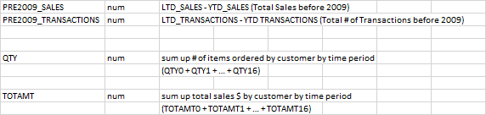
Some information on the summarized variables

Slide 15
R Demo

Slide 16
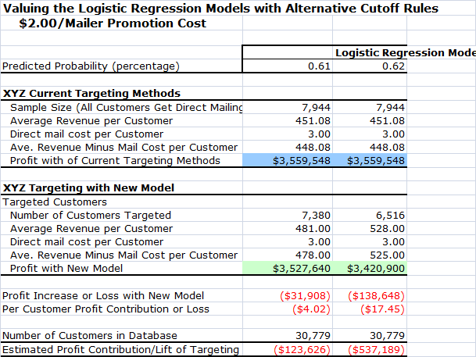
Financial Analysis
Recommendation: Use the current Targeting process

Slide 17
Next Steps
Read the material on CART/Random Forest
Read the material on Logistic Regression (411)
Dr. Tom Miller’s Sync on Data Integration
Dr. Tom Miller’s Sync on Financials
Review R, Lander’s book (Chapter 20)
Kotler’s book (Chapters 17 - 22)
Start on Solo 3 NOW!

Slide 18
Some modeling strategies
Pretend you are a domain expert & pick 50 or so variables first
Review them & clean up if necessary – numeric vs categorical (lumping?)
No NEED to create dummy variables
If ‘important’ variables have NA’s then make a decision (use or not use)
Need to decide whether to impute NA’s (MICE, amelia, etc. – quick decision)
Prepare the data for modeling
Try at least 3 methods – Logistic regression, RF, SVM, etc.
Compare the methods and pick one
Make sure that you do the validation
You will have at least 2 list of candidates – all, based on cut off
Do the financial analysis for both groups and decide

Slide 19
Questions?

