Slide 1
MSDS 450
Solo 1 Deep Dive Sync Session
July 3, 2018

Slide 2
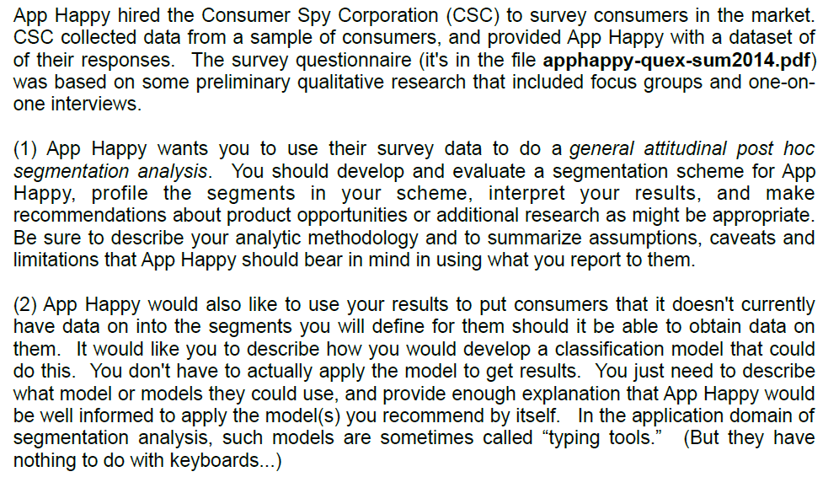
Solo 1 Assignment Details

Slide 3
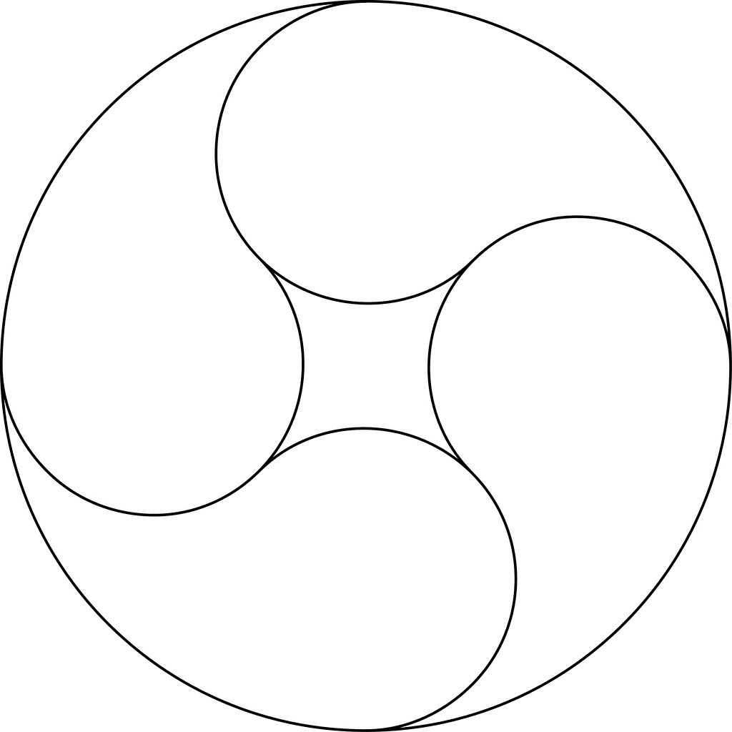
High Level Modeling Process
What is the goal?
Market Segmentation
Cluster techniques
Unsupervised Learning methods
Heuristic methods
Do not have distributional kind of assumptions
What is relevant?
Dimension reduction?
Multicollinearity?
“The formulation of the problem is often more essential than its solution, which may be merely a matter of mathematical or experimental skill.” Einstein
Problem Formulation
“All models are wrong but
some are useful”
George Box
Implementation
$$
Exploration
EDA
“You can a see a lot by looking”
Yogi Berra
Modeling/
Validation
“Models need to be as simple as possible but not simpler than necessary” Einstein

Slide 4
http://setosa.io/ev/principal-component-analysis

Slide 5
Clustering Methods – Different basis variables
Continuous attributes
Hierarchical based
Partition based (eg. k-means, PAM)
Model based (EM, mixture models)
Categorical attributes
In Solo 1, we have 40 attributes with 6-point scale
For each attribute, 6 binary variables are generated
40 x 6 = 240 binary columns (Yes/No for each score)
If there are 2,000 people, then we have 2,000 x 240 matrix
2 rows (ie 2 people) are ‘close’ if the % match is ‘high’
Time series attributes
Industrial IOT

Slide 6
Feature Engineering
“You can see a lot by looking” Yogi Berra – Getting insights
EDA – Summary, Correlations, PCA, etc.
Data cleansing
“Feature” construction & selection
Box-Cox kind of transformations you used in 410 (log, …)
Computing relevant ‘features’ from the raw data
Retail companies may use weekly # of transactions for each customer
Weekly Sales $ per customer
Zillow uses age of the house (Sale date – Build date)
Signal processing - Fourier, wavelet, etc. for IOT data
Attitudinal data – Combine responses of similar questions

Slide 7
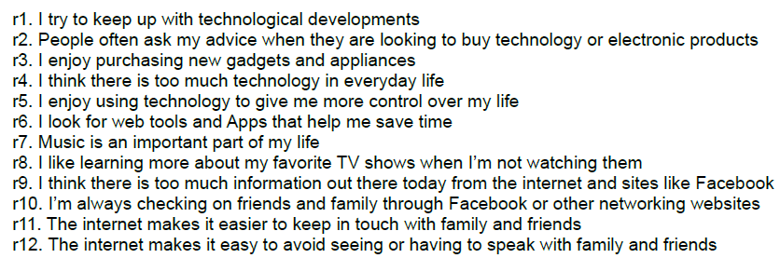
Question 24 – “Technology Savviness”
Grouping similar questions:
1, 2, 3, 5, 6 -> positive attitude towards technology
7,8 -> music/TV
10, 11 -> Internet/Communications
4, 9, 12 -> negative aspects of technology
12 variables can be reduced to 4 groups/themes/dimensions by computing means

Slide 8
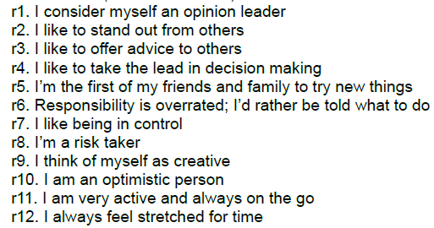
Question 25 – “Leadership”
Grouping similar questions:
1, 2, 3, 4, 5 -> Leadership
7,8 -> Control
9, 10, 11 -> Drive
6, 12 -> negative
12 variables can be reduced to 4 groups/themes/dimensions by computing means

Slide 9
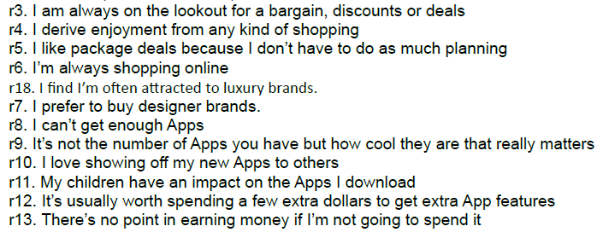

Question 26 – “Shopping”
Grouping similar questions:
3, 4, 5, 6, 7 -> bargain
8, 9, 10 -> show off
11 -> children
12, 13, 14 -> hot
15, 16, 17, 18 -> brand
12 variables can be reduced to 5 groups/themes/dimensions by computing means

Slide 10
Typing Tools
Typing tool is used on an ongoing basis for segmentation, full use of segmentation is realized only when typing tool is also delivered along with segmentation results.
Segmentation uses ‘Unsupervised’ learning methods whereas Typing tool uses ‘Supervised’ learning methods
In Typing tools, generally, fewer predictors are used – either the original variables from segmentation or summarized version or totally different variables
Several methods used – Discriminant Analysis, CART, Linear Probability Models, etc.
During the segmentation process, typing tool also can be developed & validated thru test sets or cross validation process

Slide 11
Questions?

