Slide 1

POLICY-GROUNDED EXPLAINABLE AI FOR MEDICARE FRAUD DETECTION INTEGRATING MACHINE LEARNING AND RETRIEVAL-AUGMENTED GENERATION
Roya Sanjanaki
Master of Science in Data Science | July 2026
Advisor: Dr. Xiaoyue Cheng Committee: Dr. Mahbubul Majumder · Dr. Fadi Alsaleem
Notes:
Welcome. My thesis is titled 'Policy-Grounded Explainable AI for Medicare Fraud Detection: Integrating Machine Learning and Retrieval-Augmented Generation.' I'll walk you through the problem, the data, the methods, the results, and the system I built to make these predictions actionable for fraud investigators — with no ML expertise required.

Slide 2

Presentation Overview
Introduction
Related Work
1
2
Medicare fraud problem, motivation, objectives
Fraud detection, XAI, RAG & LLM methods
Methodology
Experiments & Results
3
4
Research design, data sources, feature engineering, ML models & RAG pipeline
Performance metrics, feature importance, calibration
Discussion
Conclusion
5
6
Key findings, limitations, contributions
Takeaways, future directions, Q&A
Data Science | M.S. Thesis Defense · July 2026
2
Notes:
Here is the roadmap for the next 40 minutes. Six sections covering the full thesis: why Medicare fraud is hard to detect automatically, how I set up the experiments, what machine learning models I trained, the results and explainability analysis, the RAG chatbot, and finally the discussion and contributions.

Slide 3

Introduction
&
Related Works
Data Science | M.S. Thesis Defense · July 2026
3
Notes:
Let's start with why this problem matters. I'll cover the scale and impact of Medicare fraud, the research gap — why detection alone isn't enough — and introduce the two research objectives this thesis addresses.

Slide 4
The Medicare Fraud Problem
$60B+
1
Evolving fraud schemes:
Rule-based systems miss new fraud patterns.
Machine
Learning
2
Massive data volume:
Manual investigation is impossible at Medicare scale.
estimated annual Medicare
fraud, waste, and abuse
Source: OIG Fraud Statistics
9.5% of total Medicare spending
3
Limited explainability:
Black-box models cannot justify investigations.
Data Science | M.S. Thesis Defense · July 2026
Data Science | M.S. Thesis Defense · July 2026
4
Notes:
Medicare fraud costs U.S. taxpayers an estimated $60 billion or more annually — nearly 10% of total Medicare spending. With 65 million beneficiaries, manual review is impossible. Four problems define why this is hard: legacy rules can't adapt to evolving schemes; the massive scale demands automation; ML predictions are black boxes that investigators cannot act on; and the data has an extreme 5,824-to-1 class imbalance between fraud and legitimate providers.

Slide 5
Prior Work: ML-Based Medicare Fraud Detection
Rule-Based (Pre-2015)
Traditional ML (2015–2021)
Recent Advances (2022–2025)
OIG manual audits & claim-level flag rules
Classical ML (LR, SVM, Random Forest, Decision Trees)
Graph Neural Networks
1
1
1
National Correct Coding Initiative edits
Tree-based ensemble methods (Gradient Boosting, XGBoost)
LLMs for healthcare question answering
2
2
2
Threshold-based anomaly triggers
Learning from provider billing patterns
Remaining gap: Limited policy-grounded, investigator-oriented systems.
3
3
3
Limitation: 70M+ claims/year, unscalable
Limitation: no explainability, simulated labels
4
4
4
Data Science | M.S. Thesis Defense · July 2026
Data Science | M.S. Thesis Defense · July 2026
5
Notes:
Three eras of Medicare fraud detection. Rule-based systems couldn't scale to 70M claims/year. The 2015–2021 ML wave used RF and SVM on small subsets with no explainability. Recent deep learning work is promising but untested at real CMS scale with proper imbalance handling. This thesis fills all three gaps simultaneously.

Slide 6
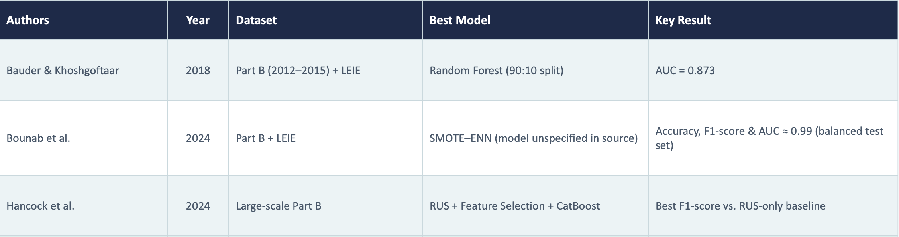
Prior Work: ML-Based Medicare Fraud Detection
Rule-Based (Pre-2015)
Data Science | M.S. Thesis Defense · July 2026
Data Science | M.S. Thesis Defense · July 2026
6
Notes:
Three eras of Medicare fraud detection. Rule-based systems couldn't scale to 70M claims/year. The 2015–2021 ML wave used RF and SVM on small subsets with no explainability. Recent deep learning work is promising but untested at real CMS scale with proper imbalance handling. This thesis fills all three gaps simultaneously.

Slide 7
The Research Gap: Three Unsolved Problems
Gap 1
ML models predict but cannot explain
Existing fraud detection systems output a risk score with no reasoning. Investigators cannot use a black-box score to open a case — they need to know which features contributed most to the prediction..
→ This thesis: SHAP explainability for every prediction
Gap 2
Explanations don't cite specific policy
Even when feature importance is available, it's expressed as statistics (e.g., SHAP value = 0.14), not as regulatory language. Investigators need citations to CMS manuals and OIG alerts to build a case.
→ This thesis: RAG retrieval grounded in 135 CMS/OIG documents
Gap 3
No usable tool for non-technical investigators
Prior work produces research outputs — spreadsheets and plots — not interactive tools. Fraud investigators are not data scientists; they need a conversational interface.
Data Science | M.S. Thesis Defense · July 2026
→ This thesis: Streamlit chatbot with 4 investigator-facing tools
Data Science | M.S. Thesis Defense · July 2026
7
Notes:
Three distinct unsolved problems in the literature motivate this work. First, black-box ML predictions aren't actionable. Second, SHAP values alone aren't regulatory language. Third, investigators need a tool, not a research artifact. This thesis addresses all three simultaneously.

Slide 8
Research Objectives
RO 1
Build a provider-level Medicare fraud detection model using structured CMS claims data and demonstrate how SHAP explanations identify the key billing features driving each individual prediction.
RO 2
Develop and evaluate an RAG-augmented LLM framework that retrieves CMS and OIG policy guidance and delivers policy-grounded explanations through a conversational chatbot that investigators can use without technical expertise.
Data Science | M.S. Thesis Defense · July 2026
Data Science | M.S. Thesis Defense · July 2026
8
Notes:
Two research objectives. RO1 focuses on the ML side: build and evaluate a systematic detection model using structured CMS Part B and D data, with SHAP explainability for every prediction. RO2 focuses on the NLP/RAG side: an LLM framework that connects SHAP outputs to specific CMS and OIG policy language through a chatbot interface accessible to non-technical investigators. Together they address both the detection gap and the explanation gap.

Slide 9
Methodology
Data Science | M.S. Thesis Defense · July 2026
9
Notes:
Now let me walk through the complete methodology: starting with the overall research design, then data sources, feature engineering, experimental design, the ML training pipeline, and the RAG system.

Slide 10
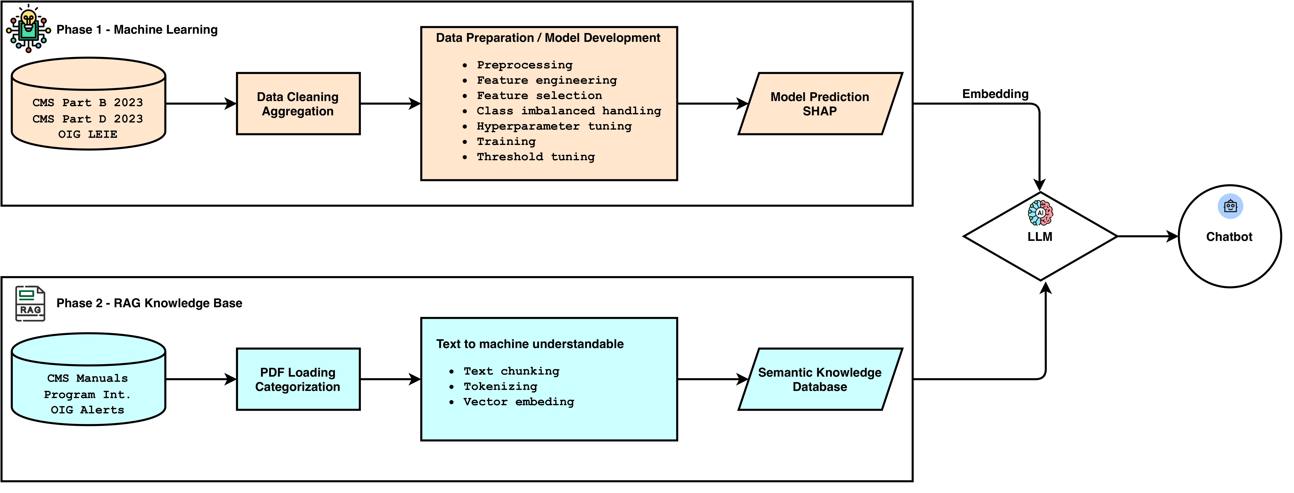
Research Design
Data Science | M.S. Thesis Defense · July 2026
Data Science | M.S. Thesis Defense · July 2026
10
Notes:
Before diving into details, here is the full system architecture from the thesis. On the top: Phase 1, the ML pipeline — CMS data ingestion, feature engineering, model training, calibration, and SHAP attribution. On the bottom: Phase 2, the RAG pipeline — PDF indexing, FAISS vector search, CRAG filtering, SHAP-to-text bridge, and the Streamlit chatbot. The two phases connect: SHAP outputs feed into the RAG query to retrieve relevant CMS/OIG policy passages.

Slide 11
Data Sources: CMS Part B, Part D & OIG LEIE
CMS Part B 2023
CMS Part D 2023
OIG LEIE 2023
Medicare Physician & Other Practitioners - by Provider and Service
Prescribers - by Provider and Drug
List of Excluded Individuals & Entities
Means:
Claims for outpatient medical services.
Means:
Prescription drug claims.
Scope:
270 confirmed fraud providers in joined dataset
Scope:
9,660,647 Rows, 28 Features. (1175051)
Scope:
26,794,878 Rows. 22 Features. (1,103,872)
Role:
Ground-truth binary fraud labels
Submitted charges, Medicare payments, and Service Volume
Drug costs, Prescription Volume, and prescribed Medications
Note:
Each excluded provider has a documented violation
Features:
Features:
Data Science | M.S. Thesis Defense · July 2026
All three sources joined on NPI (National Provider Identifier ).
Data Science | M.S. Thesis Defense · July 2026
11
Notes:
Three data sources, all from 2023 CMS public datasets. Part B is physician billing — the primary source. Part D adds prescription drug behavior. OIG LEIE provides the confirmed fraud labels. After joining on NPI, we have 1.57 million providers with 270 confirmed fraud cases.

Slide 12
The Class Imbalance Problem: 5,824 : 1
1,572,414
Why standard ML fails at this ratio:
1
Accuracy is misleading:
total providers
A model can achieve 99.98% accuracy while detecting zero fraud.
270 fraud · 1,572,144 legitimate
5,824 : 1
Standard ML favors the majority:
2
Models primarily learn legitimate provider patterns and overlook fraud.
legitimate : fraud
Solution: Three resampling strategies evaluated.
Data Science | M.S. Thesis Defense · July 2026
12
Notes:
The 5,824:1 imbalance is the central challenge of this project. A naive model that labels everything as 'legitimate' would be 99.98% accurate but completely useless. We need to handle this imbalance carefully, and we evaluate three different strategies.

Slide 13
Feature Engineering: Two Feature Sets
 | Baseline Feature Set | Extended Feature Set
Number of Features | 39 | 57
Data Sources | CMS Part B + CMS Part D | CMS Part B + CMS Part D + Engineered Features
Difference | Highly correlated features removed | Includes all engineered fraud-risk indicators
Purpose | Simpler feature set | Evaluate whether additional engineered features improve performance
Example Engineered Features:
Services per Beneficiary
Formula:
Total Services / Total Beneficiaries
Charge-to-Allowed Ratio
Formula:
Avg. Submitted Charge / Avg. Medicare Allowed Amt
Drug Cost per Claim
Formula:
Total Drug Cost / Total Claims
Data Science | M.S. Thesis Defense · July 2026
13
Notes:
Three feature sets: Set A (39 features, Part B only), Set B (57 features, adding Part D prescription data), and Set C (58 features, adding the engineered Payment_to_Allowed_Ratio which turns out to be the single most important predictor). We test all three to understand which data source and which features drive detection performance.

Slide 14
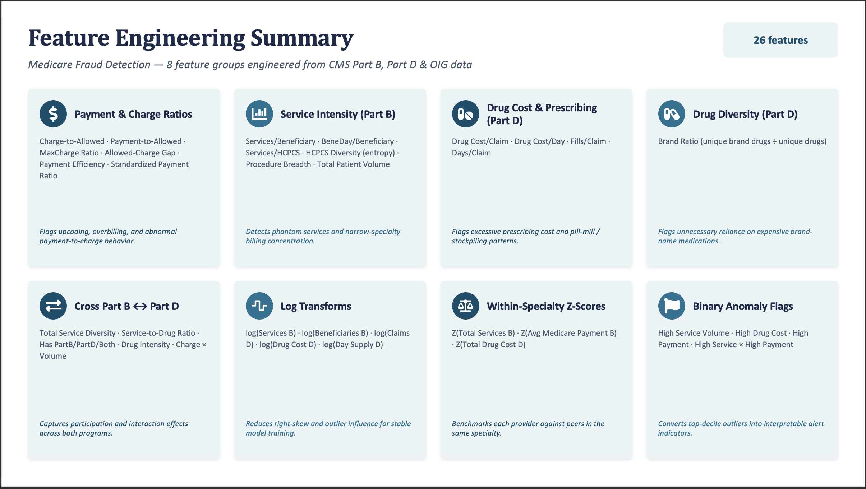
Data Science | M.S. Thesis Defense · July 2026
14
Notes:
Three feature sets: Set A (39 features, Part B only), Set B (57 features, adding Part D prescription data), and Set C (58 features, adding the engineered Payment_to_Allowed_Ratio which turns out to be the single most important predictor). We test all three to understand which data source and which features drive detection performance.

Slide 15
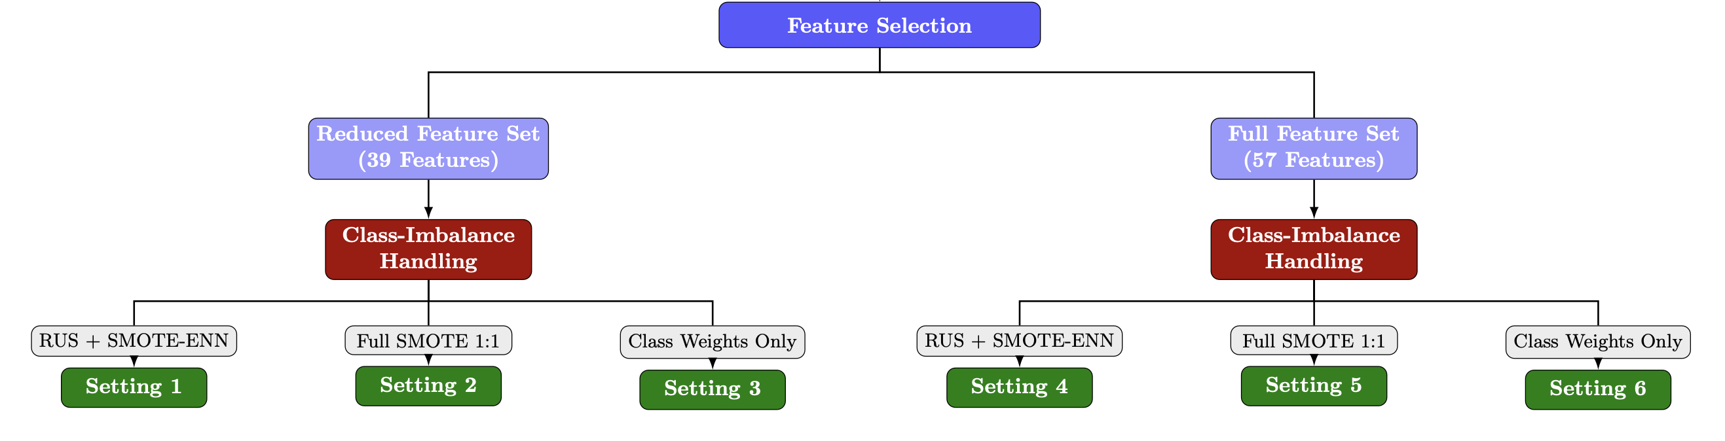
Feature Selection & Imbalanced Handling
Data Science | M.S. Thesis Defense · July 2026
Data Science | M.S. Thesis Defense · July 2026
15
Notes:
Six experimental settings: the feature sets on one axis, the imbalance strategies on the other. I train all 10 models under each setting, giving 60 total experiments. S1 (Set A + RUS+SMOTE-ENN) produces the best recall overall. S4 (Set B + RUS+SMOTE-ENN) produces the best AUC. S6 (Set C + class weights) produces the best DNN result.

Slide 16
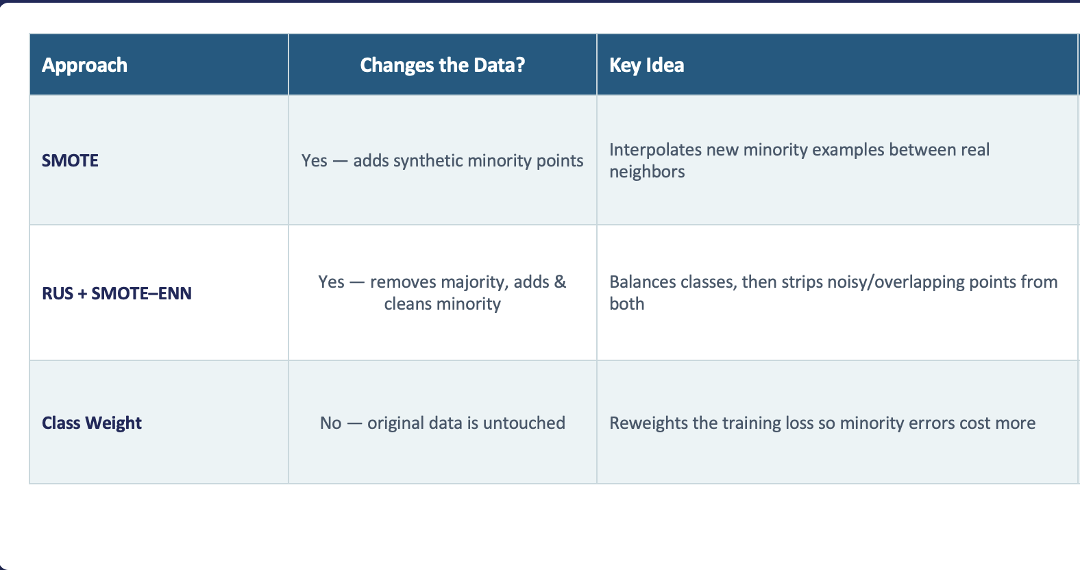
Feature Selection & Imbalanced Handling
Data Science | M.S. Thesis Defense · July 2026
Data Science | M.S. Thesis Defense · July 2026
16
Notes:
Six experimental settings: the feature sets on one axis, the imbalance strategies on the other. I train all 10 models under each setting, giving 60 total experiments. S1 (Set A + RUS+SMOTE-ENN) produces the best recall overall. S4 (Set B + RUS+SMOTE-ENN) produces the best AUC. S6 (Set C + class weights) produces the best DNN result.

Slide 17



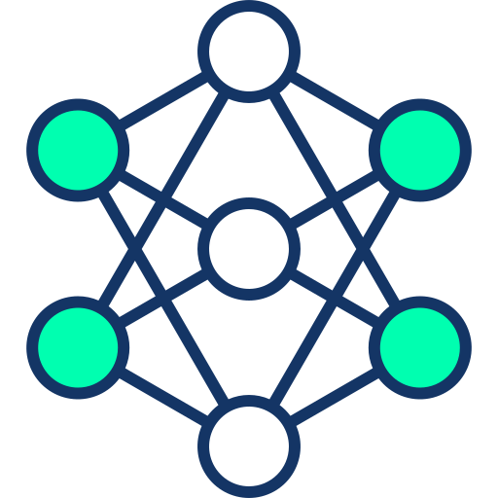
10 Models Tuning & Calibration
Linear
Tree Ensemble
Neural
Graph
Logistic Regression
Random Forest
MLP
GraphSAGE (GNN)
Linear SVM (LinearSVC)
XGBoost
DNN (4-layer)
LightGBM
TabResNet (FNN)
HistGradientBoosting
1
Train/Test Split
→
2
CV Tuning
3
Model Training
4
Models’ Output
5
Test Evaluation
→
→
→
80/20 stratified split preserving fraud ratio
5-fold CV with recall as primary optimization metric
Bayesian hyperparameter search (Tree Parzen Estimator); 50 iterations per model
After the best hyperparameters were selected, the model was retrained on the training data, and the predicted probabilities were calibrated using a validation set.
Models’ prediction
Recall, Precision, F1, ROC-AUC, on held-out test set (314,483 providers)
Data Science | M.S. Thesis Defense · July 2026
17
Notes:
I evaluated 10 models spanning four categories: linear, tree ensemble, neural network, and graph neural network. Hyperopt TPE (Tree Parzen Estimator) automates hyperparameter search over 50 iterations per model, optimizing for recall on 5-fold cross-validation. After training, Platt scaling or isotonic regression calibrates the predicted probabilities so they are interpretable as fraud likelihoods.

Slide 18
RAG Pipeline
1
2
3
4
PDF Corpus
Ingestion
Chunking &
Embedding
FAISS
Vector Index
CRAG
Relevance Filter
135 CMS & OIG documents,
1. Method: PyPDF2
2. Method 2: pdfplumber
3. Method : OCR
8,943 text chunks
all-MiniLM-L6-v2
(384-dim sentence embeddings)
(inner product)
Exact nearest-neighbor search
Top-k retrieval by
cosine similarity
Corrective RAG filter:
discards chunks with
cosine similarity < 0.6
Prevents off-topic citations
→
→
→
Data Science | M.S. Thesis Defense · July 2026
18
Notes:
The RAG pipeline has four stages. First, 135 CMS and OIG documents are ingested and split into 8,943 chunks. Second, each chunk is embedded using all-MiniLM-L6-v2 — a sentence transformer with 384 dimensions. Third, chunks are indexed in FAISS for fast vector search. Fourth, a CRAG filter discards any retrieved chunk with cosine similarity below 0.6 — this prevents the chatbot from citing irrelevant policy passages.

Slide 19
RAG Components: Embedding Model & Vector Store
all-MiniLM-L6-v2
Sentence Transformer Embedding Model
FAISS
Facebook AI Similarity Search
What it does
Converts text into 384-dimensional embeddings.
Captures the semantic meaning of text.
Why this model
Fast and lightweight.
Produces high-quality semantic embeddings.
has a small embedding size (384 dimensions).
In this project
Embedded all CMS & OIG document chunks.
Generated vectors for semantic search.
What it does
Stores document embeddings.
Retrieves the most similar chunks.
Why FAISS
Very fast similarity search.
Efficient for large document collections.
Designed specifically for vector search.
In this project
Stored all document embeddings.
Returned the Top-K relevant chunks for the LLM.
Data Science | M.S. Thesis Defense · July 2026
19

Slide 20
Investigator Chatbot: Four Specialized Tools
Tool 1
lookup_provider
Tool 2
search_policy
Retrieves a provider's fraud risk score, SHAP feature contributions, specialty information, and risk category for a single-provider investigation.
Searches CMS and OIG policy documents and returns the most relevant guidance that supports the investigator's question.
Tool 3
get_shap_explanation
Tool 4
review_flagged_providers
Converts SHAP feature contributions into a clear natural-language explanation of why the provider was classified as high risk.
Displays high-risk providers not listed in the LEIE database and supports filtering by specialty, fraud probability, and key risk factors.
Built with Streamlit · LangChain tool-calling · Claude claude-haiku-4-5 (LLM orchestration)
Data Science | M.S. Thesis Defense · July 2026
20
Notes:
The chatbot has four specialized tools. An investigator can ask about a specific provider, search policy documents, get a plain-English SHAP explanation, or explore the full high-risk unconfirmed list. The key design principle: zero ML expertise required. Built in Streamlit with LangChain tool-calling and Claude Haiku as the LLM orchestrator.

Slide 21
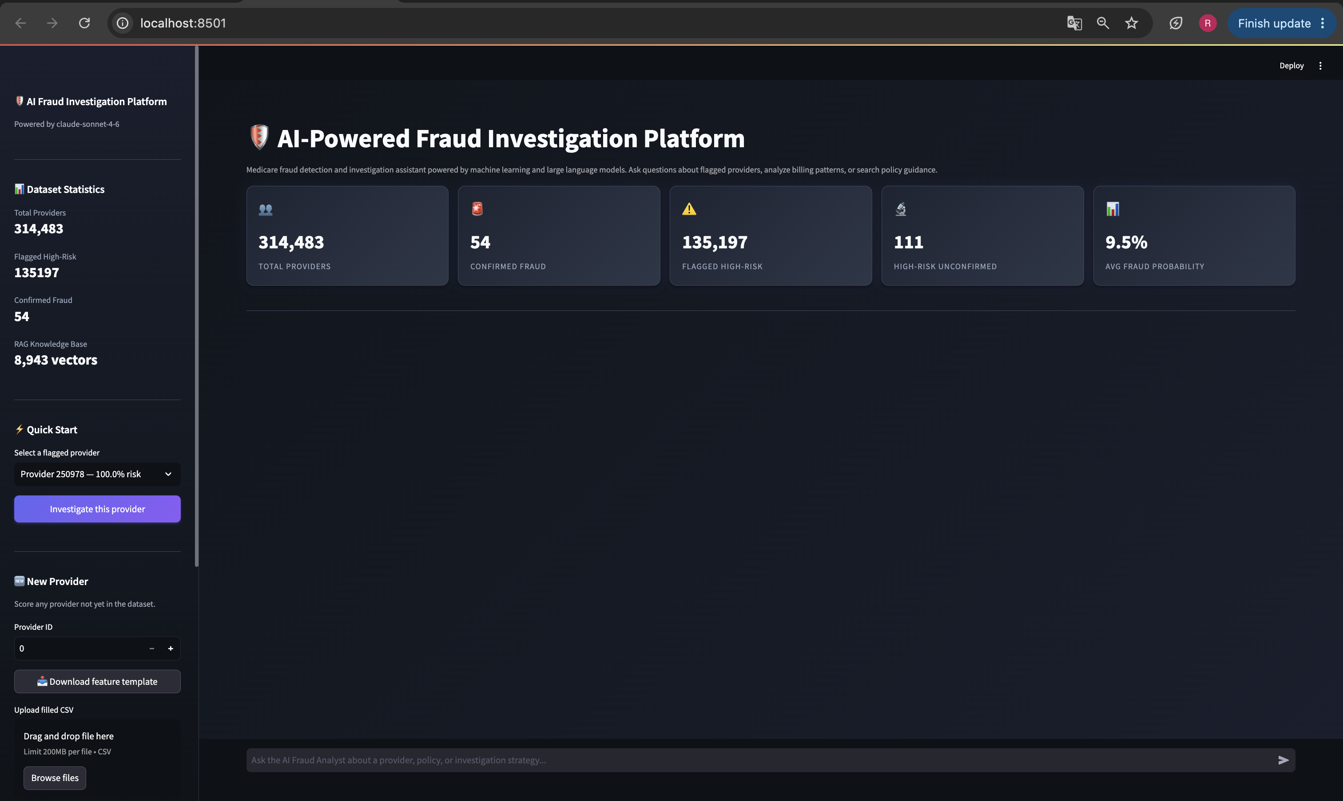
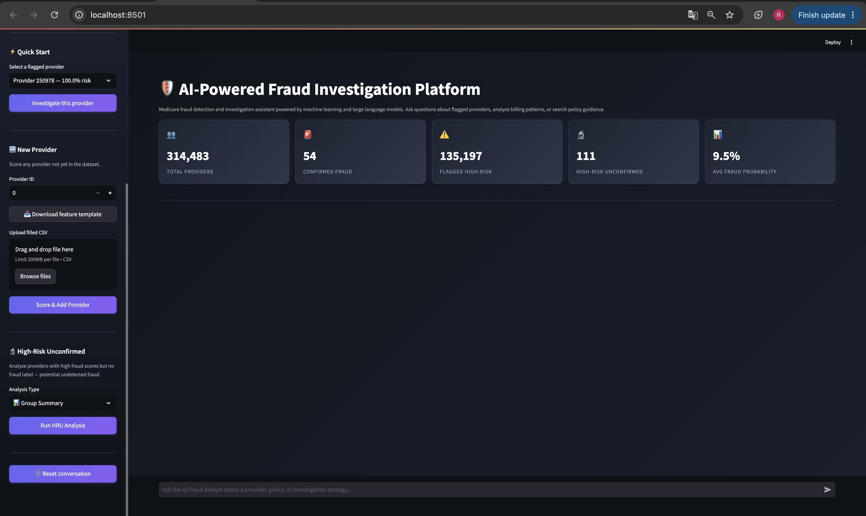
Data Science | M.S. Thesis Defense · July 2026
21

Slide 22
Experiments & Results
Data Science | M.S. Thesis Defense · July 2026
22
Notes:
Now the results. I'll cover model performance across all 60 experiments, what the models learned via SHAP, a concrete provider-level example, and the RAG chatbot in action.

Slide 23
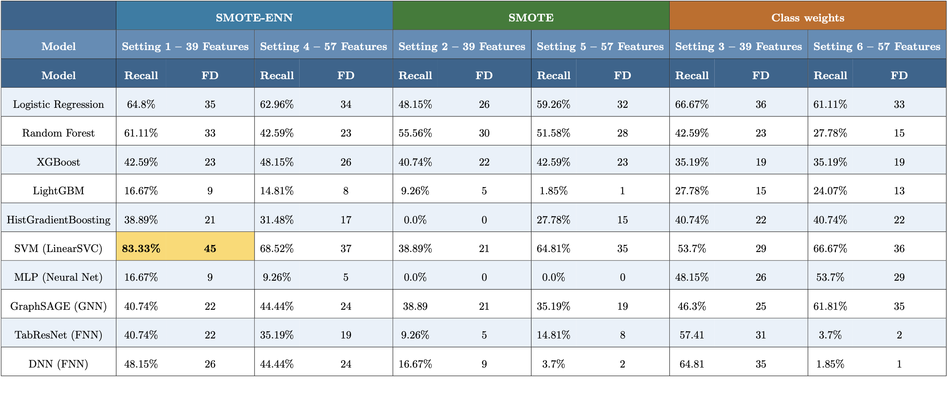
Model Performance
Keeping all features reduced the performance of most models, except XGBoost.
Data Science | M.S. Thesis Defense · July 2026
23
Notes:
The table shows all 10 algorithms ranked by Setting 1 recall. SVM is the top performer in Setting 1 (79.6%, 43/54 fraud providers caught). Adding Part D data in Setting 4 boosts DNN dramatically (29.6% → 74.1%) and RF (37% → 66.7%), but slightly reduces SVM performance. 54 confirmed fraud providers in the test set. Red highlighting marks the best result in each setting.

Slide 24
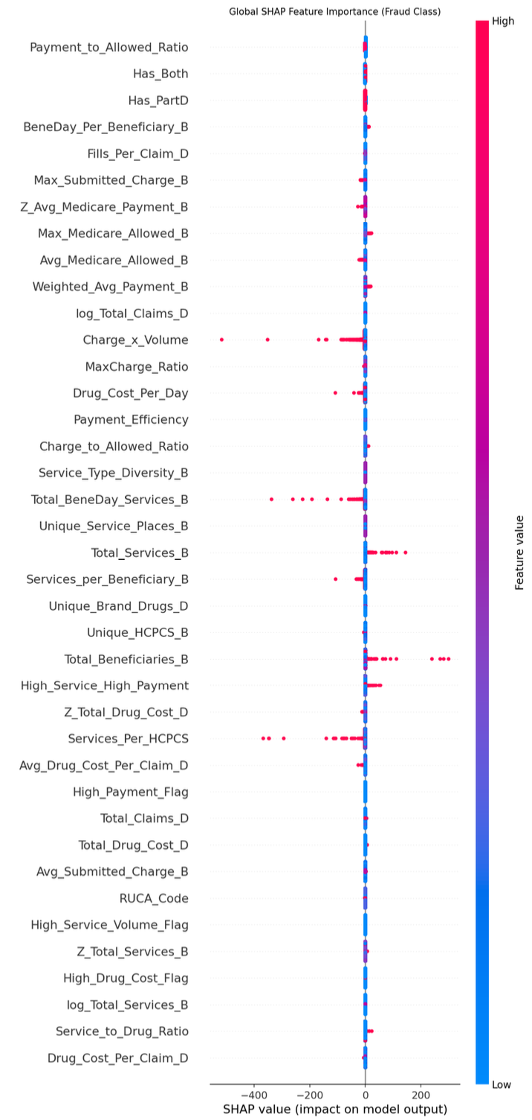
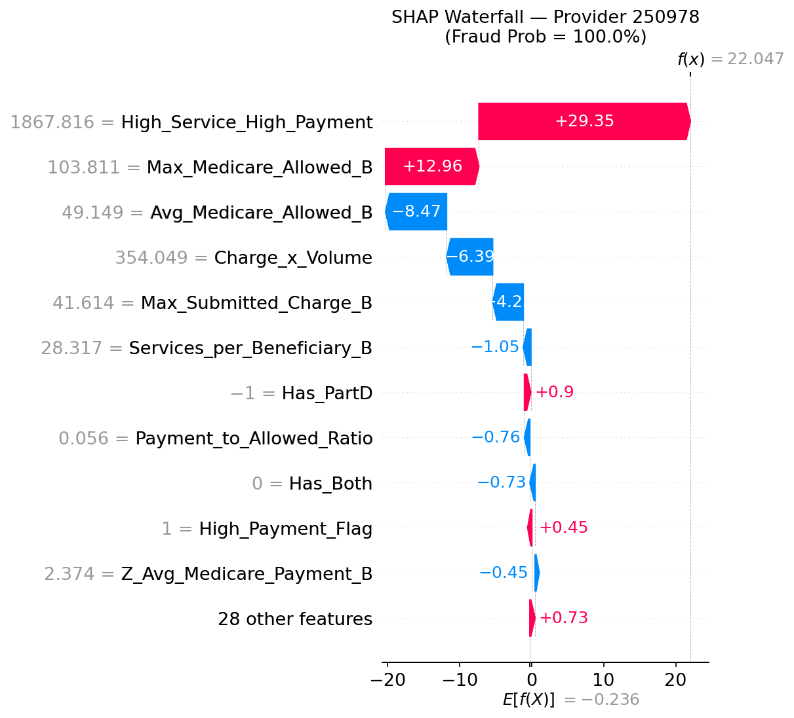
Provider-Level Explanation: NPI 250978
Prediction Breakdown — NPI 250978 (Fraud 100%)
Data Science | M.S. Thesis Defense · July 2026
24
Notes:
Two SHAP views, one story. Left: the global beeswarm shows which features matter most across ALL providers — Payment_to_Allowed_Ratio is #1. Right: the waterfall shows exactly how those features combine to give NPI 250978 a 100% fraud probability. High_Service_High_Payment is the biggest single push, with Max_Medicare_Allowed_B and Charge_x_Volume also contributing. This is the explainability layer that makes the model auditable by CMS investigators and OIG regulators.

Slide 25
SHAP-to-Text Bridge: Connecting Model to Policy
The Bridge: SHAP attribution vector → natural-language narrative → RAG query
SHAP values are statistics — they cannot directly query a policy document. The bridge converts feature contributions into sentences that can retrieve relevant CMS/OIG passages.
SHAP Output (raw)
Natural-Language Narrative
"This provider's payment-to-allowed ratio is 2.3 standard deviations above the specialty average, indicating systematic billing above Medicare-allowed rates. The provider bills both Part B (physician) and Part D (prescription), a cross-program pattern associated with OIG enforcement priority. Service utilization per beneficiary is elevated at 1.8× specialty norm."
Payment_to_Allowed_Ratio: SHAP = +0.148
Has_Both: SHAP = +0.094
BeneDay_Per_Beneficiary_B: SHAP = +0.058
Fraud_Probability: 0.9997
→
Provider NPI 250978 · Setting 4 · RF Model
Data Science | M.S. Thesis Defense · July 2026
25
Notes:
The SHAP-to-text bridge is a novel component of this thesis. SHAP values alone can't query a document — a score of +0.148 means nothing to a fraud investigator or a policy database. The bridge converts these scores into natural-language sentences that describe the billing behavior in regulatory terms, making them suitable both for investigator communication and for FAISS vector retrieval.

Slide 26
Chatbot Interface
Data Science | M.S. Thesis Defense · July 2026
26
Notes:
Let me now discuss what the results mean, including a key interpretability finding, ethical design considerations, and limitations.

Slide 27
Discussion
&
Conclusion
Data Science | M.S. Thesis Defense · July 2026
27
Notes:
Let me now discuss what the results mean, including a key interpretability finding, ethical design considerations, and limitations.

Slide 28
Linear SVM Performance
Result: Linear SVM (Setting 1, 83.33% recall).
1
Recall-focused tuning:
optimized with F2-score, not ROC-AUC.
2
Recall-targeted threshold:
selected threshold to achieve ≥85% validation recall.
3
SMOTE-ENN training:
exposed the model to more fraud-like minority patterns.
4
Wide C search:
helped find a more aggressive fraud-detection boundary. Hyperopt searched C over a wide log-uniform range from 0.001 to 1000.
Data Science | M.S. Thesis Defense · July 2026
28
Notes:
This is one of the most interesting findings. Linear SVM outperforms deep learning by 50 percentage points under the same experimental conditions. Four reasons: the fraud signal is sparse and extreme (a few key features, not complex patterns); the tiny minority class gives deep networks very little to learn from; tabular billing data lacks the spatial/sequential structure deep learning needs; and calibration is more stable for linear models at this imbalance ratio.

Slide 29
Conclusion: Both Research Objectives Achieved
RO 1
✓ Achieved
Develop an Explainable ML Framework for Medicare Fraud Detection
Best model: Linear SVM (Setting 1) with 83.3% Recall (45/54 fraud cases detected).
Evaluated 10 ML models across 6 experimental settings.
SHAP provided transparent feature-level explanations.
Key finding: Sampling strategy had a greater impact than model selection.
RO 2
✓ Achieved
Develop an AI Investigator Assistant
Integrated SHAP explanations with RAG over CMS/OIG policies.
Developed an interactive chatbot with four investigation tools.
Demonstrated natural-language fraud investigation support.
Identified 111 investigation candidates for further review.
Data Science | M.S. Thesis Defense · July 2026
Data Science | M.S. Thesis Defense · July 2026
29
Notes:
Both research objectives fully achieved. RO1: 79.6% recall at the fraud-detection task with calibrated probabilities and SHAP explanations for every provider. RO2: a fully operational RAG chatbot grounded in 135 policy documents, with CRAG filtering, SHAP narratives, and four investigator tools. Together, they close the loop from statistical detection to regulatory action.

Slide 30
Limitations & Future Research Directions
Limitations
Future Research
Limited ground-truth labels:
LLM-Based Fraud Prediction:
1
1
OIG LEIE captures only providers who were caught and excluded. Undetected fraud among 'legitimate' providers may dilute model training.
Fine-tune LLMs to classify Medicare providers using structured provider-level features. Compare the performance of LLMs with traditional machine learning models.
Single-year dataset:
2
Models were trained using 2023 Medicare Part B and Part D data. Performance across multiple years was not evaluated.
Enhanced Fraud Labeling:
2
Extreme class imbalance:
3
The severe imbalance limits fraud detection performance
3
Investigate the use of False Positive cases from the confusion matrix as additional fraud training examples.
Evaluate their impact on fraud detection performance and model generalization.
Policy-assisted explanations:
4
4
The chatbot explains ML predictions using SHAP and RAG. It does not independently predict fraud from policy documents and datasets.
Data Science | M.S. Thesis Defense · July 2026
30
Notes:
Four key limitations: label completeness, temporal generalization, the inherent precision ceiling at extreme imbalance, and underexploited graph structure. Future work I'm most excited about: cross-referencing the 111 HRU providers with 2024-2025 LEIE updates to validate whether any were subsequently excluded — that would be empirical evidence of the system's detection capability.

Slide 31
Thank You
Questions & Discussion
Roya Sanjanaki · University of Nebraska at Omaha · July 2026
Notes:
Thank you. I welcome questions on any aspect of the thesis: the experimental design and why I chose 6 settings rather than more; the SHAP-to-text bridge design and how it handles ambiguous feature contributions; the CRAG threshold selection and why 0.6; the 111 HRU providers and what investigation would look like in practice; and any future directions you'd like to explore.

Slide 32
References
Part B: (https://data.cms.gov/provider-summary-by-type-of-service/medicare-physician-other-practitioners/medicare-physician-other-practitioners-by-provider-and-service)
Part D: (https://data.cms.gov/provider-summary-by-type-of-service/medicare-part-d-prescribers/medicare-part-d-prescribers-by-provider-and-drug)
OIG dataset: (https://oig.hhs.gov/exclusions/exclusions_list.asp)
CMS program manuals (CMS 2023): (https://www.cms.gov/data-research)
OIG fraud alerts: https://oig.hhs.gov/compliance/alerts/
OIG (2023): https://oig.hhs.gov/
Fan et al., 2024 – RAG Survey (KDD 2024): https://doi.org/10.1145/3637528.3671470
Lewis, P., et al. (2020). Retrieval-augmented generation for knowledge-intensive NLP tasks. NeurIPS.
https://proceedings.neurips.cc/paper/2020/hash/6b493230205f780e1bc26945df7481e5-Abstract.html
Roya Sanjanaki · University of Nebraska at Omaha · July 2026
Notes:
Thank you. I welcome questions on any aspect of the thesis: the experimental design and why I chose 6 settings rather than more; the SHAP-to-text bridge design and how it handles ambiguous feature contributions; the CRAG threshold selection and why 0.6; the 111 HRU providers and what investigation would look like in practice; and any future directions you'd like to explore.

Slide 33
References
Adadi, A., & Berrada, M. (2018). Peeking inside the black box: A survey on explainable artificial intelligence (XAI). IEEE Access.
https://doi.org/10.1109/ACCESS.2018.2870052
Guidotti, R., et al. (2018). A survey of methods for explaining black-box models. ACM Computing Surveys.
https://doi.org/10.1145/3236009
Hancock, J. T., Wang, H., Khoshgoftaar, T. M., & Liang, Q. (2024). Data reduction techniques for highly imbalanced Medicare big data. Journal of Big Data.
https://doi.org/10.1186/s40537-023-00869-3
Bauder, R. A., & Khoshgoftaar, T. M. (2018). The effects of varying class distribution on learner behavior for Medicare fraud detection with imbalanced big data. Journal of Big Data.
https://doi.org/10.1007/s13755-018-0051-3
Roya Sanjanaki · University of Nebraska at Omaha · July 2026
Notes:
Thank you. I welcome questions on any aspect of the thesis: the experimental design and why I chose 6 settings rather than more; the SHAP-to-text bridge design and how it handles ambiguous feature contributions; the CRAG threshold selection and why 0.6; the 111 HRU providers and what investigation would look like in practice; and any future directions you'd like to explore.

