Slide 1


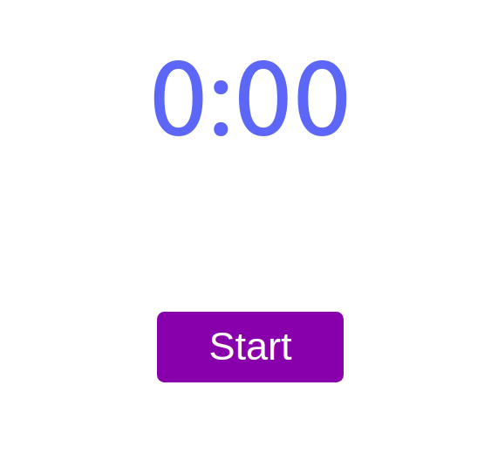


HOC

Slide 2

HOC
Higher Order Components
(It’s pattern not part of react API)
A Higher Order Component is just a React Component that wraps another one.
The higher order function:

Slide 3
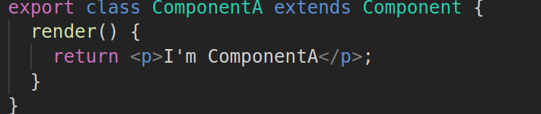
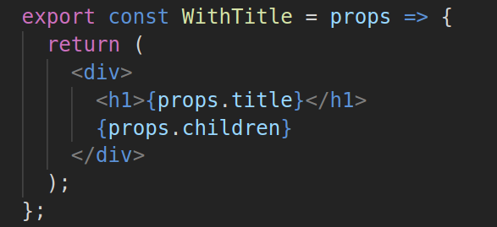
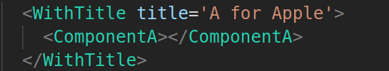
HOC
Higher Order Components
(It’s pattern not part of react API)

Slide 4
Overview
Model View Architecture
State Container
Redux
React-redux

Slide 5



MVI
Model View Architecture
Model
Action
View

Slide 6
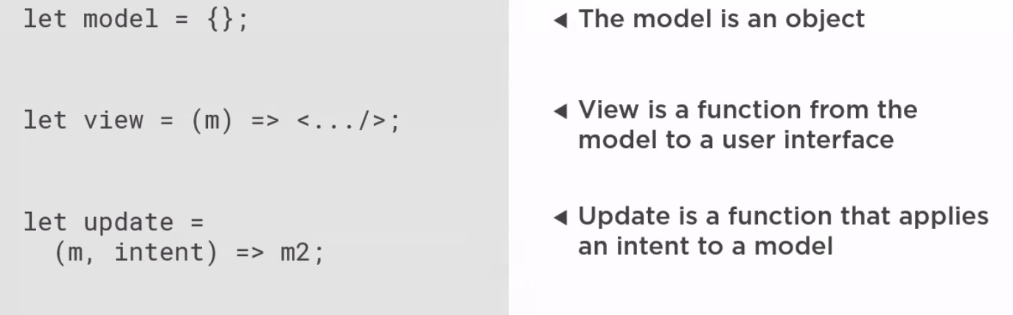
MVI
Model View Architecture

Slide 7
State
Container
Store: The State Container
Model and Update
Methods
- getState()
- dispatch()
- subscribe()

Slide 8
Redux API
Redux API
- createStore(reducer, initialState)
- getState()
- dispatch()
- subscribe()

Slide 9
React Redux
+
React Redux
Provider
Connect
- mapStateToProps()
- mapDispatchToProps()

