Slide 1



&
R Santosh Reddy
Learner……..

Slide 2
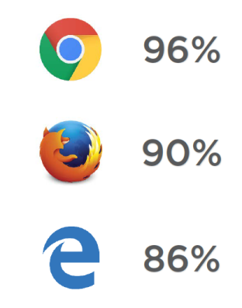
Can I use?

Slide 3
Overview
New syntax :
let, const and block Scoping
Arrow Function =>
Default Function Parameters
Rest and Spread …
Object Literals Extensions
Destructuring
For … of Loops
Template Literals
Es6 classes

Slide 4
New syntax
let, const and block Scoping
Arrow Function =>
Default Function Parameters
Rest and Spread …
Object Literals Extensions
Destructuring
For … of Loops
Template Literals

Slide 5
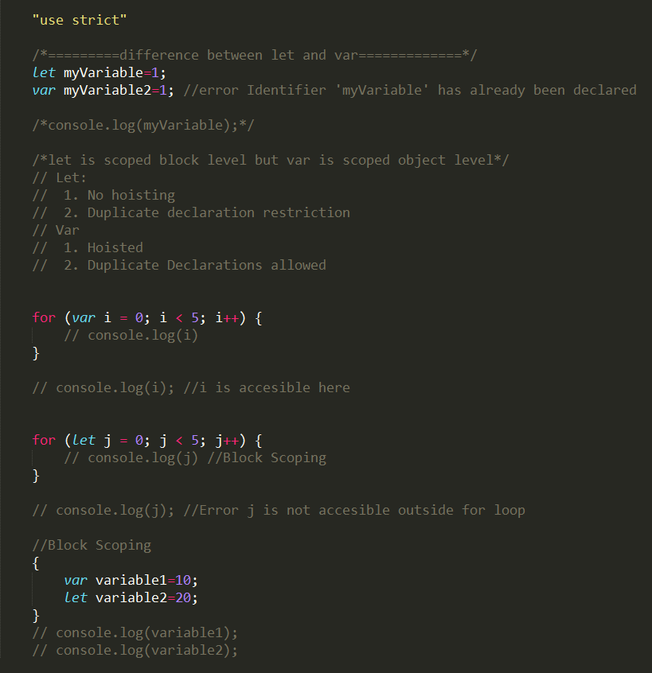
let and block Scoping

Slide 6
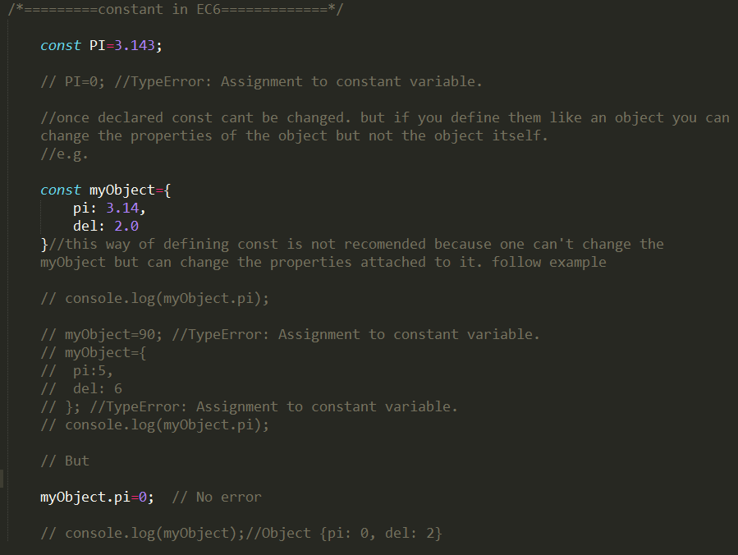
const

Slide 7
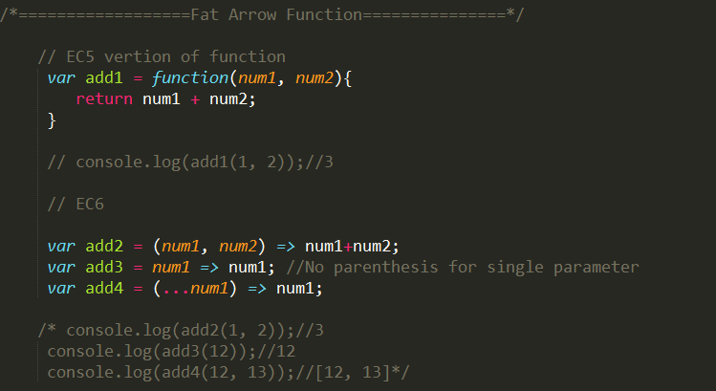
Arrow Function =>

Slide 8
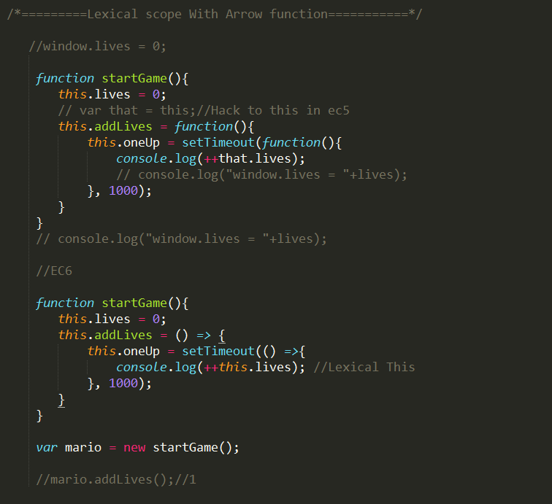
Arrow Function => (Lexical Scope)

Slide 9
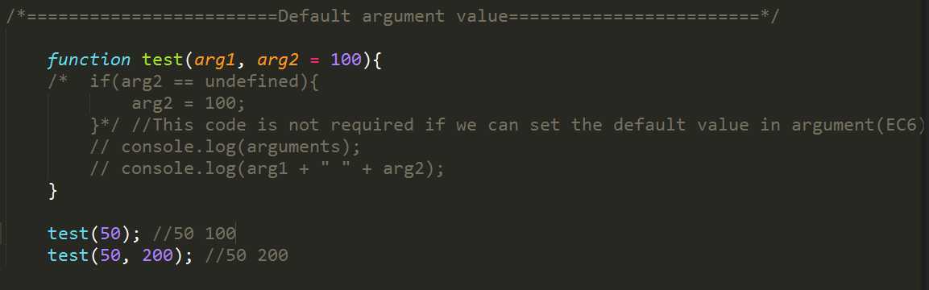
Default Function Parameters

Slide 10
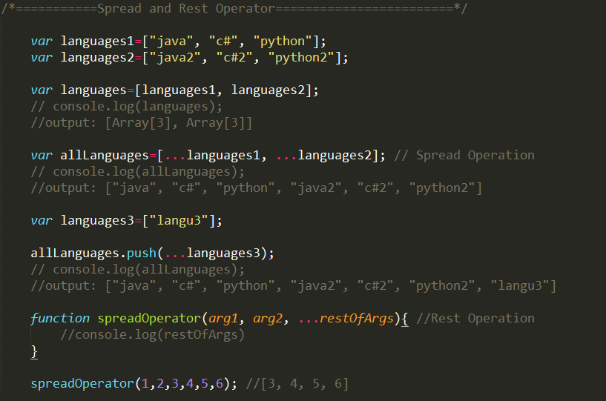
Rest and Spread …

Slide 11
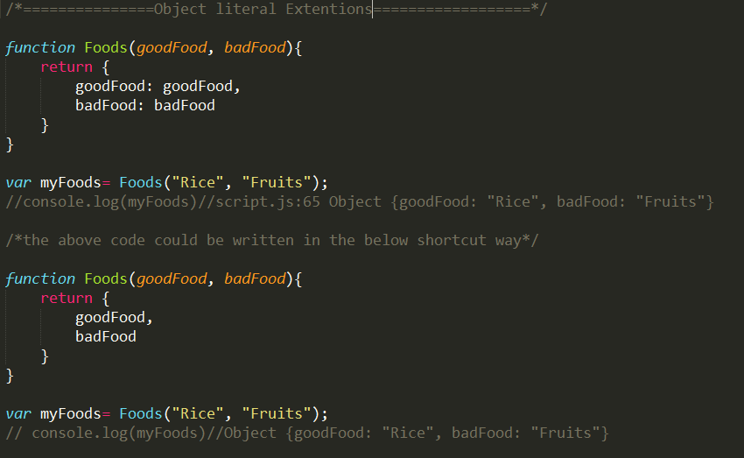
Object Literals Extensions

Slide 12
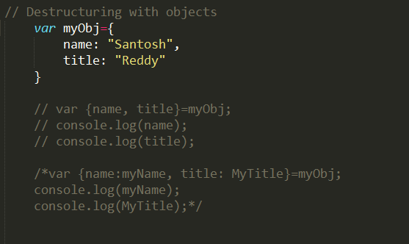
Destructuring

Slide 13
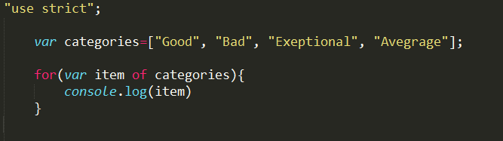
For … of Loops

Slide 14
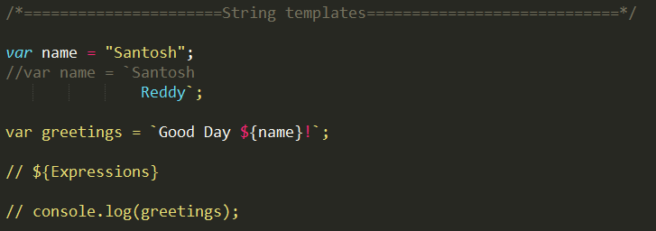
Template Literals

Slide 15
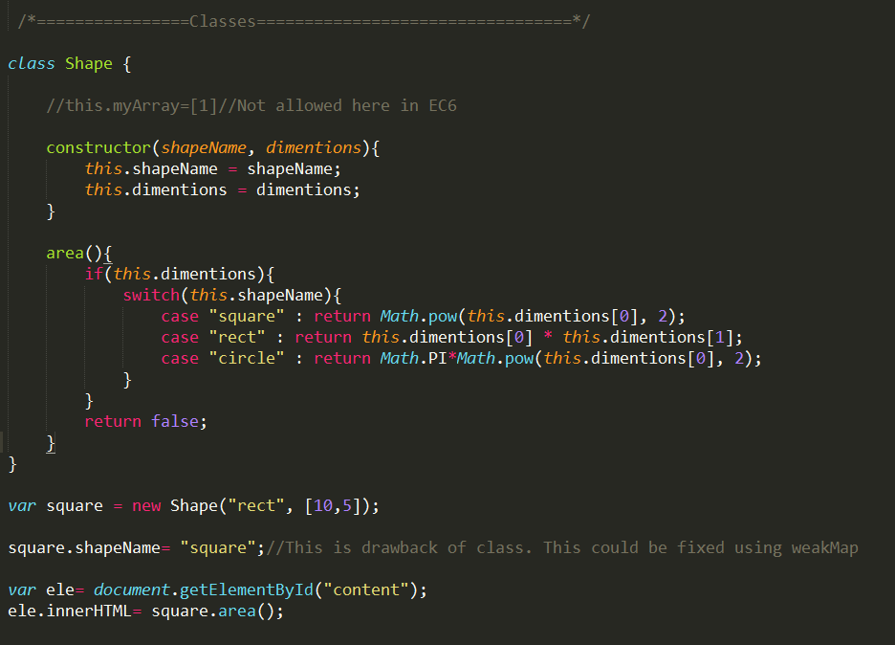
Es6 classes

Slide 16
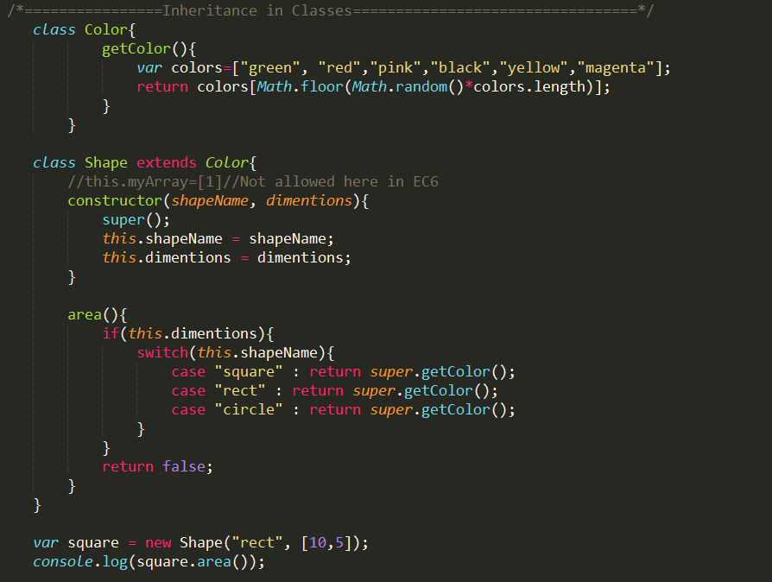
Es6 classes

Slide 17
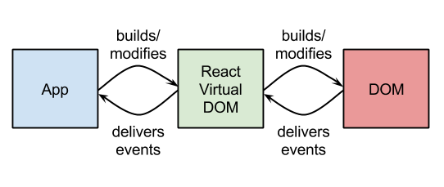
React Fundamentals

Slide 18
Prerequisites
1. HTML
2. CSS
3. JavaScript
4. Good to have ES6

Slide 19
Tools
Text editor (Sublime)
Node (to render pages)
Express (Node package module for Node)

Slide 20
React.js
Is Open source, but maintained by Facebook
Can be the “V” (or view) in MVC
Is ideal for large-scale, single page applications
Uses a high speed virtual DOM
Uses a clean and easy-to-understand JSX syntax
https://facebook.github.io/react/docs/tags-and-attributes.html
M
V
C

Slide 21
Why is React So Fast?
JS objects are faster than DOM objects.
The Real virtual DOM is a JS object.
React never reads from the “real” DOM.
React only writes to the real DOM if needed.
React efficiently handles DOM updates.

Slide 22
Ways of Creating a React Component
ES5:
Var Profile=React.createClass({
render: function(){
return()
}
});
ES6:
Class Profile extends React.Component{
render(){
return()
}
}

Slide 23
Component specs and Lifecycle
Props and States
refs
getInitialState()
getDefaultProps()
defaultProps
propTypes
LifeCycle Methods
componentWillMount
componentDidMount
componentWillUnmount

Slide 24
Comparison
 | Angular | React
Two way data binding | Yes | No / One way data flow
State | $scope | this.state, this.props
Virutal DOM | No | yes
Architecture | MVVM | V (Flux)

Slide 25
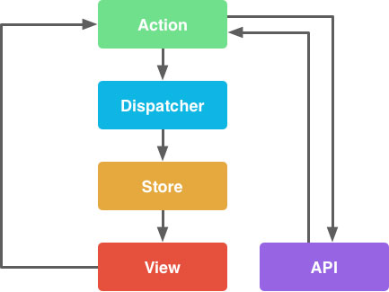
Flux

Slide 26
Code
Your first component
Using props
Using State

