Slide 1
Conversational Question-Answering on CoQA
Presenters
Rutuja Saptarshi
Sagar Talwar

Slide 2
What is CoQA ?
Structure of the dataset:
Reading Comprehensions- Story, Questions, Answers and Rationale for Training Data
Story and Questions for Testing Data
We made a model to predict answers for the Testing Data.
The rationale from the story was used to get the answer test from the passage.
Rationale: The span of the text in the passage which contains the answer text.

Slide 3
Is it as easy as it looks?
The answer is ‘no’.
Easy for a human brain to read and get the answers from the story as we do for the reading comprehensions.
But to train a model for a computer, it was a difficult task given the variety of question types.
Questions that are built up on the previous answers.
Rhetorical Questions which do not have a direct span text in the passage and requires some additional processing on the text.
Questions that have answers in a twisted context in the passage.

Slide 4
Methodology
We have trained a model which predicts the start and end of the answer text from the passage text.
The question token and the context token are the first inputs to the model.
These tokens are then processed and output is the contextualized word embedding.
These encodings of all the input sequences are then passed to a linear layer of the model which gives the final output as the start and end index of the answer in the passage.
We have used pre-trained BERT model to achieve this.

Slide 5
What is BERT? ATTENTION!!
The Bidirectional Encoder Representations from Transformers gives the pretrained methods to obtain contextualized word embeddings which can be used for many NLP tasks. In our case, the Question Answering task.
The pre-trained BERT model embeds words in a sentence by considering its context.
Tasks:
Masked Language Modeling (MLM)
Next Sentence Prediction (NSP).

Slide 6
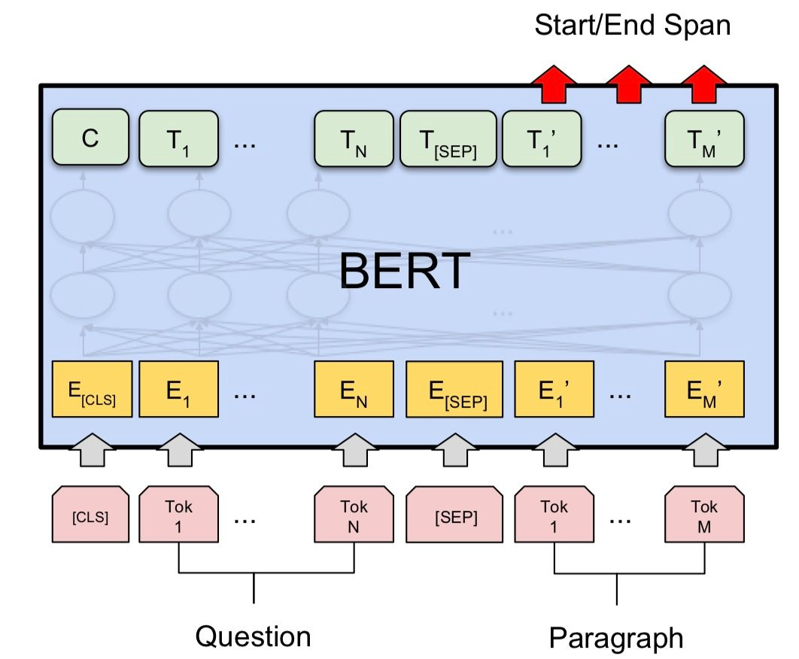
BERT used to train model for CoQA
Inputs: Paragraphs as well as the Questions
Output: Answer Span of the text from the passage
First part is the pre-trained BERT
Next the Linear Layer, which takes the contextualized word embedding of the token(output from BERT)
Final Output: Start and End of the answer from the passage.

Slide 7
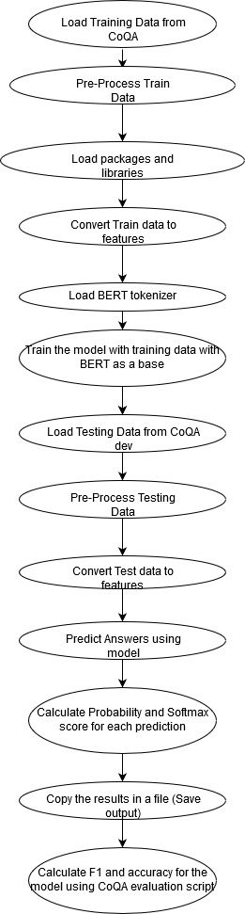
Flow Diagram

Slide 8
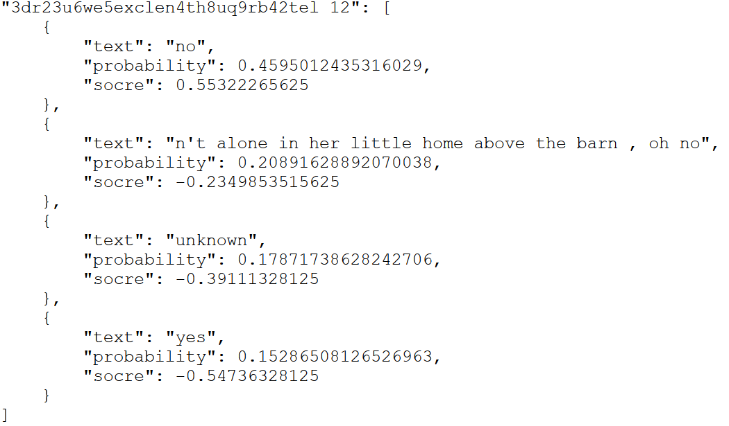
Predictions
The trained model successfully gave us the expected results on the development data.
For every question in each passage from the dev data, we got the answer text, with its probability and score.
The answer text was predicted based on the span text from the passage.

Slide 9
Accuracy and Conclusion
Based on the observed results, our model achieved average F1 score and accuracy.
We can improve the model’s accuracy if we store the previous answers and use those for predicting the answer for the current question.
In addition to this, increasing the number of epochs also improve the model’s accuracy.
Thus, the model successfully predicts the answer span text from the passage with moderate accuracy.

Slide 10
Thank You !
Any Questions?

