Slide 1
Neonatal Intensive Care Unit (NICU) Followup
Aarti | Rutuja | Sagar | Shubhangi | Vaishnavi

Slide 2
Introduction
A portal that allows Neuro Development Assessment of a newborn followed by checkups till the age of five years.
Used by Neonatologists and Pediatricians to store information about the newborn’s health conditions and to monitor their growth.
Various functionalities like Adding a new Patient, Diagnosis, Risk Factors, Immunization, Investigation, Medication should be filled initially in case of a new patient.

Slide 3
Functionalities
Add Patient
Diagnosis
Risk Factors
Immunization
Medication
Edit a patient’s details
Basic Graphical Visualization

Slide 4
Technologies
· Database : SQL Server’17
· Backend Technologies : C#, .Net 4.0, Entity Framework 6.0
· UI : Angular 6.0 , Bootstrap 4.0 , TypeScript, HTML, CSS

Slide 5
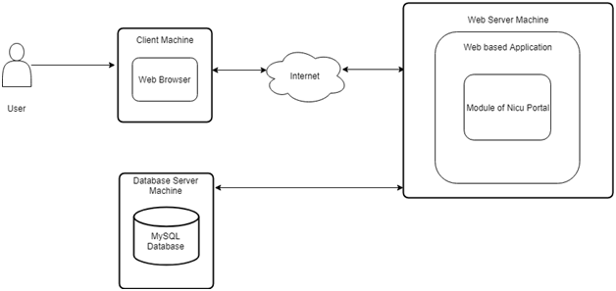
System Architecture

Slide 6
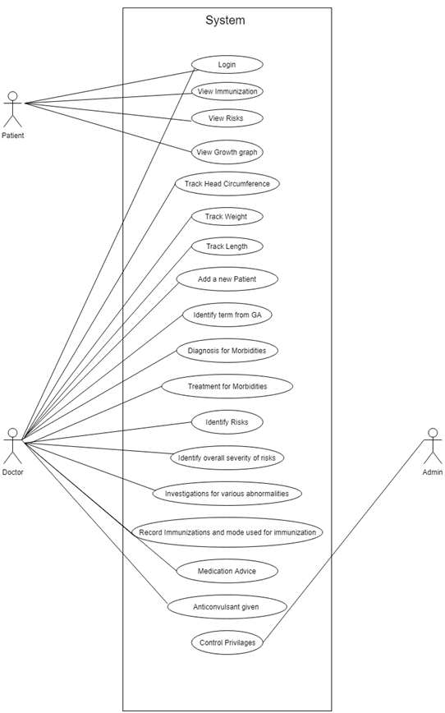
Use Case Diagram

Slide 7
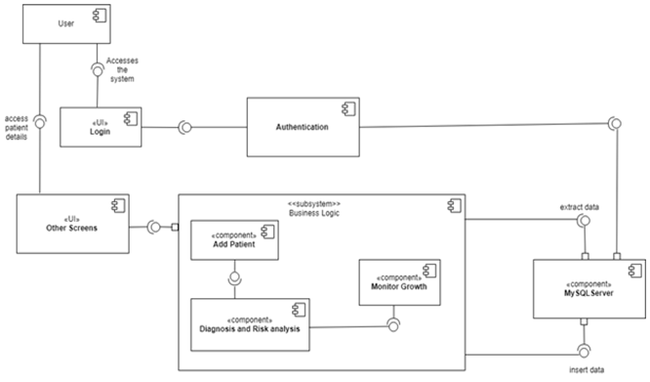
Component Diagram

Slide 8
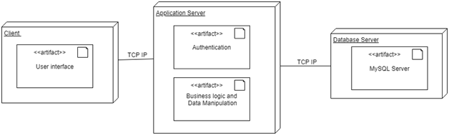
Deployment Diagram

Slide 9
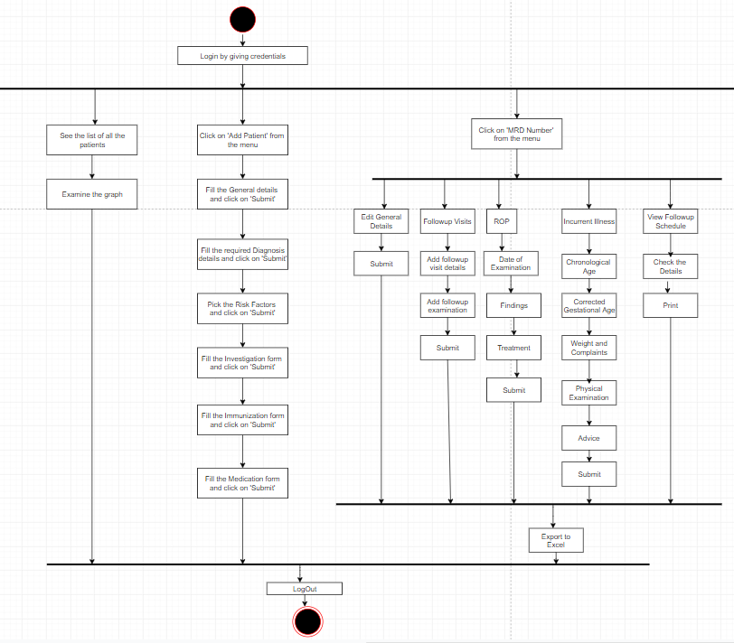
Activity Diagram

Slide 10
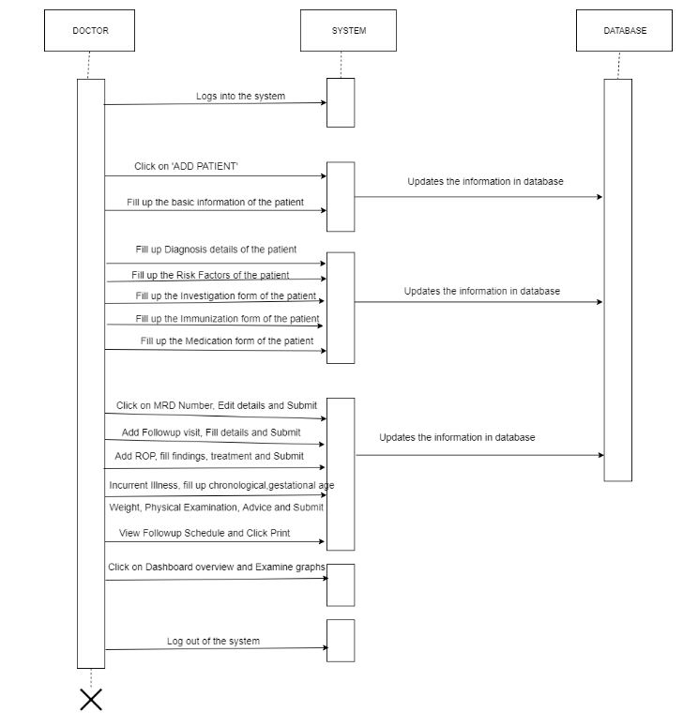
Sequence Diagram

Slide 11
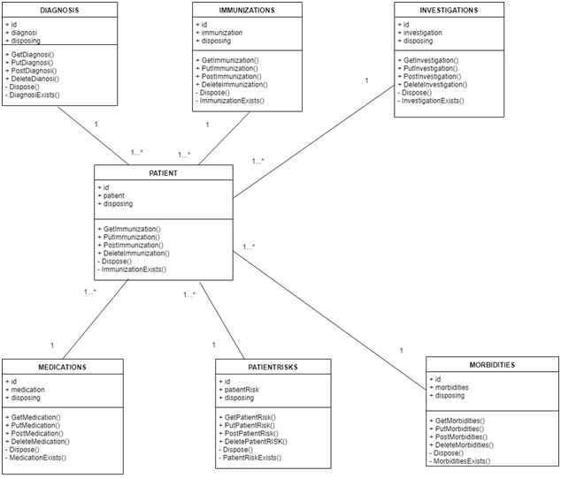
Class Diagram

Slide 12
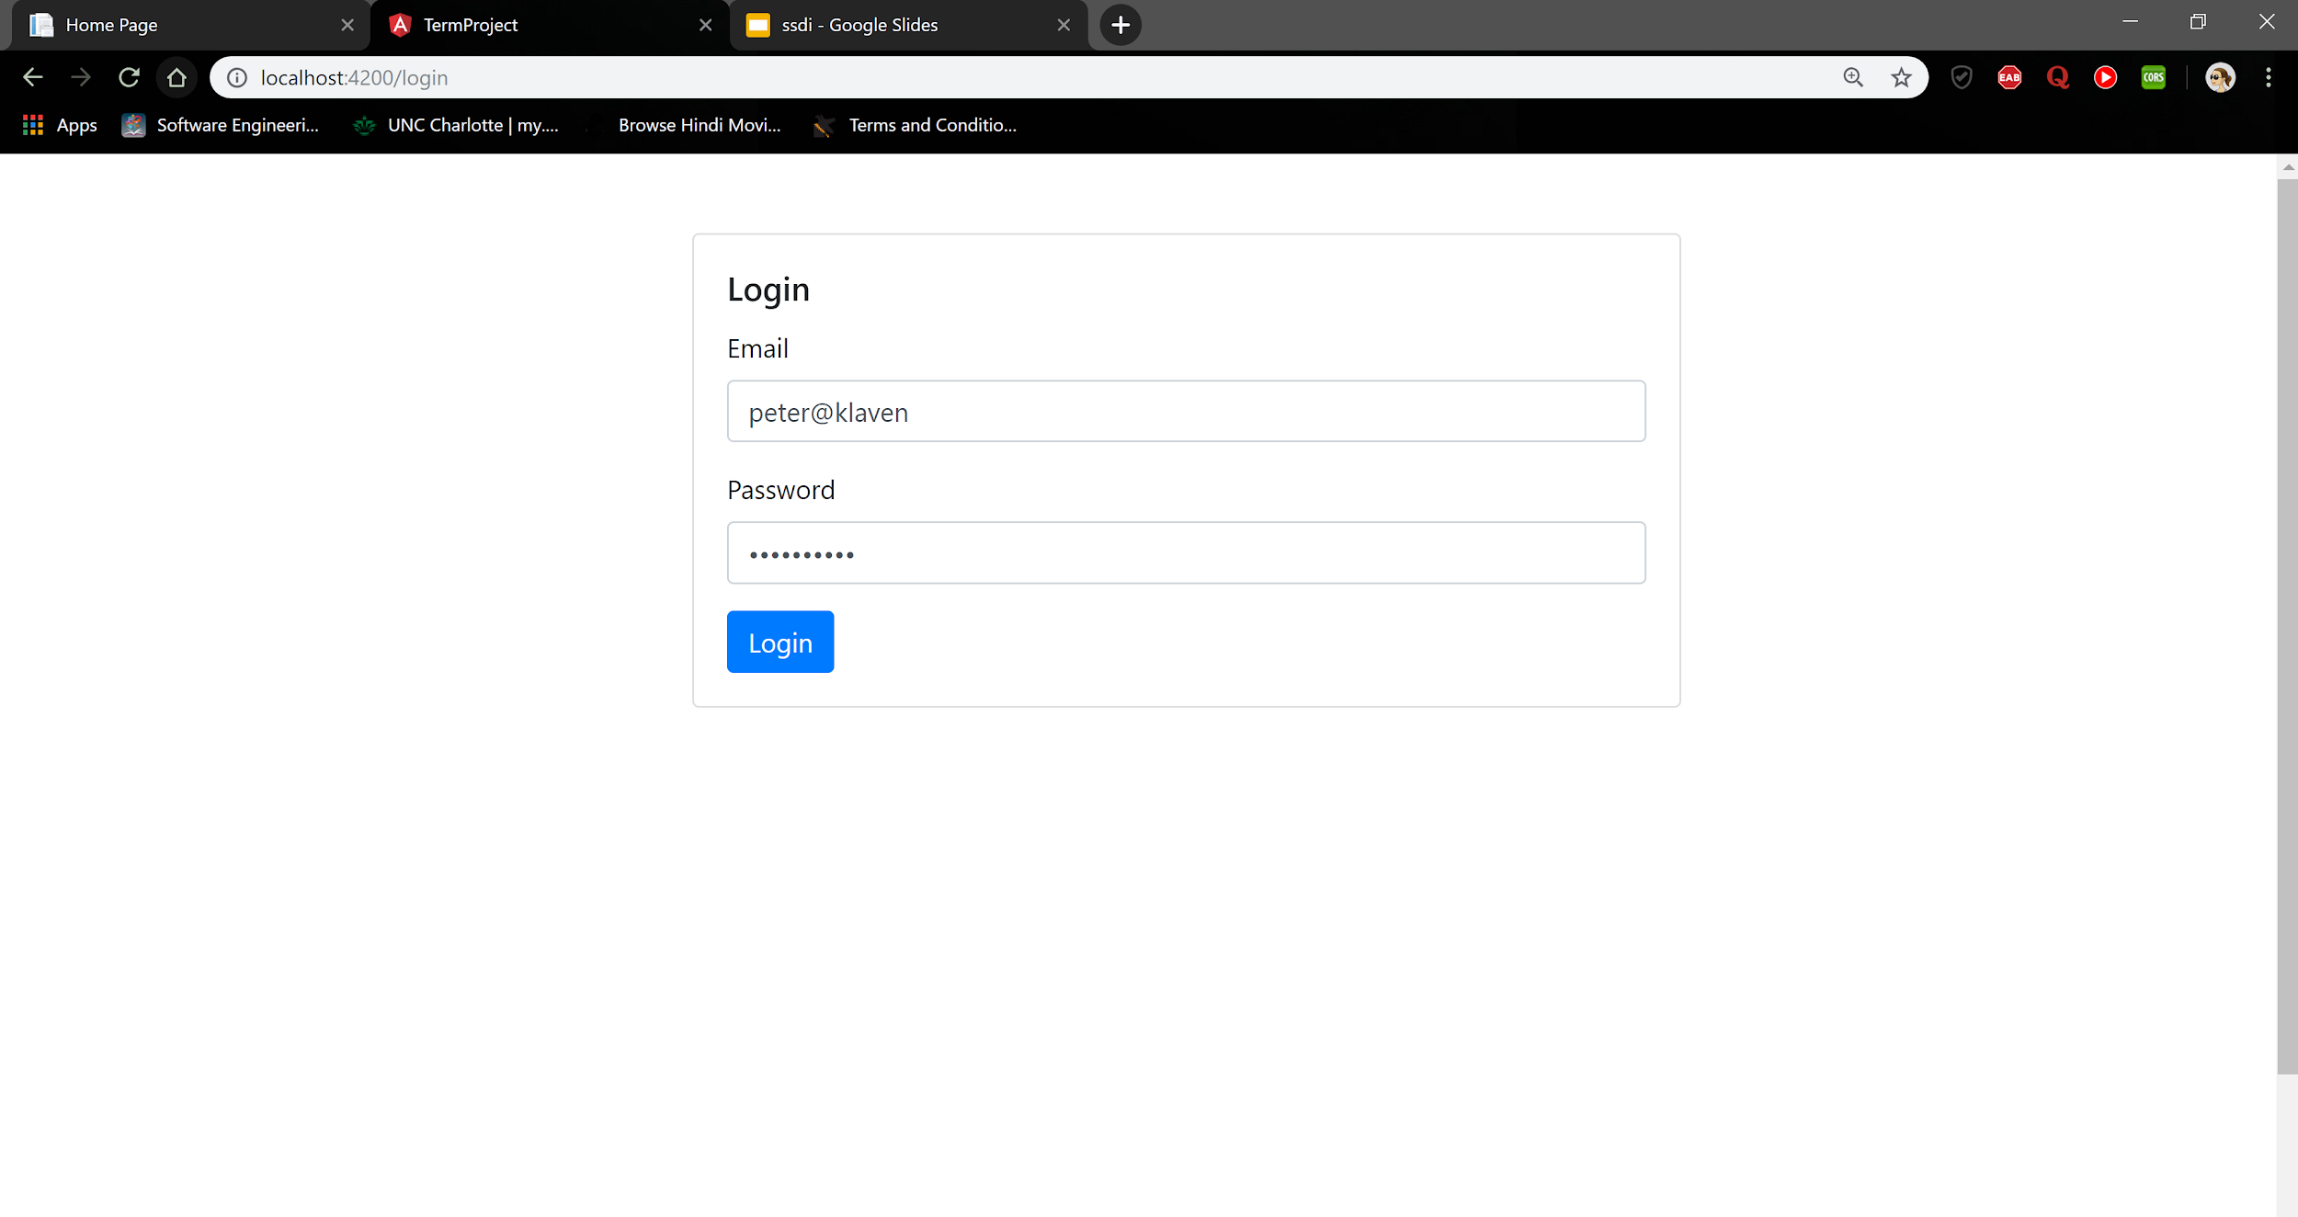

Slide 13
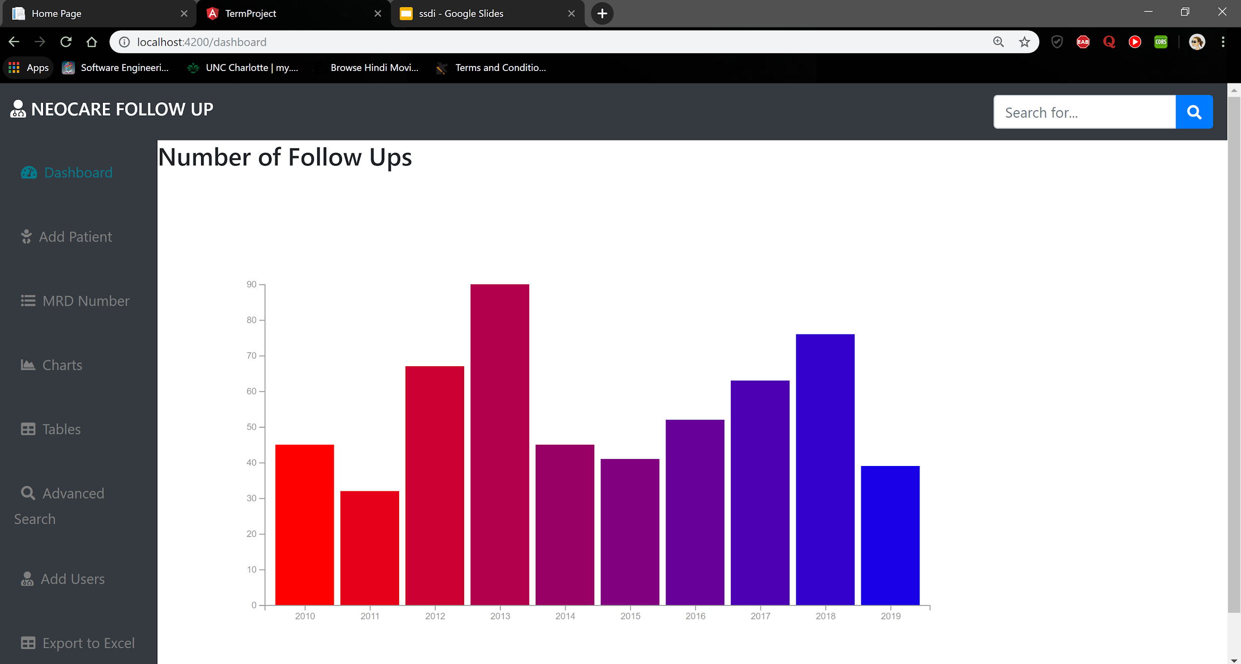

Slide 14
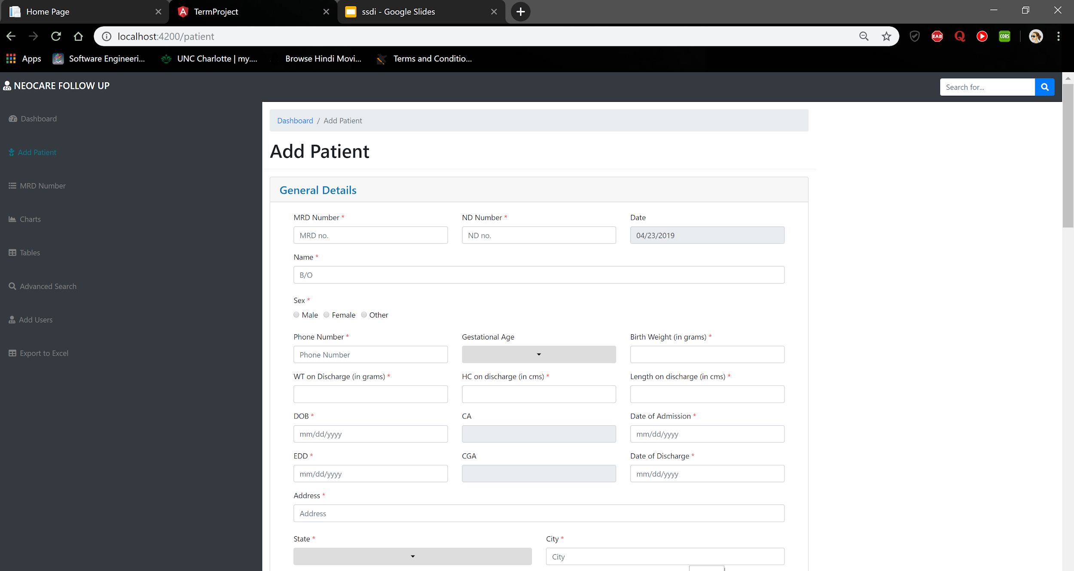

Slide 15
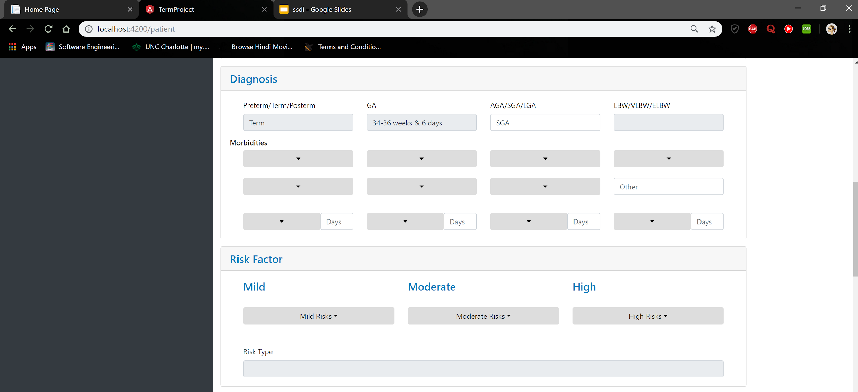

Slide 16
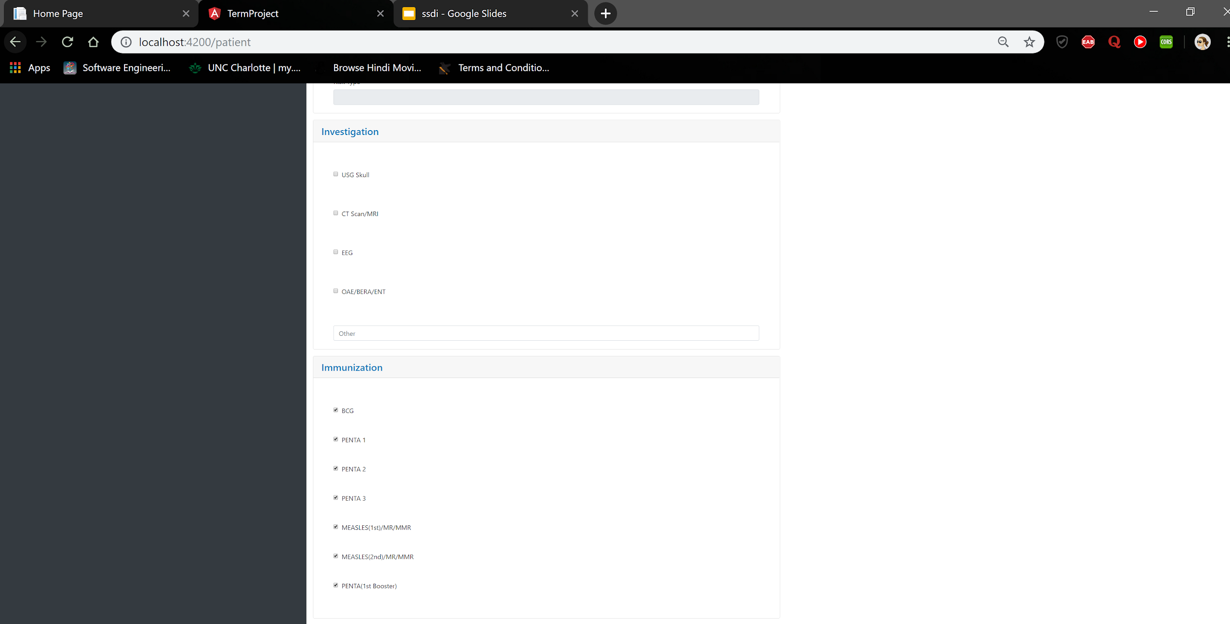

Slide 17
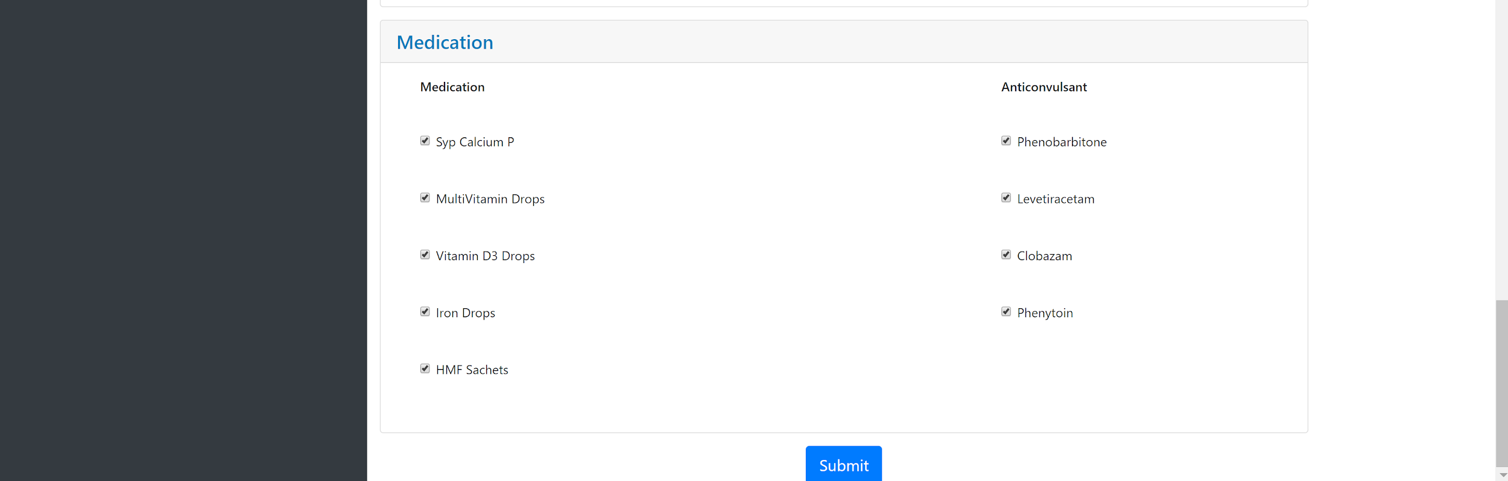

Slide 18
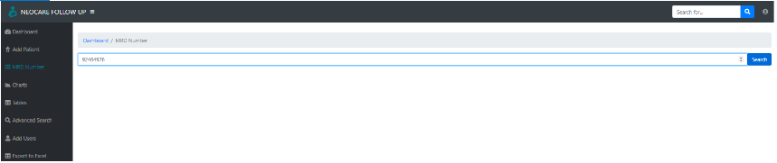

Slide 19
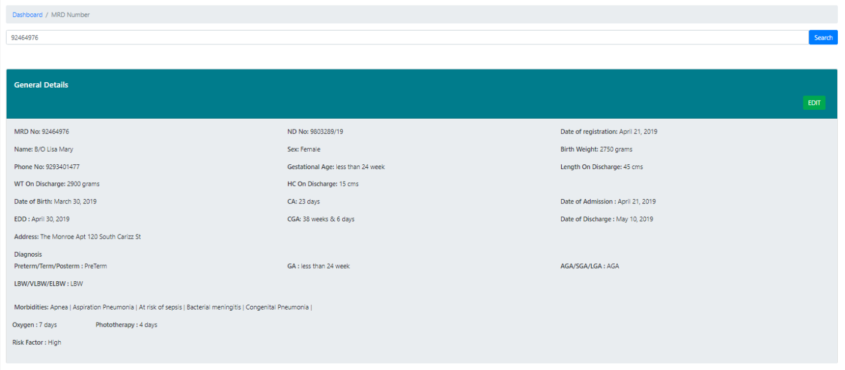

Slide 20
Future Scope
Depending on all the patient’s details and information that is present in the database, graphs will be generated where in the doctor can have a vivid idea of the patient’s health.
Graphs will be generated that gives information about the patient’s medical condition, vaccinations received by them, overall growth from the date of birth till the last visit or the date of discharge, Investigations, Immunizations etc.
Detailed information of the regular follow up visits will be maintained with proper User Interface.

Slide 21
Conclusion
Application which maintains complete history of a child right from birth to the age of 5 years was developed.
The application maintains information right from health complications from birth, risks, diagnosis, immunization records and medications given.
There are graphs provided for easy analysis of the growth and statistics of follow-ups.

Slide 22
Thank You

