Slide 1



Predicting Data Breach Trends Based on Historical Attack Patterns
Leonard Korreshi
Rishabh Sareen
Wen Bin
January 25th, 2023
Work done in partial fulfilment of the requirements of Michigan State University MTH 844; advised by Mr. Mike Friedel, ManpowerGroup; Dr. Gee Lee and Dr. Peiru Wu, Michigan State University.

Slide 2
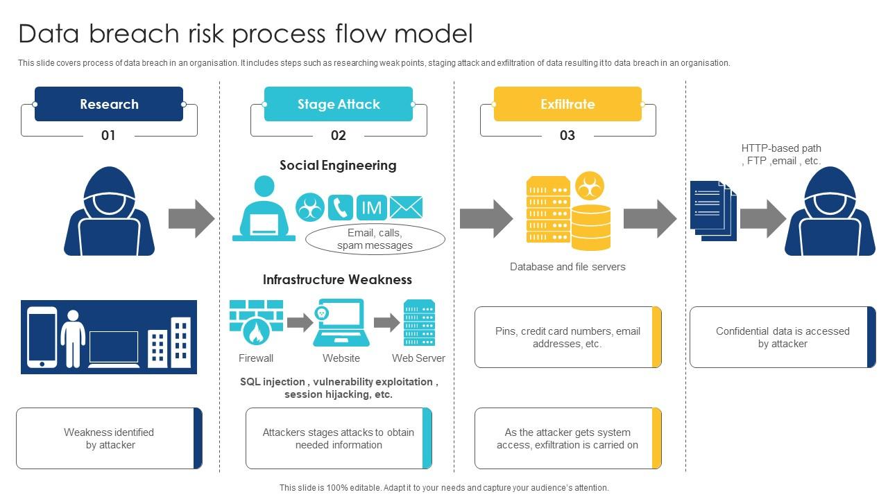

Background
ManpowerGroup being the third-largest staffing firm is actively involved in the domain of cybersecurity.
Cybersecurity is the practice of defending computers, servers, mobile devices, electronic systems, networks, and data from malicious attacks.
A data breach is an incident where information is stolen or taken from a system without the knowledge or authorization of the system’s owner. Eg: Ransomware, Denial of Service Attacks, Phishing.
Figure 1. Data Breach Risk Process Flow Model.

Slide 3
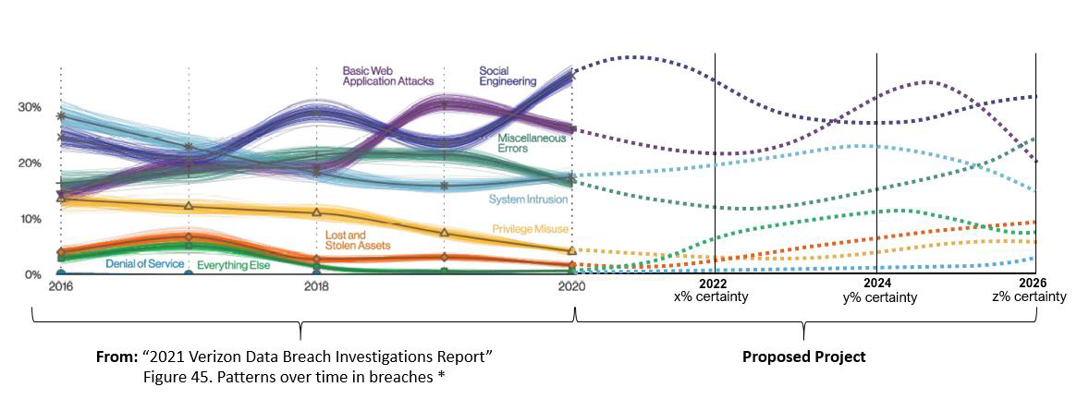
Objectives
To predict the causes of future data breaches by extrapolating historical breach trends as detailed in the Verizon’s Data Breach Investigation Report (DBIR) 2022.
To recommend specific security control recommendations that help organizations of different maturity levels to protect themselves against threats.
Figure 2. Representation of future breach pattern trends.

Slide 4

Data
The DBIR is a report published every year by Verizon containing information about data breaches and incidents and how they changed over time.
The VCDB (Verizon Community Database) is a partial store of the data used in the DBIR, publicly available as a repository on GitHub, a project-sharing website.
Each breach and incident recorded in the VCDB follows the VERIS (Vocabulary for Event Recording and Information Sharing) scheme.
The events are available as .csv and .json files.
Figure 3. VERIS logo.

Slide 5
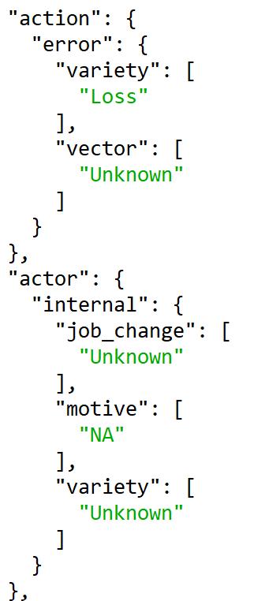
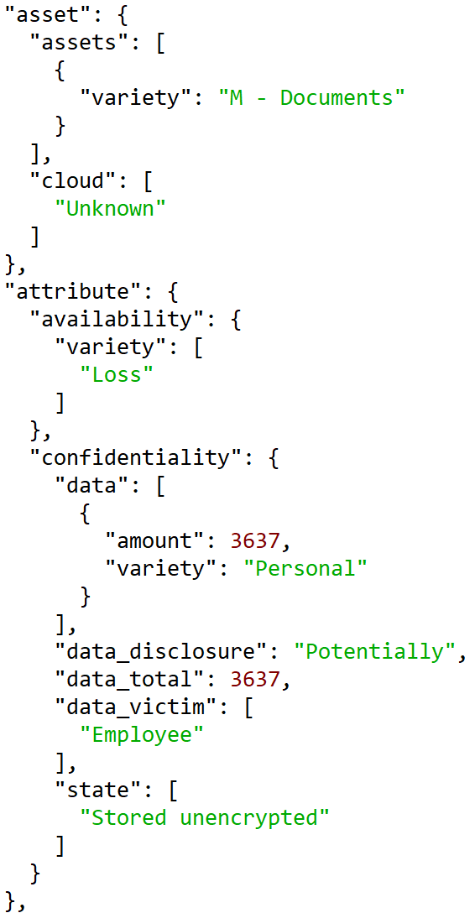
The VERIS Format
Contains nested data about the nature of an incident or data breach.
Four main fields:
Action: How was it done?
Actor: Who did it?
Asset: What was taken?
Attribute: What were the impacts?
Additional information about the victim affected, timeline information, and other available information.
Figure 4. Format of VERIS schema in a .json file.

Slide 6
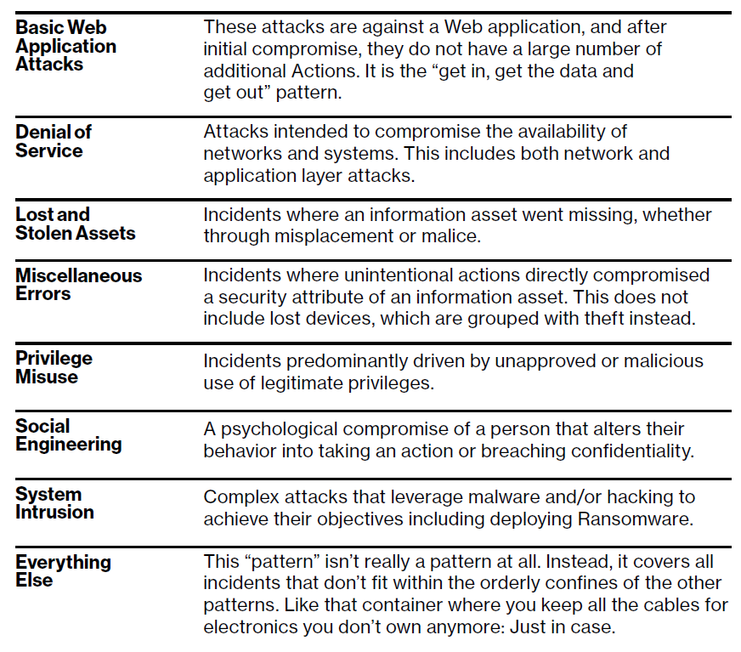
Incident Classification Patterns
Each of the collected incidents and data breaches in the VCDB are assigned to 8 different 'buckets' based on the pattern of the event.
These eight patterns define core ways data breaches occur and form the basis of what will be predicted.
Each existing incident must be classified according to what pattern it matches best, with a score indicating the closeness of match.
Figure 5. Verizon explanation of the eight patterns.

Slide 7
Challenges
The data must be reconstructed before being able to make explorations or predictions with the appropriate statistical models. The original data uses the VERIS R package to convert the .json files into usable objects.
Majority of the data only includes the years they occurred instead of date or months, and it must be considered how to handle these data, since they lack some prediction power, but to exclude them completely might cause some bias.
Some of the recent events might have already occurred but haven’t been reported yet, which can also cause some bias.

Slide 8


Thank you !
QUESTIONS ?

