Slide 1

Health Care Bot
Decision Support Systems

Slide 2

Group Members
Emirhan Kutlu
Lucie Labadie
Rosen Sasov

Slide 3
Problem
Finding an universal way to make a decision
Including some basic side factors that are important, apart from the symptoms
Big Data handling
Finding a trustworthy test data

Slide 4

Health Care Bot
Web service
Asking questions about physical state
Take the symptoms and personal data as input
Personal data: weight, height, smoker…
Compute most probable diseases
Output the diagnosis to the user along with advices

Slide 5

Why is it needed ?
First results in any search engine gives most deadly sickness
Help people go to the right place to be taken care of fast
Help for better auto-medication

Slide 6
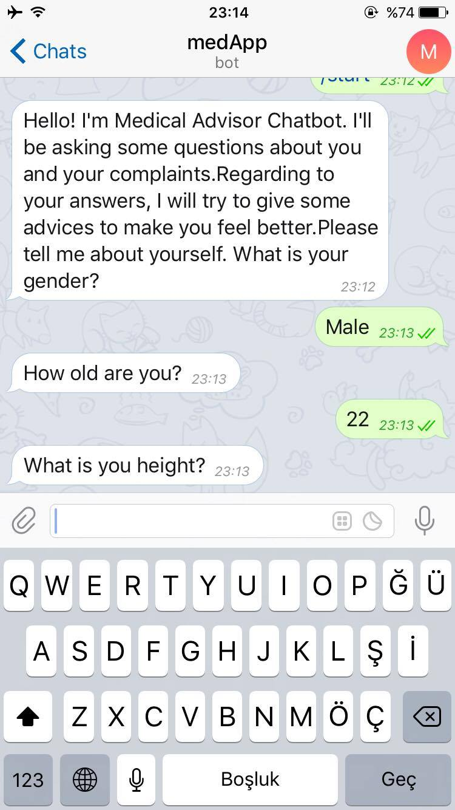
How does it works ?
Bot is asking for first symptoms
Written language recognition
Determine symptoms
Compute first set of diseases
Ask directed questions to reduce the set
Continue until the set is small enough
Gives results along with advices

Slide 7
Decision Support System
Interactive and easy to use
Knowledge-driven DSS
Input: symptoms + personal data
Output: 3 most probable diseases and advices
Limited by the database
Compute probability on diseases depending input data
Takes decision when threshold reached
Maximum number of questions
Maximum probability

Slide 8

Database
Relational Database
Many-to-many data model
3 tables
Symptoms
Diseases
Diagnosis

Slide 9
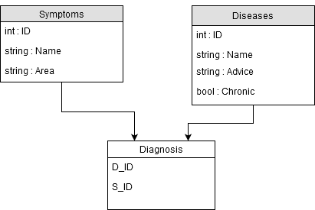
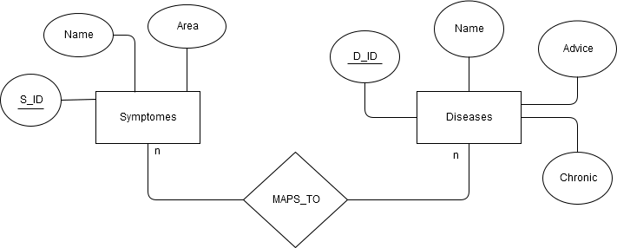
Database structure

Slide 10
Architecture
Front-end
Back-end
Bot logic
Database
Classifier

Slide 11
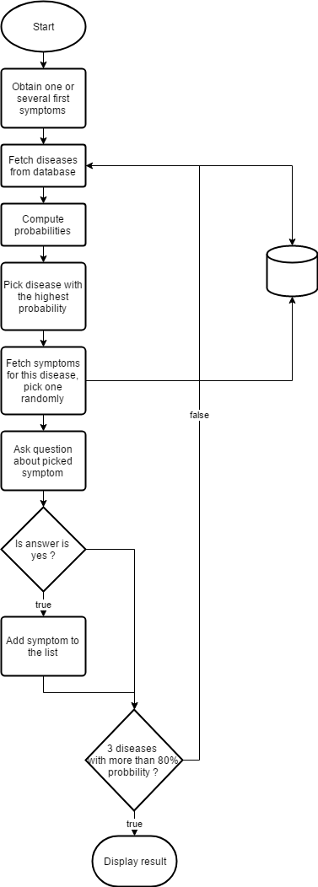
Questions logic

Slide 12

Probability computation
Compute scores
The higher scores are chosen as the most probable sicknesses
In the case of a draw we use personal information to decide between the two
Example : draw between flu and pneumonia + the patient is a smocker → pneumonia is chosen over flu
$$Score= \frac{Number of common symptoms}{Total number of symptoms for the sickness}$$

Slide 13



Technology choices
Bot logic: Telegram Bot (Python module)
Classifier: SciKit
Database: Postgresql

Slide 14
Conclusion
Could be adapted for mobile use
Could be affined for professional use
First thought wanted to use Django → did not work out
Questions logic
Finding a database
Finding a dataset for classifier
Extending the database

Slide 15
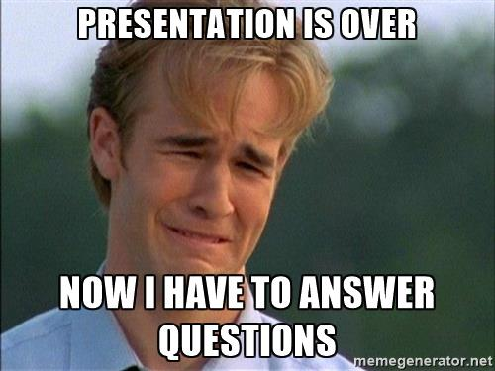
Thank you for your attention!

