Slide 1
Agenda
Doubly stochastic gradient descent
EEE 606: Adaptive Signal Processing
Rajesh, M.S. CS, On-Campus

Slide 2
Agenda
Overview
Problem Statement
QSGD Introduction
Variational Quantum Eigensolver
Quantum Neural Networks
Results
Conclusion

Slide 3
Problem Statement
Understand and implement Quantum doubly stochastic gradient descent (QSGD) for two problems:
Variational Quantum Eigensolver
Quantum Neural Networks
Compare the convergence curve of QSGD and classical (vanilla) gradient descent
Main Reference Paper:
Ryan Sweke, Frederik Wilde, Johannes Jakob Meyer, Maria Schuld, Paul K. Fährmann, Barthélémy Meynard-Piganeau, Jens Eisert. “Stochastic gradient descent for hybrid quantum-classical optimization.” arXiv:1910.01155, 2019.

Slide 4
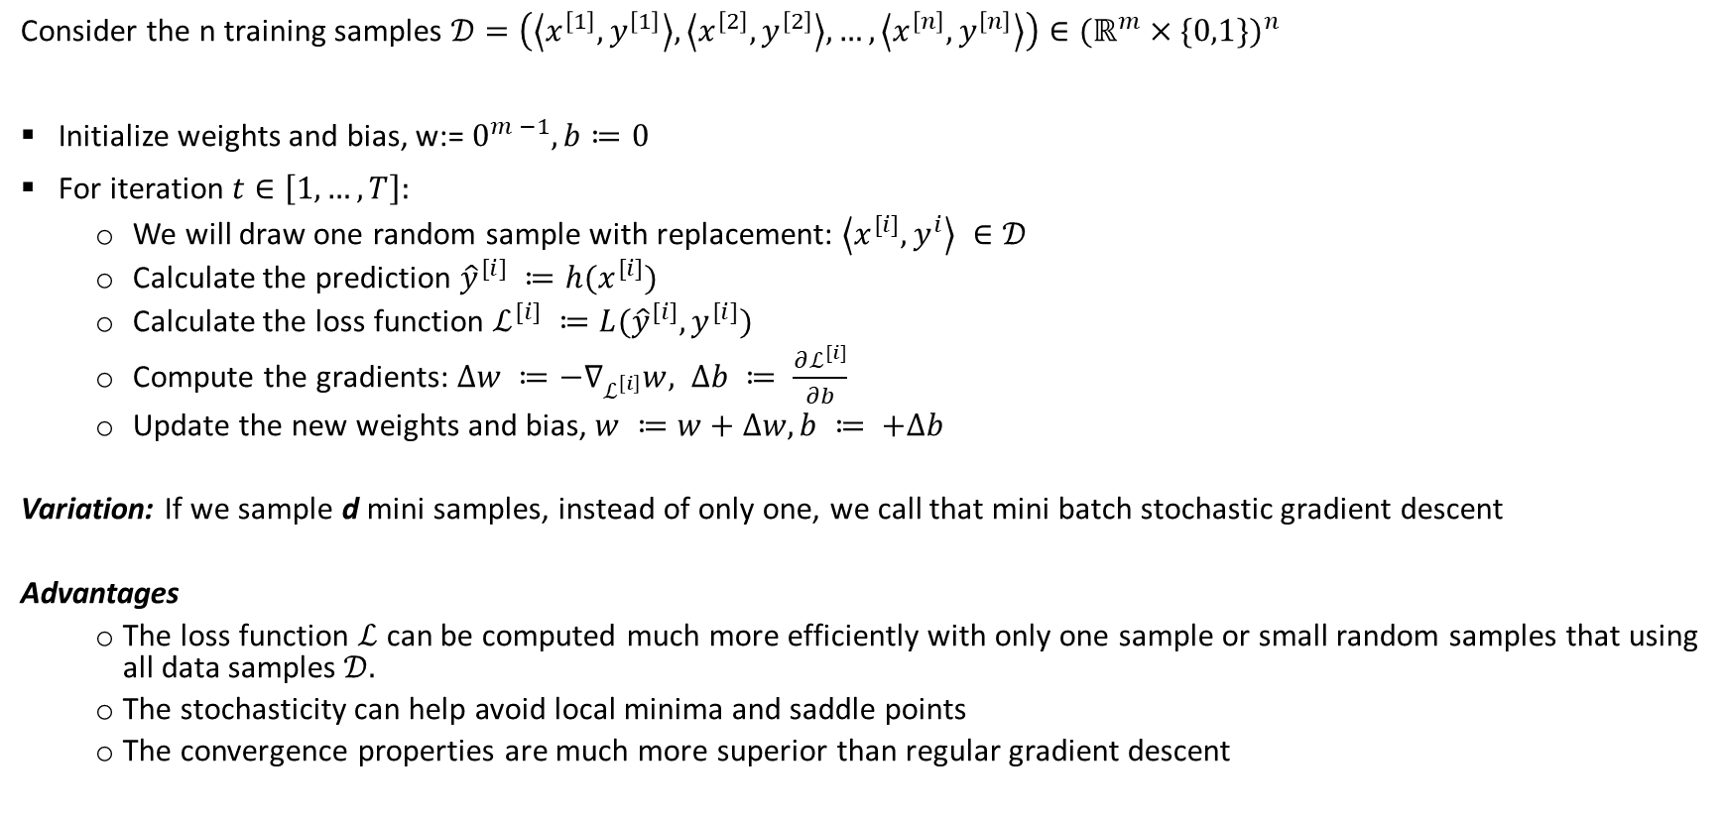
Stochastic Gradient Descent algorithm
Consider the n training samples $𝒟=\left(\left\langle x^{\left[1\right]}, y^{\left[1\right]}\right\rangle ,\left\langle x^{\left[2\right]}, y^{\left[2\right]}\right\rangle , …,\left\langle x^{\left[n\right]}, y^{\left[n\right]}\right\rangle \right)∈{(ℝ^{m}×\{0,1\})}^{n}$
Initialize weights and bias, w:= $0^{m −1}, b≔0$
For iteration $t∈\left[1, …, T\right]:$
We will draw one random sample with replacement: $\left\langle x^{[i]}, y^{i}\right\rangle ∈𝒟$
Calculate the prediction ${\hat{y}}^{[i]} ≔h(x^{[i]})$
Calculate the loss function $ℒ^{[i]} ≔L({\hat{y}}^{[i]}, y^{[i]})$
Compute the gradients: $∆w ≔−∇_{ℒ^{\left[i\right]}}w, ∆b ≔ \frac{∂ℒ^{[i]}}{∂b}$
Update the new weights and bias, $w ≔w+∆w, b ≔ +∆b$
Variation: If we sample d mini samples, instead of only one, we call that mini batch stochastic gradient descent
Advantages
The loss function $ℒ$ can be computed much more efficiently with only one sample or small random samples that using all data samples $𝒟.$
The stochasticity can help avoid local minima and saddle points
The convergence properties are much more superior than regular gradient descent

Slide 5
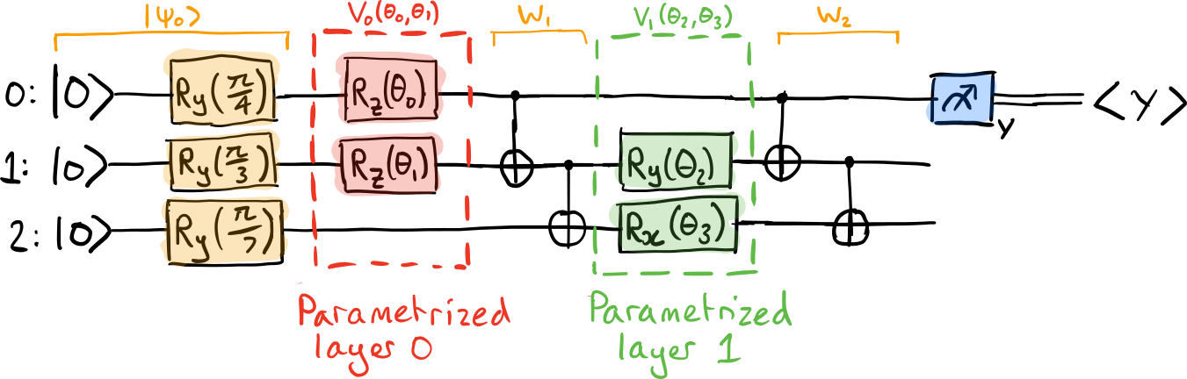
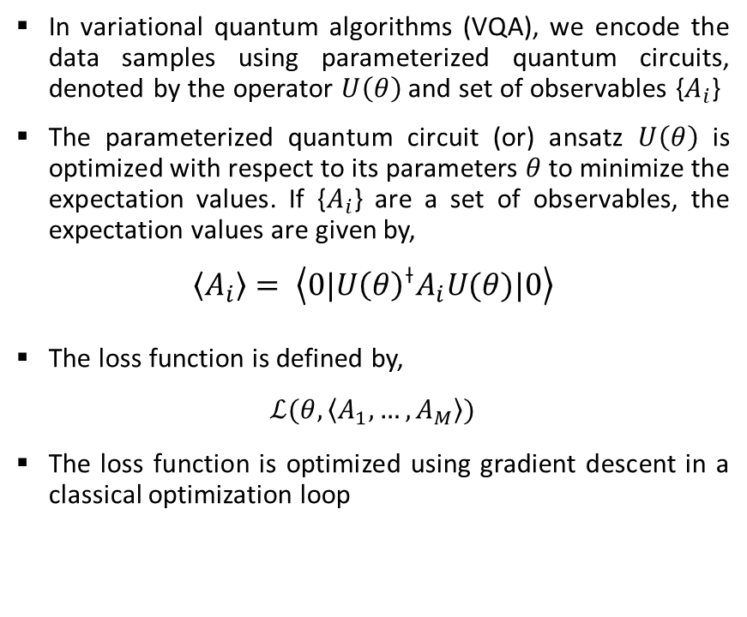
Doubly stochastic gradient descent: VQA
In variational quantum algorithms (VQA), we encode the data samples using parameterized quantum circuits, denoted by the operator $U\left(θ\right)$ and set of observables {$A_{i}$}
The parameterized quantum circuit (or) ansatz $U\left(θ\right)$ is optimized with respect to its parameters $θ$ to minimize the expectation values. If {$A_{i}$} are a set of observables, the expectation values are given by,
$$\left\langle A_{i}\right\rangle = \left\langle 0|{U\left(θ\right)}^{⟊}A_{i}U(θ)|0\right\rangle$$
The loss function is defined by,
$$ℒ(θ, \left\langle A_{1}, …,A_{M}\right\rangle )$$
The loss function is optimized using gradient descent in a classical optimization loop
Fig 1. Sample parameterized quantum circuit. Reference from Pennylane

Slide 6
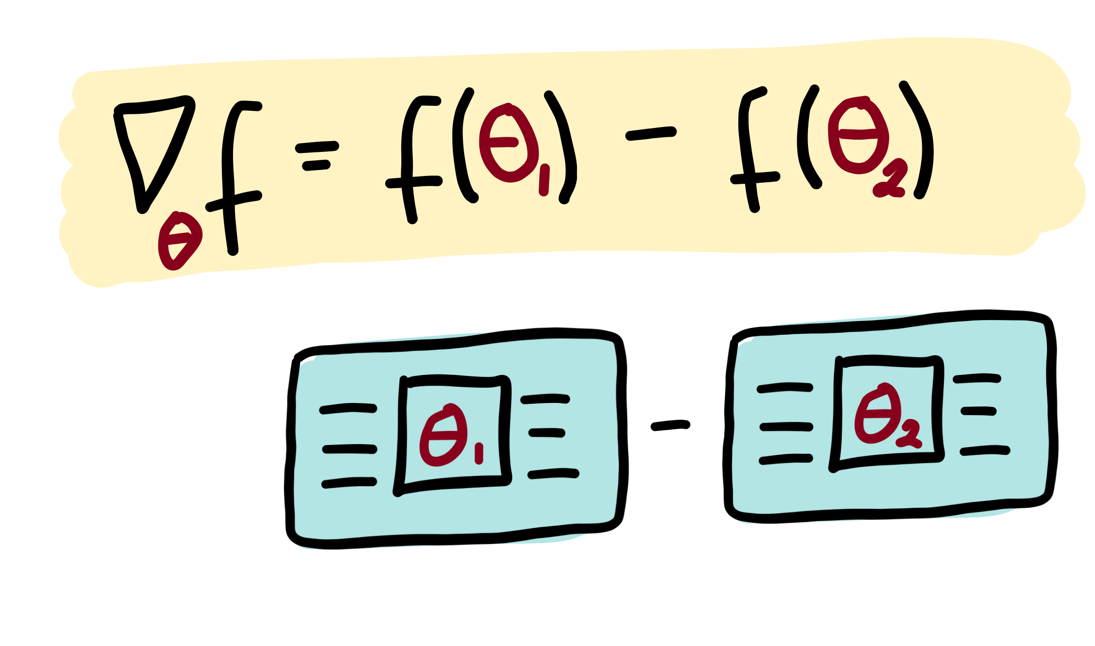
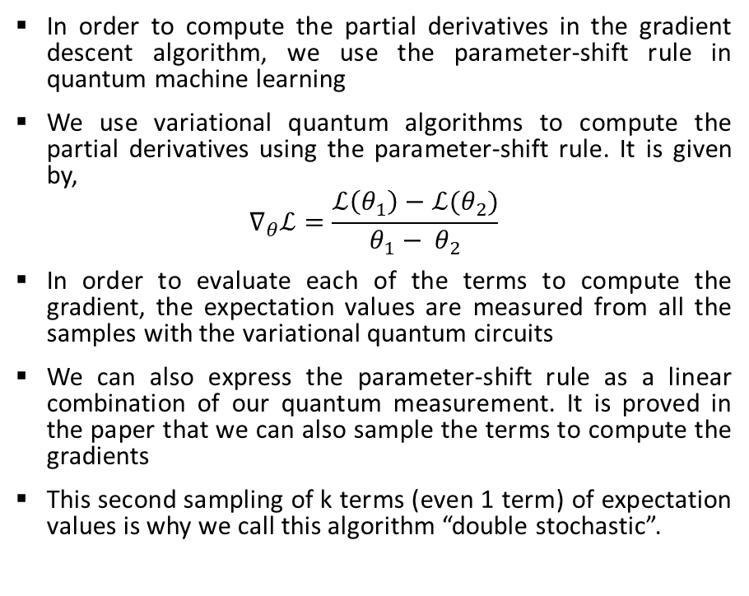
Doubly stochastic gradient descent: Parameter-shift rule
In order to compute the partial derivatives in the gradient descent algorithm, we use the parameter-shift rule in quantum machine learning
We use variational quantum algorithms to compute the partial derivatives using the parameter-shift rule. It is given by,
$$∇_{θ}ℒ=\frac{ℒ\left(θ_{1}\right)−ℒ(θ_{2})}{θ_{1}− θ_{2}}$$
In order to evaluate each of the terms to compute the gradient, the expectation values are measured from all the samples with the variational quantum circuits
We can also express the parameter-shift rule as a linear combination of our quantum measurement. It is proved in the paper that we can also sample the terms to compute the gradients
This second sampling of k terms (even 1 term) of expectation values is why we call this algorithm “double stochastic”.
Fig 2. Parameter-shift rule, pennylane

Slide 7



Variational Quantum Eigensolver
It is a variational quantum algorithms (VQA) suited for near term quantum computers to determine the ground state of the given molecule
It is one of the most important problem in quantum chemistry
The inputs to a variational quantum Eigensolver are the Hamiltonian* of the molecule and a parameterized quantum circuit.
The loss function is defined in terms of the expectation value of the Hamiltonian in the trial state
Optimization Loop
$$U(θ)$$
$$\left\langle H\right\rangle$$
$$ℒ(\left\langle H\right\rangle )$$
ansatz
Loss function
* Hamiltonian of a system is an operator corresponding to the energy of the system
Fig 3. VQE block diagram

Slide 8
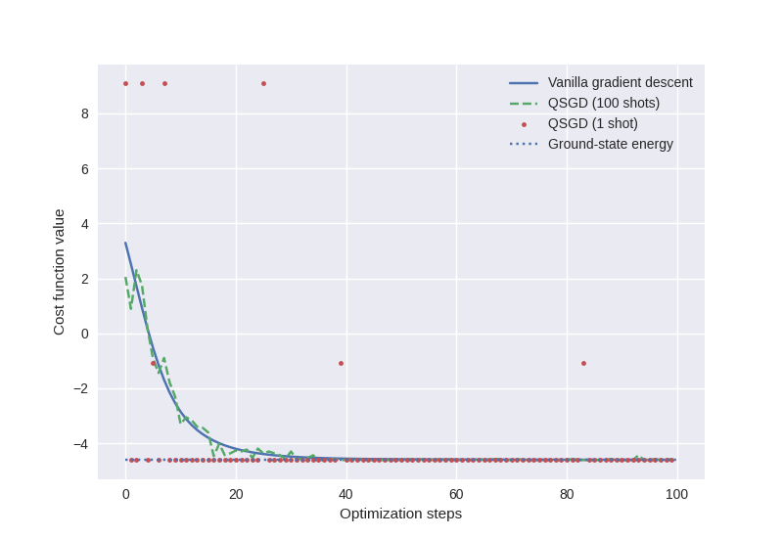
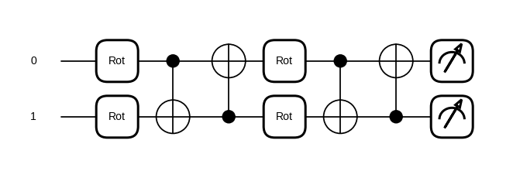

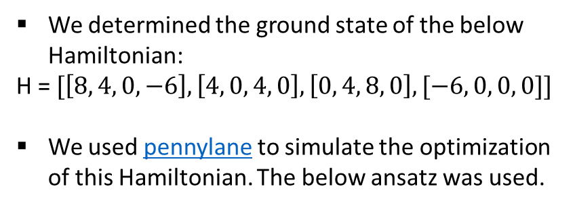
VQE: Single-shot SGD
We determined the ground state of the below Hamiltonian:
H = $[\left[8, 4, 0, −6\right], \left[4, 0, 4, 0\right], \left[0, 4, 8, 0\right], [−6, 0, 0, 0]]$
We used pennylane to simulate the optimization of this Hamiltonian. The below ansatz was used.
Parameters: Learning rate: $η=0.01$, steps = 200
Fig 4. VQE SGD ansatz
Fig 5. VQE single-shot SGD convergence curve
Observation: We can see that the loss function is almost the same as vanilla GD

Slide 9
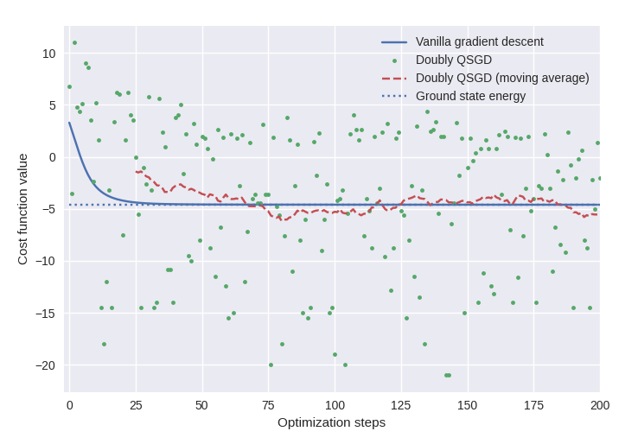
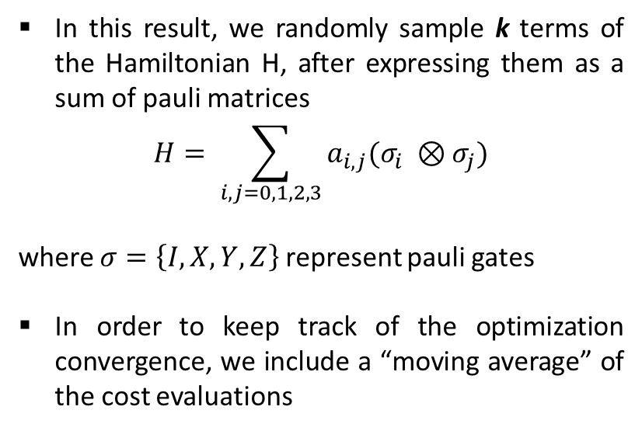
VQE: Doubly Stochastic Gradient Descent
In this result, we randomly sample k terms of the Hamiltonian H, after expressing them as a sum of pauli matrices
$$H= \sum_{i,j=0, 1, 2, 3}{a_{i,j}(σ_{i} ⊗σ_{j})}$$
where $σ=\left\{I, X, Y, Z\right\}$ represent pauli gates
In order to keep track of the optimization convergence, we include a “moving average” of the cost evaluations
Observation: We can see that the loss function is almost the same as vanilla GD, with the moving average, but does not work well without it
Fig 6. VQE doubly stochastic GD convergence curve

Slide 10
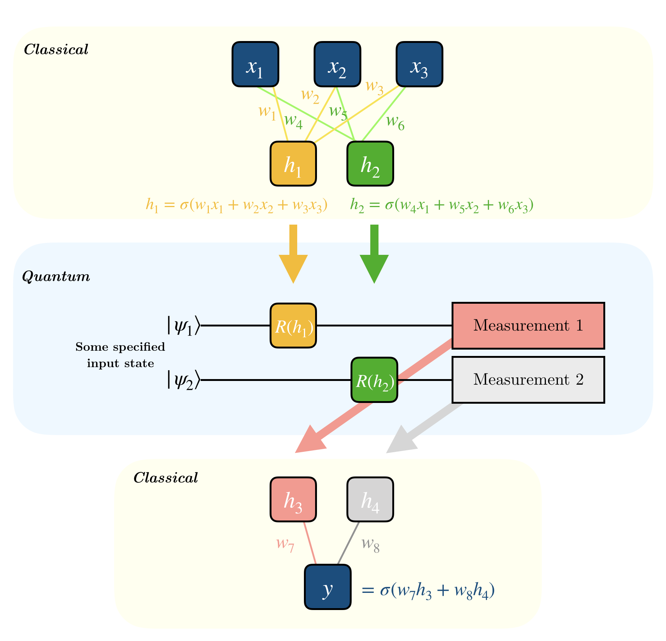
Quantum Neural Networks (QNN)
We use Hybrid quantum-classical Neural Network as a VQA in near-term quantum devices
It consists of classical quantum ansatz sandwiched in-between classical Neural Network layers.
The output from other layers are fed as the parameters to the quantum ansatz
The measurement values/expectation is fed to the input of the next classical layer
Usually, the optimization is done in the classical layer.
In this project, we have computed the optimization part using doubly stochastic gradient
Fig 7. Architecture of a QNN, IBM

Slide 11
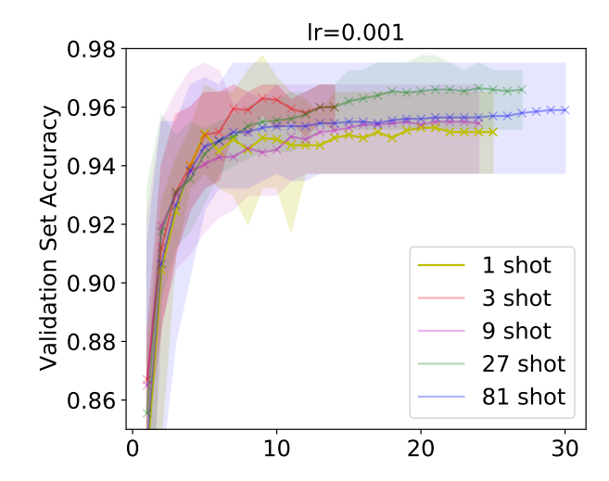
QNN: doubly stochastic gradient descent
For this classification task, we used the MNIST dataset and took 2000 samples of the digit 3’s and 6’s as training set and 200 samples for validation set.
We encode the data to the quantum circuit using a technique called amplitude encoding
We encode the data using 8 qubits
After the sampling the data, we also sample the terms used in the parameter-shift rule for implementing the doubly-stochastic gradient descent for the classifier
Observation: We can see that the accuracy improves as we increase the number of shots

Slide 12
Conclusion
In this project, we studied the doubly stochastic gradient descent using variational quantum circuits
We simulated two problems such as the VQE and QNN for the MNIST dataset
With the VQE problem:
In single shot SGD, the convergence of the ground state is very similar with the vanilla gradient descent
In doubly stochastic GD, the convergence is very similar to vanilla GD, with a moving average
With QNN, we saw the accuracy is improved as the number of shots in increased
The above simulations showed that we are able to implement the stochastic gradient descent using quantum circuits
While we get an almost similar convergence properties with vanilla gradient descent, the advantages of quantum computation comes in terms of speed, when we have a noiseless quantum computers in the future

