Slide 1
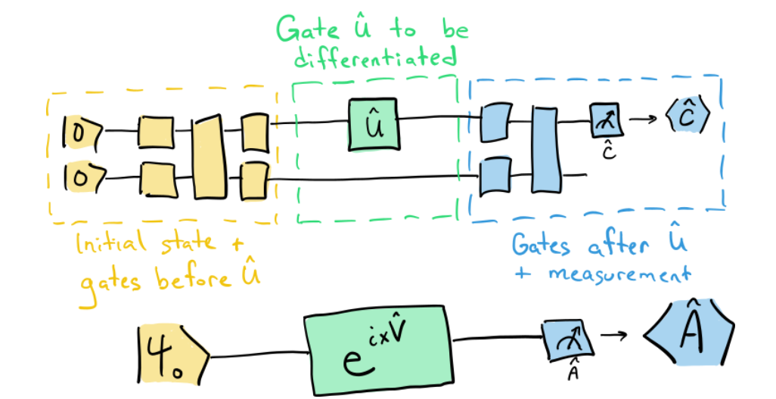
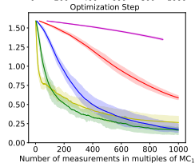

Stochastic gradient descent for hybrid quantum-classical optimization
^{Rajesh Sathya Kumar}
EEE 606 – Preliminary Project Proposal
Problem: Study the doubly stochastic gradient descent using quantum computation
Task:
Implement a parameterized quantum circuit
Optimize with doubly stochastic gradient descent
Compare the convergence curve of double stochastic vs analytic gradient descent
Challenges: Encoding practical data into an optimization problem with a quantum circuit
Goal:
To study an optimization method using quantum computation and compare with classical gradient descent
Compare the results with classical computation
Prepare a final report and present to the class
Convergence Curve – Vanilla GD vs Quantum Stochastic GD
Reference:
Sweke, R., Wilde, F., Meyer, J., Schuld, M., Faehrmann, P. K., & Eisert, J. (2019). Stochastic gradient descent for hybrid quantum-classical optimization. arXiv. https://doi.org/10.22331/q-2020-08-31-314

