Slide 1
Exploration: Design Patterns & Role Stereotypes in K-9 Mail
22-03-2022

Slide 2
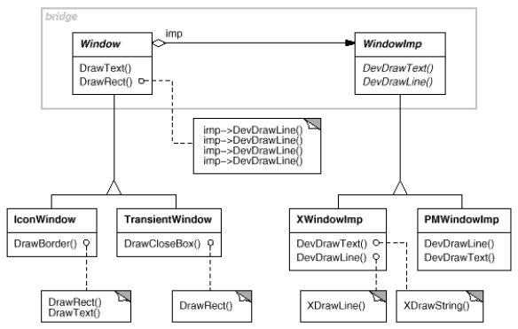
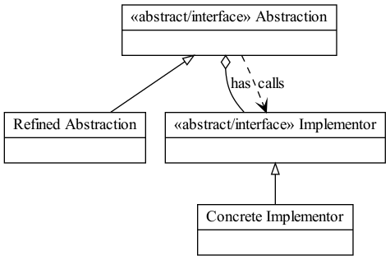
Hypothesis
A participation in a design pattern entails particular role stereotype(s)
e.g., the “bridge” pattern: abstracts both what* you want to do (abstraction) and how* you want to do it (implementor)
structurer
information holder
or service provider
structurer
or maybe interfacer?
service provider

Slide 3
Method
Case: K-9 Mail
Detect design patterns using DP-CORE (Diamantopoulos et al., 2016)
Customizable pattern definition
(problem: many false positives)
Generate class (sub)diagrams of pattern instances
Colorize the classes in the diagrams by their role stereotypes
Use ground truth role stereotypes
Discover “interesting” things*
* Work in progress, results are neither verified nor validated

Slide 4
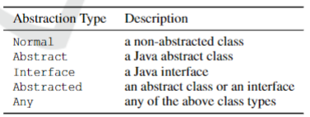
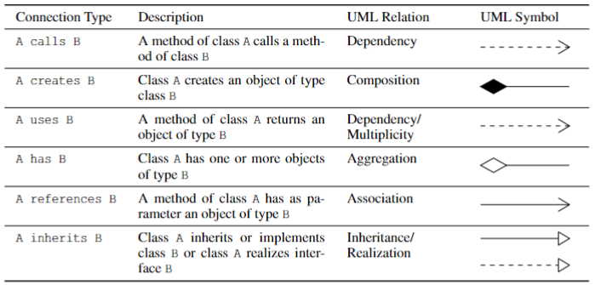
example pattern definition: “bridge”
abstracts both what you want to do and how you want to do it
Definition in DP-CORE:
Bridge
A Normal Refined Abstraction
B Abstracted Abstraction
C Normal Concrete Implementor
D Abstracted Implementor
End_Members
A inherits B
C inherits D
B has D
B calls D
End_Connections

Slide 5
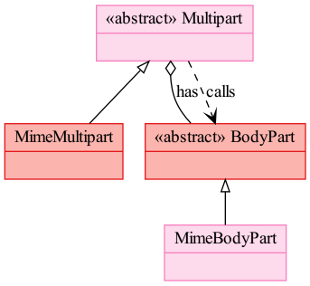
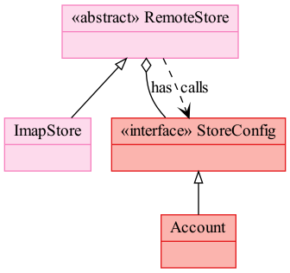
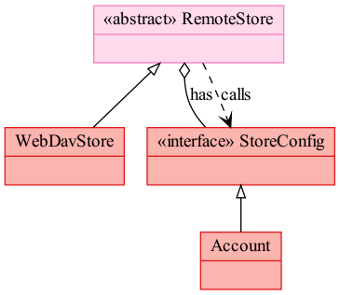
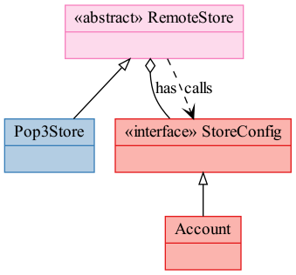
Instances of “bridge” pattern detected in K-9 Mail
Might actually have the same stereotype?
Service providers?

Slide 6
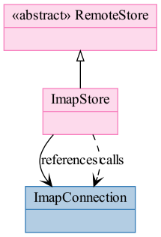
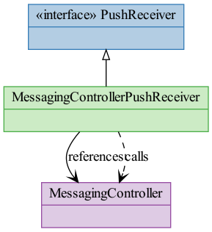
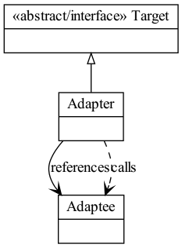
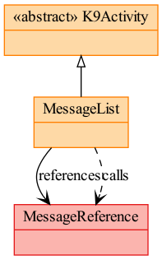
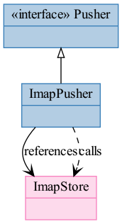
example pattern: “Adapter”
(some of) Detected instances
Definition
I need a Target but I have Adaptee instead, so I wrap the Adaptee in an Adapter that implements Target
Interfacer might be more appropriate

Slide 7
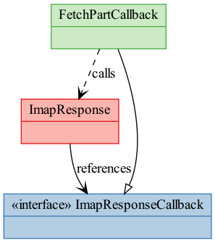
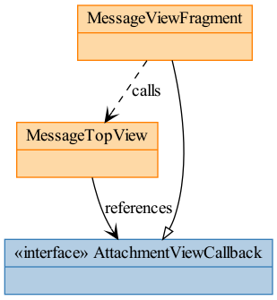
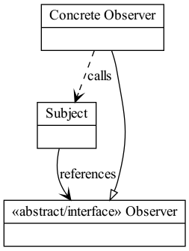
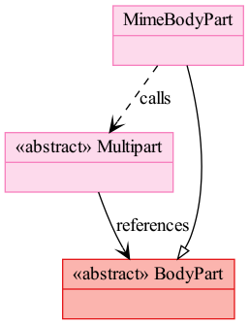
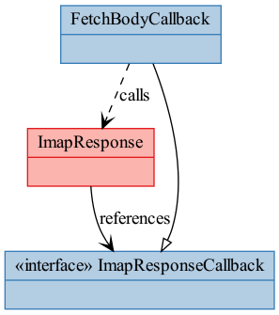
example pattern: “Observer”
All Detected instances
Definition
Subject notifies all Observers when it changes state
Observers comply to an interface
Should only be interface?

Slide 8
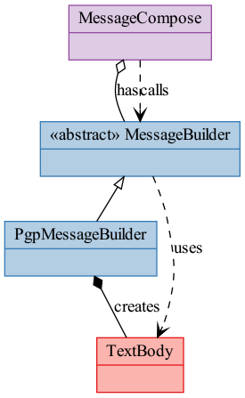
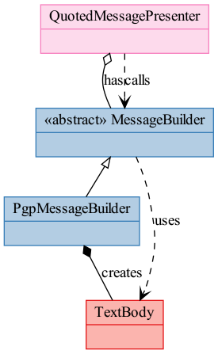
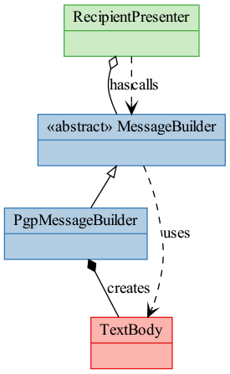
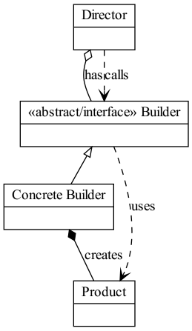
example pattern: “Builder”
All Detected instances
Definition
A Director relies on Builders to create a complex Product

Slide 9
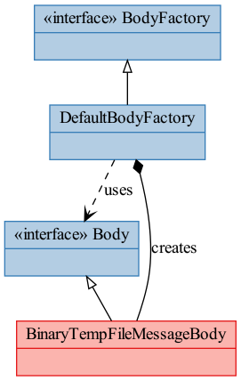
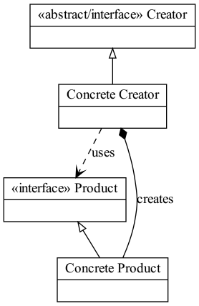
example pattern: “Factory method”
Detected instance
Definition
Define an interface for creating an object, but let subclasses decide which class to instantiate
very similar to builders

Slide 10
Side note: complication in detecting creational patterns
In K-9 Mail, some Builders do not return the product immediately because they are asynchronous builders
i.e., the build() method returns (void) immediately, and there is a callback mechanism that will notify the builder’s invoker once the product is ready
This is common now; not so much when the GoF design patterns book was first released
Those Builders cannot be detected with the current pattern detection tool

Slide 11
And more:
“Abstract Factory”: hard to define with DP-CORE
“Command”: detected so many instances, hard to select true positives
“Composite”, “Decorator”, “Proxy”, “Visitor”: no detected instances in K-9 Mail

Slide 12
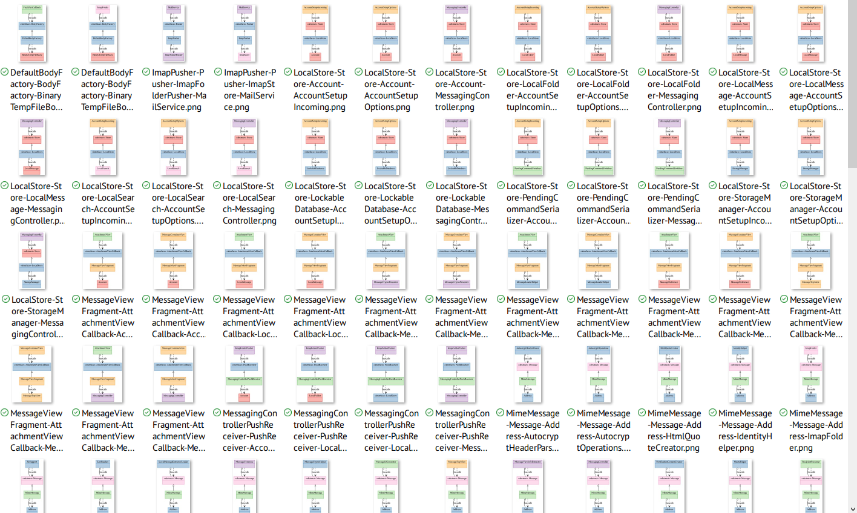
“Command” pattern: detected instances

Slide 13
Potential uses
Discover role stereotypes of pattern participants
Enhance design pattern detection algorithms, e.g.,
for Observer: Subject is (mutable) Information Holder (has state, can change state)
for Adapter, Command (too many instances detected with diverse stereotype combinations)
Discover common interaction patterns between role stereotypes
Enhance role stereotype classifier, e.g.,
when a class acts as an abstract Implementor in a Bridge pattern, Structurer might be a more appropriate role stereotype

Slide 14
Potential uses
Summarization: get a higher-level view of a system, e.g.,
A Bridge can be considered one large Structurer that interacts with two (types of) Service Providers, for instance

Slide 15
More (possible) summarizations
Builders, Factories are just fancy constructors

Slide 16
More (possible) summarizations
Target and Adapter can be considered an Interfacer

Slide 17
More (possible) summarizations
In a higher-level view, an Interfacer to Service Providers can be considered a Service Provider
Similarly for Information Holders in place of Service Providers

Slide 18
What’s next?
Explore further in this direction
Deeper (on select patterns)
Wider (examine more patterns)
“Patterns emerge,” they are not engineered
→ pattern mining from the 3 cases (K-9 Mail, Bitcoin Wallet, Sweet Home 3D)
Extend Kathryn’s Rologram

