Slide 1
Coordination by hand is where disaster response loses people
DispatchProof · AgentX PS-03 · Team “Ratnesh's team” (CB9B1D)
• The problem, in the organisers' words: during floods and heatwaves, alerts, rescue requests and relief supplies are coordinated by hand.
• Reports arrive duplicated, in two languages, with facts missing — and a plan approved against yesterday's crew availability gets executed today.
• DispatchProof: two cooperating agents, one code-enforced approval gate, one append-only audit trail.
• Ward alerts and area-wise updates in Hindi and English — the PS-03 brief, covered: a synthetic alert is correlated by Agent A and reflected in the ward situation update.
• The output a duty officer can trust: an acknowledged, evidence-backed responder assignment — not a message that says “rescued”.
All data in this deck and demo is synthetic: the fictional ward “Ghatauli”, scripted reports, fictional crews.

Slide 2
Two agents, a hard boundary, one gate
The separation is in the code, not in the prompts
Agent A — Intake & Verification
extracts facts · links duplicates · flags missing info
NO code path to dispatch
Agent B — Resource Coordination
matches capability → best-fit capacity → proximity
reserves crews · cannot approve or dispatch
severity is read-only
The Gate + tools.py
approval binds plan hash + resource-state version
checked at Approve AND inside dispatch
dispatch exists only as a tool call
Dispatch permission for both agents: NOT GRANTED
(enforced server-side — an agent identity gets 403)
• Shared memory: one SQLite case store — reports, incidents, plans, approvals, dispatches, acknowledgements, audit. State survives refresh and restart.
• Scoring is code: the urgency rubric is a published table computed by a pure function. The model layer only extracts facts, and the system runs in a labelled rules mode without it.
Import graph: agent_a → {store, rubric, llm} · agent_b → {gate, rubric} · tools → {gate, store, templates_hi, fixtures} · neither agent imports tools.

Slide 3
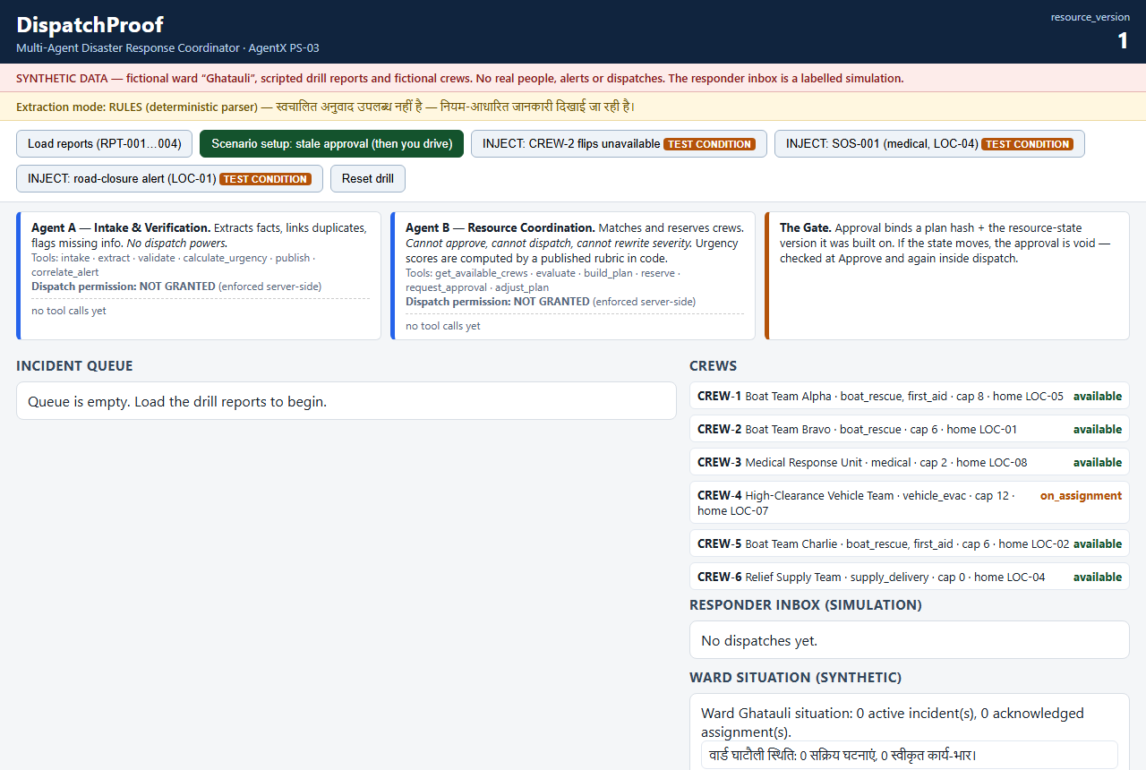
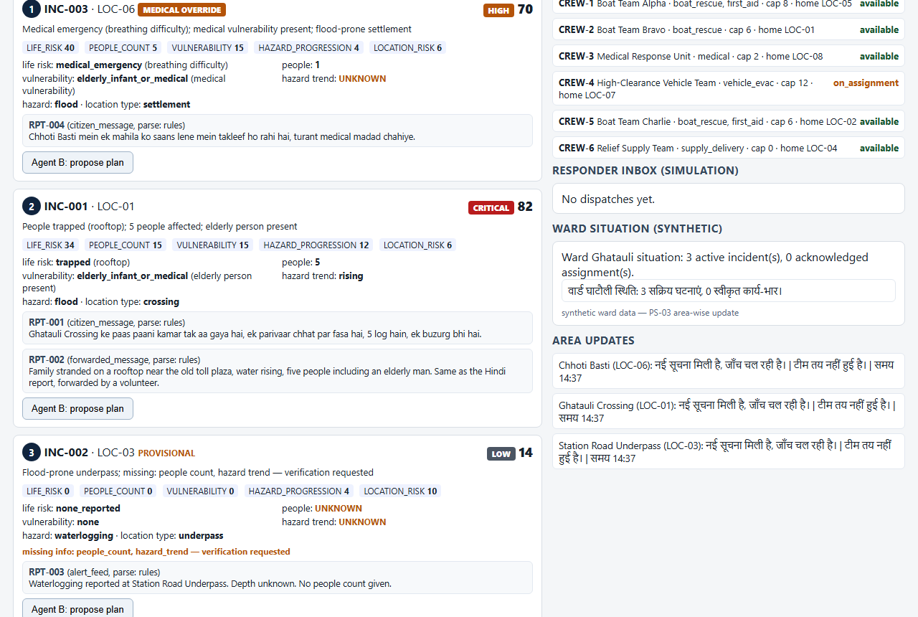
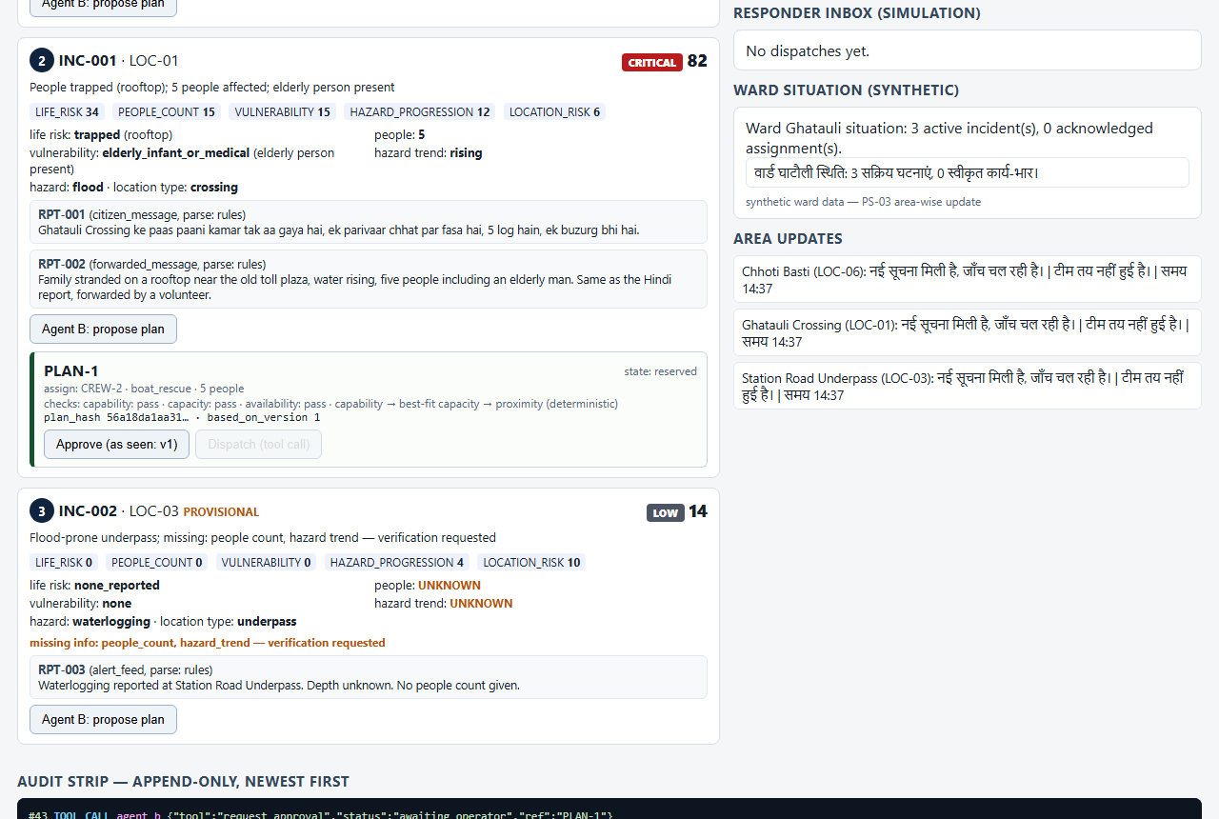
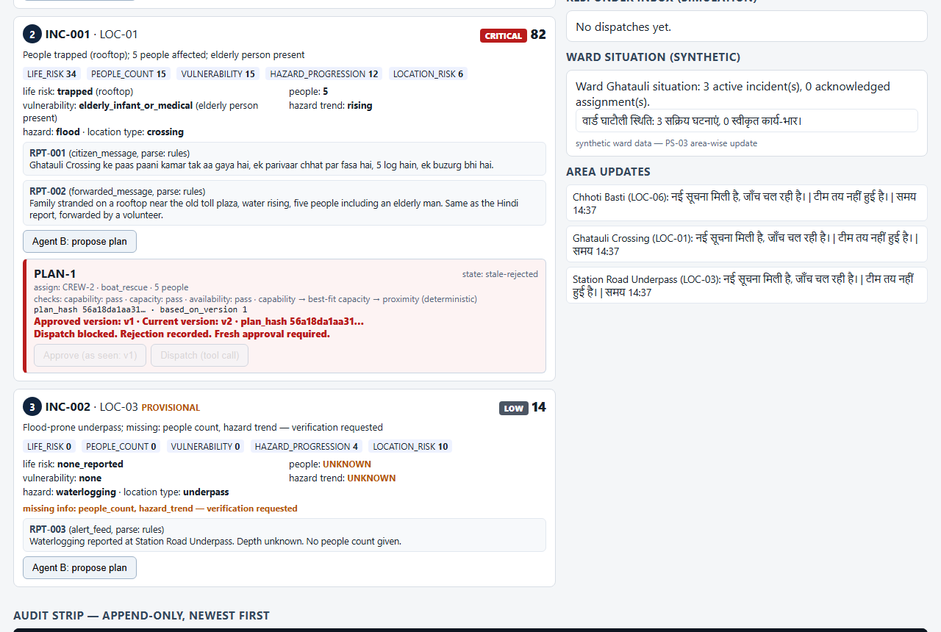
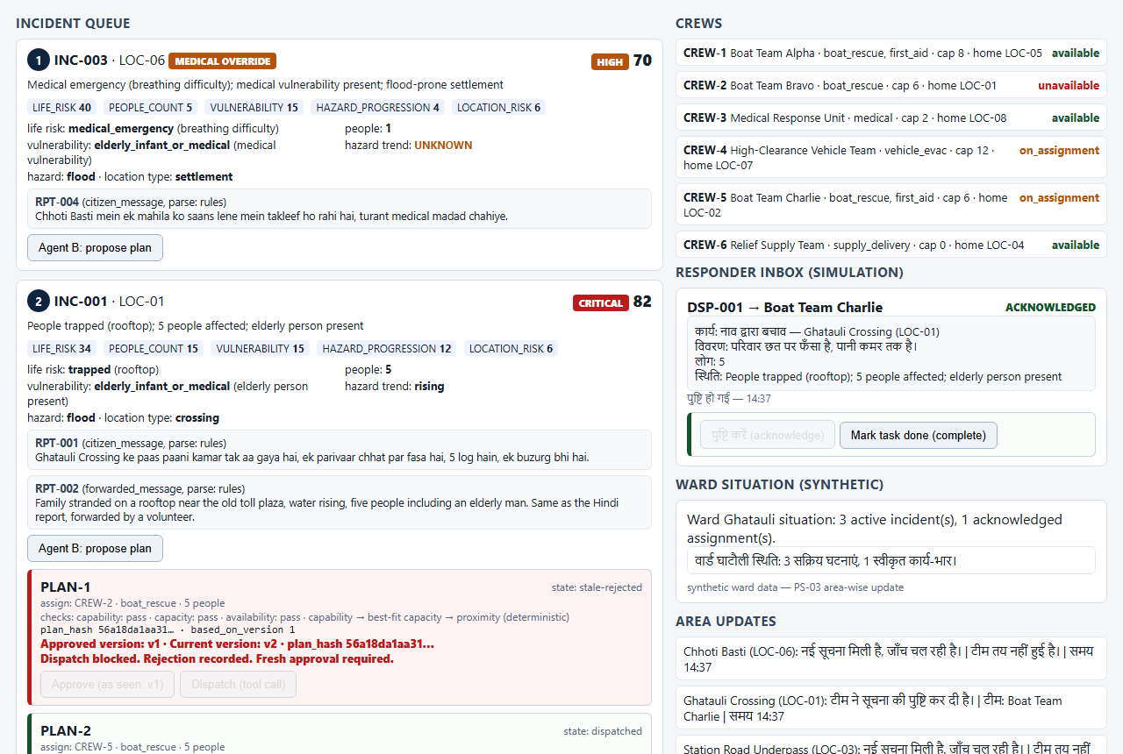
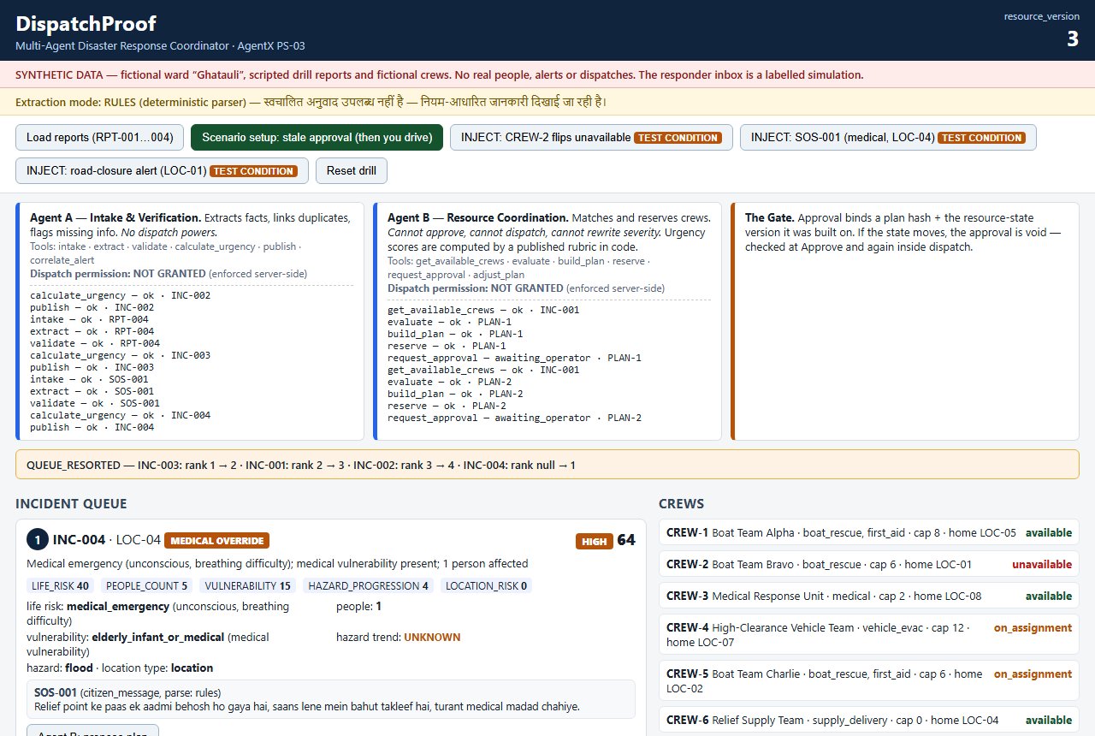
The demo is the evidence
Screenshots of the real running console, in demo order
1 · Empty console, synthetic banner, audit at zero
2 · Duplicate pair linked — both texts, one incident
3 · Plan card: hash + resource version
4 · REJECTED_STALE — the stale approval refused
5 · Responder inbox: Hindi task, acknowledged
6 · Medical SOS takes queue rank 1

Slide 4
Declared before the build, run cold
Ten predeclared cases · run 2026-11-11 against the built product · pytest, one command
T01 | Stale approval is rejected (409, audit order) | PASS
T02 | Revised plan approves; approval is single-use | PASS
T03 | Dispatch → acknowledge → persistence after refresh | PASS
T04 | Duplicate reports link, never discard (both orders) | PASS
T05 | Rubric scoring exact: 82 / 14 / 70, reproducible | PASS
T06 | Audit completeness + append-only enforcement | PASS
T07 | Medical SOS jumps the queue (rank 1) | PASS
T08 | Restart recovery — state intact from SQLite | PASS
T09 | Rules-mode fallback, labelled per report | PASS
T10 | Agent separation is structural (import graph) | PASS
Result: 18/18 PASS — the 10 predeclared cases above plus 8 review-added cases (server-side authorization, idempotency, concurrency, committed rejection, alert correlation, tool traces, 2 Round-1 regressions), reported separately in tests/test_deltas.py. Judges can re-run: python -m pytest tests/ -q

Slide 5
What this system does not do
Honesty and limits — named before a judge finds them
• All data is synthetic: the fictional ward Ghatauli, scripted reports, fictional crews — labelled on every screen.
• The responder inbox is a labelled simulation: no real SMS or WhatsApp is sent to anyone.
• The crew flip is an injected test condition, disclosed here, on screen, and in the audit payload.
• One ward, one scenario (flood). No maps, no real alert feeds, no multi-ward scaling claims.
• Extraction runs in rules mode in this build: a deterministic parser; the model adapter is wired but no key is configured, and every audit row says so.
• The audit is tamper-evident, not tamper-proof — and the claim is bounded: stale-plan dispatch is prevented under the tested assumptions. Nothing here claims to make emergency response safe.
Consistency between deck, video, README and repo is the credibility play — every claim here is checkable in the code.

Slide 6
Stated targets, not measured results
What a field deployment would be held to
• Target: every approved dispatch bound to the state it was approved against — zero stale executions, enforced by the gate.
• Target: acknowledgement-separated dispatch states for 100% of assignments, each reconstructible from the audit alone.
• Target: duplicate reports linked without data loss, in Hindi and English intake alike.
• A pilot needs next, in this order: real alert-feed integration, responder identity, multi-ward state.
•
• We did not mark any incident “rescued”. We established an acknowledged assignment, with evidence of what happened.
DispatchProof · github.com/rsaxena3011/dispatchproof · Team “Ratnesh's team” (CB9B1D) — Ratnesh Saxena + Akshay Kumar

