Slide 1

DEPARTMENT OF COMPUTER SCIENCE AND ENGINEERING
Major Project On
YOLO-Extract Improved YOLOv5 for Aircraft Object Detection in Remote Sensing Images
Presented By BATCH-03 :
N.SINDHUJA (20631A0549)
M.RAAM SAI BHARADWAJ (20631A0538)
G.SAI VINAY (20631A0544)
V.SAI CHARAN (20631A0542)
K.BHARATH (20631A0503)
Guide & HOD :
Mr. P. RATHAIAH M.Tech(CSE)
Sr.Assistant Professor

Slide 2
Contents
Abstract
Existing System And Its Disadvantages
Proposed System And Its Advantages
System Requirements
System Architecture
Data Flow Diagram
Algorithms
Modules
UML Diagrams
System Testing
Output Images
Conclusion
References

Slide 3
Abstract
Remote sensing targets include small and dense target forms, as well as complicated target backgrounds, as compared to natural images.
As a consequence, detection accuracy is insufficient and the target location cannot be exactly discovered. We proposes a new algorithm called YOLO-extract for detecting aircraft objects in remote sensing images.
The YOLO-extract algorithm is based on the YOLOv5 algorithm and optimizes its model structure to improve detection accuracy and identify target location accurately.
The experimental results on the test data set show that compared with the YOLOv5 algorithm, the YOLO-extract algorithm has a faster convergence speed, reduces the calculation amount and the number of parameters, but increases the mAP and the detection speed by 3 times.

Slide 4
Existing System
In previous studies they introduced a new model for detecting remote sensing targets at different scales. The model is based on You Only Look Once (YOLO)-V3 and uses DenseNet (Densely Connected Network) to enhance feature extraction capability.
The detection scales were increased to four based on the original YOLO-V3. The experiment are performed on RSOD (Remote Sensing Object Detection) dataset and UCS-AOD (Dataset of Object Detection in Aerial Images) datasets.
In another study they introduced the YOLOv5, the smooth Kullback-Leibler divergence loss function was used to replace the cross entropy loss function, and the CS and Glass module was designed to replace the residual module.

Slide 5
Disadvantages Of Existing System
Compared with natural images, remote sensing targets have small and dense target shapes as well as complex target backgrounds.
As a result, insufficient detection accuracy and target location cannot be accurately identified.
YOLO-V3 with DenseNet may not have incorporated the latest advancements or updates made to the YOLOv3 model, as it seems to be a previous iteration of the YOLO model.
YOLOv5's feature extraction might be limited in capturing complex patterns in remote sensing images.
YOLOv5 might not utilize the Coordinate Attention mechanism,which might result in less precise focus on important spatial locations in the input images, affecting target localization accuracy.
Although YOLOv5 introduces the smooth Kullback-Leibler divergence loss function to replace the cross-entropy loss, it might not be as effective in bounding box regression.

Slide 6
Proposed System
We propose a new algorithm called YOLO – extract for detecting aircraft objects in remote sensing images based on YOLOv5 Algorithm.
The YOLO – extract algorithm is based upon the YOLOv5 algorithm and optimizes its model structure to improve detection accuracy and identify the target location accurately.
The algorithm integrates a new feature extractor with stronger feature extraction ability into the network and borrows the idea of residual network to integrate coordination attention mechanism into the network.
The mixed dilated convolution is combined with the redesigned residual structure to enhance the feature and location information extraction ability of the shallow layer of the model and optimize the feature extraction

Slide 7
Advantages of the Proposed Model
YOLO-extract optimizes the model structure of YOLOv5, which can lead to improved detection accuracy. The modifications made in YOLO-extract may enhance the overall performance of the model compared to the existing work.
YOLO-extract integrates a new feature extractor with stronger feature extraction capabilities. This enhancement can better capture complex patterns and characteristics of remote sensing images, making the model more effective in detecting aircraft objects.
By incorporating the Coordinate Attention mechanism into the network, YOLO-extract can better focus on important spatial locations in the input images, helping to improve the precision and accuracy of target location.

Slide 8
System Requirements
Software Requirements
Software : Anaconda
Primary Language : Python
Frontend Framework : Flask
Back-end Framework : Jupyter Notebook
Database : Sqlite3
Front-End Technologies : HTML, CSS, JavaScript and Bootstrap4
Hardware Requirements
Operating System : Windows Only
Processor : i5 and above
Ram : 8gb and above
Hard Disk : 25 GB in local drive

Slide 9
System Architecture
Dataset
Image Processing
Data Augmentation
Build & Training the Model
Performance Evaluation

Slide 10
Data Flow Diagram
Import Libraries
Yes
No
Verify
No Process
Exploring the dataset
Image processing
Loading the pretrained model
Image Processing
Data Augmentation
Building the model – YOLO V5 – YOLO V6 – YOLO V7 – YOLO V8
Training the Model
Final Outcome
User Input
Sign up & Sign in
End Process

Slide 11
Algorithms
YOLOV5: YOLOv5 is a model in the You Only Look Once (YOLO) family of computer vision models. YOLOv5 is commonly used for detecting objects. YOLOv5 comes in four main versions: small (s), medium (m), large (l), and extra large (x), each offering progressively higher accuracy rates. Each variant also takes a different amount of time to train.
YOLOV6: YOLOv6, is a single-stage object detection algorithm. A single-stage object detection model performs object localization and image classification within the same network
YOLOV7: YOLOv7 algorithms can be used to recognize and track objects as they move through a production line, allowing for more efficient and accurate manufacturing.
YOLOV8: YOLOv8 is a new state-of-the-art computer vision model built by Ultralytics, the creators of YOLOv5. The YOLOv8 model contains out-of-the-box support for object detection, classification, and segmentation tasks, accessible through a Python package as well as a command line interface.

Slide 12
Modules
Data exploration: Here, we will load data into system.
Processing: Here, we read data for processing.
Splitting data into train & test: Here, we split the data into training data & testing data
Model generation: Model building – YOLOV5 – YOLOV6 – YOLOV7 – YOLOV8. Algorithms accuracy calculated
User signup & login: Using this module will get registration and login
User input: Using this module will give input for prediction
Prediction: final predicted displayed

Slide 13
UML DIAGRAMS

Slide 14
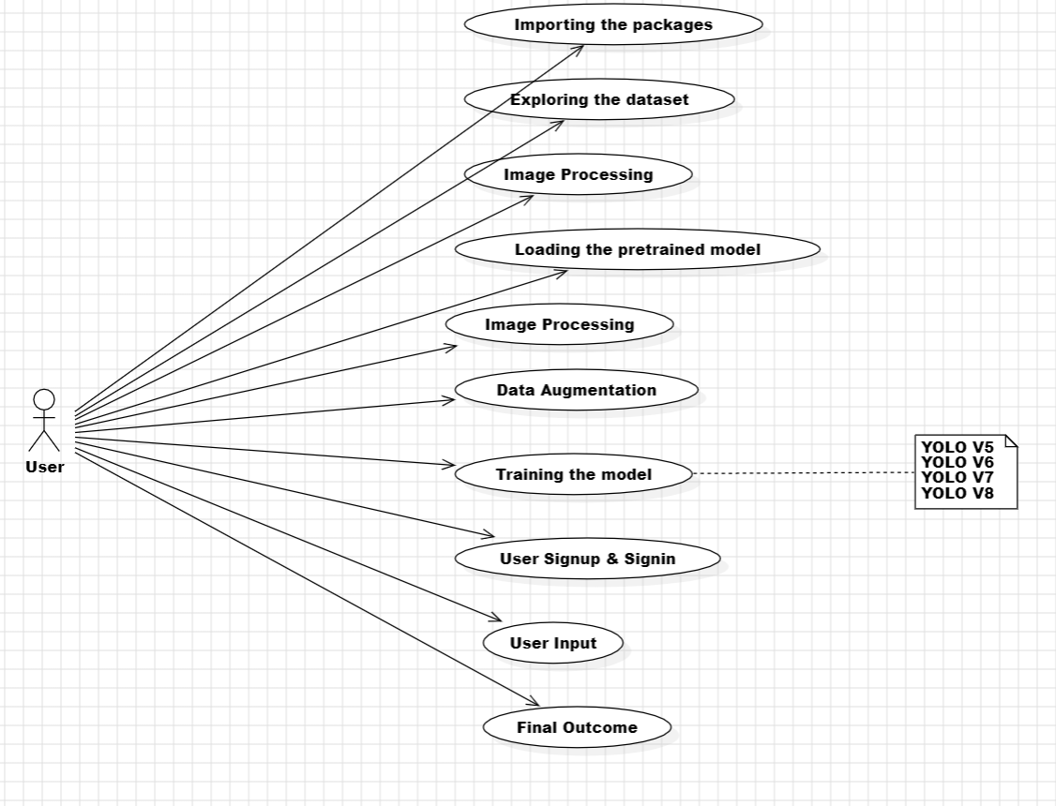
Use Case Diagram

Slide 15
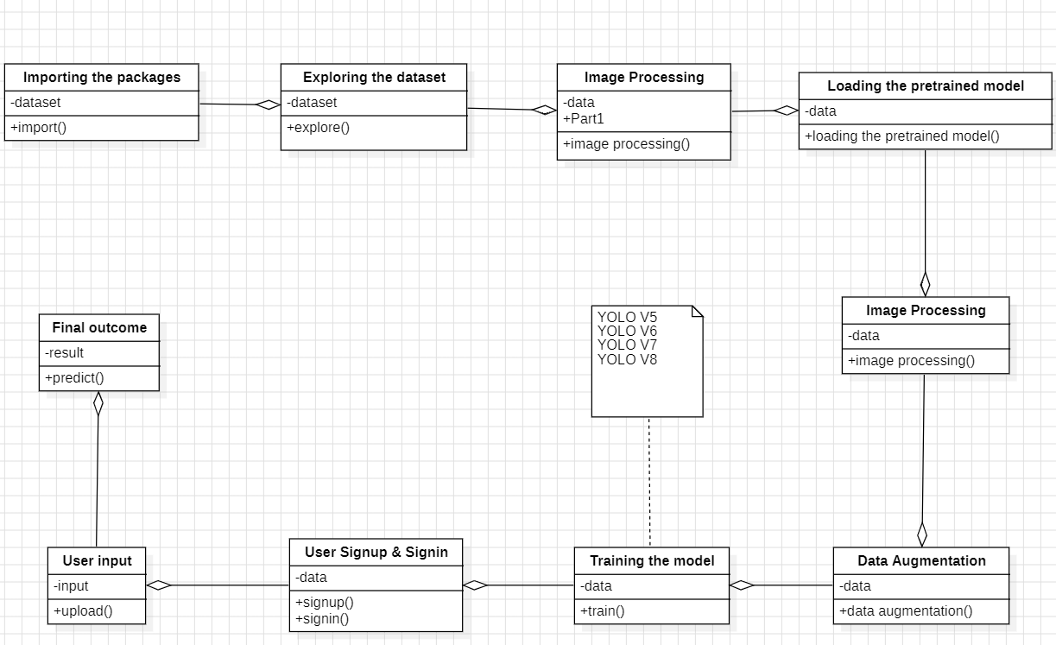
Class Diagram

Slide 16
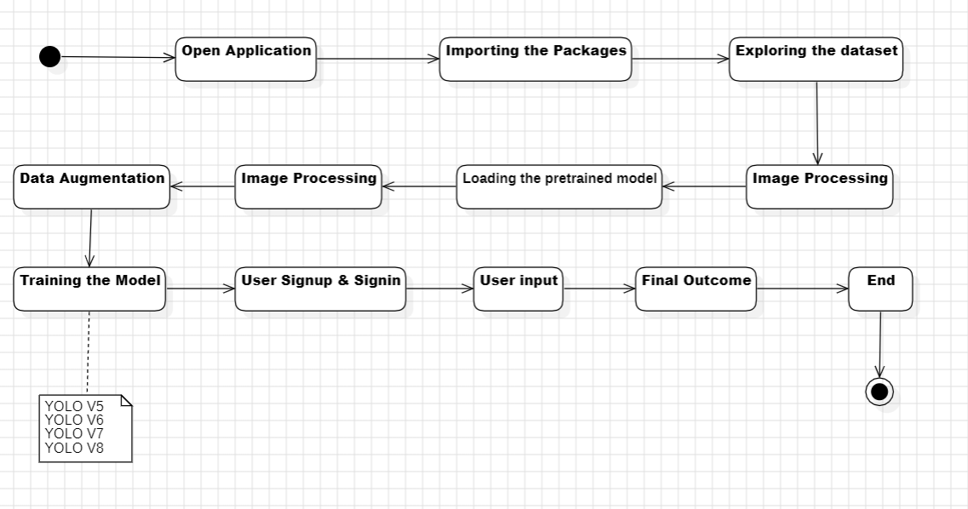
Activity Diagram

Slide 17
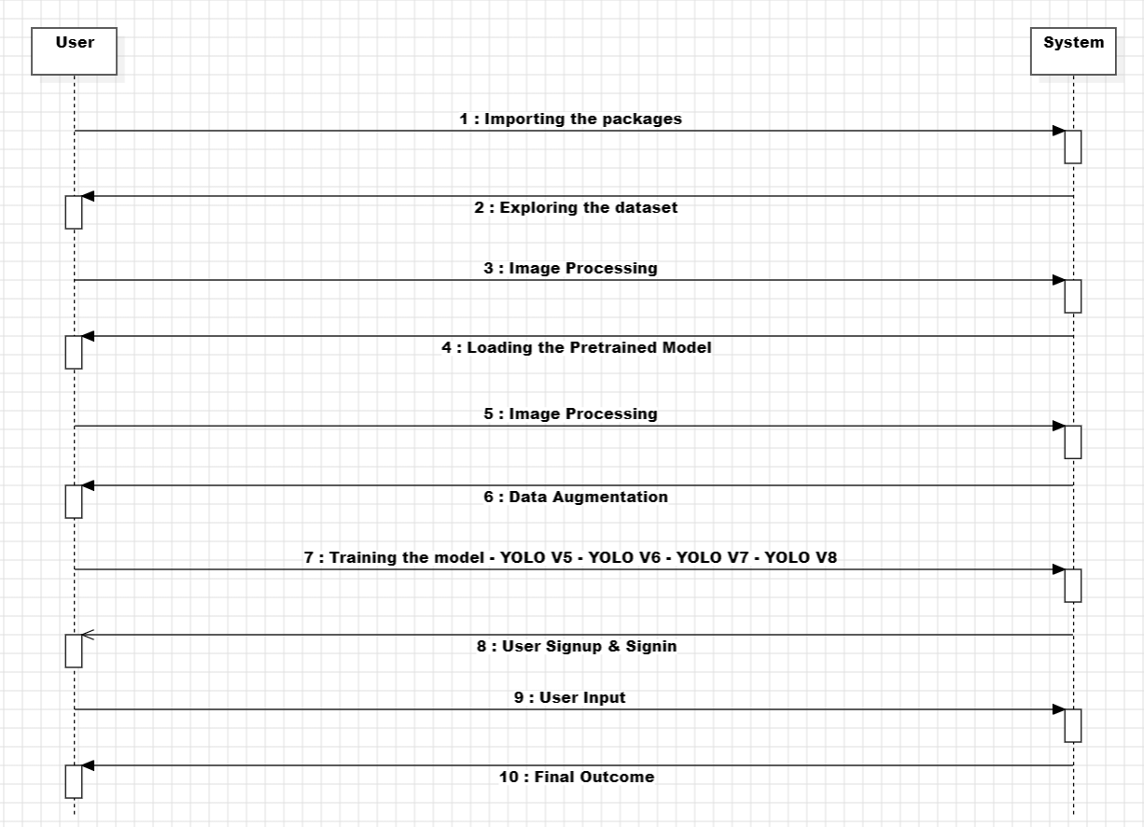
Sequence Diagram

Slide 18
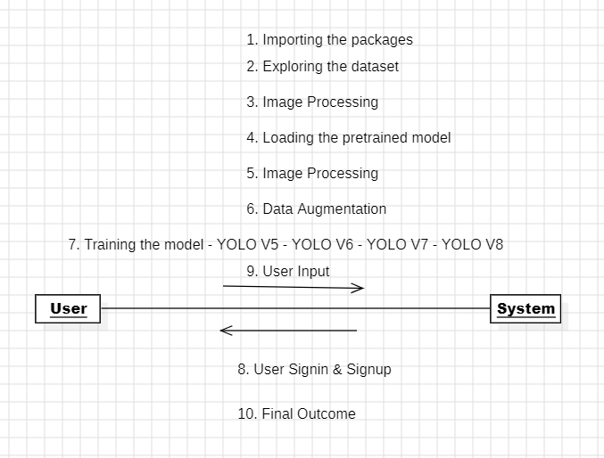
Collaboration Diagram

Slide 19
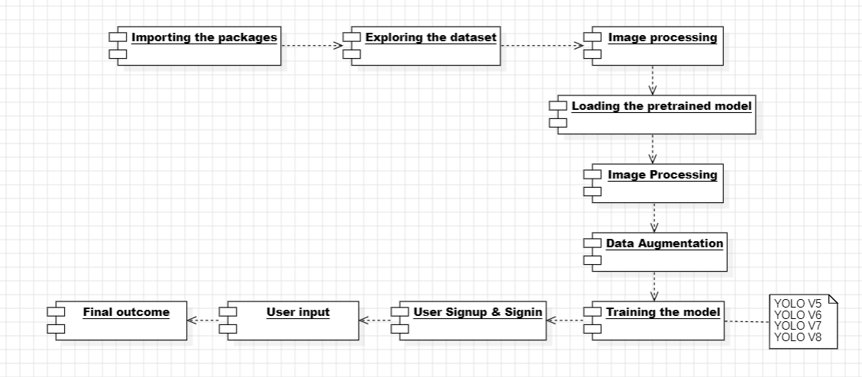
Component Diagram

Slide 20
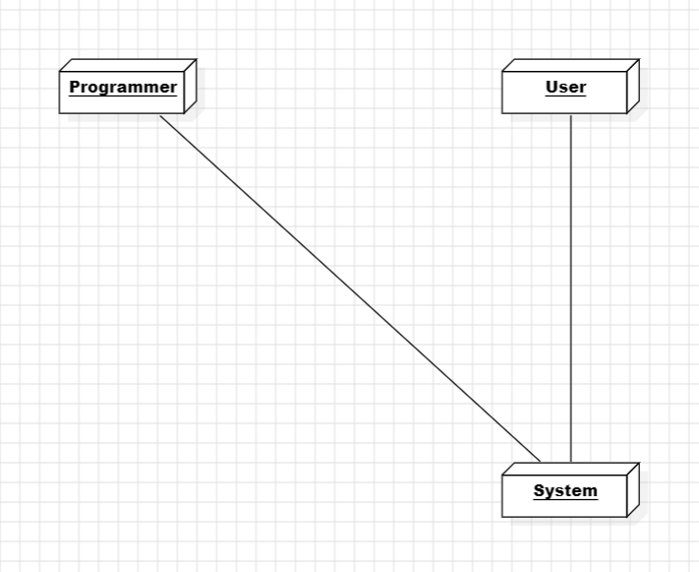
Deployment Diagram

Slide 21
SCREENSHOTS

Slide 22
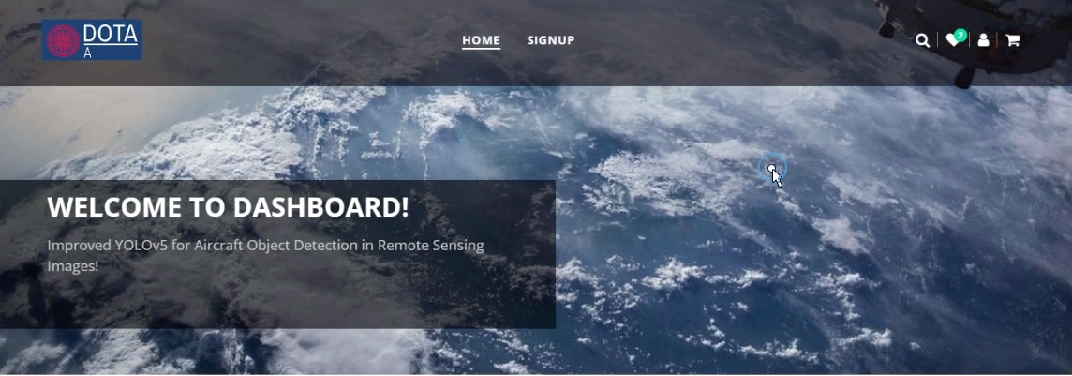

Slide 23
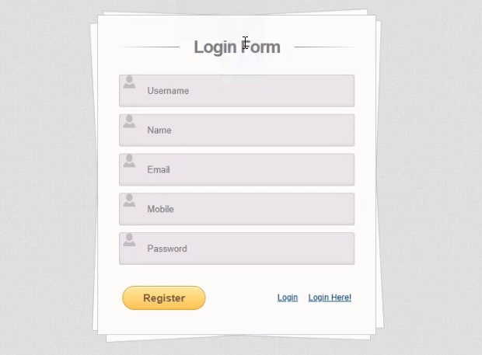

Slide 24
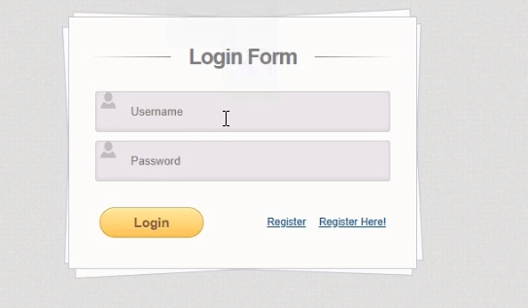

Slide 25
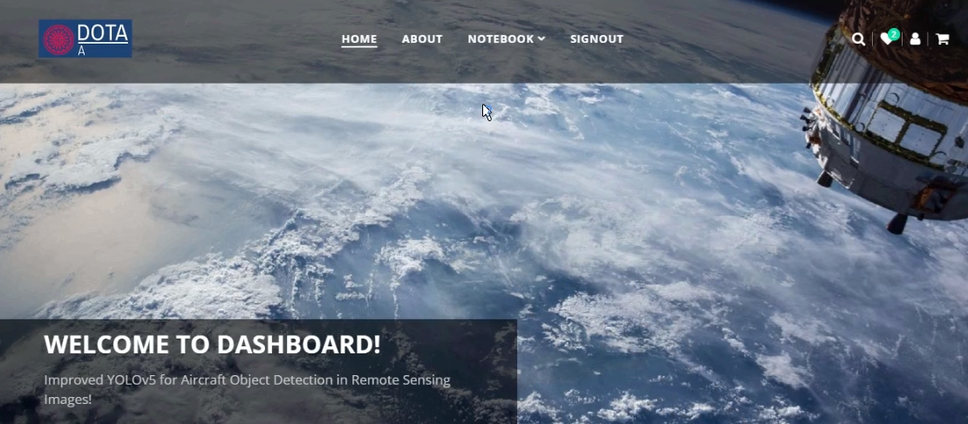

Slide 26
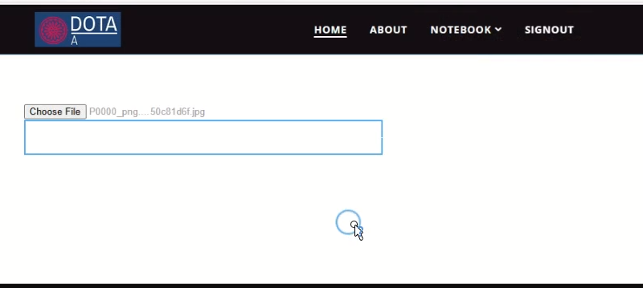

Slide 27
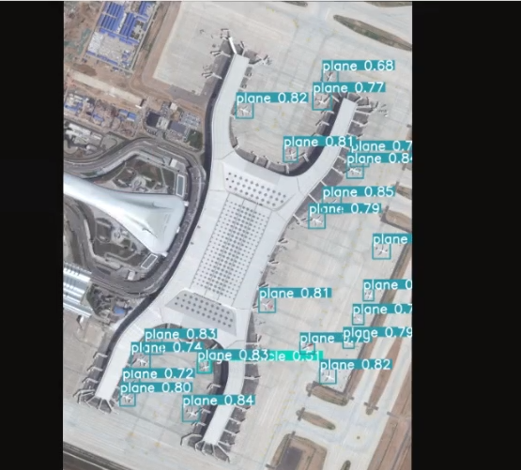

Slide 28
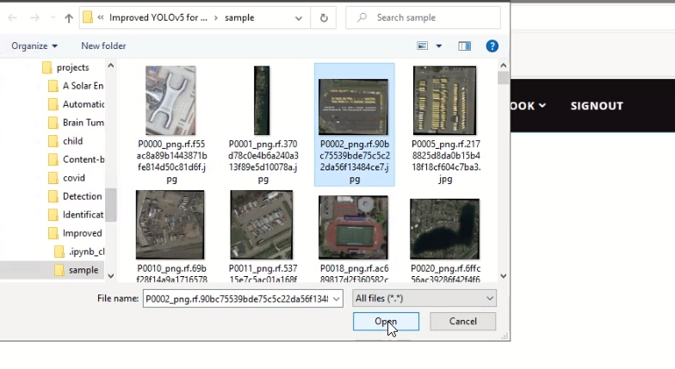

Slide 29
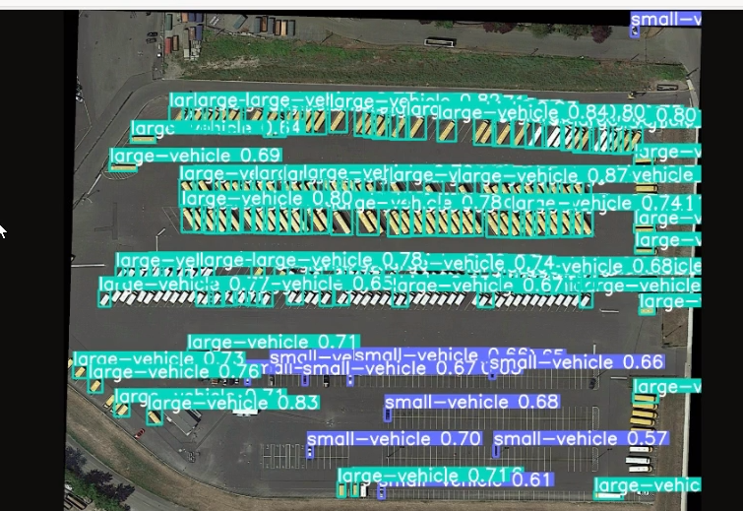

Slide 30
Conclusion
In this work, We developed the YOLO-extract algorithm based on the YOLOv5 algorithm, which overcome the some of the shortcomings in an YOLOv5 model such as detection accuracy and speed are low, and it is easily affected by the background of the images.
Based on the characteristics of aircraft targets on optical remote sensing images, We optimizes the structure of the yolov5 model, introduces dilated convolution to improve the feature extraction capability of the model for aircraft targets, and finally optimizes the convergence speed of the loss function plus block model, as well as improves the detection accuracy and detection speed of the model.
Experiments show that the method in this work can greatly improve the ability to overcome the interference of factors such as aircraft attitude and complex background.
It is difficult to extract different types of aircraft target features in remote sensing images, and there are few data sets for aircraft types, so the detection of aircraft types cannot be completed. In subsequent experiments, relatively clear remote sensing images can be selected to learn and detect different types of aircraft features.

Slide 31
References
C. Cao, J. Wu, X. Zeng, Z. Feng, T. Wang, X. Yan, Z. Wu, Q. Wu, and Z. Huang, ‘‘Research on airplane and ship detection of aerial remote sensing images based on convolutional neural network,’’ Sensors, vol. 20, no. 17, p. 4696, Aug. 2020.
C. Cao, J. Wu, X. Zeng, Z. Feng, T. Wang, X. Yan, Z. Wu, Q. Wu, and Z. Huang, ‘‘Research on airplane and ship detection of aerial remote sensing images based on convolutional neural network,’’ Sensors, vol. 20, no. 17, p. 4696, Aug. 2020.
F. Yu and V. Koltun, ‘‘Multi-scale context aggregation by dilated convolutions,’’ 2015, arXiv:1511.07122.
R. Girshick, ‘‘Fast R-CNN,’’ in Proc. IEEE Int. Conf. Comput. Vis. (ICCV), Dec. 2015, pp. 1440–1448.
S. Ren, K. He, R. Girshick, and J. Sun, ‘‘Faster R-CNN: Towards real-time object detection with region proposal networks,’’ in Proc. Adv. Neural Inf. Process. Syst., vol. 28, 2015, pp. 1–15.

