Slide 1
CS 408
Computer Networks
Chapter 2: Protocols and the TCP/IP Protocol Suite

Slide 2
Protocols
Cooperative action is necessary
  computer networking is not only to exchange bytes
  huge system with several utilities and functions. For examples
    error detection
    Encryption
    Routing
    etc.
For proper communication, entities in different systems must speak the same language
  there must be mutually acceptable conventions and rules about the content, timing and underlying mechanisms
Those conventions and associated rules are referred as “PROTOCOLS”

Slide 3
Protocol Architecture
Task of data transfer is broken up into some modules
  Why?
  How do these modules interact?
For example, file transfer could use three modules
  File transfer application
  Communication service module
  Network access module
Notes:
Answer to Why? – Same reason as dividing a big program into smaller functions. It is difficult to attack big problems as a whole.
Answer to interaction question? – Modules have a layered structure. Each layer (module) provides service to upper layer and expects service from lower layer. Details are explained later in this ppt file.

Slide 4
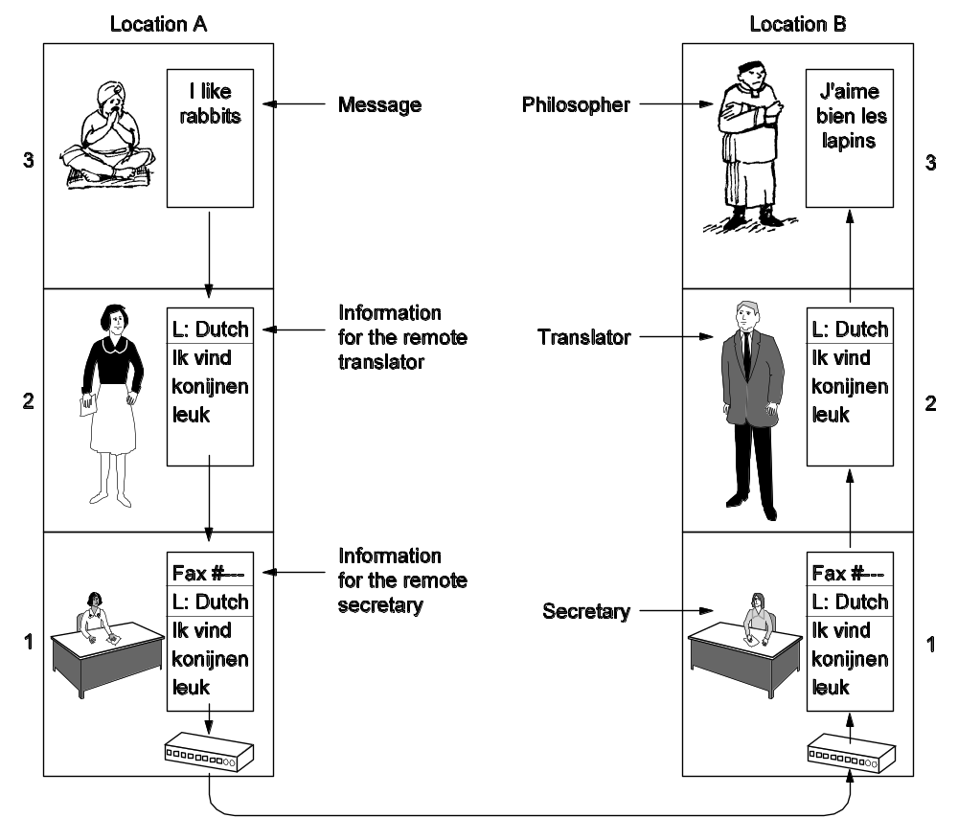
A Real World Example to Protocol Architecture philosopher-translator-secretary architecture
Issues:
peer-to-peer protocols are independent of each other
  for example, secretaries may change the comm. medium to email
  or the translators may agree on using another common language
Each layer adds a header

Slide 5
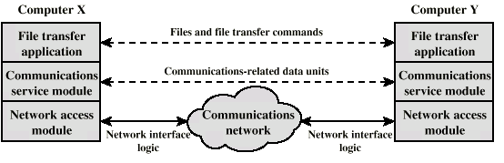
Simplified File Transfer Architecture
File Transfer Application Layer: Application specific commands, passwords and the actual file(s) – high level data
Communications Service Module: reliable transfer of those data – error detection, ordered delivery of data packets, etc.
Network Module: actual transfer of data and dealing with the network – if the network changes, only this module is affected, not the whole system

Slide 6
General protocol architecture principles that we have seen so far
Layered structure
  Protocol stack
Each layer provides services to upper layer; expect services from lower one
  Layer interfaces should be well-defined
Peer entities communicate using their own protocol
  peer-to-peer protocols
  independent of protocols at other layers
  if one protocol changes, other protocols should not get affected

Slide 7
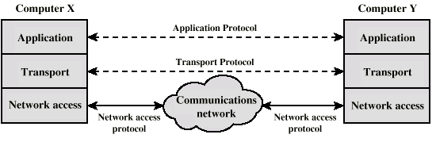
A General Three Layer Model
Generalize the previous example for a generic application
  we can have different applications (e-mail, file transfer, …)
Network Access Layer
Transport Layer
Application Layer

Slide 8
Network Access Layer
Exchange of data between the computer and the network
Sending computer provides address of destination
  so that network can route
Different switching and networking techniques
  Circuit switching
  Packet switching
  LANs
  etc.
This layer may need specific drivers and interface equipment depending on type of network used.
But upper layers do not see these details
  independence property

Slide 9
Transport Layer
Reliable data exchange
  to make sure that all the data packets arrived in the same order in which they are sent out
  Packets nor received or received in error are retransmitted
Independent of network being used
Independent of application

Slide 10
Application Layer
Support for different user applications
e.g. e-mail, file transfer

Slide 11
Addressing Requirements
Two levels of addressing required
Each computer needs unique network address
Each application on a (multi-tasking) computer needs a unique address within the computer
  The service access point or SAP
  The port number in TCP/IP protocol stack

Slide 12
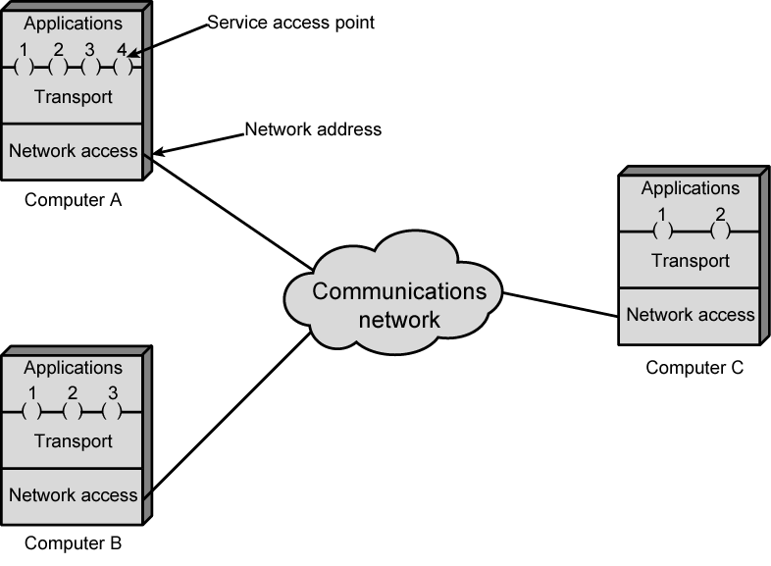
Protocol Architectures and Networks
or ports

Slide 13
Protocol Data Units (PDU)
User data is passed from layer to layer
Control information is added/removed to/from user data at each layer
  Header (and sometimes trailer)
  each layer has a different header/trailer
Data + header + trailer = PDU (Protocol Data Unit)
  This is basically what we call packet
  each layer has a different PDU

Slide 14
Transport PDU
Transport layer may fragment user data
Each fragment has a transport header added
  Destination port
  Sequence number
    since the transport layer may split application data into smaller packets
  Error detection code (generally at trailer)

Slide 15
Network PDU
Adds network header
  network address for destination computer
  optional facilities from network (e.g. priority level)

Slide 16
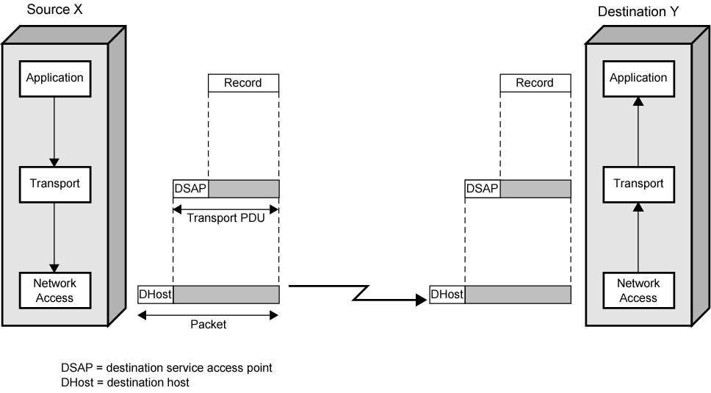
Operation of a Protocol Architecture
Transport Header
Transport Header
Network Header
Network Header
(Network PDU)

Slide 17
Standard Protocol Architectures
Common set of conventions
Nonstandard vs. standard protocols
  Nonstandard: K sources and L receivers lead to K*L different protocols
  If common protocol used, we design only once
Products from different vendors interoperate
  Customers do not stick to a specific vendor
  If a common standard is not implemented in a product, then that product’s market is limited; customers like standard products

Slide 18
Standard Protocol Architectures
Two approaches (standard)
  OSI Reference model
    never used widely
    but well known
  TCP/IP protocol suite
    Most widely used
Another approach (proprietary)
  IBM’s Systems Network Architecture (SNA)

Slide 19
OSI Reference Model
Open Systems Interconnection (OSI)
Reference model
  provides a general framework for standardization
  defines a set of layers and services provided by each layer
  one or more protocols can be developed for each layer
Developed by the International Organization for Standardization (ISO)
  also published by ITU-T (International Telecommunications Union)

Slide 20
OSI Reference Model
A layered model
  Seven layers – seven has been presented as the optimal number of layer
Delivered too late (published in 1984)!
  by that time TCP/IP started to become the de facto standard
Although no OSI-based protocol survived, the model is still valid (in the textbooks)
  For Data Link Layer (that we will see later) OSI protocols are still valid

Slide 21
OSI - The Layer Model
Each layer performs a subset of the required communication functions
Each layer relies on the next lower layer to perform more primitive functions
Each layer provides services to the next higher layer
Changes in one layer should not require changes in other layers

Slide 22
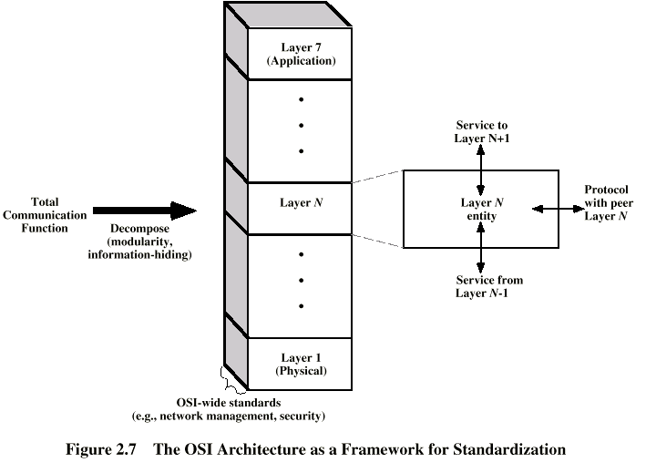
OSI as Framework for Standardization
layer functionalities are described by ISO; different standards can be developed based on these functionalities

Slide 23
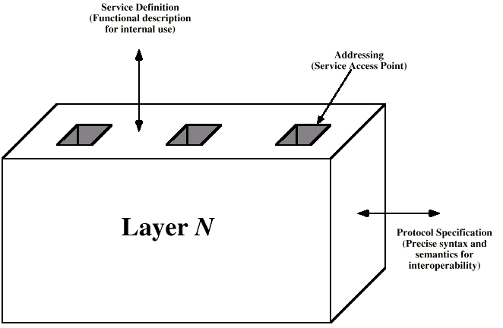
Layer Specific Standards

Slide 24
Elements of Standardization
Protocol specification
  Operates between the same layer on two systems
    May involve different platforms
  Protocol specification must be precise
    Format of data units
    Semantics of all fields
Service definition
  Functional description of what is provided to the next upper layer
Addressing
  Referenced by SAPs

Slide 25
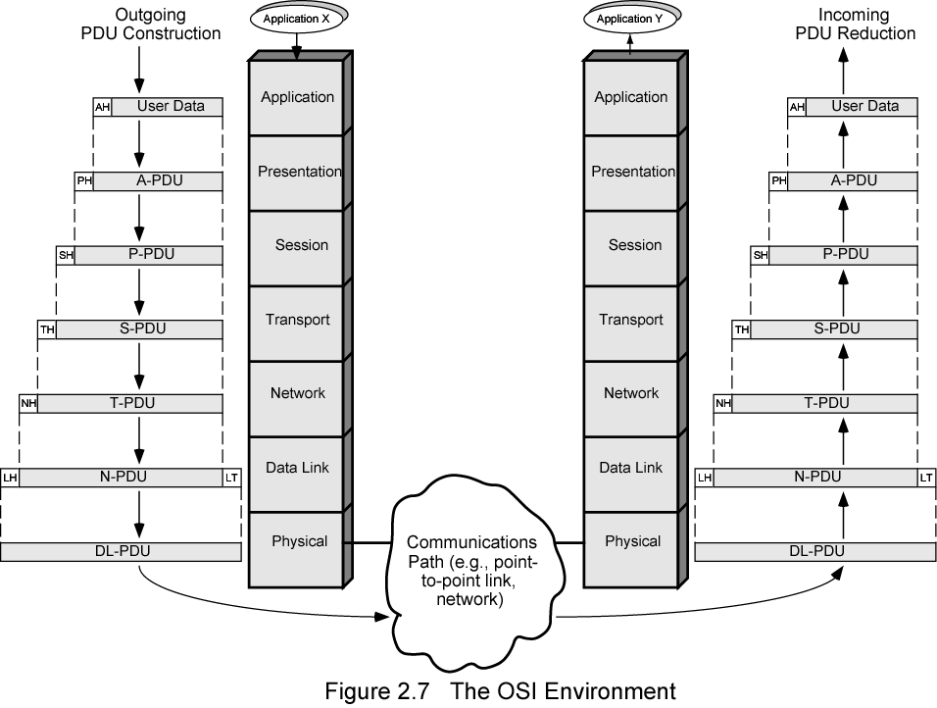
The OSI Environment

Slide 26
OSI Layers (1)
Physical
  Physical interface between devices
  Characteristics
    Mechanical - interface specs
    Electrical - voltage levels for bits, transmission rate, coding, etc.
Data Link
  Basic services: error detection and control, flow control at the link level (point to point)
    Higher layers may assume error free transmission
  Later a sublayer is added to Data Link Layer
    MAC (Medium Access Control) sublayer
    to deal with broadcast networks

Slide 27
OSI Layers (2)
Network
  Transfer of information through communication network
    network related issues
  Network nodes (relays/routers) should perform switching and routing functions
  QoS (Quality of Service) and congestion control are also addressed in this layer
  Several other internetworking issues
    e.g. differences in addressing, max. data length, etc.
  Higher layers do not need to know about underlying networking technology
  Not needed on direct links

Slide 28
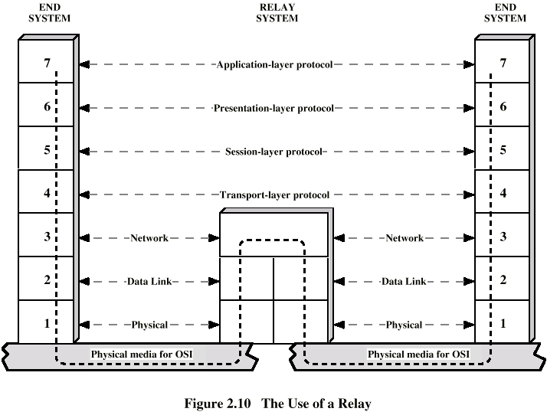
Use of a Relay/Router

Slide 29
OSI Layers (3)
Transport
  End to end exchange of data
  In sequence, no losses, no duplicates
  If needed, upper layer data are split into smaller units
Session
  Control of dialogues
    whose turn to talk?
    Dialogue discipline (full-duplex, half-duplex)
  Checkpointing and recovery

Slide 30
OSI Layers (4)
Presentation
  Data formats
  Data compression
  Encryption
Application
  Support for various applications

Slide 31
TCP/IP Protocol Suite
Most widely used interoperable network protocol architecture
Specified and extensively used before OSI
  OSI was slow to take place in the market
Funded by the US Defense Advanced Research Project Agency (DARPA) for its packet switched network (ARPANET)
  DoD (Department of Defense) automatically created an enormous market for TCP/IP
Used by the Internet and WWW

Slide 32
TCP/IP Protocol Suite
TCP/IP does not have an official layer structure
But protocols imply one
  Application layer
  Transport (host to host / end to end) layer
  Internet layer
  Network access layer
  Physical layer
Actually TCP/IP reference model has been built on its protocols
  That is why that reference model is only for TCP/IP protocol suite
  and this is why it is not so important to assign roles to each layer in TCP/IP; understanding TCP, IP and the application protocols would be enough

Slide 33
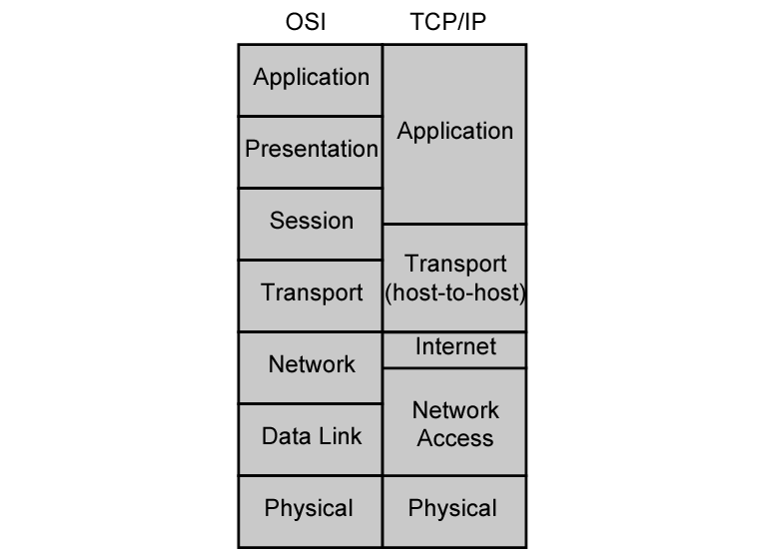
OSI vs. TCP/IP
HTTP, SMTP, …
TCP, UDP
IP

Slide 34
Network Access and Physical Layers
TCP/IP reference model does not discuss these layers too much
  the node should connect to the network with a protocol such that it can send IP packets
  this protocol is not defined by TCP/IP
  mostly in hardware
  a well known example is Ethernet

Slide 35
Internet Layer
Connectionless, point to point internetworking protocol (uses the datagram approach)
  takes care of routing across multiple networks
  each packet travels in the network independently of each other
    they may not arrive (if there is a problem in the network)
    they may arrive out of order
  a design decision enforced by DoD to make the system more flexible and responsive to loss of some subnet devices
Implemented in end systems and routers as the Internet Protocol (IP)

Slide 36
Transport Layer
End-to-end data transfer
Transmission Control Protocol (TCP)
  connection oriented
  reliable delivery of data
  ordering of delivery
User Datagram Protocol (UDP)
  connectionless service
  delivery is not guaranteed
Can you give example applications that use TCP and UDP?

Slide 37
Application Layer
Support for user applications
A separate module for each different application
  e.g. HTTP, SMTP, telnet

Slide 38
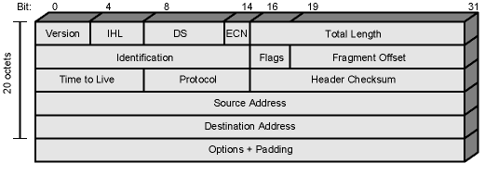
IP (Internet Protocol)
The core of the TCP/IP protocol suite
Two versions co-exist
  v4 – the widely used IP protocol
  v6 – has been standardized in 1996, but still not widely deployed
IP (v4) header minimum 20 octets (160 bits)

Slide 39
IPv6
IPv6
  Enhancements over IPv4 for modern high speed networks
  Support for multimedia data streams
But the driving force behind v6 was to increase address space
  128-bit as compared to 32-bit of v4
Not backward compatible
  all equipment and software must change

Slide 40
TCP
Transmission Control Protocol
  end to end protocol
  Reliable connection = provides flow and error control
In TCP terms, a connection is a
  temporary association between entities in different systems
TCP PDU
  Called “TCP segment”
  Includes source and destination port
    Identify respective users (applications)
    pair of ports (together with the IP addresses) uniquely identify a connection; such an identification is necessary in order TCP to track segments between entities.

Slide 41
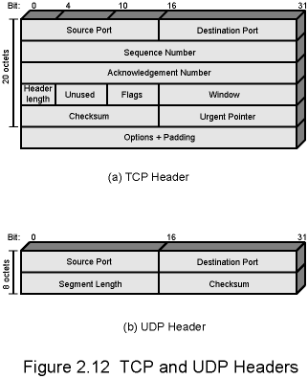
TCP Header

Slide 42
UDP
User Datagram Protocol
Alternative to TCP
  end-to-end protocol
Not guaranteed delivery
No preservation of sequence
No protection against duplication
Minimum overhead

Slide 43
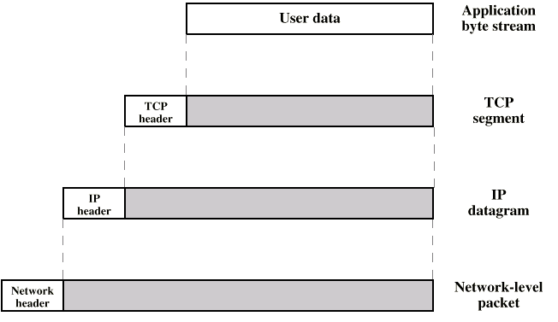
PDUs in TCP/IP
Dest. Port
Sequence number
Checksum
….
Dest. Address
Source address
….
Dest. Network Address
Priority info

Slide 44
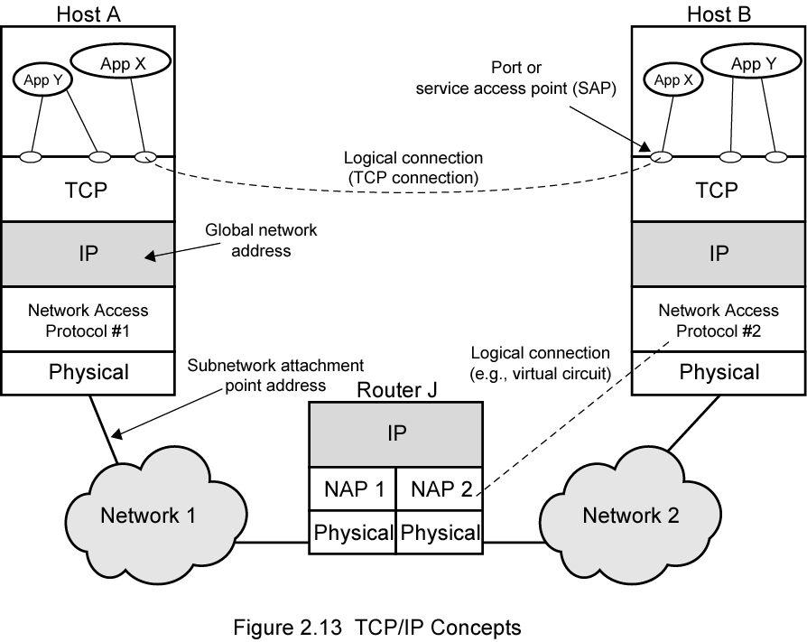
Operation of TCP and IP

Slide 45
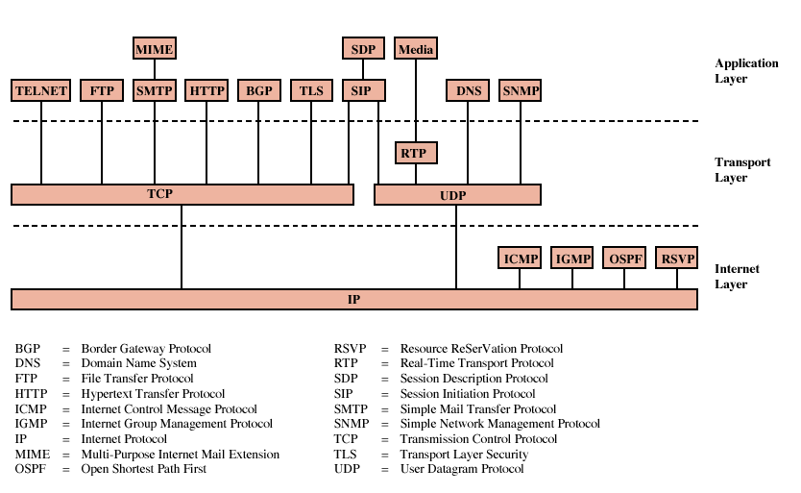
Some Protocols in TCP/IP Suite

Slide 46
Internetworking
Interconnected set of networks
  May be seemed as a large network
Each constituent network is a subnetwork
Entire configuration referred to as an internet
  not the Internet
    conceptually the same, but by “internet” we do not mean a specific network
    the Internet is the most important example of an internet

Slide 47
Internetworking Devices
Each subnetwork supports communication among the devices attached to that subnetwork
  End systems (ESs)
Subnetworks connected by intermediate systems (ISs)
  In practice, ISs are routers that are used to relay and route packets between different subnetworks
  If subnetworks use different Network Access Protocols, router should support all of the protocols
  In OSI terminology, a router works at layer 3 (network layer)

Slide 48
Routers
Interconnect dissimilar subnetworks without any modifications on architecture of subnetworks
Must accommodate differences among networks, such as
  Addressing schemes
    network addresses may need to be translated
  Maximum packet sizes
    if two subnetworks have different limits for max. packet sizes, then router may need fragment/reassemble the packets
We have seen that subnetworks may have different network access and physical layers, but they have to speak the same (inter)network protocol implemented in all end systems and routers
  The most important internetwork protocol is the IP protocol

Slide 49
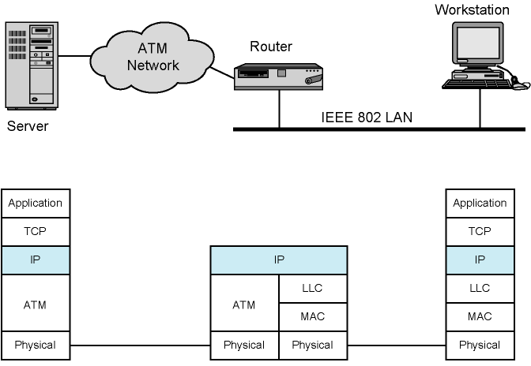
Configuration for TCP/IP Example
WAN

Slide 50
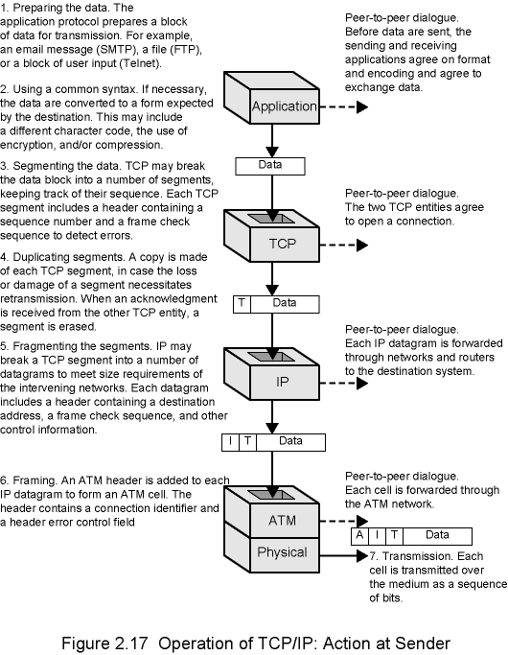
Action of
Sender

Slide 51
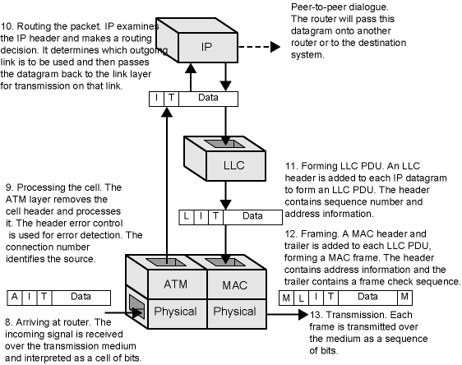
Action of Router

Slide 52
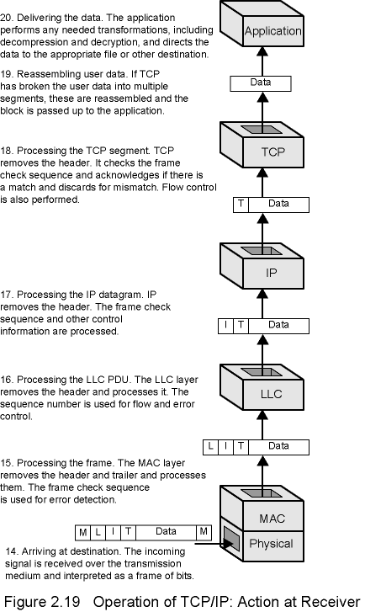
Action of
Receiver

Slide 53
Standards
Required to allow for interoperability among equipments
Advantages
  Ensures a large market for equipment and software
  Allows products from different vendors to communicate
Disadvantage
  Freeze technology (???)

Slide 54
Standards Organizations in Networking
Internet Society
ISO (International Organization for Standardization)
  more formal
  NGO, but most members are from governments
ITU-T (formerly CCITT)
  International Telecommunications Union
  UN agency
  governmental
Notes:
NGO: Non-Govermental Organization

Slide 55
Internet Society (ISOC)
Internet development and standardization
3 suborganizations
  IAB (Internet Architecture Board)
    overall Internet architecture
  IETF (Internet Engineering Task Force)
    protocol engineering and development
  IESG (Internet Engineering Steering Group)
    monitors IETF standardization efforts

Slide 56
IETF Organization
Grouped in areas
  e.g. applications, security, routing, etc.
  each area has an Area Director, who is also member of IESG
Each area has several working groups
  working groups actually contribute to standards/protocols, etc.
Voluntary participation in IETF working groups
For detail see
  www.ietf.org or
  RFC 3160 - The Tao of IETF - A Novice's Guide to the Internet Engineering Task Force

Slide 57
Internet Drafts and RFCs
Internet Draft
  Draft and temporary documents
  expires in 6 months, if IESG does not approve it as an RFC
  can be resubmitted
  published online
  comments are welcome
RFC (Request for Comments)
  final version
  can obsolete previous RFCs about the same topic
  actually an RFC can be of any type of document
    not necessarily a standard
    Best Current Practice, Experimental, Informational RFCs
    April 1st RFCs (http://en.wikipedia.org/wiki/April_1_RFC )
      My favorite is IP over Avian Carriers (RFC 1149)

Slide 58
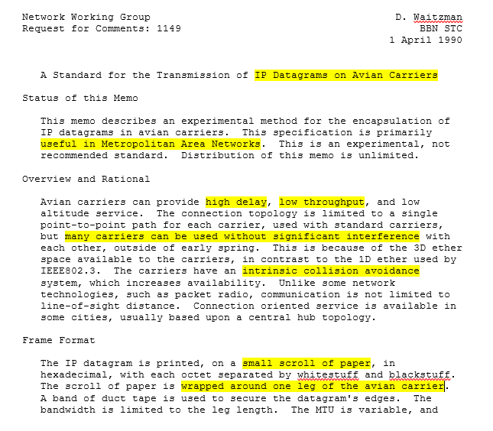


Slide 59
Internet Standards Track
Steps involve increasing amount of scrutiny and testing
Step 1: Internet Draft
Step 2: Proposed standard
  Internet Draft approved as an RFC by IESG
  must remain at least six months to advance
Step 3: Draft standard
  at least two independent and interoperable implementations
  must remain at least 4 months
Step 4: Internet standard
  Significant operational experience
    key difference between ISOC and other standardization organizations
  Consensus needed

Slide 60
Internet Assigned Numbers Authority (IANA)
An ISOC entity responsible for all “unique numbers” on the Internet
  including IP addresses
Almost all protocols work with numeric parameters
  e.g. port numbers, error codes, status codes, message types, options, etc.
  the meanings of all numeric codes are mostly specified in RFCs, but number assignment is formalized by IANA

