Slide 1
Project Documentation using Sphinx
Rob Blumenfeld
11/21/13

Slide 2
Why?
Documenting/Note-taking is something we all do
Given that there is a lot of sharing and cross-pollination of ideas in the lab →effective ways of communication and sharing data
Productivity
Training
Mentoring

Slide 3
What I am proposing
A few systems for documenting & sharing
Sphinx: Notes ←→Webpages
ipynb: IPython Notebooks
To the extent that we use python to code and look at data
Plan:
Describe Sphinx, show examples and discuss
Show a few examples of ipynb’s and discuss
If interested in this proposal I can lead a workshop to get us up to speed on the “how to’s”

Slide 4
Also:
At a future date (or if there is time today)
NetworkX
BrainX
Two excellent python packages that do graph-theory (the second of which I am helping to develop)

Slide 5
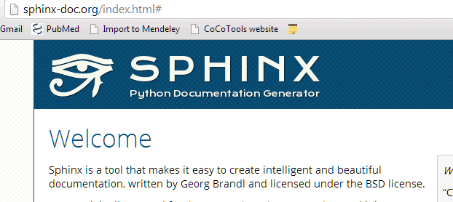
Sphinx
It takes text files → webpages
Uses reStructuredText as its mark-up language

Slide 6
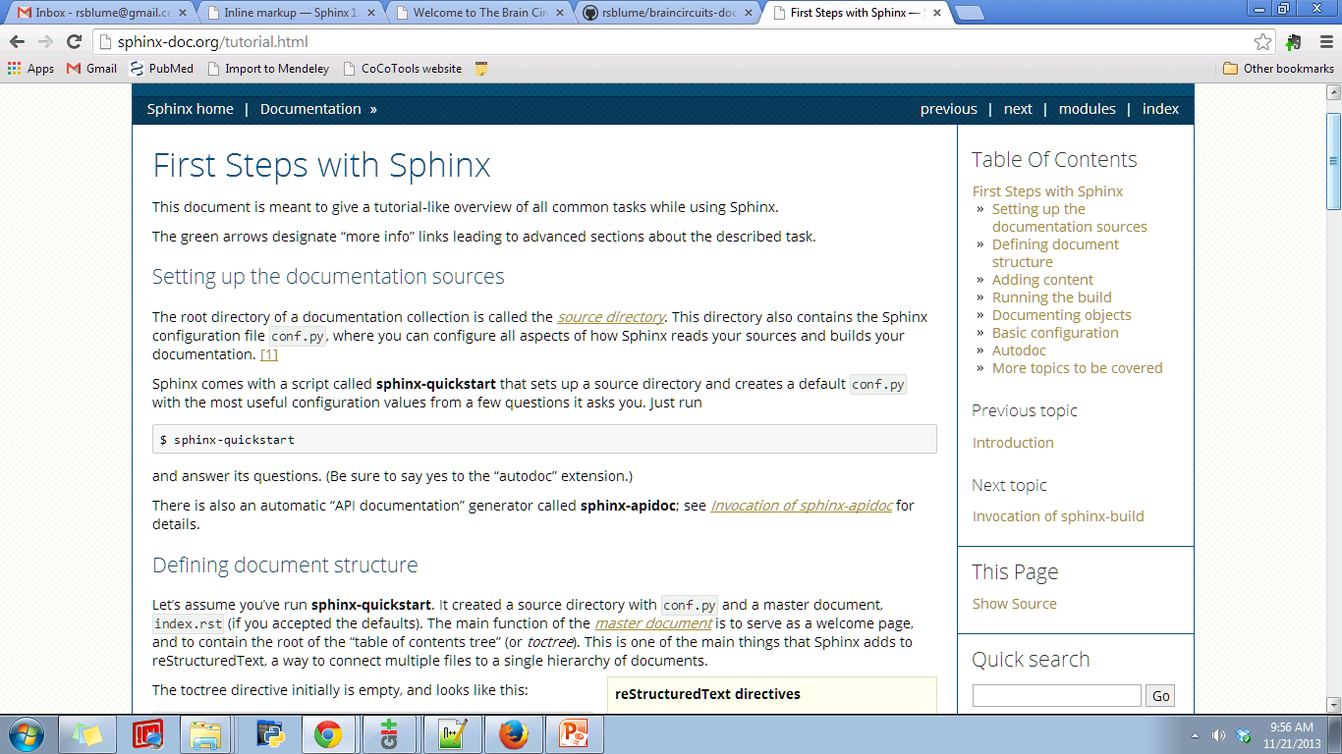
http://sphinx-doc.org/tutorial.html

Slide 7
CoCoTools-doc
http://cocotools.github.io/index.html
Layout
Autodoc

Slide 8
braincircuits-doc
Show source and build Directory
Ideas
Lab projects

Slide 9
sphinx building
example

Slide 10
Git and Github
The documentation is already under version control on github
Version control and sharing
Like dropbox but much more powerful →
Best way (that I have found) to do heavy collaborative analysis projects

Slide 11
Ipynb
Cocotools tutorials
Start from bash…..
SfN poster

