Slide 1
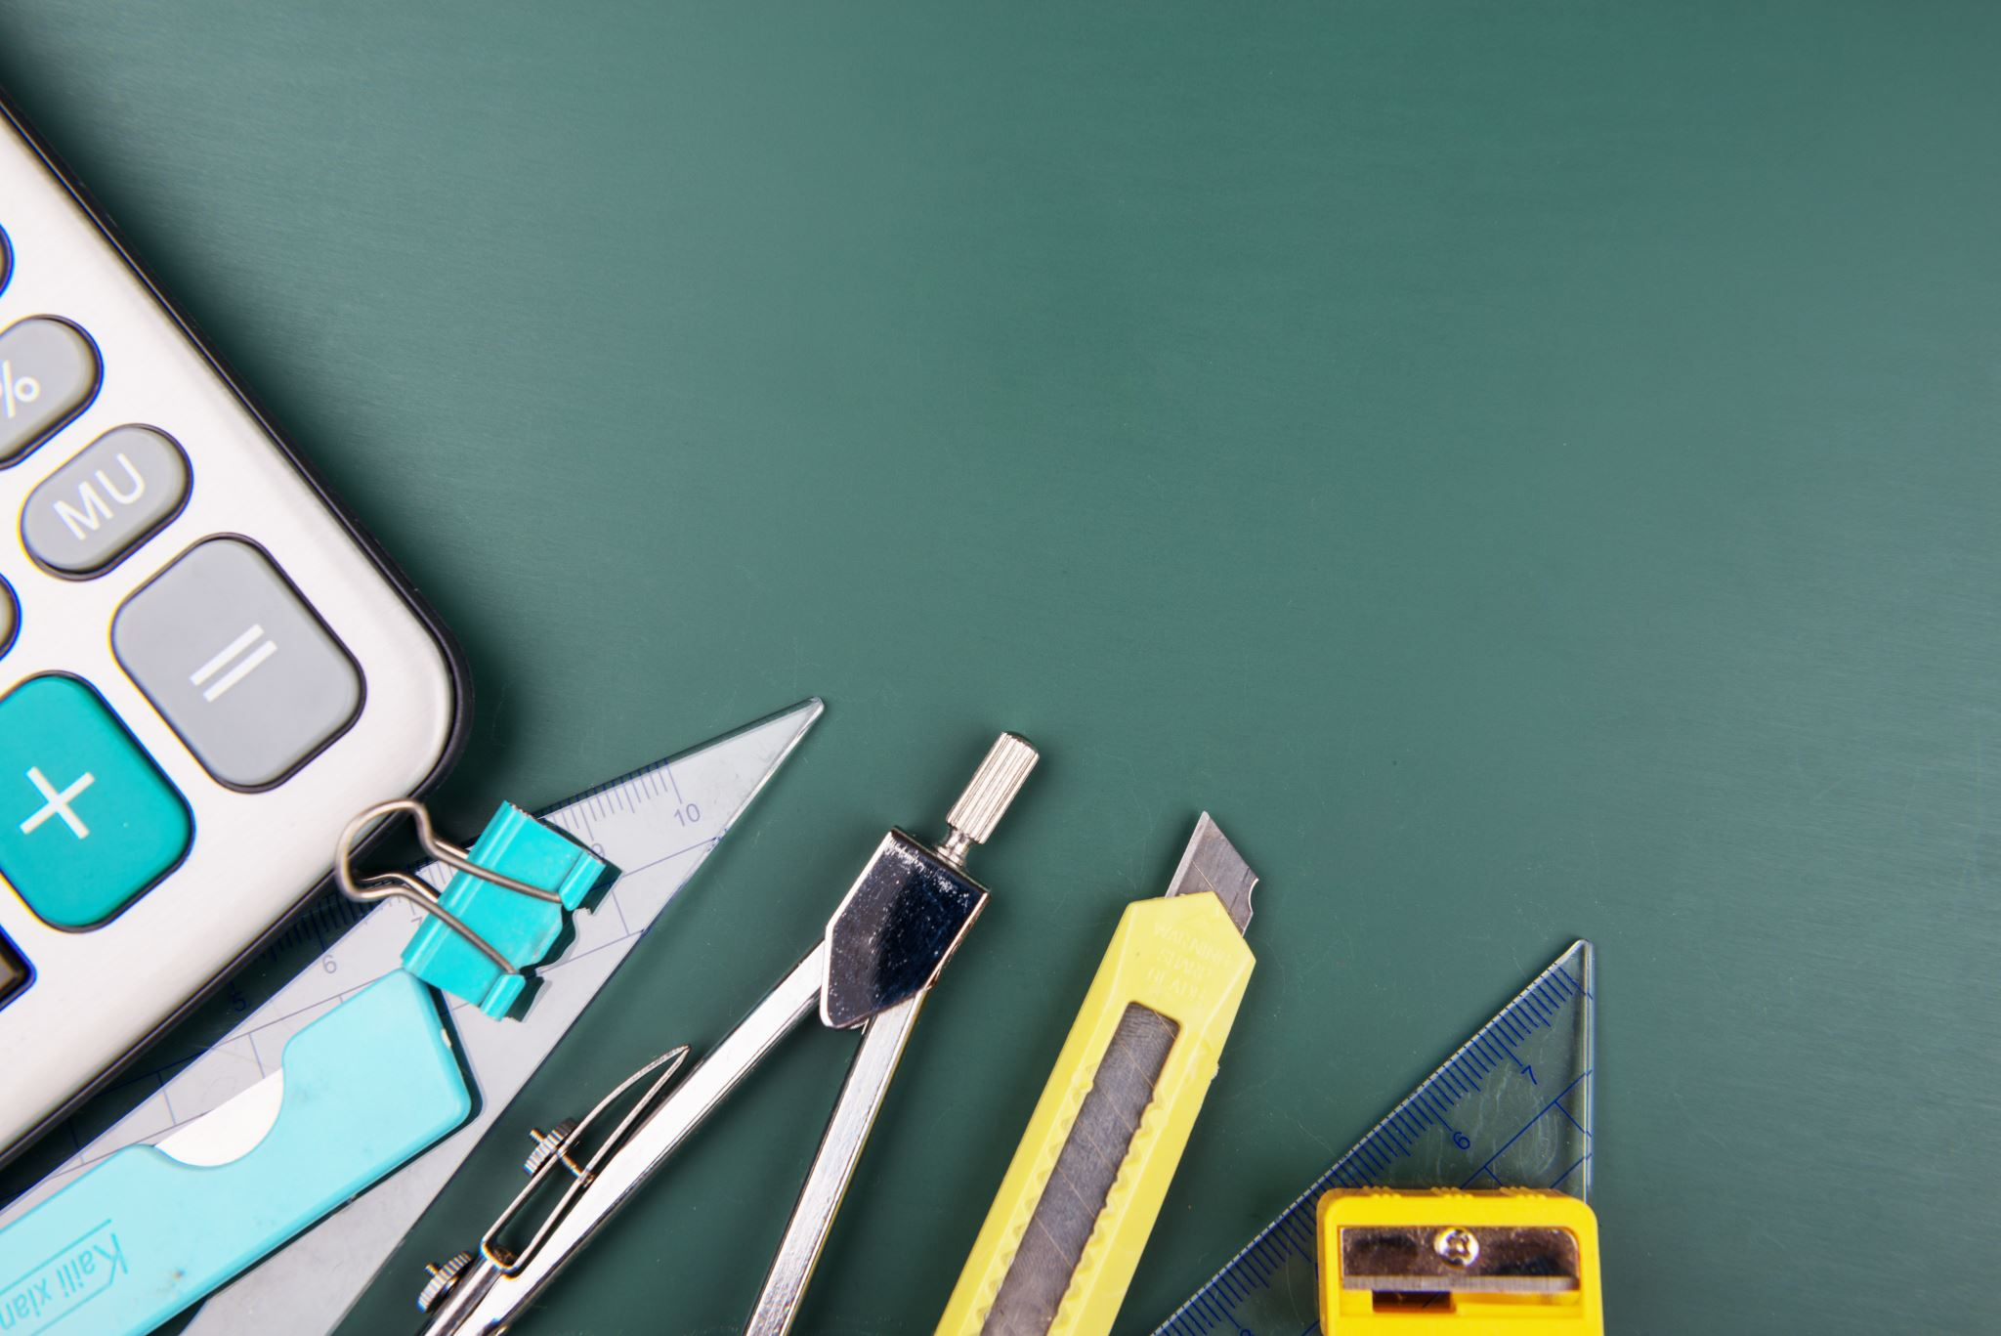
NextHikes IT Solutions Project1
Building Basic Calculator
Roshan Borde

Slide 2
Building Basic Calculator
Introduction:
In this project uses PyQt6, a Python graphical user interface toolkit, to create a basic GUI calculator in visual studio code. With the calculator's interactive interface, users may carry out simple arithmetic operations including addition, subtraction, multiplication, and division.
The basic feature of calculator are values input and the outcome of the computations are shown on a display screen.
Operation and number buttons: Contains operators (+, -, *, /), digits (0–9), a clear button (C), and an equals button (=).
In interactive design, calculations are carried out when the = button is clicked and buttons adjust the display dynamically in answer to user input.

Slide 3
Packages used & Purpose
In this project I used QApplication, QWidget, QVBoxLayout, QLineEdit, QPushButton, QGridLayout from PyQt6.QtWidgets packages
QApplication: QApplication is used to manage and run a GUI application.
QWidget: Qwidget is the base class for all pyqt graphical user interface (GUI) and it is used to visible interface and interact with its components effectively
QVBoxLayout: This is used to arrange components in a vertical column, one below the other.
QLineEdit: This is used to display screen for the calculator where the input and result are shown.
QPushButton: This is used to create a button widget with given label text.
QGridLayout: This is used to place the button at the specified row and column in the grid layout

Slide 4
R & D
In the project I used https://realpython.com/python-pyqt-gui-calculator website which is already shared by NextHikes with us.
This is a compressive site to learn all basic fundamental about pyqt GUI Calculator including various widgets, types of layout, windows, application and other.
This site was very helpful at the time of coding part for building a calculator.
Second important source I used YouTube, I went through a multiple YouTube channels and videos to understand the process and steps which need to be taken.
Third Important source I used ChatGPT because sometime browsing a particular concept or searching on YouTube I did not get proper result so I used ChatGPT to get exact clarification.

Slide 5
Challenges
At the initial time It was completely new to me like starting from Visual Studio code, environment set up, installation of pyqt and offcourse packages of pyqt library. Because at beginning I had only worked on Jupiter Notebook and google collabs with some packages of python like Numpy, Pandas, matplotlib and other.
The second thing that, I never worked like this project of any company to build a complete product like calculator, so there was some fear in mind how to navigate this.
To build a code like more than fifty to hundred line it seems to be difficult.
While working in a coding part I had to face lot of difficulties on indentation because correct indentation is very much important for all subsequent line of code under each heading.

Slide 6
Learning Outcome
In this project, I learnt how to build a graphical interface using PyQt6, where I can create user-friendly windows, buttons, and displays. I also learnt how to organize these components neatly using layouts like GridLayout and vertical boxes Layout.
I also understood how to connect user actions, like button clicks, to specific functions, making the application interactive and functional. Additionally, I searched how to enhance the visual appeal of my application with colors, fonts, and styles.
By integrating Python logic with the graphical design, I created a working calculator.

Slide 7
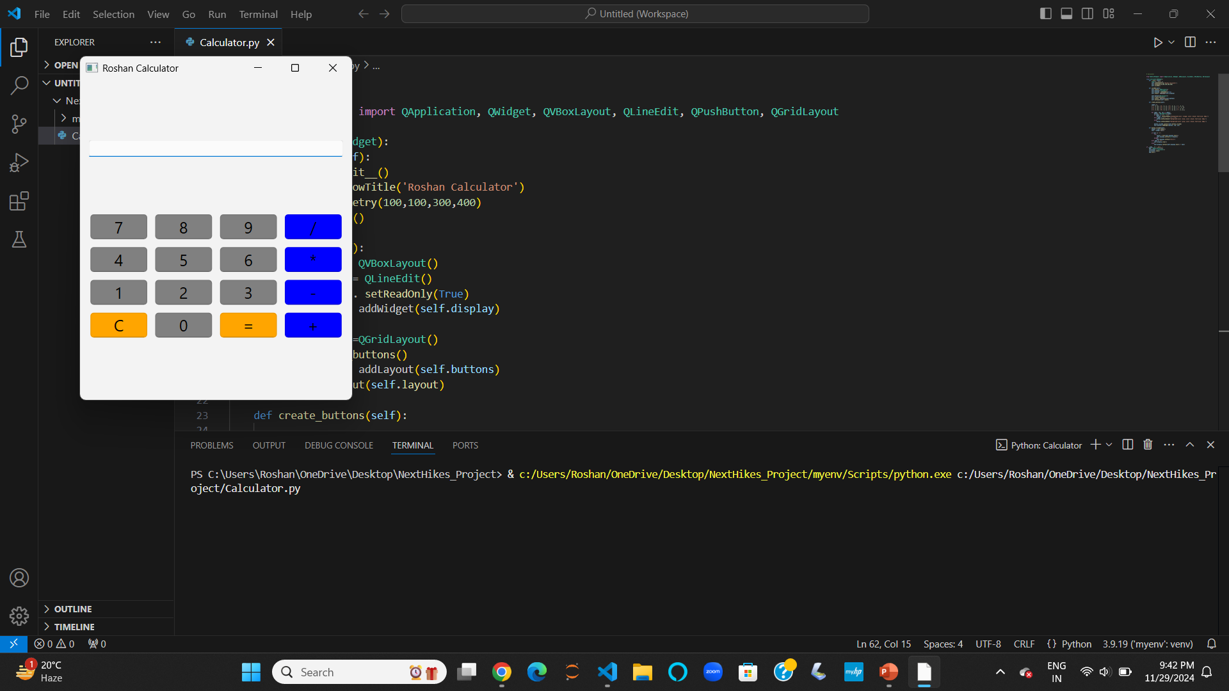
Result

Slide 8
Thank You

