Slide 1

Paldea Finance Tracker
Milestone 2.0 Final Presentation
IST 303 – Fall 2025
Team Paldea:
Qiao Huang, Samantha Aguirre, Gerves F. Baniakina,
Rachan Sailamai, Manish Shrivastav

Slide 2

Project Overview & Objectives
Project Scope: Flask-based MVC web application for financial management.
Core Value Proposition:
- Real-time budget tracking.
- Multi-currency normalization (Story 13, 15).
- Predictive forecasting (Story 9).
Milestone 2.0 Achievement:
- Delivered full Reporting, Visualization, and Multi-Currency modules.
Presenter: Qiao Huang

Slide 3

Technical Architecture
Tech Stack: Python (Flask), SQLAlchemy (ORM), SQLite, Bootstrap 5.
Key Models (models.py):
- User: Handles authentication and currency prefs.
- Transaction: Polymorphic design for Income/Expense.
- ScheduledReport: Manages automated background tasks.
Presenter: Qiao Huang

Slide 4
Code Deep Dive: Currency Logic
@paldea_app.route('/convert_currency', methods=['POST'])
@login_required
def convert_currency():
# ... setup ...
# STRATEGY: Try primary API, fallback to secondary, fallback to 1:1
try:
url = f"https://api.exchangerate-api.com/v4/latest/{from_currency}"
response = requests.get(url, timeout=5)
if response.status_code == 200:
rates = response.json().get('rates', {})
rate = rates.get(to_currency)
except Exception as e:
print(f"API 1 failed: {e}")
# ... fallback logic ...
converted_amount = amount * rate
# ... save to ConversionHistory ...
Presenter: Qiao Huang

Slide 5
Epic 4: Enhanced Visualization
Objective: Provide actionable insights (User Story 2, 5).
Implementation:
- Dynamic Spending Calculation in 'home' route.
- Visual Feedback: Logic determines progress bar colors.
- Green < 70% | Yellow 70-90% | Red > 90%.
Presenter: Samantha Aguirre

Slide 6
Code Deep Dive: AI Forecasting
from sklearn.linear_model import LinearRegression
# STRATEGY: Prepare historical vectors for regression model
if len(expenses_for_forecast) >= 2:
X = np.array(range(len(expenses_for_forecast))).reshape(-1, 1)
y = np.array(expenses_for_forecast)
model = LinearRegression()
model.fit(X, y) # Train model on last 6 months
# Predict next month (index = length of array)
next_month_prediction = model.predict([[len(expenses_for_forecast)]])[0]
# Calculate confidence based on R-squared score
forecast_confidence = min(100, max(0, 100 - abs(model.score(X, y) * 100 - 100)))
Presenter: Samantha Aguirre

Slide 7
Epic 5: Export & Reporting
Objective: Data portability and compliance (Story 10, 12).
Features:
- PDF Generation: Programmatic drawing via ReportLab.
- CSV Export: In-memory buffer handling.
- Tax Summary: Filtering for deductible categories.
Presenter: Gerves Francois Baniakina

Slide 8
Code Deep Dive: PDF Engine
from reportlab.platypus import SimpleDocTemplate, Table, Image
@paldea_app.route('/export_pdf')
def export_pdf():
buffer = BytesIO()
doc = SimpleDocTemplate(buffer, pagesize=letter)
# STRATEGY: Generate charts dynamically using Matplotlib
with tempfile.TemporaryDirectory() as tmpdir:
fig, ax = plt.subplots(figsize=(6, 4))
ax.bar(['Income', 'Expenses'], [total_income, total_expenses])
plt.savefig(chart1_path)
# Embed chart into PDF flowable
story.append(Image(chart1_path, width=5*inch, height=3.33*inch))
doc.build(story) # Build PDF in memory
Presenter: Gerves Francois Baniakina

Slide 9
Agile Methodology & Process
Process Overview:
- 2-Week Sprints aligned with coursework.
- Decomposed User Stories into granular Tasks.
Velocity & Tracking:
- Maintained Burndown charts to track progress.
- Initial velocity variance stabilized in Phase 3.
Presenter: Rachan Sailamai

Slide 10
Quality Assurance & Lessons
Testing Strategy (pytest):
- Unit Tests: Model constraints.
- Integration Tests: Route logic and redirects.
- Coverage: ~87%.
Lessons Learned:
- Challenge: Headless browser rendering for PDFs.
- Success: Robust MVC separation allowed easy API integration.
Presenter: Manish Shrivastav

Slide 11
Live Demonstration

Slide 12
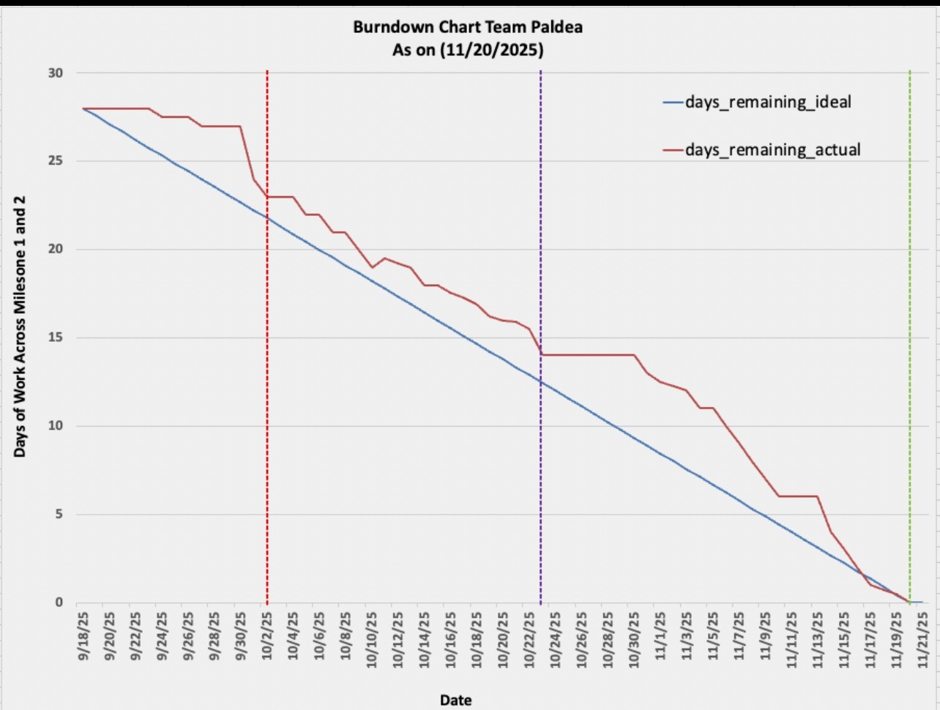
Final Burndown Chart – Milestone 2.0

Slide 13
Key Successes
• Completed full MVC finance tracking system
• Delivered forecasting, visualization, and reporting on time
• Improved stability and modular architecture
• Strong team collaboration and communication

Slide 14
Key Failures & Challenges
• Early delays due to API and environment failures
• Integration of forecasting & PDF generation required extra debugging
• Agile velocity inconsistent in early sprints
• UI/UX improvements limited by time constraints

Slide 15
Lessons Learned
• Importance of clear communication in distributed teams
• Breaking user stories into smaller tasks stabilizes sprint velocity
• Early testing prevents critical roadblocks later
• Designing for API failure increases system reliability

