Slide 1
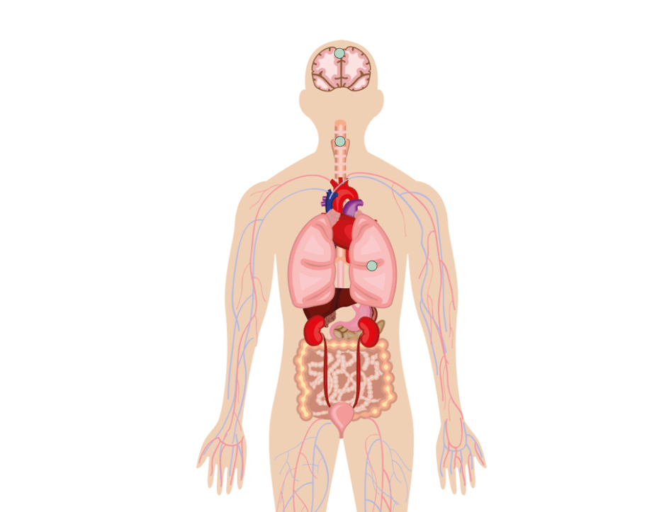
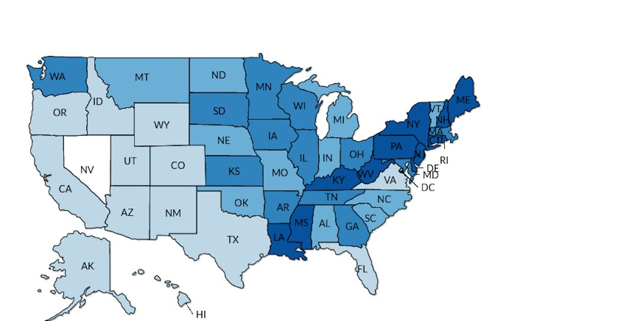
Slide bar: select a year
Heatmap: Cancer cases by state in 1989
1975
2018
1989
Stage caught
Highlighted cancer type selection
II
I
III
IV
Size of roman numeral ∝ number of data points
Treatments
Demographics
The top 3-5 treatment methods based on popularity
Option 1
Option 2
Option 3
Hispanic
White
Black
24
Mean survival (months)
Mean survival (months)
18
12
6
1984
1988
1992
1996
2000
2004
2008
2012
2016
T1
T2
T3
Year
Treatments

