Slide 1
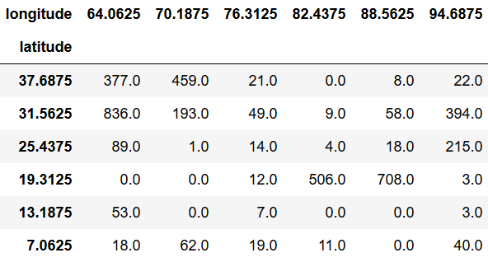
Sequence of length 60 with offset 1
...
...
...
Relative Humidity
Relative Humidity
Relative Humidity
Temperature
Temperature
Temperature
t - 60
...
t - 1
Sequence of length 60 with offset 2
Monsoon over Kerala (t)
...
...
...
Relative Humidity
Relative Humidity
Relative Humidity
Temperature
Temperature
Temperature
t - 61
...
t - 2

Slide 2
...
...
...
Relative Humidity
Relative Humidity
Relative Humidity
Temperature
Temperature
Temperature
t - 60
...
t - 1
TimeDistributed
Conv2D, 16, 3x3
Conv2D, 16, 3x3
Conv2D, 16, 3x3
TimeDistributed
Conv2D, 16, 3x3
Conv2D, 16, 3x3
Conv2D, 16, 3x3
TimeDistributed
MaxPool2D, 2x2
MaxPool2D, 2x2
MaxPool2D, 2x2
ConvLSTM2D, 16, 3x3
ConvLSTM2D, 16, 3x3
ConvLSTM2D, 16, 3x3
Dense, 1024
Dense, 1024
Dense, 1024
Dense, 1

