Slide 1
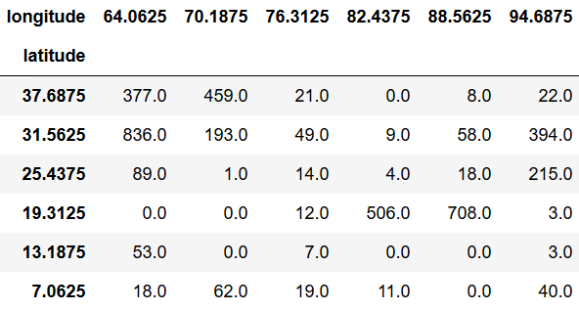
…
Relative Humidity
Temperature
3D-Tensor containing values of three features at a single timestep

Slide 2
Sequence of length 60 with an offset of 1 day
...
...
...
Relative Humidity
Relative Humidity
Relative Humidity
Temperature
Temperature
Temperature
t – 60 days
...
t – 1 day
Sequence of length 60 with an offset of 2 days
Monsoon over Kerala (t)
...
...
...
Relative Humidity
Relative Humidity
Relative Humidity
Temperature
Temperature
Temperature
t – 61 days
...
t – 2 days

Slide 3
...
...
...
Relative Humidity
Relative Humidity
Relative Humidity
Temperature
Temperature
Temperature
Exemplary test sequence
t - 60
...
t - 1
TimeDistributed
Conv2D, 16, 3x3
…
Conv2D, 16, 3x3
TimeDistributed
Conv2D, 16, 3x3
…
Conv2D, 16, 3x3
TimeDistributed
MaxPool2D, 2x2
…
MaxPool2D, 2x2
ConvLSTM2D, 16, 3x3
ConvLSTM2D, 16, 3x3
ConvLSTM2D, 16, 3x3
Dense, 1024
Dense, 1024
Dense, 1024
Dense, 1

