Slide 1
Zeppelin

Slide 2
Trackplan
Signal
Magnet
Reed switch

Slide 3
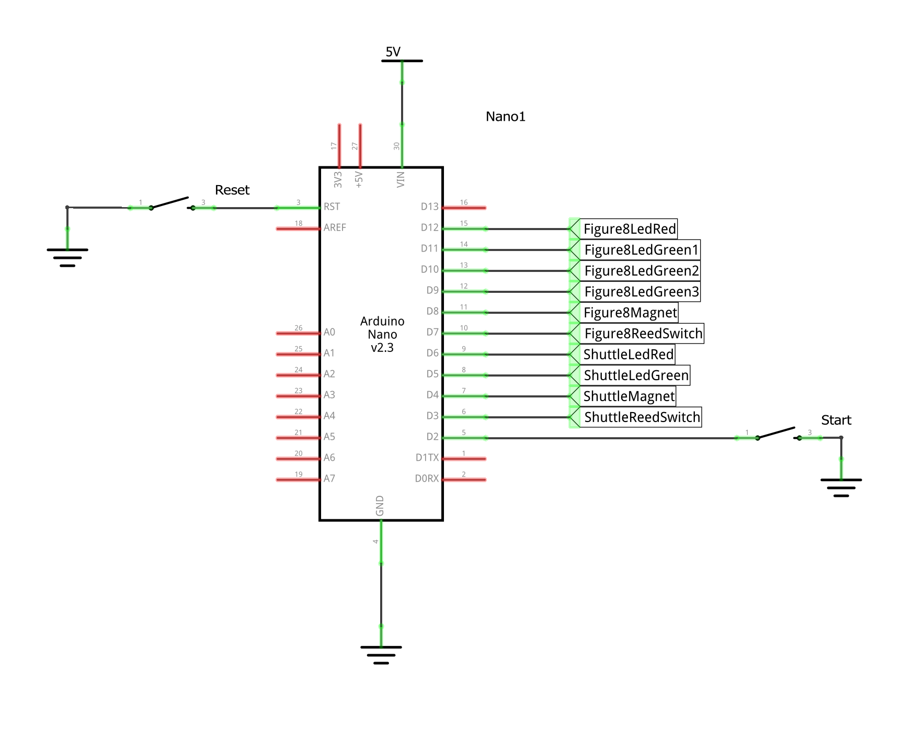
Schematic - Arduino

Slide 4
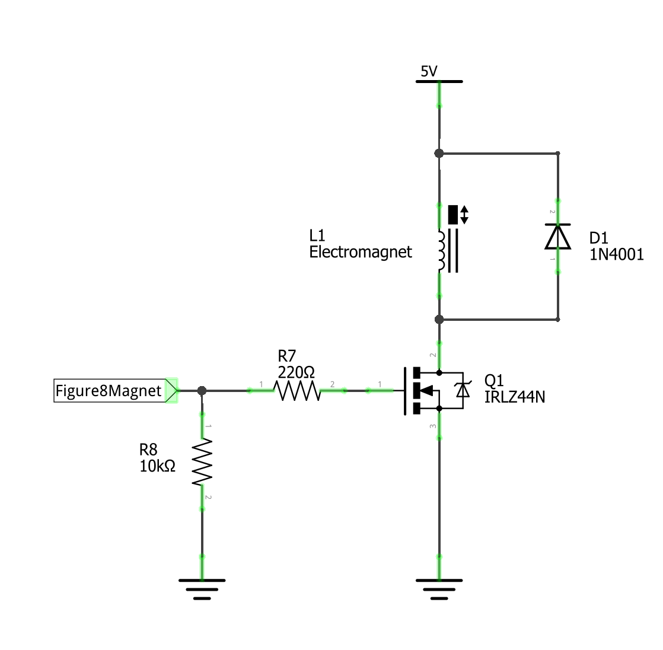
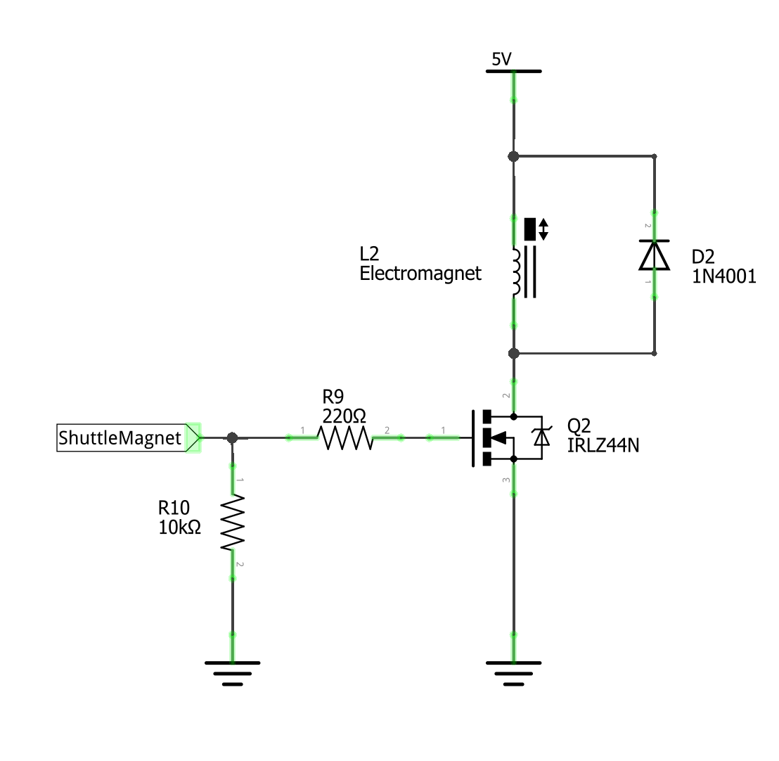
Schematic - Magnet

Slide 5
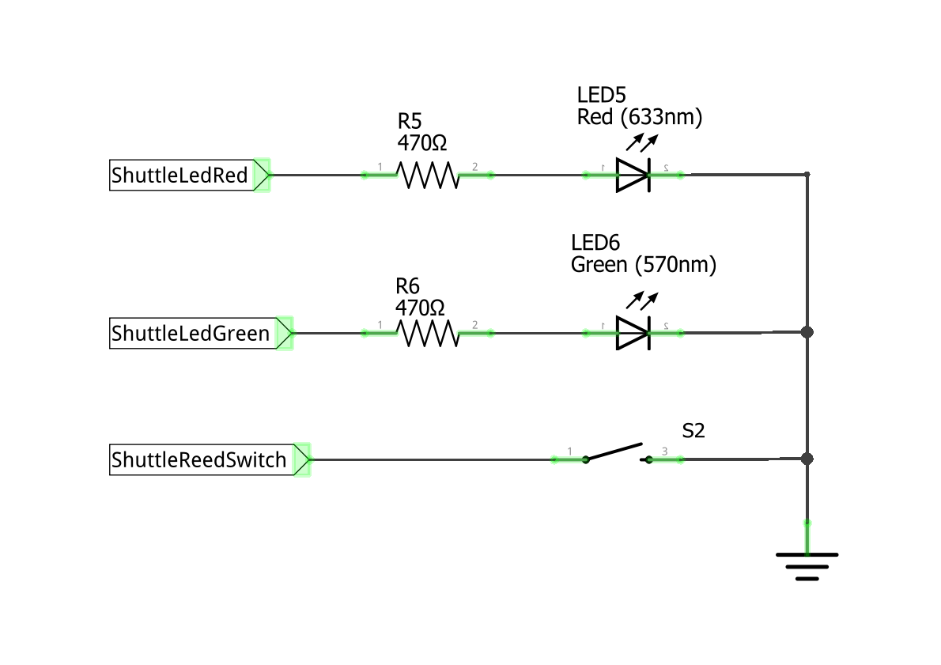
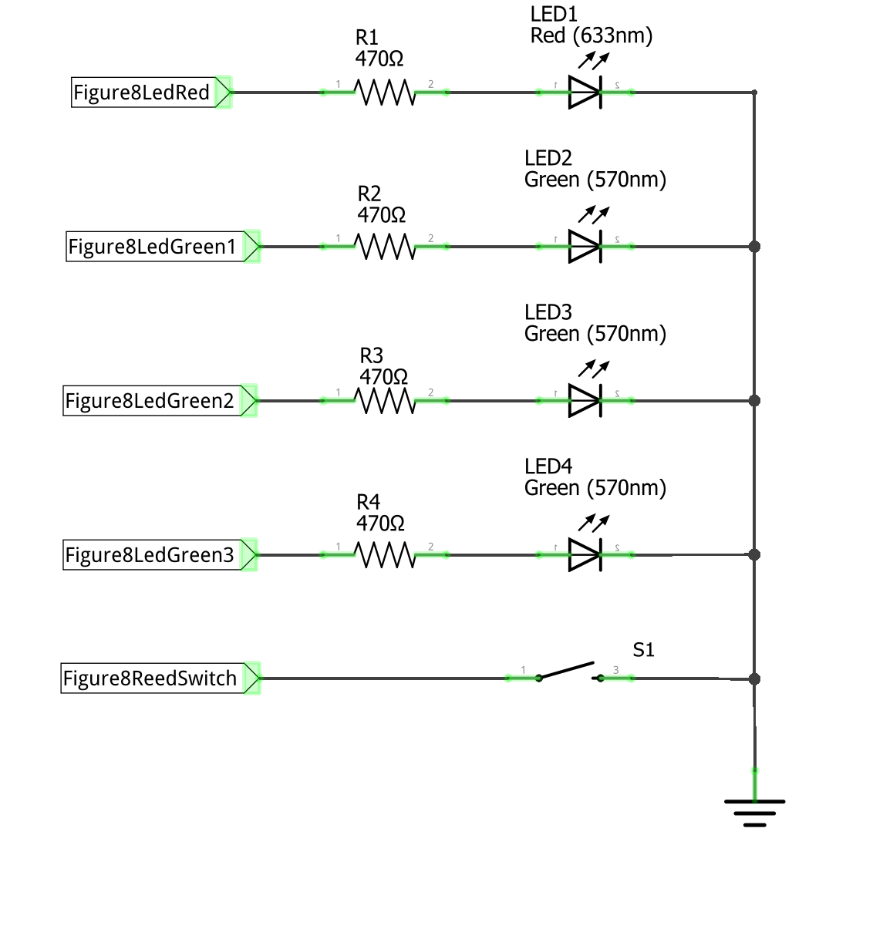
Schematic - Signals

Slide 6
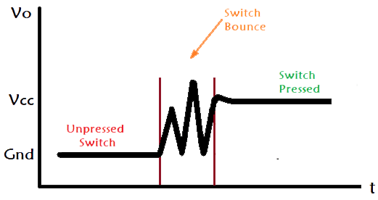
Software – Debouncing switches

Slide 7
Software – bouncing switches
V
Switch bounce
Switch pressed
VCC
Unpressed switch
GND
t

Slide 8
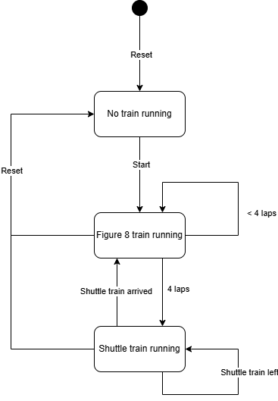
Software – State machine

Slide 9
Software – State machine

Slide 10
Software – State machine
Both magnets are on
Both signals are red

Slide 11
Software – State machine

Slide 12
Software – State machine
Count the number of laps
The signal reflects the number of laps
The figure 8 magnet is off

Slide 13
Software – State machine

Slide 14
Software – State machine
Wait till the shuttle trains arrives
The shuttle signal is green
The figure 8 magnet is on

Slide 15
Software – State machine

