Slide 1

HARD AT HEARING
at the workplace
Dr. Roland Siegbert & Claudia Mohn
This work is licensed under: cc-by-nc

Slide 2
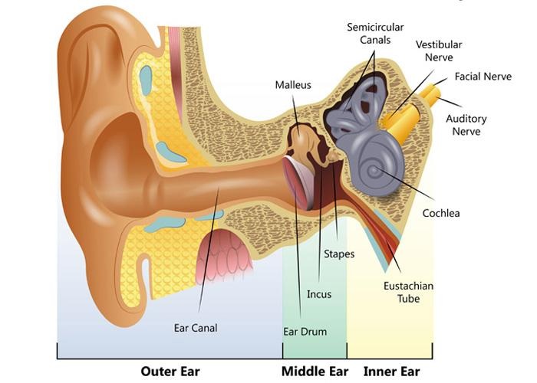
PERIPHERAL HEARING SYSTEM
https://www.hearinglink.org/your-hearing/about-hearing/how-the-ear-works/

Slide 3
DIFFERENCE: HEARING – UNDERSTANDING
Hearing = auditorial processing, Understanding = (learned) skill of the auditory cortex
Only by constant hearing of language, music and sounds we can identify, remember and understand auditory information; when something is heard and sent to the brain, it can be recognized, processed and therefore be understood
=> the more often a word is heard, the better it can be understood (Known problems: rare words, loanword, proper nouns, foreign languages…)
Each word has a characteristic acoustic pattern, which is used to recognize it (Known problems: bad pronunciation)

Slide 4
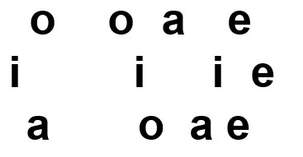
OPTICAL EXAMPLE: UNDERSTANDING LANGUAGE

Slide 5
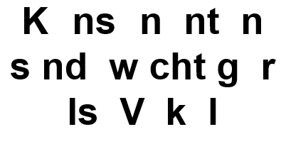
OPTICAL EXAMPLE: UNDERSTANDING LANGUAGE

Slide 6
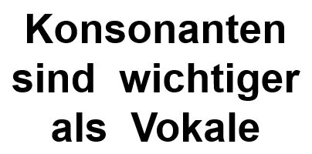
OPTICAL EXAMPLE: UNDERSTANDING LANGUAGE

Slide 7
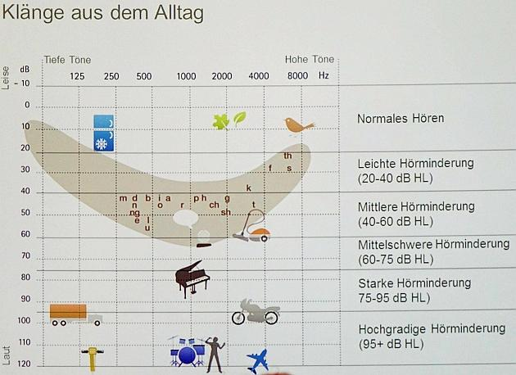
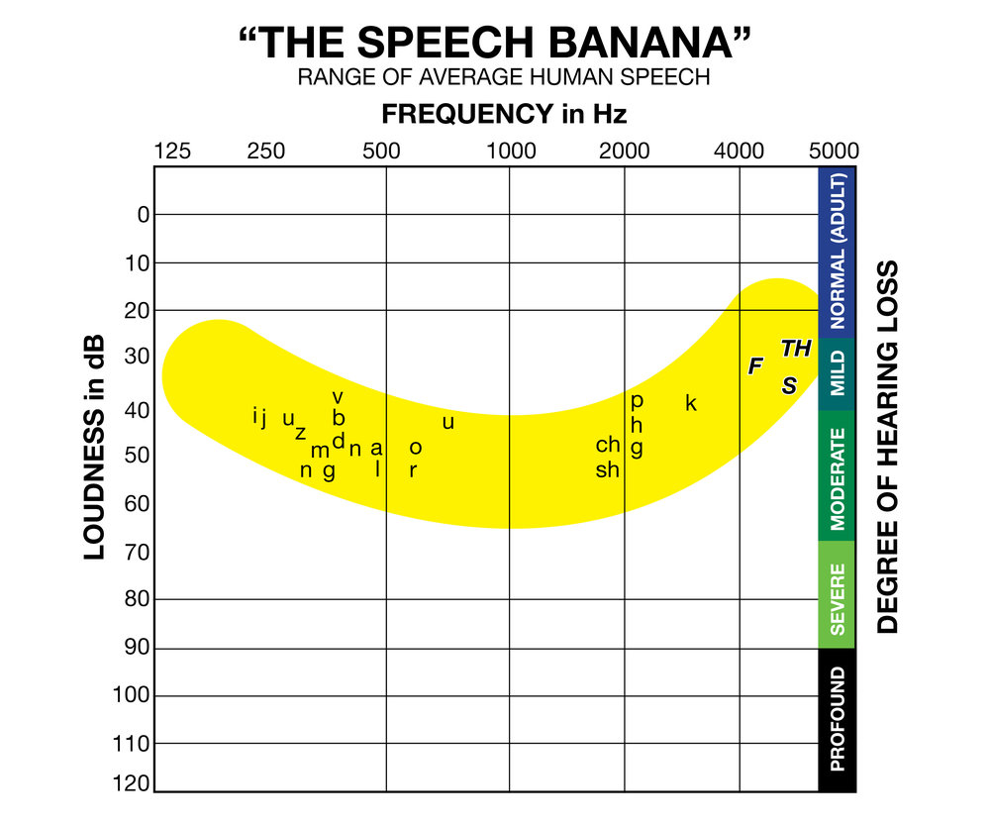
SPEECH BANANA
http://www.se-wil.ch/wp-content/uploads/2017/03/Bild1.jpg|wikimedia commons

Slide 8
OPTICAL EXAMPLE: UNDERSTANDING LANGUAGE
Genitiv ins Wasser, weil es dativ ist.
Geh nie tief ins Wasser, weil es da tief ist.

Slide 9
OPTICAL EXAMPLE: UNDERSTANDING LANGUAGE
His bowl is empty. Who was the cereal killer?
His bowl is empty. Who was the serial killer?

Slide 10
OPTICAL EXAMPLE: UNDERSTANDING LANGUAGE
Which celebrity is always ready for cereal?
Reese, with her spoon.

Slide 11
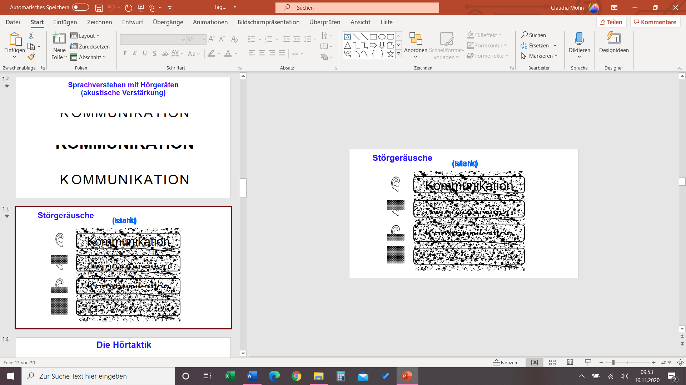
HEARING AND UNDERSTANDING UNDER NOISE
The deaf und CI-Carriers can not suppress noise as good as the non-disabled.
For CI: Speech-processor can not differentiate between important and unimportant > CI-Carries and SSDs often hear both sounds at once.
(= monoaural hearing / PUHL)

Slide 12
CONSEQUENCES OF BEING DEAF
Misunderstanding by hearing mistake (similar words / prosody)
Environmental sounds and noise (many voices, soundscape, large rooms)
Ambient noise (riot) von useful noise (language) hard to differentiate
Language (indistinct, faint, dialect, speaker far away)
Lip movement (hidden, distorted, bad, turned away, upper limit low (max. 1/3))
Hyperacusis (a paradox)
Non-expressive body language (gestures/facial expressions)
Reasoning powers / combination skills

Slide 13
COMBINING AND UNDERSTANDING
The hard at hearing are hard at collecting
What is heard
What can be lipread
Body language
Knowledge about situation / persons (context) > lexicon
Reasonable combination of previous social experiences > social competence

Slide 14
COMBINING AND UNDERSTANDING
The hard at hearing are hard at collecting
What is heard
What can be lipread
Body language
Knowledge about situation / persons (context) > lexicon
Reasonable combination of previous social experiences > social competence
All this material is collected, to fill gaps, when the audible information is not enough

Slide 15
COMBINING AND UNDERSTANDING
The hard at hearing are hard at collecting
What is heard
What can be lipread
Body language
Knowledge about situation / persons (context) > lexicon
Reasonable combination of previous social experiences > social competence
All this material is collected, to fill gaps, when the audible information is not enough > continuously-running operation

Slide 16
CHALLENGE AND PERFORMANCE OF REASONING/UNDERSTANDING
Very high mental load (Multi-Tasking), comparable
  Crossword puzzling ‚on the side‘ all day
  Combinatorial skills
  Similar to a lively group one is part of where the language is foreign

Slide 17
CHALLENGE AND PERFORMANCE OF REASONING/UNDERSTANDING
Very high mental load (Multi-Tasking), comparable
  Combinatorial skills
  Crossword puzzling ‚on the side‘ all day
  Similar to a lively group one is part of where the language is foreign
Loop: Concentration > Immense combinatorial load (stress) > performance (is limited) > exhaustion / overburdening > concentration drops > combinatorial skills drop …

Slide 18
WHAT IS A COCHLEAR IMPLANT?
‚Electrical ear‘
An electrode will be inserted into the cochlea
Direct triggering of the hearing nerve
These electric signals ‚can‘ be interpreted as sound
Huge difference to hearing aid
  A hearing aid generates acoustic signals and require a minimal function of the inner ear
  A CI ‚replaces‘ the inner ear

Slide 19
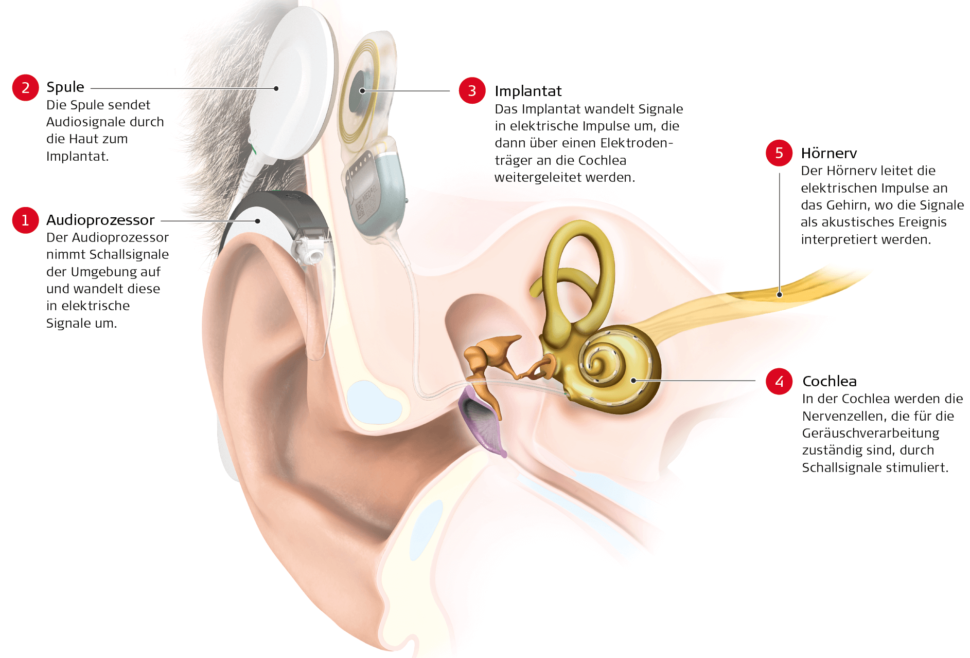
SETUP OF A COCHLEAR IMPLANT
wikimedia commons

Slide 20
HEARING AND UNDERSTANDING WITH AN AID & CI
Hearing has to be relearned
This requires years of training more than
Months of training required for a hearing aid
Only a minimal coverage of the hearing spectrum can be covered with a CI
CI is no natural hearing but closer to a ‚new‘ connection to the brain reusing a tight nerve bundle and the auditorial cortex

Slide 21

HEARING EXAMPLES OF THE CI (IN GERMAN)
Hörsimulation mit CI
Original
A hearing impression of a CI carrier

Slide 22
WHAT YOU CAN DO FOR YOUR FAMILY, COLLEAGUES AND YOURSELF
Good lighting
Calm/silent environment
Good seating
Good lip movement
Clear language and eye contact
Good loudness
Make eye contact before speaking
Important information in written form
Good communication hygiene
Use FM system, speech-to-text services
Video Conferences
Everybody is on mute (except speaker)
Important infos -> Chat !!!
Questions in chat (to not interrupt flow)
Short answers to be noted in chat or
Order of answers/answering noted in chat
Keep the meetings short
  Agendas
  Minutes

