Slide 1
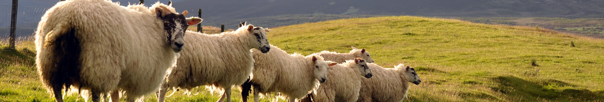
Meat Consumption Around the World
Trends and differences across continents
Raquel Marques & Effie Carvalho
Notes:
Hello everyone. We are Raquel and Effie, and today we are going to present our project: Meat Consumption Around the World.

Slide 2
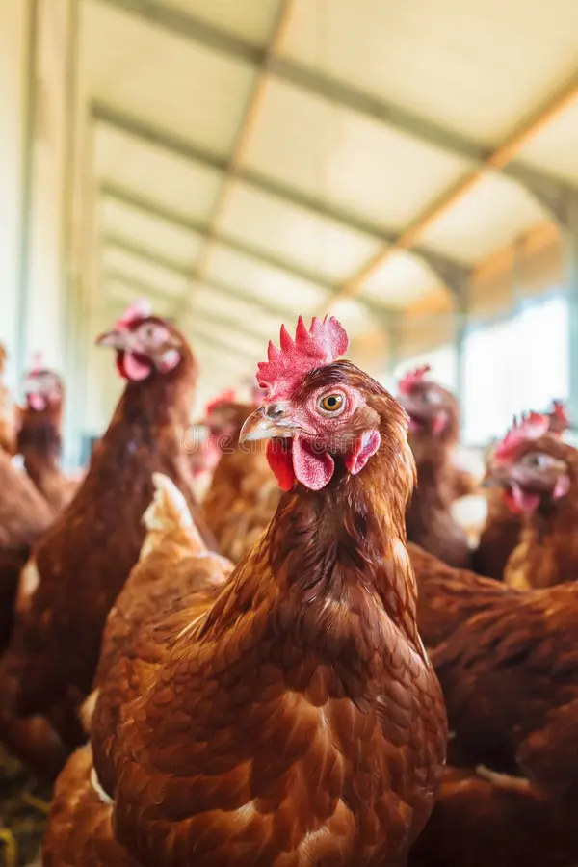
OUR QUESTION
What are we trying to find out?
How does meat consumption differ across continents, what factors may explain these differences, and how has consumption changed over time?
Notes:
To guide our project our main questions were: how does meat consumption differ between continents? what factors may explain these differences, and how meat consumption has changed over time.

Slide 3
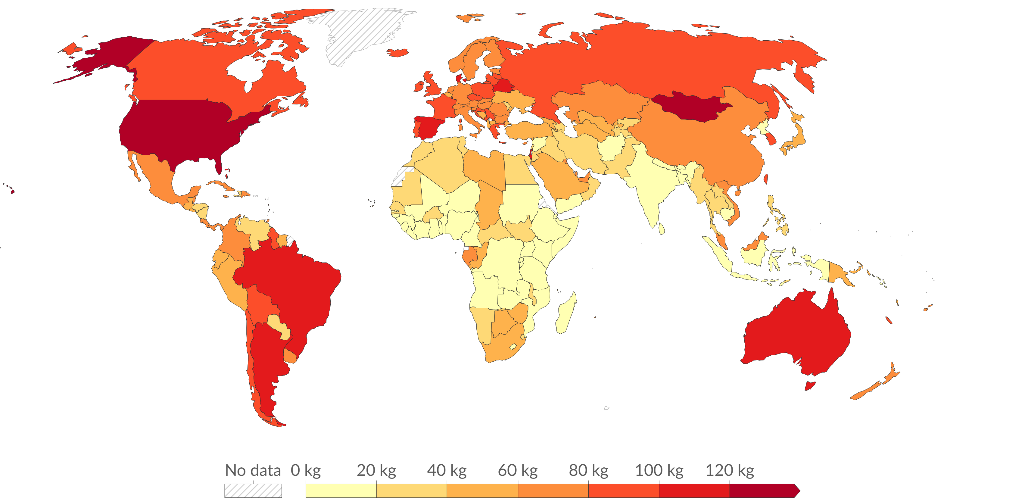
COUNTRY EXTREMES THE GLOBAL PICTURE
Across 169 countries, meat intake ranges from 3.5 to 136 kg per person
Data source: Food and Agriculture Organization of the United Nations (2025)
Notes:
First, we looked at individual countries.
We found a very large difference between countries.
Meat consumption ranges from only 3.5 kilograms to 136 kilograms per person per year.
This already shows us that eating habits are very different around the world.

Slide 4
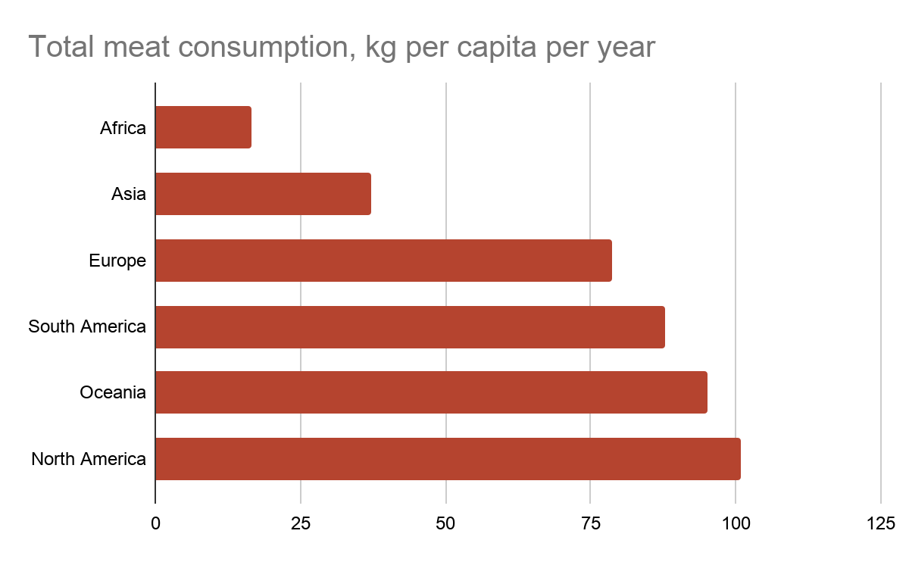
THE GLOBAL PICTURE
North America eats about six times more meat than Africa
6×
100.8 kg in North America vs 16.7 kg in Africa
Three tiers
Americas and Oceania above 87 kg, Europe at 79 kg, Asia and Africa far below.
Notes:
Now, if we look at the continents, the differences become even clearer.
North America consumes about six times more meat per person than Africa.
North America is at around 100.8 kilograms per person, while Africa is at only 16.7 kilograms.
We can also see three main groups: the Americas and Oceania have the highest levels, Europe is in the middle, and Asia and Africa have lower levels.

Slide 5
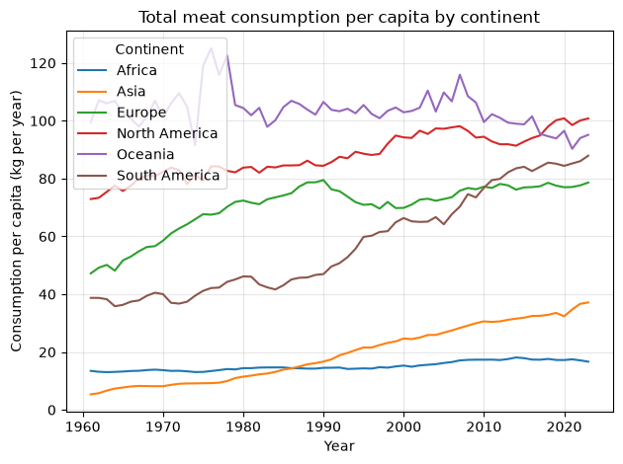
HOW IS IT CHANGING?
Who changed the most?
Change 1960 → 2023, kg per person
Asia
5.37 → 37.15
+591%
South America
38.74 → 87.92
+127%
Europe
47.22 → 78.63
+67%
North America
72.93 → 100.8
+38%
Africa
13.48 → 16.67
+24%
Oceania
99.46 → 95.14
−4%
Notes:
Next, we looked at how meat consumption changed between 1960 and 2023.
Asia had the biggest increase, growing by 591 percent.
Oceania was different because consumption changed with minus 4
%

Slide 6
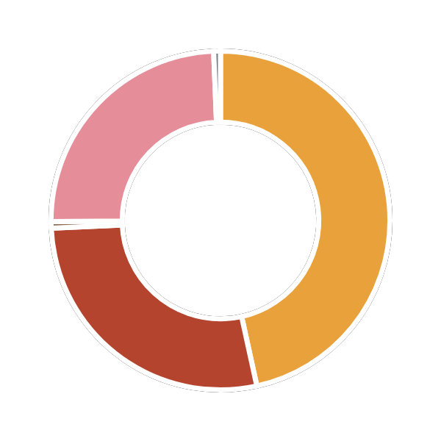
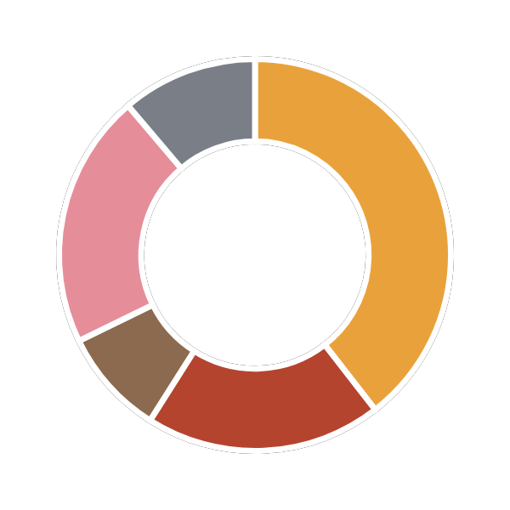
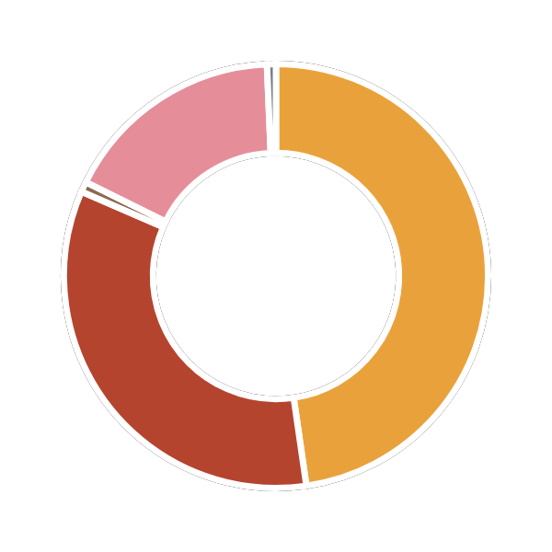

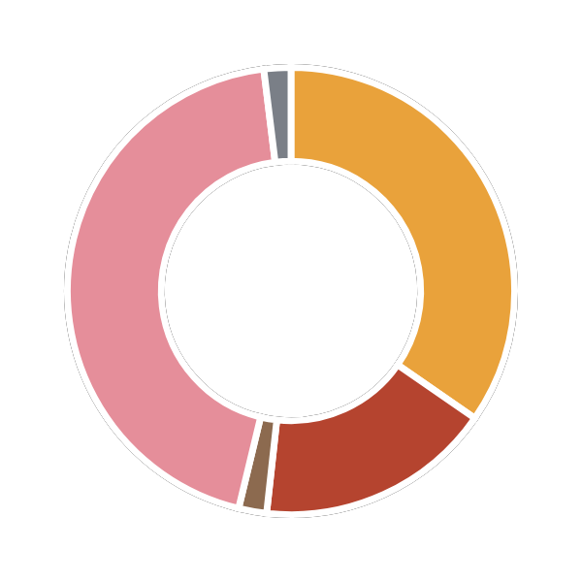
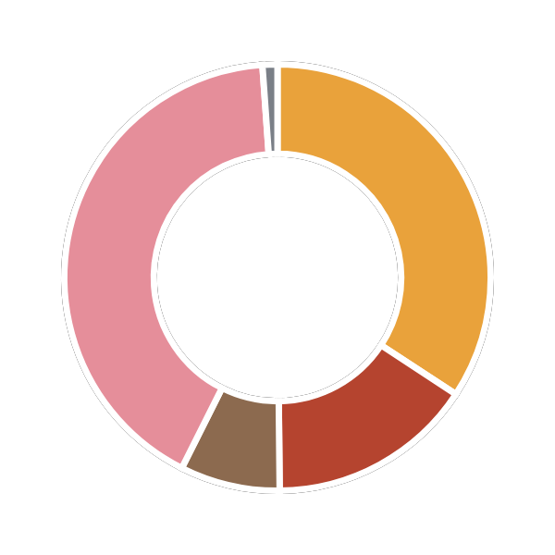
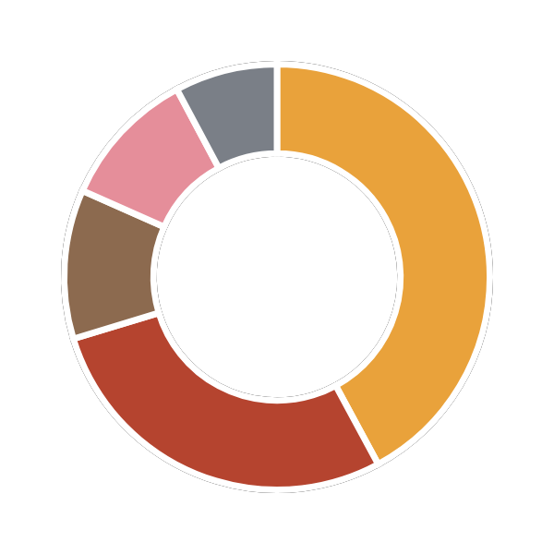


WHAT ARE WE EATING?
Poultry leads on most continents, pork in Europe and Asia
Did you know?
Animals get slaughtered for meat:
North America
Poultry · 100.8 kg
Oceania
Poultry · 95.1 kg
South America
Poultry · 87.9 kg
10
Cows per second
47
Pigs per second
2400
Chickens per second
Europe
Pork · 78.6 kg
Asia
Pork · 37.1 kg
Africa
Poultry · 16.7 kg
Poultry
Beef and buffalo
Sheep and goat
Pork
Other meats
Notes:
But it is not only about how much meat people eat. We also looked at what types of meat they eat.
Poultry is the most consumed meat in North America, South America, Oceania and Africa.
In Europe and Asia, pork is the most consumed type.
For that, So, every second, around 10 cows, 47 pigs and 2,400 chickens are slaughtered for meat consumptionn.
The number of chickens is especially high compared with the other animals.
This helps us understand the scale of global meat production.

Slide 7
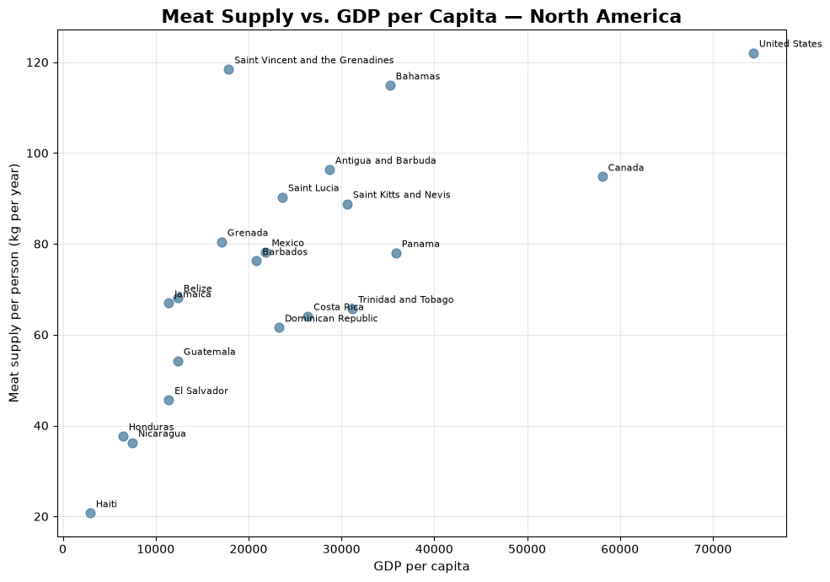
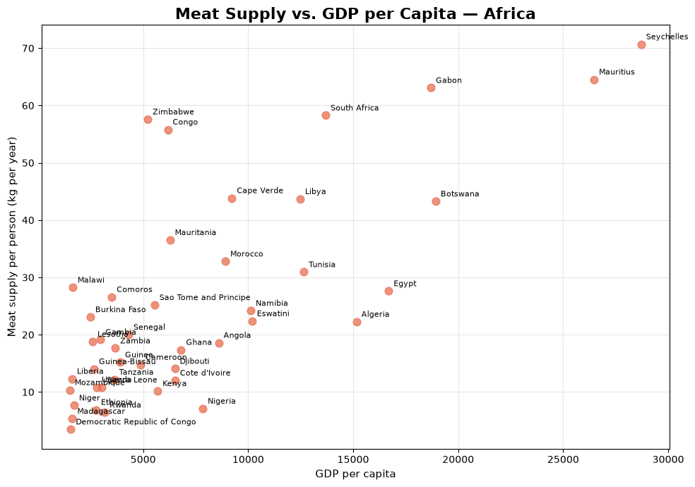
Does Income Matter?
Notes:
We also wanted to look at GDP per capita and see if there is a relationship between income and meat consumption.
This allows us to explore whether countries with higher income also tend to have higher meat consumption.

Slide 8
OUR COHORT GUESSES
Who guessed their country’s top meat?
Got it right
Partly right
Got it wrong

Slide 9

OUR COHORT GUESSES
Who guessed their country’s top meat?
Got it right
Partly right
Got it wrong
Pablo
Spain · pork
Lena
France · beef, chicken & pork tied
Lervin
Netherlands · chicken
Andrea
Italy · pork
Miguel
Spain · chicken, then pork
Pariya
Iran · beef & lamb
Pietro
Italy · pork
Juliana
Brazil · beef
Yurii
Ukraine · poultry
Jovanna
UK · chicken
Adi
Portugal · fish & seafood

Slide 10
OUR COHORT RANKING
Our cohort ranking
4
Portugal
Top 3 in our cohort
5
United Kingdom
Argentina
115.0 kg
6
France
Brazil
104.6 kg
1
7
Netherlands
Spain
100.8 kg
2
8
Italy
3
9
Ukraine
10
Iran
Notes:
We then decided to look at a smaller group of countries, including countries connected to our class.
Argentina has the highest consumption, at around 115 kilograms per person, and the type of meat which is more consumed is cow
Brazil is second, with 104.6 kilograms , and Spain is third, with 100.8 kilograms.

Slide 11







OUR COHORT RANKING
Once fish is included
4
France
Top 3 in our cohort with fish
5
Brazil
Portugal
152.8 kg
6
United Kingdom
Spain
137.7 kg
1
7
Italy
Argentina
122.1 kg
2
8
Netherlands
2
3
9
Ukraine
10
Iran
Notes:
However, the ranking changes when we include fish and seafood.
Portugal moves to first place, with 152.8 kilograms per person.
Spain is second with 137.7 kilograms, and Argentina is third with 122.1 kilograms.
This shows why the definition of what we measure is important when we compare countries.

Slide 12
Conclusions
Big gaps between continents North America (100.8 kg) eats about six times more meat per person than Africa (16.7 kg).
1
Poultry leads, pork follows Poultry is the top meat in the Americas, Oceania and Africa; pork leads in Europe and Asia.
2
Asia changed the most Meat per person in Asia grew by 591% since 1960; Oceania is the only continent that declined (−4%).
3
Higher income, higher meat supply Countries with higher GDP per capita generally tend to have higher meat supply per person.
4
Next step A more detailed project could link food waste to meat consumption.
5
Notes:
So, what did we learn from our analysis?
First, there are very large differences between continents. North America consumes about six times more meat per person than Africa.
Second, poultry is the main type of meat in several continents, while pork is more important in Europe and Asia.
Third, Asia had the biggest increase in meat consumption since 1960.
Would be interesting to do a more detailed project how could link food waste to meat consumption.
We need to start to take care about our planet and about every living beings that live in there.
Overall, our analysis shows that meat consumption is very different depending on the region, the type of meat, and the period we look at.

Slide 13

Thank you!
Questions?
Raquel Marques & Effie Carvalho
Notes:
Thank you for listening.
We hope our analysis gave you a better understanding of meat consumption around the world.
We are happy to answer any questions.

