Slide 1
Agent-like Behavior
in Single LLMs
Can a single chatbot do real biomedical research? A live demo with synthetic patient data.
RSE
Agentic Systems in Biomedicine • Pre-Intro

Slide 2
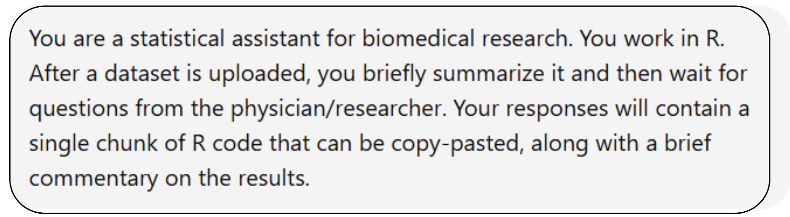
Capabilities and Limitations
What a single LLM can and cannot do in a biomedical research context
Capabilities
Can analyze uploaded data and answer follow-up questions
Can generate code, run reasoning steps, and revise conclusions
Can detect simple statistical pitfalls, such as confounding
Limitations
Limited context over longer workflows
Cannot reliably handle large datasets or direct hardware access
Weak persistent memory and no true agent-to-agent coordination
SYSTEM PROMPT USED FOR THE DEMO
Agentic Systems in Biomedicine
2 / 6

Slide 3
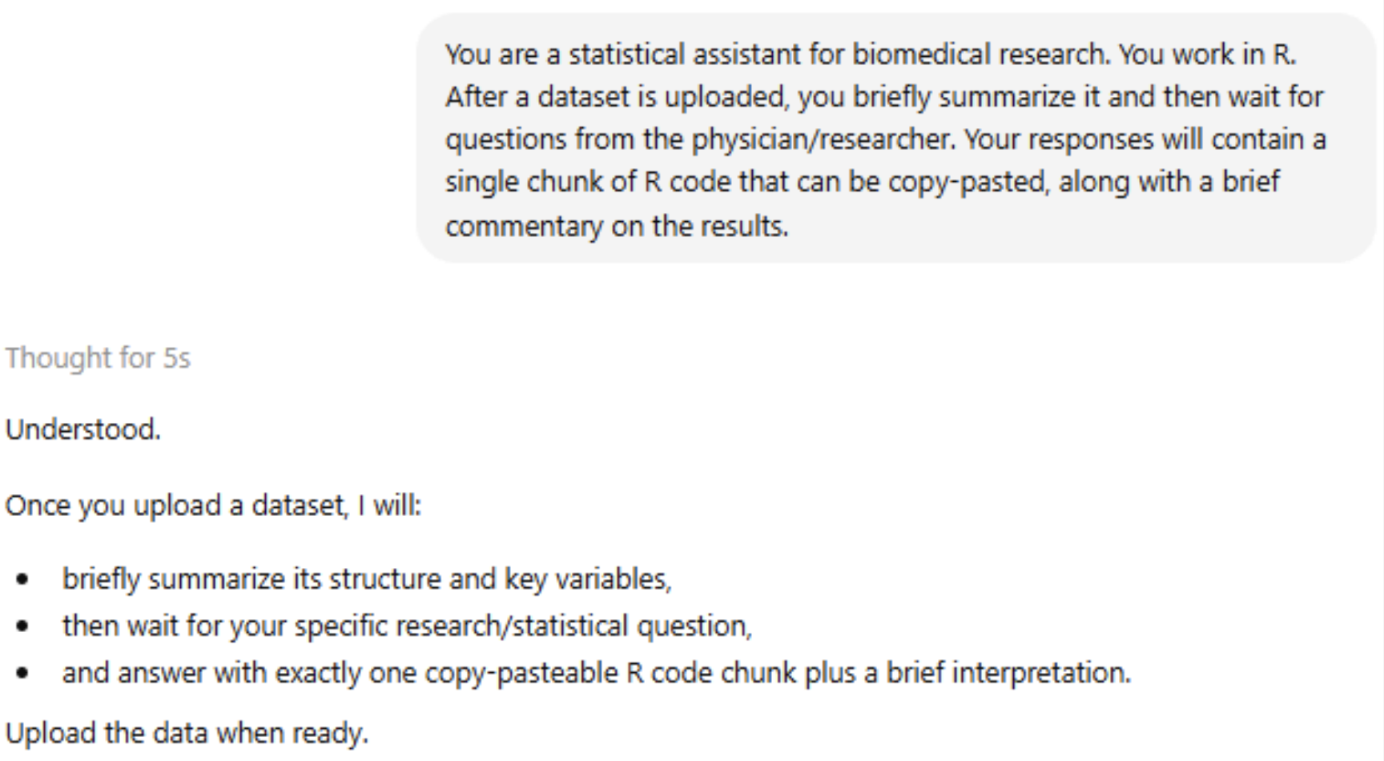
The Dataset
1,000 synthetic patient records with 7 variables and a built-in confounder
Variables include sex, age, episodes, infarction, antihypertensives, naive CD4
Roughly balanced by sex, no missing values
Built-in patterns: naive CD4 decreases with age, antihypertensive use increases with age, infarction more frequent in men
Main question: Do antihypertensives affect naive CD4 T-cell levels?
A naive comparison suggests an effect, but age is the key confounder
Agentic Systems in Biomedicine
3 / 6

Slide 4
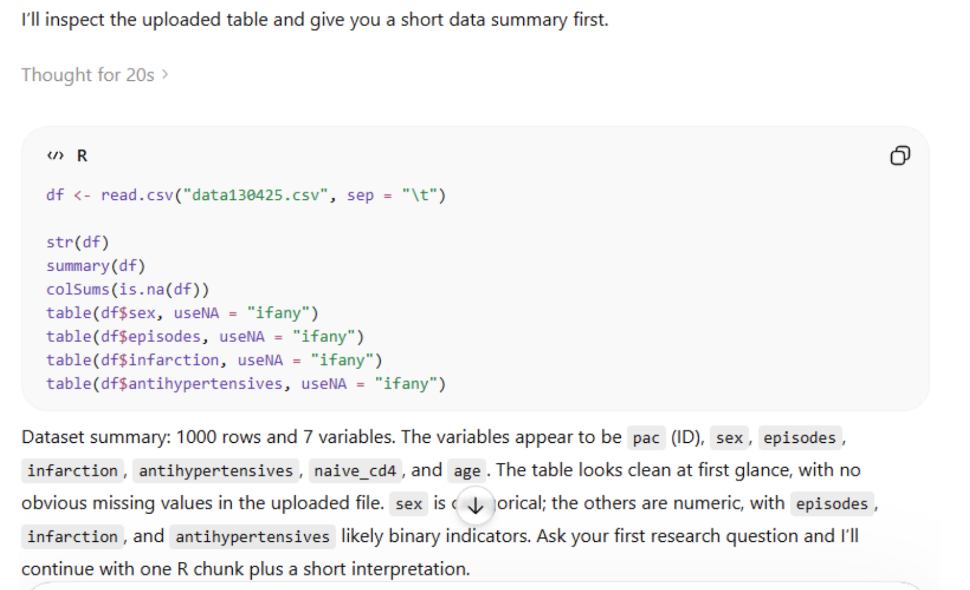
Data Upload + Summary
The LLM inspects the uploaded table, identifies variable types, and reports a clean summary
Agentic Systems in Biomedicine
4 / 6

Slide 5
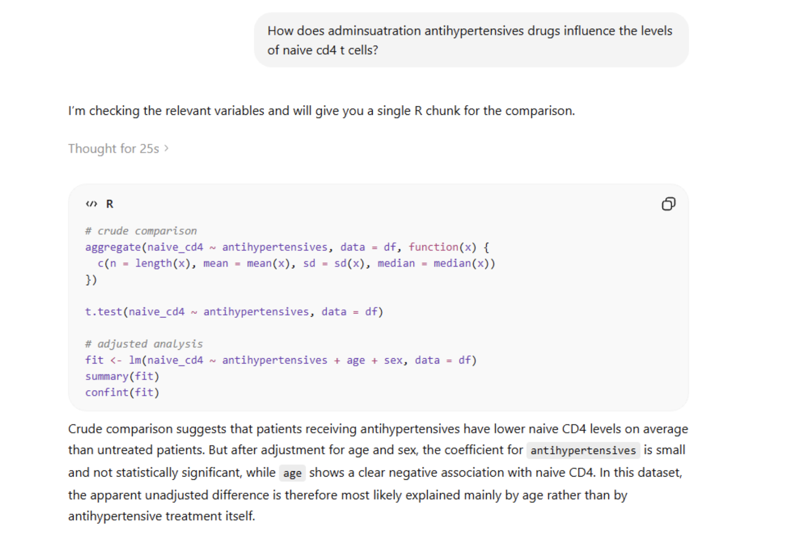
Research Question + Initial Analysis
User asks about antihypertensives and CD4 levels — the model runs crude + adjusted analyses
Agentic Systems in Biomedicine
5 / 6

Slide 6
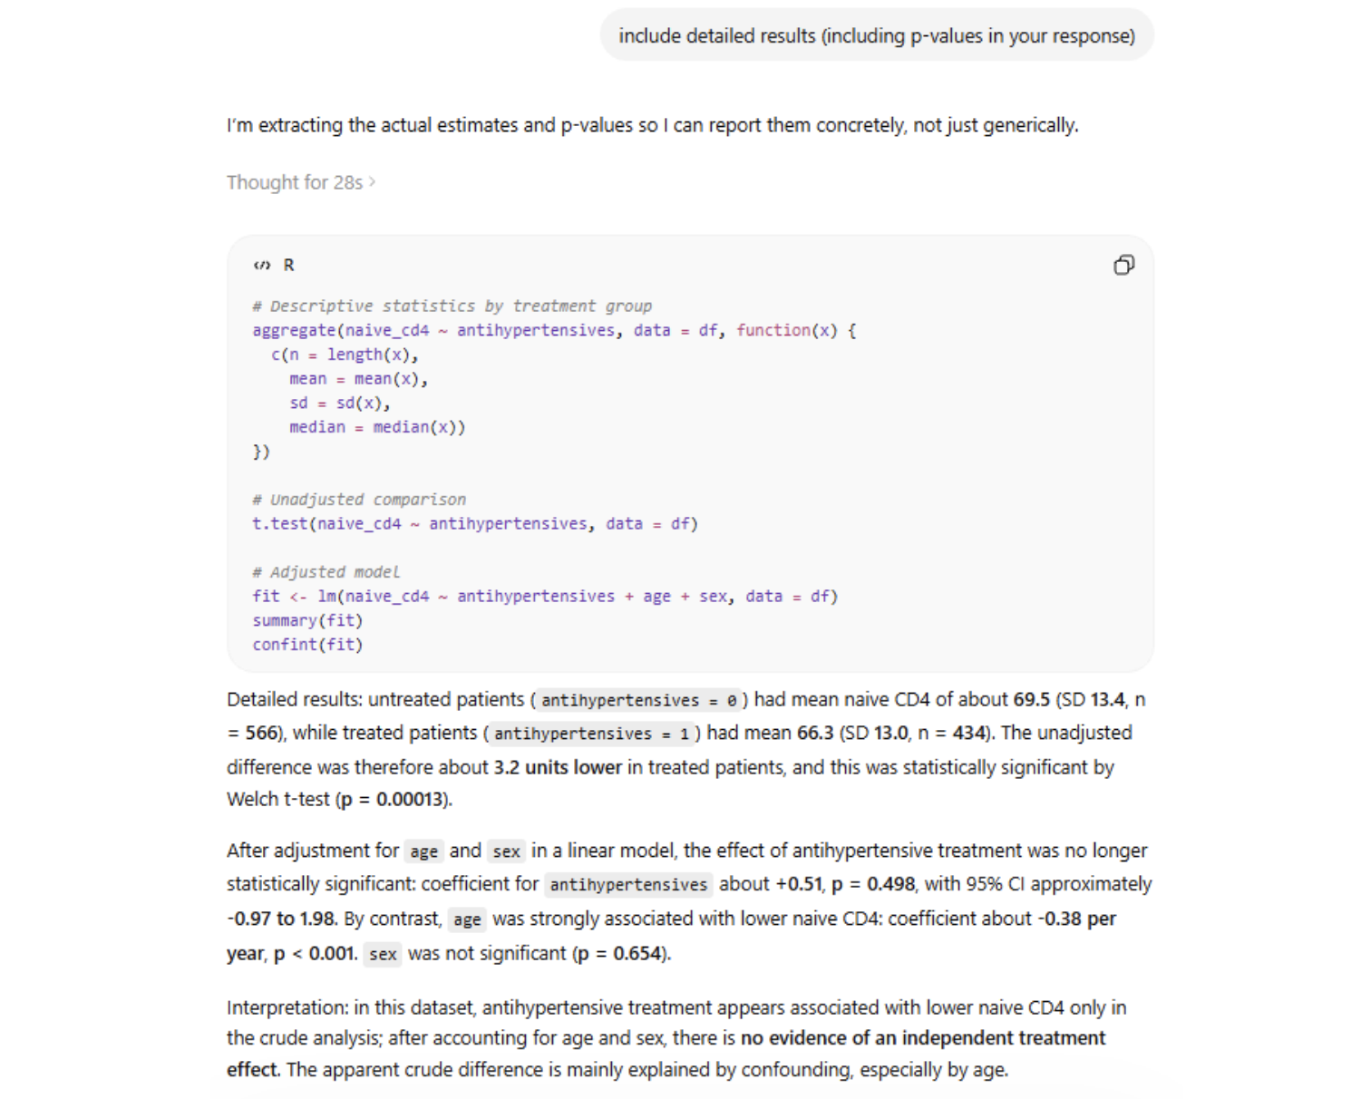
Detailed Results + Interpretation
After adjustment for age and sex, the apparent treatment effect vanishes — age is the confounder
Agentic Systems in Biomedicine
6 / 6

