Slide 1
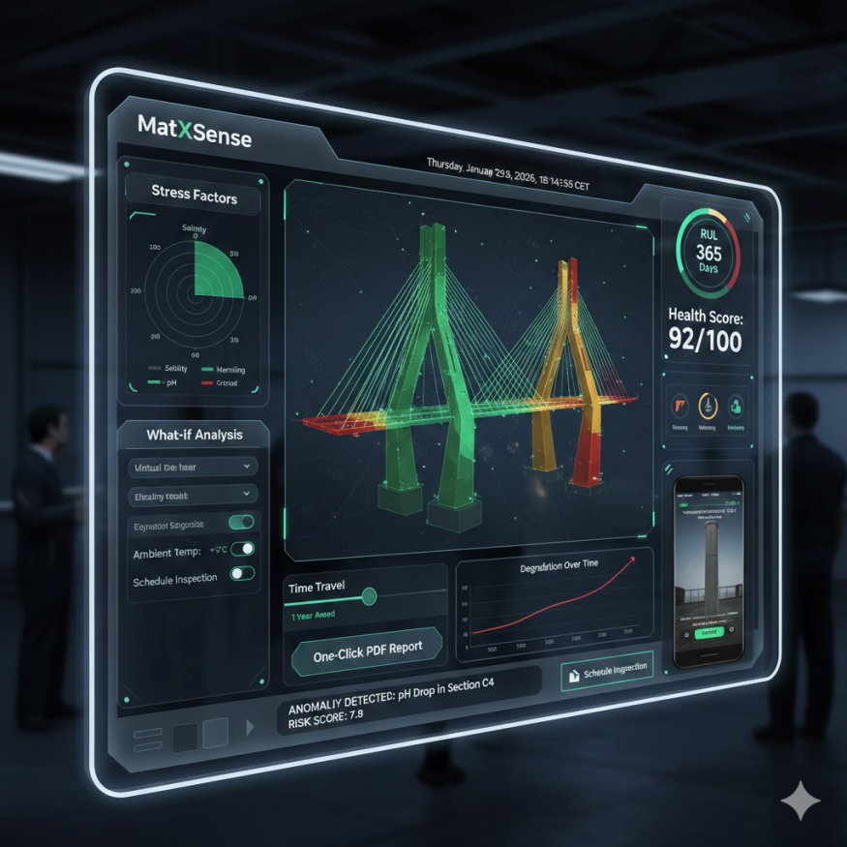
MatXSense: Predictive Digital Twin for Material Integrity
.Chemistry + Material Science + Machine Learning + IoT

Slide 2



Problem Statement
Materials like steel, concrete, and polymers degrade silently due to environmental exposure. Current monitoring is expensive and reactive.
The Silent Threat
High Costs & Risks
Reactive Approach
Materials degrade unseen, leading to catastrophic failures due to manual inspections
Expensive, infrequent monitoring means late detection and safety hazards.
Current methods respond to failure, rather than preventing it.
By the time damage is visible, failures are costly and risky

Slide 3





How It Works
Blending Chemistry Models with Machine Learning
Chemistry Models
Machine Learning
Predictive Insights
Data Input
We combine material science with cutting-edge AI to forecast degradation.

Slide 4




The MatXSense Advantage
Cost Savings
Enhanced Safety
Sustainability
Reduce unexpected repairs and downtime.
Prevent failures, protect assets and lives.
Optimize material lifespan, minimize waste.

Slide 5
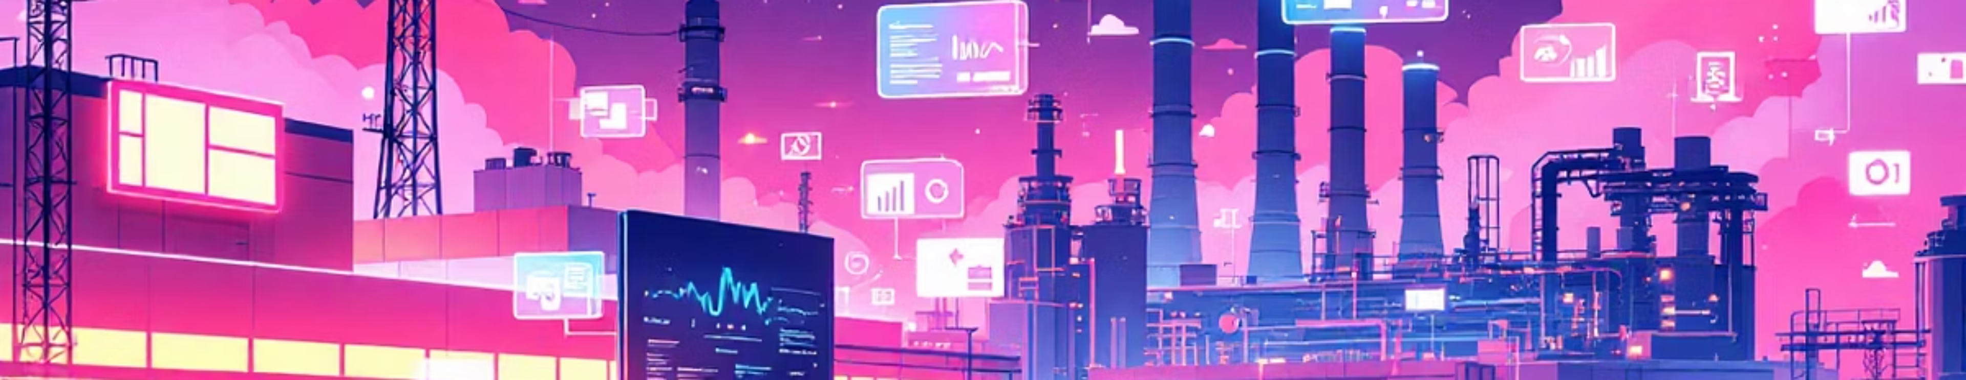
Market Opportunity
Target Industries
Energy & utilities (Oil & Gas, Renewables)
Chemical processing facilities.
Aerospace & Defense
Manufacturing plants & Infrastructure

Slide 6
Competitive Advantage
(Value proposition)
Faster to deploy
Reduced cost
Chemistry informed ML
Designed for emerging markets
Bridges academic digital twins and heavy enterprise

Slide 7



INNORICA
Martin Chauke
Hamza
Romualdo Sebany
CS student @ USTHB
Python Developer
ML/Data Science enthusiast
Electronics Engineer
UI/UX designer, IoT
Software development
lead

Slide 8
QUESTIONS & ANSWER

