Slide 1




This presentation has live demo at the end
MatXSense
Predicting material degradation under chemical and environmental stressors.
Presented By:
Presented To:
Romualdo SEBANY
Martin Chauke
Hamza Abdessamed BOUMAZA
BLAST HACKATON

Slide 2


01 | The problem
02 | Our Solution
03 | Value proposition
04 | Target Audience
07 | Why Invest
08 | Vision
09 | Team
10 | Contacts
Agenda

Slide 3

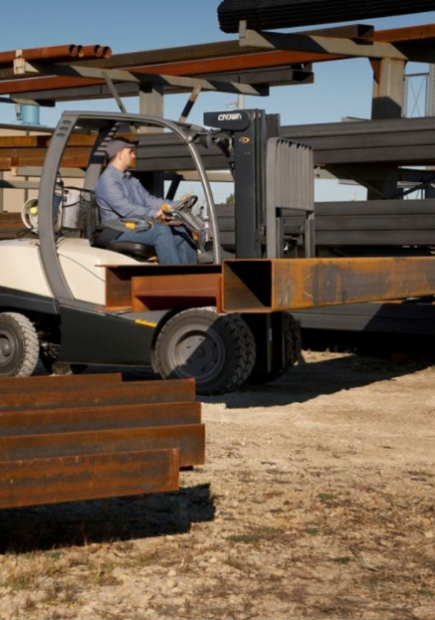
01
Unexpected equipment
failures
03/10
02
Manuel inspections ( slow + expensive )
The problem
Heavy industries in Algeria :
cement;
chemical plants,
mineral processing,
pipeline
03
Corrosion from humidity, salinity, pH & temperature
04
Production downtime

Slide 4


04/10
Our Solution
AI-Powered Digital Twin Platform
# 2
Predict degradation & Remaining Useful Life ( RUL )
# 1
# 4
Real-time sensor monitoring
# 3
Early warning alerts
maintenance optimization

Slide 5
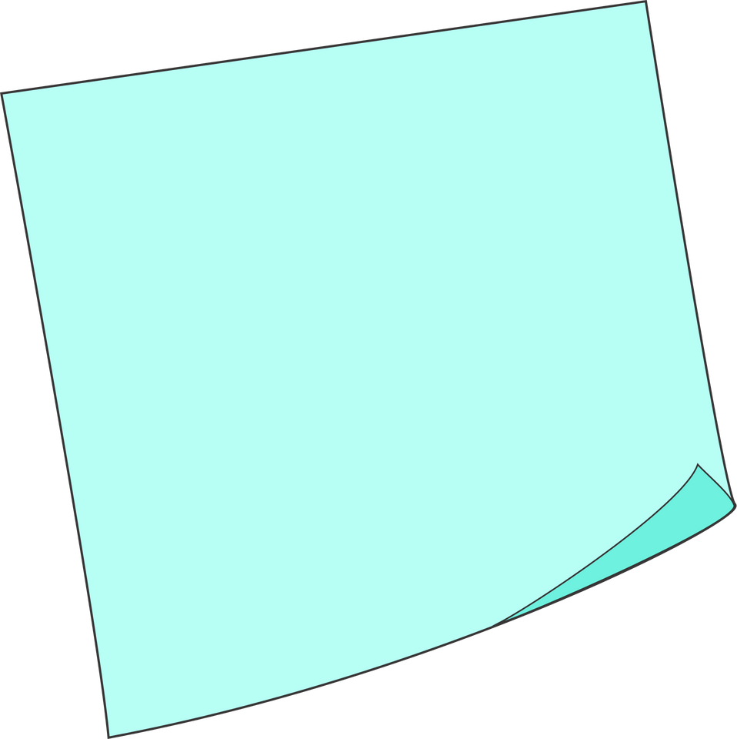
Value Proposition
05/10
For factories :
#1 Reduce downtime
“ We don’t wait for materials to fail, we predict when chemistry says they will. “
#2 Lower maintenance costs
#3 Extend equipment lifetime
#4 Improve safety
#5 Increase production uptime

Slide 6
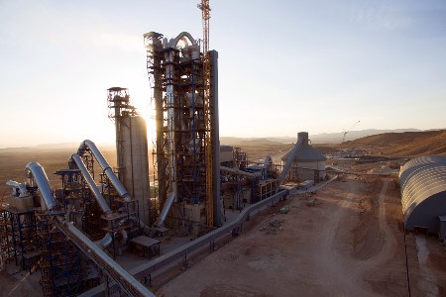

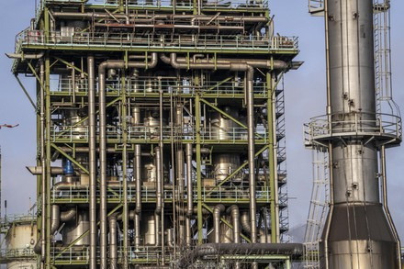
06/10
Target Audience

Slide 7
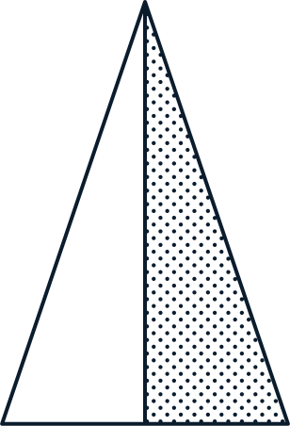


How do we make money ?
07/10
1st
2nd
3rd
4th
Saas Subscription
Sensor
+
deployement setup
premium analytics modules
enterprise integrations

Slide 8
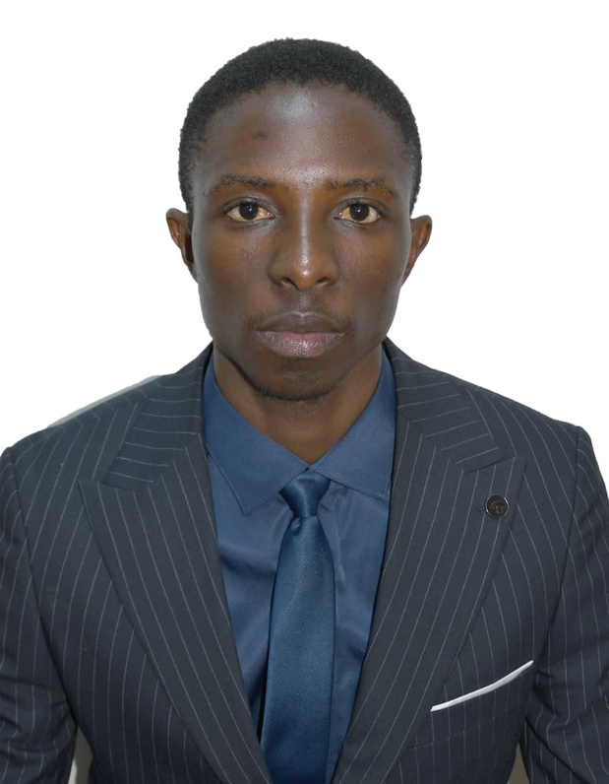
08/10
Message from project founder
Solving a real industrial pain point in as fast-growing industry 4.0 market with a recurring revenue model and strong technical barries ( AI + chemistry + IoT ).
Built to scale across Africa.

Slide 9
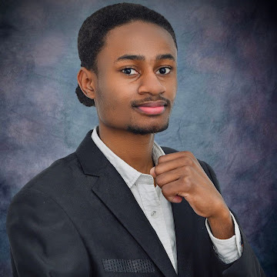
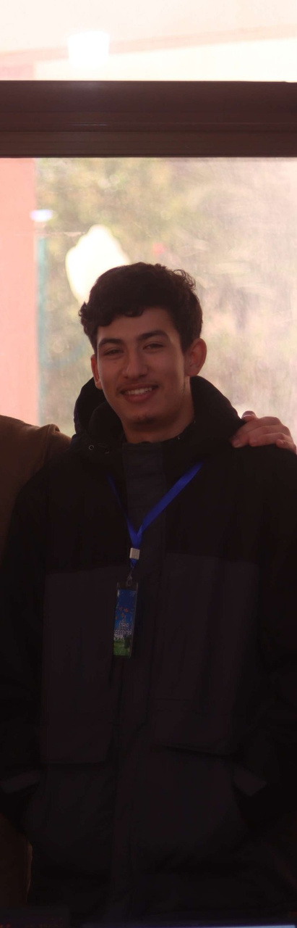

Our team
09/10
Martin Chauke
Romualdo SEBANY
Hamza Abdessamed BOUMAZA
Project Coordinator
AI & Software developer
Electronic designer

Slide 10
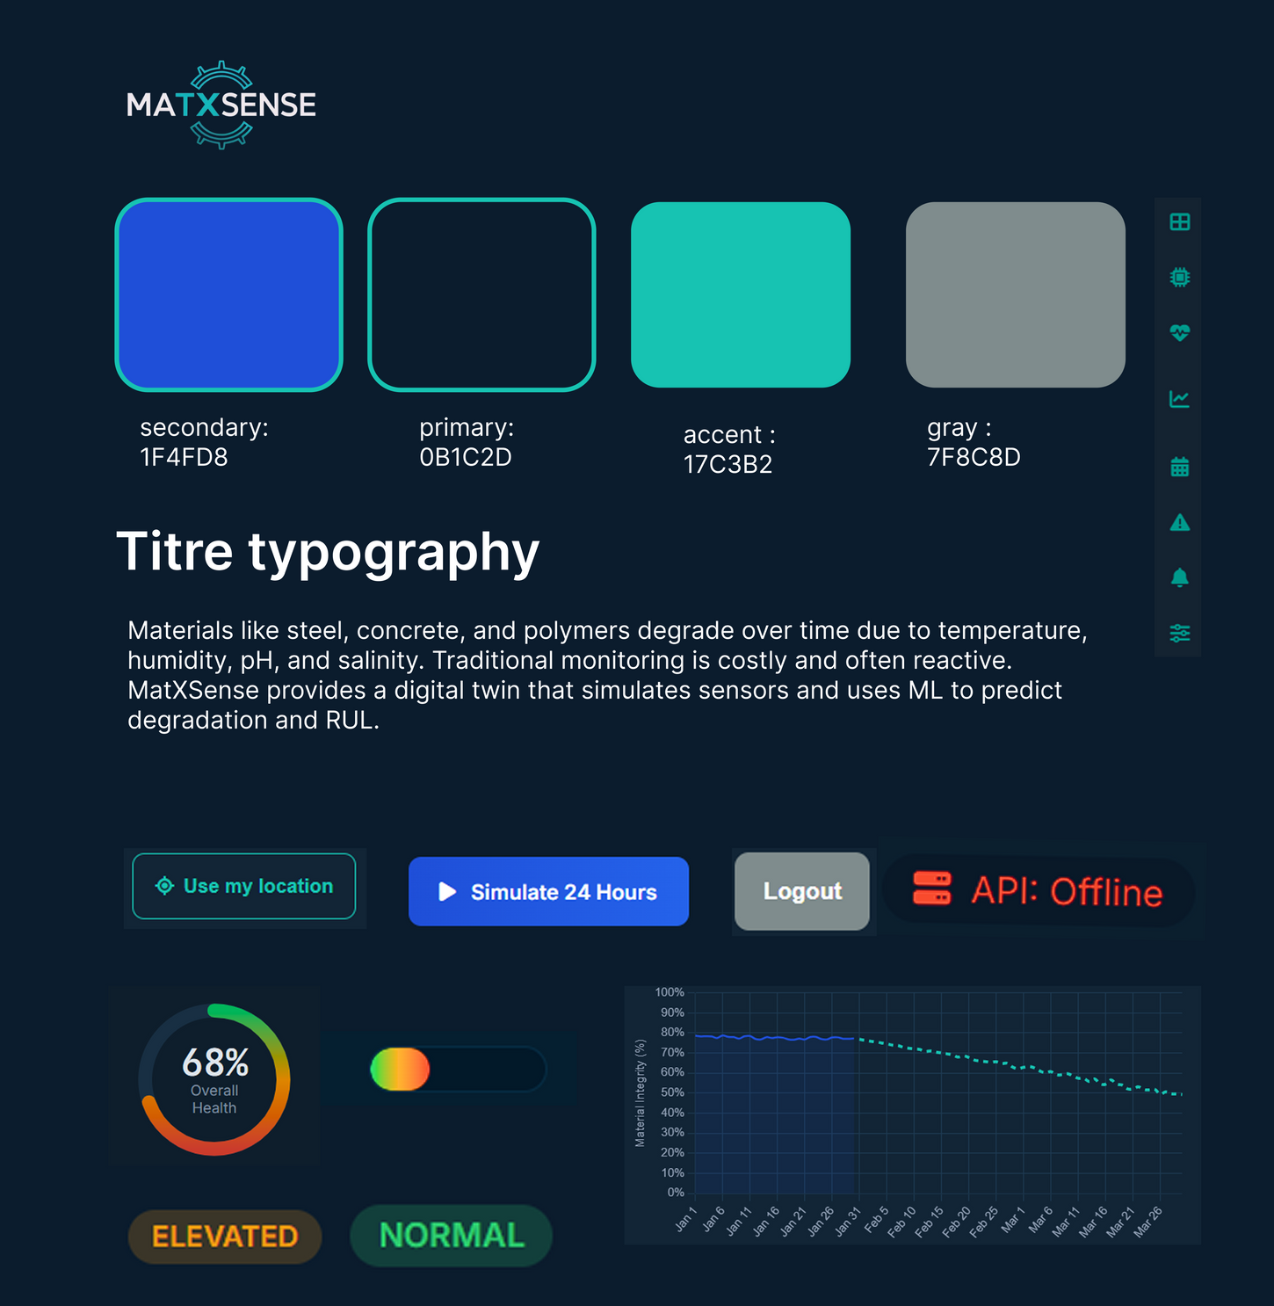
Visual Identity

Slide 11
10/10
Thank you
CONTACT US
E-mail
martinchauke2003@gmail.com
romualdosebany@gmail.com
Social Media
linkedin.com/in/martin-chauke
inkedin.com/in/romualdo-sebany
Phone
+213-554-684-610
213-655-871-889
Address
123 Anywhere St., Any City, ST 12345
City 2 University Blida 1, Algeria

