Slide 1
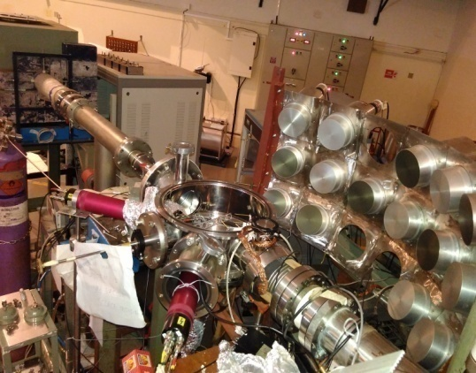
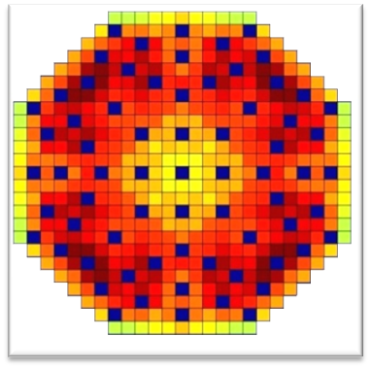

Advisory Committee
Srikumar Banerjee, BARC
B. K. Dutta, HBNI
S. M. Sharma, BARC
S. Kailas, BARC
S. Ganesan, BARC
P. D. Krishnani, NDPCI
Saibal Basu, BARC
NDPCI - BRNS School
on
Nuclear Reactions and Applications
2 - 12 November, 2016
Participation and Important
Dates
Participants desiring to attend the school may send their applications through proper channel to the secretary of the school by 15st Aug. 2016.
Selection of participants will be intimated by 31st August, 2016.
Accommodation will be provided to all out station participants. Travel assistance will be provided to few selected student participants.
Neutron Array Setup
Technical Programme Committee
Alok Saxena, NPD, BARC (Chairman)
Umasankari K., RPDD, BARC (Convener)
B. K. Nayak, NPD, BARC
K. Devan, IGCAR
M. P. S. Fernando, NPCIL
Mala N. Rao, SSPD, BARC
Gopal Mukerjee, VECC
G. Pandikumar, RSDD, IGCAR
R. G. Thomas, NPD, BARC
Rajeev Kumar, RPDD, BARC
Devesh Raj, RPDD, BARC
Kapil Deo, RPDD, BARC
Debanik Roy, BRNS
Raman Sehgal, NPD, BARC
S. V. Suryanarayana, NPD, BARC
Convener
Dr. Umasankari Kannan
RPDD, BARC, Mumbai - 400085
uma_k@barc.gov.in
Tel: +91-22-25595305
Secretary
Dr. S. V. Suryanarayana
NPD, BARC, Mumbai - 400085
snarayan@barc.gov.in
Tel: +91-22-25593662
Link: www.*****
AHWR Core
Multipurpose Hall, TSH
Anushaktinagar, Mumbai-400094
Organized by:
Nuclear Data Physics Centre of India
Bhabha Atomic Research Centre
Notes:
1

Slide 2
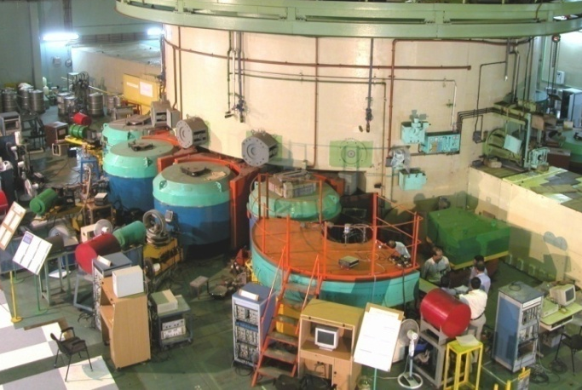
Background
Nuclear energy is going to play a major role to satisfy the ever increasing global demand of energy. Advanced energy systems will have to address several aspects such as safety, management of long lived wastes and proliferation resistance of fuels. Internationally, several efforts are underway towards the development of advanced nuclear systems that would use more efficiently the uranium and thorium resources, and produce a minimal amount of long-lived nuclear waste.
The design of the advanced nuclear system requires research and development in numerous fields. Nuclear Data Physics Centre of India (NDPCI) is a body established for co-ordinating all the nuclear data physics activities from lab to application to users.
The success of the advanced reactor systems strongly depends on the physics inputs in terms of basic nuclear data. Recently, there have been several developments in the field of nuclear data physics worldwide. It would be appropriate to review the status in pace with the recent advances in the field. The deliberations in the school would be multi fold like revisiting the fundamentals, updating the knowledge and directions for the future work.
At this juncture, a school on “Nuclear Reactions And Applications” will give a platform for exchanging information on the nuclear data physics aspects such as neutron scattering, neutron induced reactions and applications for advanced reactor design.
Spectrometers in Dhruva Reactor
for Condensed Matter Research
Topics to be covered
Theory of compound nucleus reactions.
Experimental study on neutron induced reaction cross sections using n_TOF method.
Error analysis of the experimental data.
Evaluation and processing of the nuclear data.
Neutron scattering for condensed matter application
Special talks on nuclear data and applications.
Notes:
2

