Slide 1
Introductory talk on Geant4
Raman Sehgal
Nuclear Physics Division
(BARC, Mumbai)
rsehgal@barc.gov.in
sc.ramansehgal@gmail.com

Slide 2
Things to be discussed
1) Quick Brushup of OOPs in C++
2) Geometries in Geant4
3) Structure of Geant4 application

Slide 3
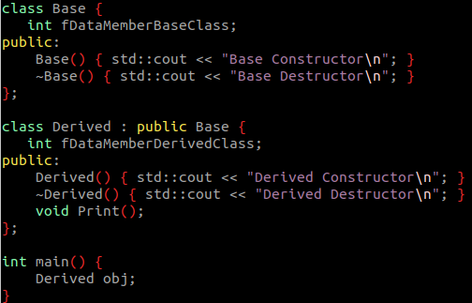
Quick Brush up of C++
1) Class is basically a user-defined data type
2) The variables of class is known as objects
3) Class contains following
(a) Data members :
(b) Member functions:
4) Constructor : A special function without any return
type and is called automaticallyupon creation of
objects of class
5) Construct can be default (without any parameters), or parameterized constructor.
6) Its always a good practice to define constructor.
These are used to set the data member upon creation
Of object.
Base
The variable defined inside the class
The functions that operates on those variables
Derived

Slide 4
10) Two types of classes are there:
(a) Abstract classes : Objects CAN’T be instantiated
(b) Concrete classes : Object CAN be instantiated
13) It is mandatory to implement all the pure virtual function in derived class,
otherwise the derived class itself become an Abstract class
14) Pointers of base class can hold the reference to the object of base class
(A very important concept, which is extremely used while write Geant4 simulation code)
Base *ptr = new Derived; // base class holding object of derived class
Derived *derivedPtr = static_cast<Derived*>(basePtr) //casting the base class pointer to derived class

Slide 5
Code snippet to demonstrate Abstract and Concrete class
class Square : public Shape {
double side;
public:
Square(double s){
side = s;
}
void Draw() {
std::cout << "Drawing Circle\n";
}
void Area() {
std::cout << "Area : " << (side*side) << std::endl;
}
};
int main(){
//Shape s ;
//Not allowed as it is a abstract class
Square s(4);
s.Area();
return 0;
}
class Shape {
public:
virtual void Area() = 0; // Pure virtual function
};

Slide 6
Geometry in Geant4 (Things to be discussed)
1) Steps involved to create the detector geometries
2) Some of the complex geometries available in Geant4
3) Discussion of “Materials” in brief.
4) Geometry hierarchy in a detector setup.
5) How to import / export the geometry
6) Use of GDML

Slide 7
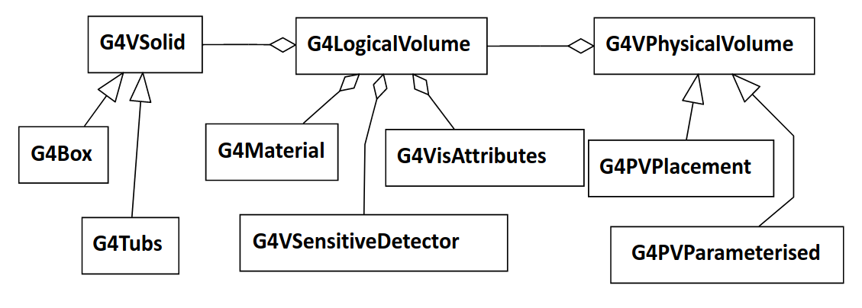
Software architecture of Detector geometry
Basically consist of three layers
1) Solid (Shape) : G4VSolid : Defines the shape and size of the geometry
2) Logical Volume : G4LogicalVolume : material, sensitivity, visualization
attributes, physical placement of daughter volumes etc.
3) Physically place volume : G4VPhysicalVolume : defines position, rotatation,
and mother volume

Slide 8
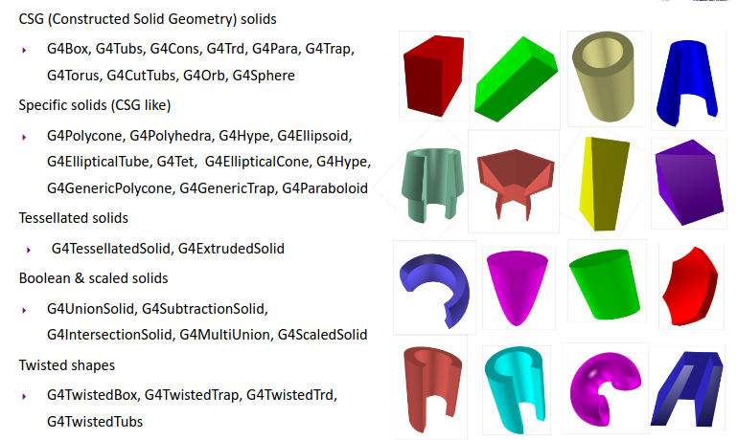
Various Shapes available in Geant4
Computing volumes and weights
• Geometrical volume of a generic solid or boolean composition can be
computed from the solid volume:
G4double GetCubicVolume();
– Exact volume is determinatively calculated for most of CSG solids, while
estimation based on Monte Carlo integration is given for other solids.
• Overall weight of a geometry setup (sub-geometry) can be computed from the
logical volume:
G4double GetMass(G4bool forced=false,
G4bool propagate=true, G4Material* pMaterial=0);
– The computation may require a considerable amount of time, depending
on the complexity of the geometry.
– The return value is cached and reused until forced=true.
– Daughter volumes will be neglected if propagate=false

Slide 9
Concept of Half lengths
10,0
Geant4 geometry works on the concept of half lengths
Suppose we want to create the box of
[10 cm X 20 cm X 30 cm ] : Required dimension
[5 cm X 10 cm X 15 cm ] : Specified Half length
Same concept is applicable to all the geometries
Cone, Tube, etc.
-5,0
0,0
5,0
-10,0

Slide 10
Cone and Polycone
Worth discussing as they are used in frequently in experiment setup.
Cone is same as tube but having different lower and upper radius.
Polycone is something like connecting various cones and tubes one after the another.
Different constructors exist
G4Polycone("MyPolycone", sPhi, dPhi, numZ, z, rmin, rmax);
double z[8] = {-10., 0., 5., 8., 12., 15., 19, 21};
double rmin[8] = {5., 2., 2., 8., 9, 9, 12., 6};
double rmax[8] = {7., 5., 5., 10., 10, 12, 15, 8};
G4Polycone("LeadBlock",0., 2*M_PI, 8, z, rmin, rmax);

Slide 11
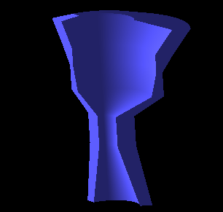


Polycone
double z[8] = {-10., 0., 5., 8., 12., 15., 19, 21};
double rmin[8] = {5., 2., 2., 8., 9, 9, 12., 6};
double rmax[8] = {7., 5., 5., 10., 10, 12, 15, 8};
G4Polycone("LeadBlock",0., 2*M_PI, 8, z, rmin, rmax);

Slide 12
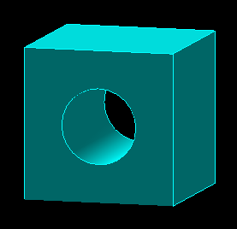

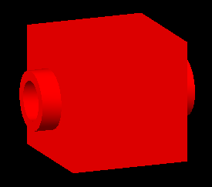
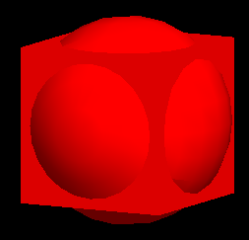
Boolean Operation
G4SubtractionSolid :
Subtraction of one shape from another.
G4SubtractionSolid( const G4String&pName,
G4VSolid* pSolidA ,
G4VSolid* pSolidB ) ;
G4Box boxA("boxA",3*m,3*m,3*m);
G4Orb orb("orbB",4*m);
G4SubtractionSolid subtracted("subtracted_boxes",&boxA,&orb);
G4UnionSolid:
Union of two shapes.
G4UnionSolid( const G4String&pName,
G4VSolid* pSolidA ,
G4VSolid* pSolidB ) ;
G4UnionSolid union("subtracted_boxes",&boxA,&orb);

Slide 13
Defining Materials
Material can be define in two ways :
1) Using the exising NIST database provided by Geant4
-- Contains a lot of material as elements, isotopes and compound.
-- Need an object of NistManger class
-- G4NistManager *nist = G4NistManager::Instance();
-- G4Material *world_mat = nist->FindOrBuildMaterial("G4_AIR");
(G4_Pb, G4_Al, G4_Mg, G4_Na .. etc.)
(G4_BAKELLITE, G4_ANTHRACENE etc..)
2) Making your own material that can be defined using the various
classes available
-- Isotope : G4Isotope
-- Element : G4Element
-- Molecules : G4Material
-- Compound and Mixture : G4Material

Slide 14
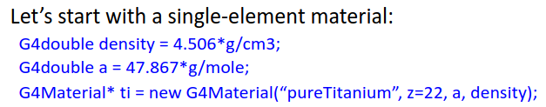
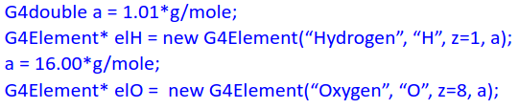
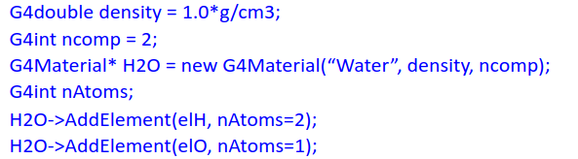
Defining Materials
Creating Elements
Getting Water from NISTManager object
G4Material *world_mat =
nist->FindOrBuildMaterial("G4_WATER");
Finally creating material from elements

Slide 15
Creating Logical Volume and it Physical placement
G4LogicalVolume(G4VSolid* pSolid,
G4Material* pMaterial,
const G4String& name);
G4Box box(“test”, 5*cm, 5*cm, 5*cm);
G4Material Al;
G4LogicalVolume *logicalBox = new G4LogicalVolume(box, Al, “LogicalBox”);
G4PVPlacement(G4RotationMatrix *pRot,
const G4ThreeVector &tlate,
G4LogicalVolume *pLogical,
const G4String& pName,
G4LogicalVolume *pMotherLogical,
G4bool pMany,
G4int pCopyNo,
G4bool pSurfChk=false);
new G4PVPlacement(0,
G4ThreeVector(),
logicalBox,
“PhysicalVolume”,
motherLogicalVol,
false,
0,
true);

Slide 16
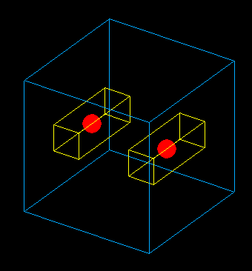
Understanding the Geometry Hierarchy
Raw shapes never forms the part of geometry hierarchy.
Physical placement is alway done for a logical volume.
The geometry hierarchy consist of Mother-Daughter relationship.
One Logical volume contains other Physical Volume daughter volumes
The mother logical volume forms the local coordinate system for all its daughter volumes.
If a mother volume is placed more than once, all its daughter volumes will be there in all physical volumes
Only Exception : World Volume
Its a unique physical volume which contains all the other volume of your detector setup
World volume also forms the global coordinate system.

Slide 17
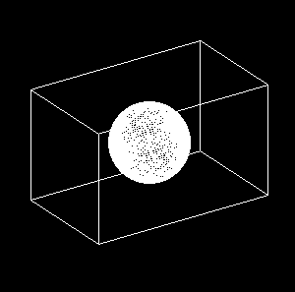
Understanding Physical placement in the Geometry Hierarchy
Both Box and Orb are placed with respect to world reference frame
Box is placed with respect to world reference frame
Orb is place with respect to box reference frame

Slide 18
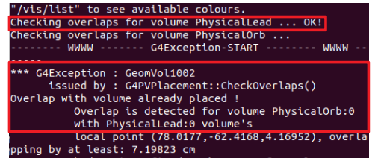
Both Box and Orb are placed with respect to world reference frame

Slide 19
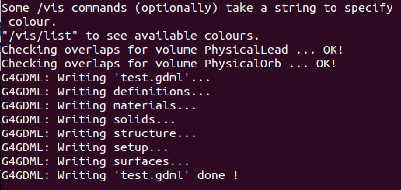
Box is placed with respect to world reference frame
Orb is place with respect to box reference frame

Slide 20
Geometry Hierarchy Tree
World
Complete hierarchy contains 5 shapes
But you had created only 3 shapes.
World, Box and Orb
Mother box contains Orb daughter
Multiple placement of mother box contains all the daugter volumes
Make sure you give proper copy number and name to physical placement
Box_1
Box_2
Orb
Orb

Slide 21
Exporting Geometry
If the same geometry setup needs to be used in multiple simulations or needs to be used by different people
Geant supported geometry export format
GDML (Graphics Description Markup language)
A portable format, similar to XML.
Can be read by standalone application
Various XML reading libraries are present.
Xerces-C is used by Geant4

Slide 22
Moving ahead
Till now, whatever we understood
Defining shapes, logical volume and their physical placement
Define material and attaching them to the shapes to convert them to logical volumes
{
C++
Alternative way to achieve the same thing.
Instead of doing a the detector construction at compile that (as done above),
Idea is to generate it at run time.
Reading a text file (XML)
Benefits : Allows to quickly recreate the full detector construction with very few lines of code

Slide 23
GDML : Graphics Description Markup Language
XML formatted text file.
It implements hierarcy of volumes in a detector setup as the tree of geometries.
Allows to define the material, and place the volumes.
Makes the detector construction portable, and independent of the remaining simulation code.

Slide 24
Benefits of using GDML
Language independent
Containing user defined tags.
Can be processed by any library that can process XML.
Provides hierarchal structure, and mother daughter relationship can be easily maintained.
Hierarchical structure make its suitable for object oriented programming.

Slide 25
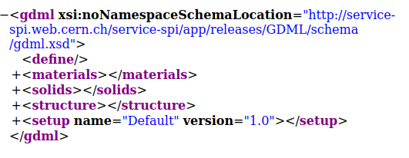
Overview of GDML : Various Components
The flow of a default GDML file follows:
1) Definitions
2) Materials
3) Solids
4) Structures
5) Setup
NOTE : Your internet browser is a very useful tool to have a look at the XML file.

Slide 26
Various GDML Solids
GDML supports all the solids provided by Geant4
Box
Orb
Sphere
Cone
Tube
Parboloid
Ellipsoid
Polyhedro
Polycone
Torus
Trapezoid
Cut Tube
Segment of a Tube
Twisted tube
Extruded Solids
Tesellated Solids
Tetrahedrons
Twisted Generic Trapezoid
Twisted Box

Slide 27
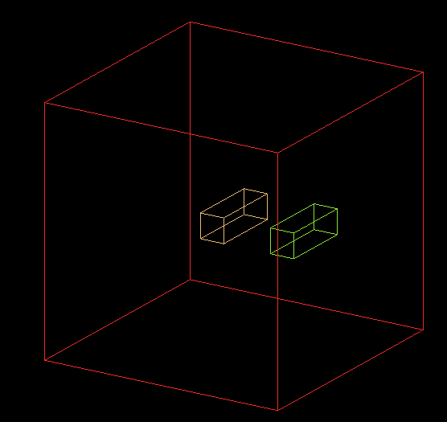
All the pieces of GDML

Slide 28

All the pieces of GDML
<solids> tag of GDML

Slide 29
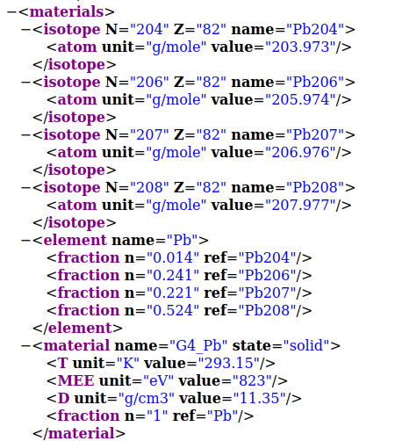
<materials> tag of GDML

Slide 30
<structure> tag of GDML
Structure tag actually defines how different components of detector setup are arranged.
(Actually shows the mother-daughter relatioship)
Both logical and physical volumes are defined in one structure
It show the hierarchy of detector components.
It consist of sequence of volumes tags, that define your logical volumes.
Each volume tag, keeps a pointer to the associated solid and the material.
Structure actually correponds to the your physical detector

Slide 31
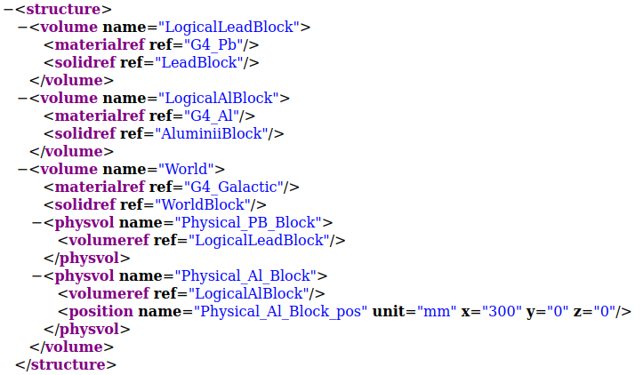
Structures cont...

Slide 32

Finally the <setup> tab
Setup contains the pointer to you world volume.
While creating a detector setup using gdml as an input file, we need to return a pointer to world volume from the “Construct” function of DetectorConstruction file.
It is possible to define multiple geometry setup, and chosing different volumes as world volume.
Moreover, we can actually split this geometry description in multiple file, which allows more granularity, and ease of maintainance.

Slide 33
Exporting/ Importing GDML into Geant4
The GDML files can be imported directly into Geant4, in the detector construction class
Required class : G4GDMLParser : (#include <G4GDMLParser.hh>)
As usual this class contains various functions :
We will focus on Write and Read
An object of “G4GDMLParser” class is required.
G4GDMLParser myGDMLParser;
To export a full detector construction written in C++
myGDMLParser.Write(“geom.gdml”,pointerToPhyWorld);
To import a full detector setup, just do
myGDMLParser.Read(“geom.gdml);
Finally return the pointer to physical world volume to Geant.
return MyGDMLParser.GetWorldVolume()
NOTE : Geant4 needs to be compile with xercesC library

Slide 35
Building Complete GEANT application
-- Basic Structure of Geant4 Code
-- Where to write what

Slide 36
Things to be discussed
Geant4 Analogy of real experiment
Basic structure of the simulation code.
Writing a basic simulation code
Mandatory classes for your simulation code.
-- Implementation of these mandatory classes
Getting the required information out of you simulation
-- Optional classes
-- Implementation of these optional classes

Slide 37
Geant4 Analogy of the real experiment setup
Beam On : As in real experiment the Geant4 run starts with “Beam On”
A run is basically a collection of event.
As in experiment once the run start, user cannot change anything
--> Geometry Setup
--> Physics processes to study
Before starting the run, following things need to be initialized
--> Detector setup (geometry is optimized)
--> Physics List (cross-section tables are calculated, depending upon the materials used in the geometry creation)

Slide 38
Important user classes : Geant4 Program structure
Define your entry point : main() : There is no starting point provided by Geant4.
It is the place where you actually registers different component of you application.
Initialization classes : Classes whose objects needs to initiated before you simulation starts.
Detector : G4VUserDetectorConstruction
Physics : G4VUserPhysicsList / Existing or Implemented
UserActions : G4VUserActionInitialization
Action classes :
instantiated in the G4VUserActionInitialization
The action classes are invoked during the event loop : ie. When you simulation is running.
G4VUserPrimaryGeneratorAction
G4UserRunAction
G4UserEventAction
G4UserStackingAction
G4UserTrackingAction
G4UserSteppingAction
The classes starting with G4V are abstract classes.
Their objects can’t be created.
They are there to provide a skeleton required by Geant4
User needs to inherit these classes, and to implement few functions which are mandatory.

Slide 39
Creation of your DetectorConstruction : G4VUserDetectorConstruction
class G4VUserDetectorConstruction
{
public:
G4VUserDetectorConstruction();
virtual ~G4VUserDetectorConstruction();
virtual G4VPhysicalVolume* Construct() = 0;
};
class Sim01_DetectorConstruction : public G4VUserDetectorConstruction
{
public:
Sim01_DetectorConstruction(){}
~Sim01_DetectorConstruction(){}
G4VPhysicalVolume* Construct(){
//Write your stuff here
//construct all your materials
//construct all your volumes
//declare you volume as sensitive
}
};
(Pure virtual function)
The Construct method should return the pointer to the world physical volume, which represents your entire geometry setup.

Slide 40
Define your Physics
There is no default particles and physics process that comes automatically in your simulation code.
Not even particle transport.
Derive your own concrete class from G4VUserPhysicsList abstract base class.
– Define all necessary particles
– Define all necessary processes and assign them to proper particles
– Define all the required cut-off ranges
OR use the various physics lists that are already available in GEANT4.
FPFP_BERT (add few more list)

Slide 41
Primary Generator : G4VUserPrimaryGeneratorAction
The second mandatory user class : Controls the generation of primary particles.
--> This is again a abstract class
--> You cannot instantiate it : Will not do anything on its own
class G4VUserPrimaryGeneratorAction
{
G4VUserPrimaryGeneratorAction();
virtual ~G4VUserPrimaryGeneratorAction();
virtual void GeneratePrimaries(G4Event* anEvent) = 0;
};
class Sim01_PrimaryGeneratorAction : public G4VUserPrimaryGeneratorAction
{
G4ParticleGun *fParticleGun;
Sim01_PrimaryGeneratorAction(){}
~Sim01_PrimaryGeneratorAction(){}
void GeneratePrimaries(G4Event*){
fParticleGun->GeneratePrimaryVertex();
}
};
The generate primaries method is called at the beginning of every event.
Your primary generator will not generate any primary particle, until you call GeneratePrimaryVertex() function

Slide 42
Sim01_PrimaryGeneratorAction::Sim01_PrimaryGeneratorAction() {
int numOfParticle = 1;
fParticleGun = new G4ParticleGun(numOfParticle);
G4ParticleTable *particleTable = G4ParticleTable::GetParticleTable();
G4ParticleDefinition *particle = particleTable->FindParticle("mu-");
fParticleGun->SetParticleDefinition(particle);
fParticleGun->SetParticleMomentumDirection(G4ThreeVector(0.,0.,-1.));
fParticleGun->SetParticleEnergy(3.*GeV);
fParticleGun->SetParticlePosition(G4ThreeVector(0.,0.,30.*cm));
}
Called only once
void Sim01_PrimaryGeneratorAction::GeneratePrimaries(G4Event *event) {
fParticleGun->SetParticleMomentumDirection(G4RandomDirection());
fParticleGun->GeneratePrimaryVertex(event);
}
Called in the beginning of every event

Slide 43
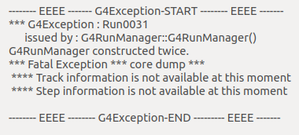
Run Manager : G4RunManager
One of the manager class in Geant4 .
Helps in linking various objects and modules required during the initialization and run.
The program cannot run without the Run Manager.
User can inherit in their derived class to customize the behaviour
G4RunManager or its Derived class must be singleton
--> Only one object should exist in the program’s memory.
Singleton instance helps in accessing the same RunManager object in different locations in the code.

Slide 44
Action Initialization : G4VUserActionInitialization
Basically used to instantiate various classes required during event loop
class Sim01_ActionInitialization : public G4VUserActionInitialization
{
public:
Sim01_ActionInitialization(){}
virtual ~Sim01_ActionInitialization(){}
virtual void BuildForMaster() const{}
virtual void Build() const{
// Link the objects of classes invoked
during the event loop
// EventAction, SteppingAction
}
};
class G4VUserActionInitialization
{
G4VUserActionInitialization();
virtual ~G4VUserActionInitialization();
virtual void Build() const = 0;
}

Slide 45
Structure of main() function
Define your entry point : main() :The place where you actually registers different components of your application.
Things TODO:
1) Instantiate your RunManager
2) Instantiate your DetectorConstruction
3) Instantiate your PhysicsList
4) Instantiate your ActionInitialization
5) Run your code
Optional
6) Instantiate your Visualization Manager
Int main(){
G4RunManager *runManager = new G4RunManager;
DetectorConstruction *det = new DetectorConstruction();
G4VModularPhysicsList *physicsList = new FTFP_BERT;
ActionInitialization *actIni = new ActionInitialization();
runManager->SetUserInitialization(det);
runManager->SetUserInitialization(physicsList);
runManager->SetUserInitialization(actIni);
G4UImanager *UImanager = G4UImanager::GetUIpointer();
Uimanager->ApplyCommand(“/control/execute Run.mac”);
}
Run.mac
/run/initialize
/run/beamOn 100

Slide 46
Our program is running : Where is the output ??
Geant4 runs the full simulation silently.
The required information needs to extracted.
Just to see what going on :
--> use UI commands : /tracking/verbose 1
This will basically start printing all the tracking information.
--> Particle information (location, direction etc.)
--> Step information
--> Energy loss
--> Associated volume
--> TrackId

Slide 47
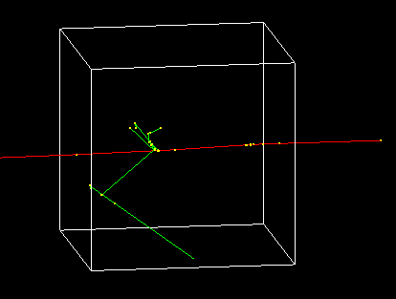
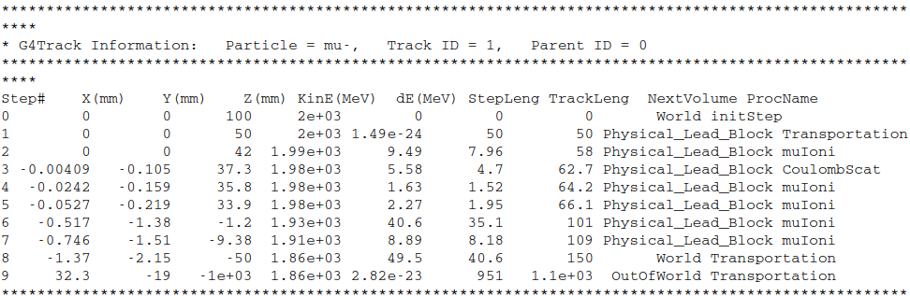

Slide 48
Managers Classes in Geant4
Geants provides a lot of Manager classes
G4RunManager::GetRunManager() : Gives you access to the Run related information
G4EventManager::GetEventManager() : Gives you access to the Event related information
G4SDManager::GetSDMpointer() : Gives you access to Sensitive detector manager
G4NistManager::Instance() : Gives access to Material database
G4AnalysisManger::Instance() : Gives access to pointer to Analysis manager
All these are singleton classes : Only one object exist during the life cycle of simulation
Beauty is that they can be called anytime and anywhere in the simulation
Other manager which needs to access by using the pointer from simulation
G4TrackingManager : Gives you access to the Track related information
G4SteppingManger : Gives you access to the Steps related information
G4StackManager : Gives you access to the Stacking related information

Slide 49
Geant4 Classes to get the information from the simulations
Information can be fetched at different levels, depending upon the requirements.
--> Run level information (G4UserRunAction)
--> Event level information (G4UserEventAction)
--> Step level information (G4UserSteppingAction)
--> Few more are also there.
--> Storing the data from simulation to ROOT files.
These will be discussed in detail in the coming talks.

Slide 50
Thanks for your attention

