Slide 1

Basic Structure of the Geant4 Simulation Toolkit
http://cern.ch/geant4
The full set of lecture notes of this Geant4 Course is available at
http://www.ge.infn.it/geant4/events/pisa_jan2006/geant4course.html

Slide 2

Contents
Geant4 packages and kernel
  major functions
  organization and architecture
Tracking and processes
  how tracking is done
  overview of processes
User classes
System of units, intercoms, environment variables
1

Slide 3
Geant4 Kernel
Provides central functionality of the toolkit
  handles runs, events, tracks, steps, hits, trajectories
  implements Geant4 as a state machine
  provides a framework for:
    physics processes
    visualization drivers
    GUIs
    persistency
    histogramming/analysis
    user code
1

Slide 4

Run
A run is a collection of events which are produced under identical conditions
Within a run, user cannot change:
  Detector or apparatus geometry
  Physics process settings
By analogy to high energy physics a Geant4 run begins with the command “BeamOn”
  Detector is inaccessible once beam is on
At beginning of run:
  Geometry is optimized for navigation
  Cross sections are calculated according to materials in setup
  Low-energy cutoff values are defined
1

Slide 5

Event
At beginning of processing, an event contains primary particles (from generator, particle gun, ...), which are pushed onto a stack
During processing, each particle is popped from the stack and tracked.
When the stack is empty, processing of the event is over
The class G4Event represents an event
At the end of processing it has the following objects:
  List of primary vertices and particles (the input)
  Hits collections
  Trajectory collections (optional)
  Digitizations collections (optional)
1

Slide 6
Track
A track is a snapshot of a particle within its environment
  as the particle moves, the quantities in the snapshot change
  at any particular instance, a track has position, physical quantities
  it is not a collection of steps
Track object lifetime
  created by a generator or physics process (e.g. decay)
  deleted when it:
    leaves world volume
    disappears (particle decays or is absorbed)
    goes to zero energy and no “at rest” process is defined
    user kills it
No track object survives the end of an event (not persistent)
  User must take action to store track record in trajectory
1

Slide 7
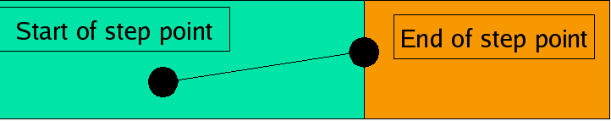

Step
The step is the basic unit of simulation
  Has two points (pre-step, post-step)
  Contains the incremental particle information (energy loss, elapsed time, etc.)
  Each point contains volume and material information
  If step is limited by a boundary, the end point stands exactly on the boundary, but is logically part of next volume
  Hence boundary processes such as refraction and transition radiation can be simulated
1

Slide 8
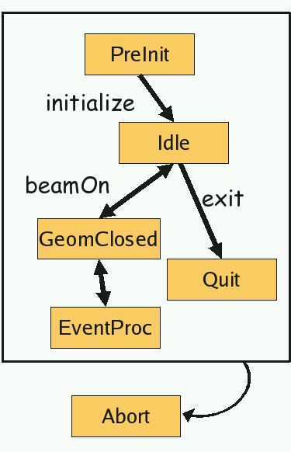

Geant4 as a State Machine
Geant4 has six application states
G4State_PreInit: initialization, definition of geometry, material, particles and physics
G4State_Idle: may start run or modify geometry/physics for next run
G4State_GeomClosed: geometry is optimized, cross section tables updated, ready to process event
G4State_EventProc: an event is being processed
G4State_Quit: normal termination
G4State_Abort: fatal exception and program is aborting
D
1

Slide 9
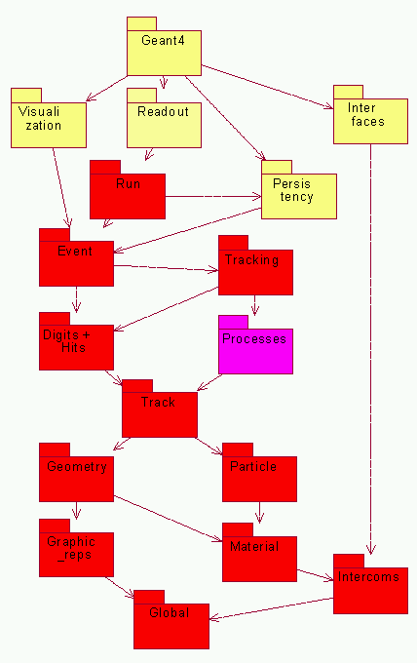
Geant4 Categories
Geant4 consists of 17 categories
  Each is independently developed and maintained by a working group
Categories designed to minimize dependence
  Geant4 kernel consists of categories in red
D
1

Slide 10
Tracking and Processes
Geant4 tracking is general
  It is independent of:
    the particle type
    the physics processes assigned to the particle
  It enables all processes to:
    contribute to the determination of the step length
    contribute to any possible changes in physical quantities of the track
    generate secondary particles
    suggest changes in the state of the track (e.g. to suspend, postpone or kill)
1

Slide 11
Processes in Geant4
All the work of particle decays and interactions is done by processes
  Particle transportation is also a process; the particle can interact with geometrical boundaries and any kind of field
  There is also a shower parameterization process which can take over from transportation
Each particle has its own list of applicable processes. At the beginning of each step, all of these processes are queried for a proposed physical interaction length
The process with the shortest proposed length (in space-time) is the one that occurs
  The chosen process also limits the step size
1

Slide 12
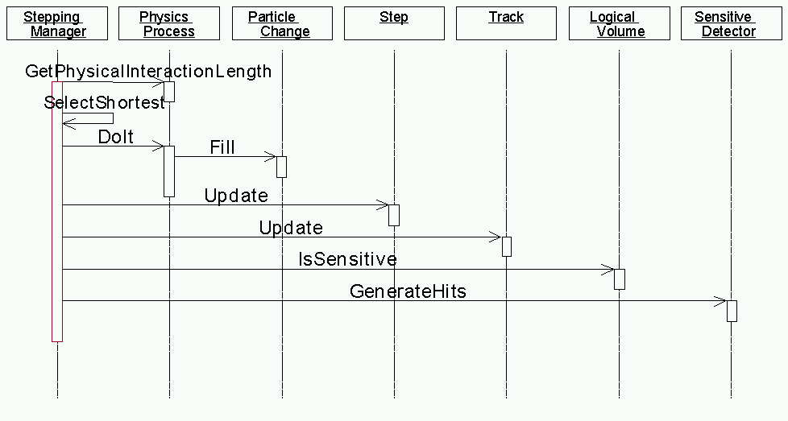
How Geant4 Runs (one step)
D
1

Slide 13
Cuts in Geant4
A “cut” in Geant4 is really a production threshold
  Only applies to physics processes which have infrared divergence
  It is not a tracking cut
An energy threshold must be determined at which discrete energy loss is replaced by continuous energy loss
  old way:
    track primary until cut-off is reached, calculate continuous energy loss and dump it at that point, stop tracking primary
    above cut-off create secondaries, below cut-off add to continuous energy loss of primary
  Geant4 way:
    Specify range (which is converted to energy for each material) at which continuous energy loss begins, track primary down to zero range
    above specified range create secondaries, below range add to continuous energy loss of primary
1

Slide 14
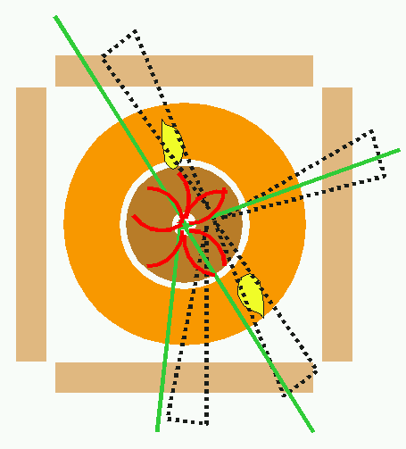

Track Stacking
G4Track is a class object -> easy to suspend or postpone tracks
Example:
  Suspend tracks at entrance to calorimeter, i.e. simulate all tracks in tracking region before generating showers
  Suspend “looper” tracks or abort or postpone them to next event
Stacking allows prioritized tracking without a perfomance penalty
Well thought-out prioritization or abortion of tracks/events make simulation more efficient
D
1

Slide 15
User Classes
Use these classes to build your application on top of the Geant4 toolkit (class names in red are mandatory)
Initialization classes
  G4VUserDetectorConstruction
  G4VUserPhysicsList
Action classes
  G4VUserPrimaryGeneratorAction
  G4UserRunAction
  G4UserEventAction
  G4UserStackingAction
  G4UserTrackingAction
  G4UserSteppingAction
Main() - not provided by Geant4
1

Slide 16
Describe Your Detector
Derive your own concrete class from G4VUserDetectorConstruction
In the virtual method Construct(),
  assemble all necessary materials
  build the volumes of your detector geometry
  construct sensitive detector classes and assign them to the detector volumes
Optionally you may define:
  regions for any part of your detector (for production ranges)
  visualization attributes of detector elements
  magnetic (or other) fields
1

Slide 17
Select Physics Processes
Geant4 does not have any default particles or processes
  even particle transporation must be explicitly defined by user
Derive your own concrete class from G4VUserPhysicsList abstract base class
  define all necessary particles
  define all necessary processes and assign them to the proper particles
  define production threshold (cutoff) ranges and assign them to world volume and each region
Geant4 provides many utility classes/methods to assist in the above tasks
Example (educated guess) physics lists exist for EM and hadronic physics
1

Slide 18
Generate Primary Event
For each event, user must define all details of initial particle
Derive concrete class from G4VUserPrimaryGeneratorAction abstract base class
Geant4 provides several ways to do this:
  derive your own generator from G4VPrimaryGenerator
  use provided generators:
    G4ParticleGun (user provides number, energy, direction, type)
    G4HEPEvtInterface, G4HepMCInterface (interfaces to high energy generator programs)
    G4GeneralParticleSource (mostly for radioactivity)
1

Slide 19

User Action Classes
G4UserRunAction
  BeginOfRunAction (define histograms)
  EndOfRunAction (fill histograms)
G4UserEventAction
  BeginOfEventAction (event selection)
  EndOfEventAction (analyze event)
G4UserTrackingAction
  PreUserTrackingAction (create user defined trajectory)
  PostUserTrackingAction
G4UserSteppingAction
  UserSteppingAction (kill, suspend, postpone track)
G4UserStackingAction
  PrepareNewEvent (reset priority control)
  ClassifyNewTrack
    invoked when new track is pushed
    can set track as urgent, waiting, postpone or kill
  NewStage
    invoked when urgent stack is empty
    event filtering
1

Slide 20
The main() Program
Geant4 does not provide main()
  However, many examples are provided in the Application Developers Guide
In main(), you must:
  Construct G4RunManager (or a class derived from it)
  Provide to G4RunManager pointers to mandatory user classes:
    G4VUserDetectorConstruction
    G4VUserPhysicsList
    G4VUserPrimaryGeneratorAction
Other classes which can be defined in main()
  VisManager
  (G)UI session
  Optional user classes
1

Slide 21
Setting Up a User Interface Session
Geant4 provides several G4UISession concrete classes
  Select the one that is appropriate for your computing envirnoment
  In main(), construct one of them
  Invoke its sessionStart() method
UI sessions provided:
  G4UIterminal – C- and TC-shell like character terminal
  G4GAG – Tcl/Tk of Java PVM based GUI
  G4JAG – interface to JAS (Java Analysis Studio)
  G4UIBatch – batch job with macro file
1

Slide 22
Visualization
Derive your own concrete class from G4VVisManager according to your computing environment
Geant4 provides interfaces to several graphics drivers:
  DAWN – Fukui renderer
  WIRED – event display
  RayTracer – ray tracing by Geant4 tracking
  OpenGL
  OpenInventor
  VRML
1

Slide 23
Manager Classes
Managers classes broker transactions between objects within a category and communicate with other managers
They are singletons
The user will have the most contact with G4RunManager
  Must register detector geometry, physics list, particle generator to it
Other manager classes:
  G4EventManager – handles event processing, user actions
  G4TrackingManager – handles tracks, trajectory storage, user actions
  G4SteppingManager – handles steps, physics processes, hit scoring, user actions
  G4VisManager – handles visualization drivers
1

Slide 24
System of Units
Internal units system used in Geant4 is completely hidden from user code and from Geant4 source code implementation
Each hard-coded number must be multiplied by its proper unit
  radius = 10.0 * cm;
  kineticE = 1.0 * GeV;
To retrieve a number, it must be divided by the desired unit:
  G4cout << eDep / MeV;
Most commonly used units are provided , but user can add new ones
With this system, importing/exporting physical quantities is straightforward and source code is more readable
1

Slide 25
Commands/Intercoms
In Geant4, user can define commands and macros to run applications
The Intercoms category handles the framework mechanism of defining and delivering commands
  It is exportable to any other application
  It is independent of other Geant4 categories
  Uses strong type and range checking
    C++ syntax : aCmd -> SetRange(“x>0. && y>0.”);
  Dynamic command definition / activation
  Commands can be hard coded or issued by (G)UI
Macro files are enabled
  Loop, foreach, alias, ...
1

Slide 26
The G4 Prefix
For portability “G4” is prepended to raw C++ type names
  G4int, G4double, ...
  This way Geant4 implements correct type for a given architecture
G4cout and G4cerr are ostream objects defined by Geant4
  G4endl is also provided
Some GUIs are buffer output streams so that they display print-outs on another window or provide storing/editing functionality
  The user should not use std::cout, etc.
Users should not use std::cin for input. Instead use the user-defined commands provided by the intercoms category
  e.g. G4UIcmdWithADouble
1

Slide 27
Environment Variables
To compile, link and run a Geant4-based simulation, the following environment variables must be set:
  G4SYSTEM – operating system (e.g. Linux-g++)
  G4INSTALL – base directory of Geant4 (where the compiled libraries are)
  G4WORKDIR – where you run your application
  CLHEP_BASE_DIR – location of the compiled CLHEP libraries
Variables for physics processes (if those processes are used):
  G4LEVELGAMMADATA – location of photon evaporation data
  G4LEData -- location of cross sections for low energy EM module
  G4RADIOACTIVEDATA – for radioactive decay processes
  NeutronHPCrossSections – location of high precision neutron db
Additional variables for GUI, Visualization, Analysis
1

Slide 28
Summary
The Geant4 toolkit consists of 17 categories, each designed for minimal dependence on the others
The largest unit of a simulation application is the run, which consists in turn of events, tracks, and steps
  a track is a snapshot of a dynamic particle, not a trajectory
Tracking and physics are carried out by processes
Production thresholds and stacking allow for efficient simulation
  Geant4 tracks particles down to zero energy
User classes allow the simulation to be customized
  user must build the apparatus, select the physics
  commands allow user to communicate with simulation
1

