Slide 1
Physics List in Geant4
What is a Physics List (Is it really required ?? )
Various Physics List Interface (usecase depends on the expertise)
UserPhysicsList (Level1 : Write from scratch)
ModularPhysicsList (Level 2 : More convenient to implement)
Prepacked Physics List (Level 3 : Provided by Geant4 Toolkit)
Reference Physics List
How to extend them

Slide 2
What is a Physics List
Setting up the physics environment:
Particles and the associated physics processes
An object of a C++ class, which is responsible of defining following:
Particles used in simulation
Physics process associated with each particle
Is it really required ??
Yes, as it is one the 3 mandatory object that needs to be registered with RunManager
Eventually its just an interface to define physics of your application.
User is supposed to have a good idea of the physics behind the application
Removal of particles and process may lead to incomplete or unpredictable simulation results

Slide 3
Why not all the physics is included by default by Geant4
Will that be a good idea : Yes / No ? NO
There are different model that defines the same interaction.
Some are approximation and some are extremely precise.
Effect on computation time
You actually DON’T need all the particles
Eg. : Study of energy deposition by gamma radiation in NaI
One may not need optical photon and the associated process,
Unless you need to do its photon yield study
or PMT response study.
For these reasons Geant4 does not following integral physics approach rather it follows application based physics approach.

Slide 4
Application based physics approach
Provides
Independent Particles to be used
Independent physics components : Physics process
These components (processes) may be select in the custom physics list defined by user.
One important process that should always be there : Transportation
This must be assigned to all the stable particles
Depending upon the requirement one needs to chose different components.
Results in efficient simulation run.
Sometimes you may afford less accurate calculation, so you may get faster model for a particular interaction

Slide 5
Creating a Physics List
There are three ways
UserPhysicsList : Create from scratch using components (processes) and particles
available in Geant4
ModularPhysicsList : Again going to use existing components and particles but it provides an easy to use interface.
Prepacked Physics List : Use the PhysicsList already existing in Geant4
(A good start point)

Slide 6
UserPhysicsList : Inheritance mechanism of C++ : G4VUserPhysicsList
Utilizes the Inheritance mechanism of C++
Base class : G4VUserPhysicsList
The most basic interface
User needs to specify all the particles that may be used generated during the lifetime of a run.
For each of these particles specify all the associated process
Transportation needs to be attached to all the stable particles.
Not suitable for less experience users
But provides great flexibility.
Hence recommended for advance users.

Slide 7
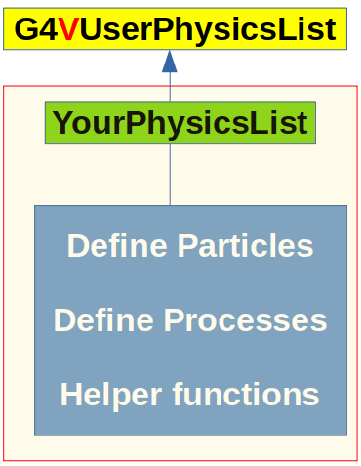
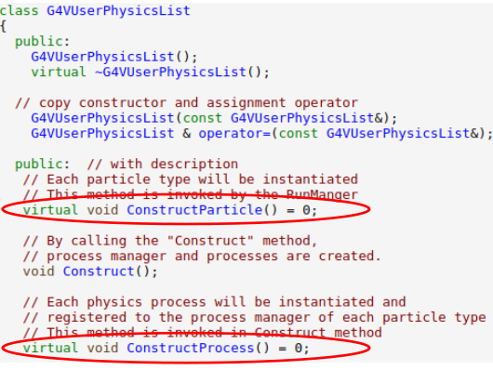
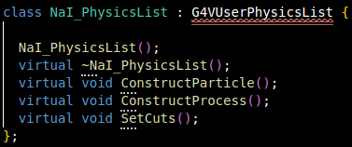
UserPhysicsList : Interface to define Physics List
G4VUserPhysicsList : Defines the interface for Geant4 Physics List.
Recipe to implement you physics list
Inherit the G4VUserPhysicsList in your physics list
Implement the 2 mandatory functions
(Pure virtual functions in G4VPhysicsList)
ConstructParticle()
responsible for creating all the
particles required during simulation
ConstructProcess()
responsible for assigning the required processes with each particle type

Slide 8
UserPhysicsList cont..
Add some snapshots

Slide 9
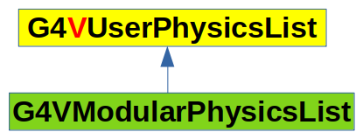
ModularPhysicsList : Inheritance mechanism of C++ : G4VModularPhysicsList
Utilizes the Inheritance mechanism of C++
Base class : G4VModularPhysicsList
G4VModularPhysicsList Class is inherited from G4VUserPhysics List
Different Processes related to particular physics are already attached to respective particles
Electromagnetic Physics: Attach all the particles which undergoes electromagnetic interactions to the corresponding process.
User don’t have to worry for individual particles and the associated processes.
Provide more convenient way to create user define physics lists.
Automatically attached Transportation to all the constructed particles.
User may add more helper functions for debugging or to get additional information about the physics process and the associated particles.

Slide 10
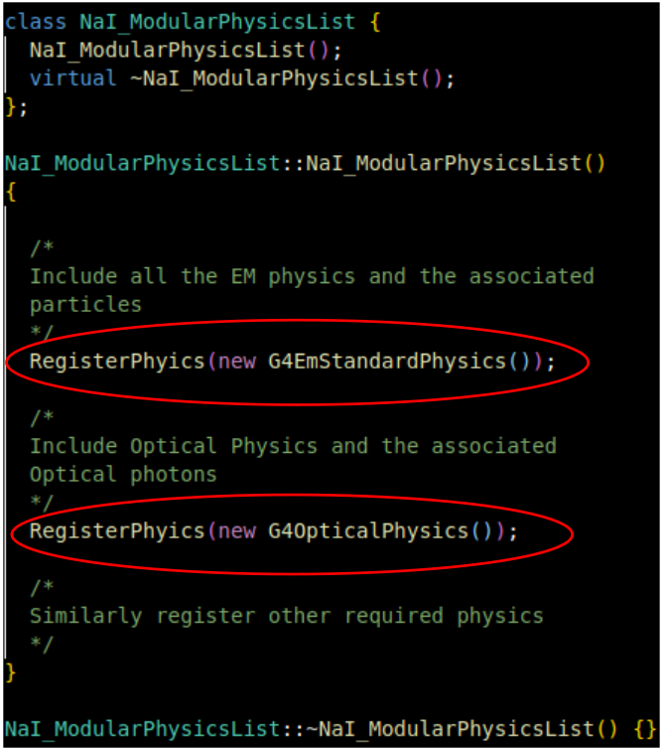
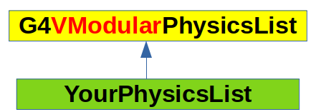
Defining a user defined physics list using G4VModularPhysicsList
G4VModularPhysicsList : Defines the higher level interface for Geant4 Physics List.
Recipe to implement you physics list
Inherit the G4VModularPhysicsList in your physics list
Register the desired physics in the constructor of your physics list.

Slide 11
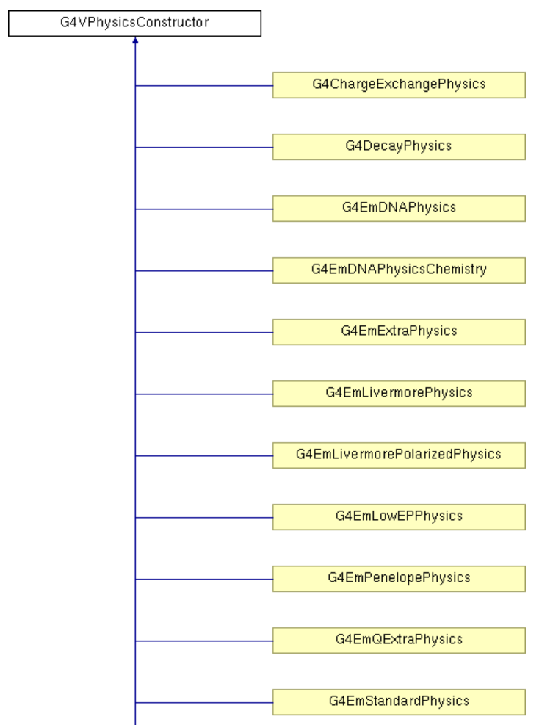
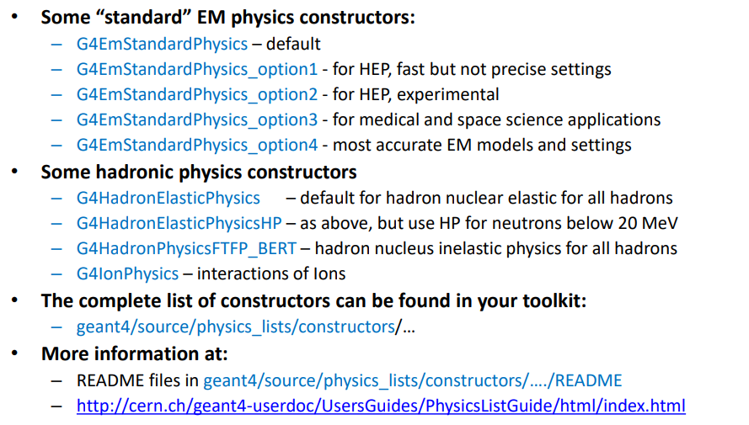
Existing Physics constructor required use ModularPhysicsList interface
What all Physics constructor are already defined.
https://apc.u-paris.fr/~franco/g4doxy/html/classG4VPhysicsConstructor.html

Slide 12
Pre-Packaged PhysicsList : Inheritance NOT required
Pre-packaged physics list provides several advantages
Ready to use physics list : Just create an object of the existing pre-packaged class and inform the RunManager
Extremely easy to use, even for beginners.
Created and maintained by experts, chances of error are extremely less.
Warning : Responsibility lies with the user. One has see carefully chose the physics list based on the his application.
Also the user is responsible to validate the chosen physics list for his application.

Slide 13
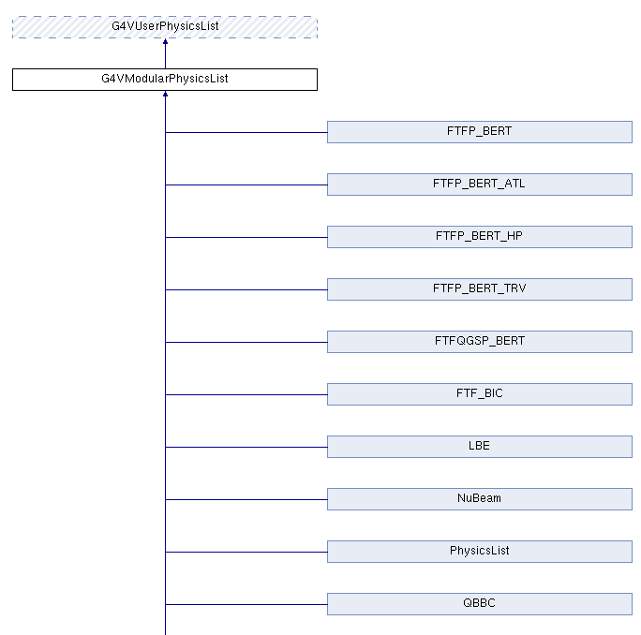
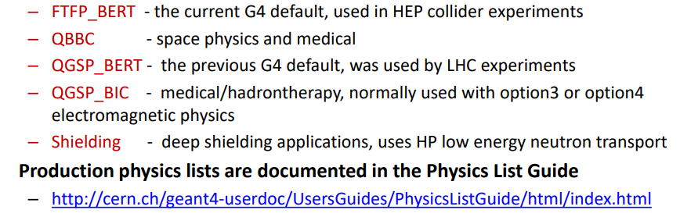
Pre-Packaged PhysicsList cont..
All the pre-packaged physics list are very well documented, and is used by large group of people.
https://apc.u-paris.fr/~franco/g4doxy4.11/html/classG4VModularPhysicsList.html
They need to be used in the same way as user defined ModularPhysicsList.
Details : https://geant4.web.cern.ch/documentation/dev/plg_html/PhysicsListGuide/reference_PL/index.html

Slide 14
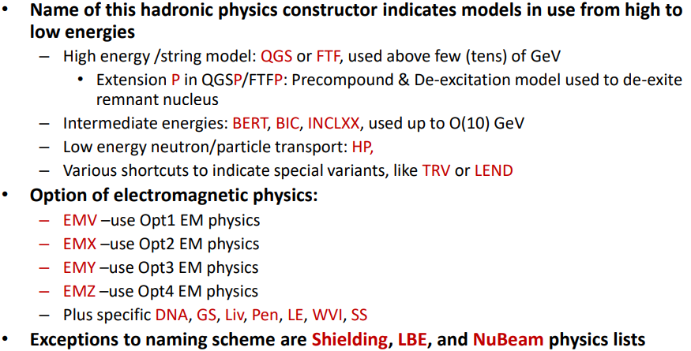
Naming conventions of various Pre-packaged Production Physics lists
Most of the physics lists follows name of Physics Constructor

Slide 15
Heading
Content

Slide 16
Conclusion
Physics list is one of the mandatory class used in Geant4 Simulation
To do a logical simulation all the required particles and process needs to be registered within the physics list.
Various interface exists to define you physics list
G4VUserPhysics : Provides the maximum level of flexibility but needs expertisze, hence \can safely be used for simple experiment setup
G4VModularPhysicsList : Provides a convenient way to define you physics list, and is generally used for more complex physics problem.
Reference (pre-packaged) physics lists makes the life easier and is a good starting point for beginners.
Physics lists must be selected with extreme care to get the meaningful results from the simulations.

Slide 17
Assignment
You have to write the simulation code to simulate the interaction of 662 keV gammas with NaI crystal.
Specification of NaI Crystal : Cylinder of 2 inch diameter, 2 inch height
Energy resolution : 40 keV
Particle source : gammas of 662 keV
Physics List creation : (a) Pre-packaged
(b) ModularPhysicsList
(c) User Physics List.
Final outcome : Should get a gaussian peak at 662 keV.
spectras from all the three types of physics lists should match

Slide 18
Heading
Content

Slide 19
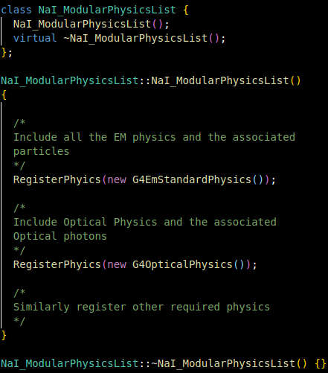
Heading
Content

Slide 20
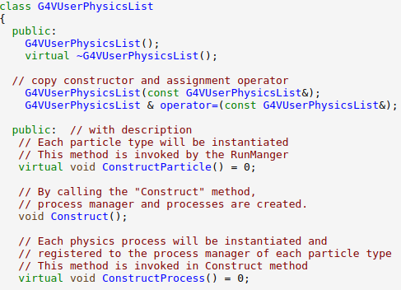
Heading
G4VUserPhysicsList
Content
G4VUserPhysicsList
YourPhysicsList
G4VModularPhysicsList
Define Particles
Define Processes
Helper functions
G4VModularPhysicsList
YourPhysicsList

