Slide 1
Geometries for Detector Construction in Geant4
Raman Sehgal (BARC)

Slide 2
Things to be discussed
1) Steps involved to create the detector geometries
2) Some of the complex geometries available in Geant4
3) Discussion of “Materials” in brief.
4) Geometry hierarchy in a detector setup.
5) How to import / export the geometry
6) Use of GDML
5) How to read CAD geometries.

Slide 3
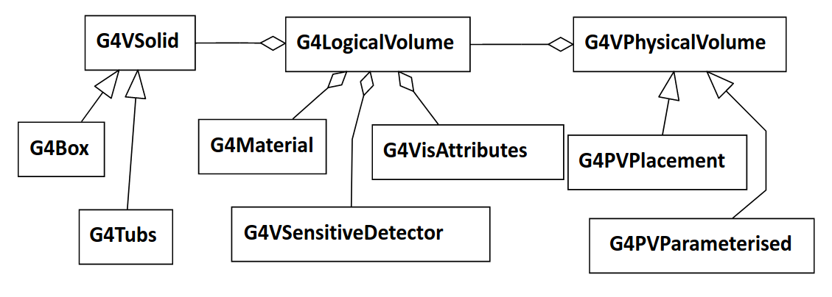
Software architecture of Detector geometry
Basically consist of three layers
1) Solid (Shape) : G4VSolid : Defines the shape and size of the geometry
2) Logical Volume : G4LogicalVolume : material, sensitivity, visualization
attributes, physical placement of daughter volumes etc.
3) Physically place volume : G4VPhysicalVolume : defines position, rotatation,
and mother volume

Slide 4
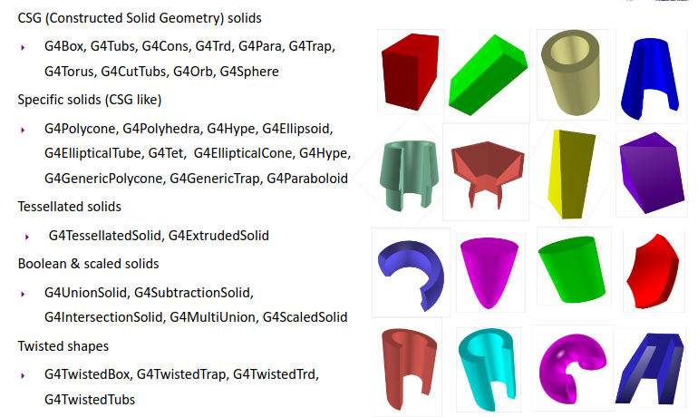
Various Shapes available in Geant4
Computing volumes and weights
• Geometrical volume of a generic solid or boolean composition can be
computed from the solid volume:
G4double GetCubicVolume();
– Exact volume is determinatively calculated for most of CSG solids, while
estimation based on Monte Carlo integration is given for other solids.
• Overall weight of a geometry setup (sub-geometry) can be computed from the
logical volume:
G4double GetMass(G4bool forced=false,
G4bool propagate=true, G4Material* pMaterial=0);
– The computation may require a considerable amount of time, depending
on the complexity of the geometry.
– The return value is cached and reused until forced=true.
– Daughter volumes will be neglected if propagate=false

Slide 5
Concept of Half lengths
10,0
Geant4 geometry works on the concept of half lengths
Suppose we want to create the box of
[10 cm X 20 cm X 30 cm ] : Required dimension
[5 cm X 10 cm X 15 cm ] : Specified Half length
Same concept is applicable to all the geometries
Cone, Tube, etc.
-5,0
0,0
5,0
-10,0

Slide 6
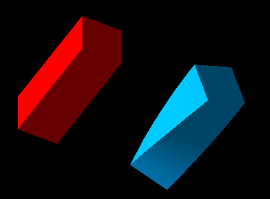
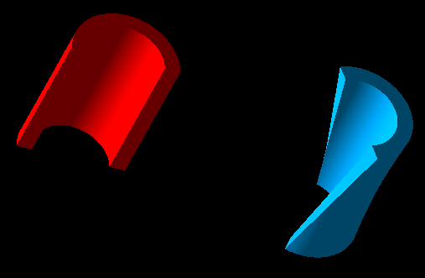
Twisted Box and Twisted Tube
G4Box(“Box”,halfX,halfY,halfZ)
G4TwistedBox(“TwistedBox”,twist,halfX,halfY,halfZ)
G4Tubs(“Tube”,rmin,rmax,dz,sphi, dphi)
G4TwistedTubs(“TwistedTube”,twist,rmin,rmax,dz,dphi)

Slide 7
Cone and Polycone
Worth discussing as they are used in frequently in experiment setup.
Cone is same as tube but having different lower and upper radius.
Polycone is something like connecting various cones and tubes one after the another.
Different constructors exist
G4Polycone("MyPolycone", sPhi, dPhi, numZ, z, rmin, rmax);
double z[8] = {-10., 0., 5., 8., 12., 15., 19, 21};
double rmin[8] = {5., 2., 2., 8., 9, 9, 12., 6};
double rmax[8] = {7., 5., 5., 10., 10, 12, 15, 8};
G4Polycone("LeadBlock",0., 2*M_PI, 8, z, rmin, rmax);

Slide 8
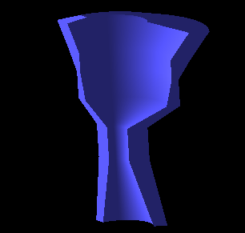

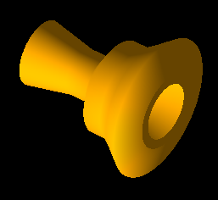
Polycone
double z[8] = {-10., 0., 5., 8., 12., 15., 19, 21};
double rmin[8] = {5., 2., 2., 8., 9, 9, 12., 6};
double rmax[8] = {7., 5., 5., 10., 10, 12, 15, 8};
G4Polycone("LeadBlock",0., 2*M_PI, 8, z, rmin, rmax);

Slide 9
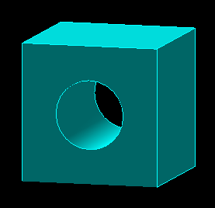
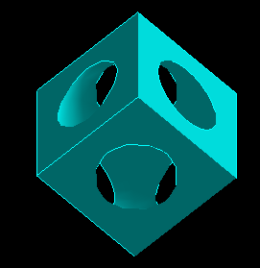
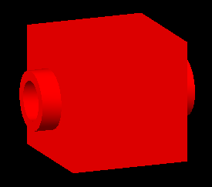
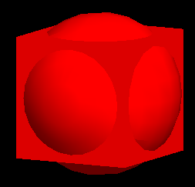
Boolean Operation
G4SubtractionSolid :
Subtraction of one shape from another.
G4SubtractionSolid( const G4String&pName,
G4VSolid* pSolidA ,
G4VSolid* pSolidB ) ;
G4Box boxA("boxA",3*m,3*m,3*m);
G4Orb orb("orbB",4*m);
G4SubtractionSolid subtracted("subtracted_boxes",&boxA,&orb);
G4UnionSolid:
Union of two shapes.
G4UnionSolid( const G4String&pName,
G4VSolid* pSolidA ,
G4VSolid* pSolidB ) ;
G4UnionSolid union("subtracted_boxes",&boxA,&orb);

Slide 10
Defining Materials
Material can be define in two ways :
1) Using the exising NIST database provided by Geant4
-- Contains a lot of material as elements, isotopes and compound.
-- Need an object of NistManger class
-- G4NistManager *nist = G4NistManager::Instance();
-- G4Material *world_mat = nist->FindOrBuildMaterial("G4_AIR");
(G4_Pb, G4_Al, G4_Mg, G4_Na .. etc.)
(G4_BAKELLITE, G4_ANTHRACENE etc..)
2) Making your own material that can be defined using the various
classes available
-- Isotope : G4Isotope
-- Element : G4Element
-- Molecules : G4Material
-- Compound and Mixture : G4Material

Slide 11
Defining Materials
G4Isotope and G4Element class defines the properties of the atom.
-- Atomic Number, number of nucleons, cross-section per atom
G4Material on the other hand defines the macroscopic properties
-- temperature, pressure, density
-- absorption length, radiation length etc.

Slide 12
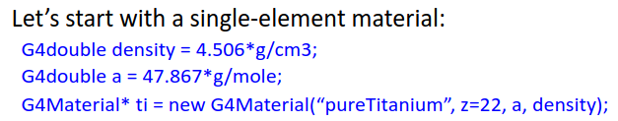
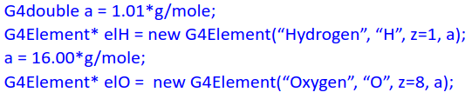
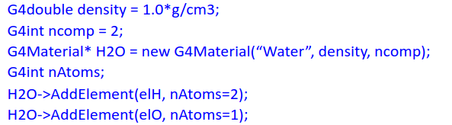
Defining Materials
Creating Elements
Getting Water from NISTManager object
G4Material *world_mat =
nist->FindOrBuildMaterial("G4_WATER");
Finally creating material from elements

Slide 13
Defining Compund Materials
Composition of compound materials
G4Element* elementH = ...;
G4Material* Air = ...;
G4Material* H2O = ...;
density = 1.200*g/cm3;
G4Material* myMaterial = new G4Material("MyNewMaterial",density,ncomponents=3);
MyMaterial->AddMaterial(H20,35*perCent);
myMaterial->AddMaterial(Air, 25*perCent);
myMaterial->AddElement(elementH, 40*perCent);

Slide 14
Creating Logical Volume and it Physical placement
G4LogicalVolume(G4VSolid* pSolid,
G4Material* pMaterial,
const G4String& name);
G4Box box(“test”, 5*cm, 5*cm, 5*cm);
G4Material Al;
G4LogicalVolume *logicalBox = new G4LogicalVolume(box, Al, “LogicalBox”);
G4PVPlacement(G4RotationMatrix *pRot,
const G4ThreeVector &tlate,
G4LogicalVolume *pLogical,
const G4String& pName,
G4LogicalVolume *pMotherLogical,
G4bool pMany,
G4int pCopyNo,
G4bool pSurfChk=false);
new G4PVPlacement(0,
G4ThreeVector(),
logicalBox,
“PhysicalVolume”,
motherLogicalVol,
false,
0,
true);

Slide 15
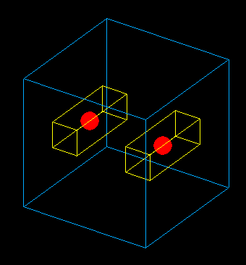
Understanding the Geometry Hierarchy
Raw shapes never forms the part of geometry hierarchy.
Physical placement is alway done for a logical volume.
The geometry hierarchy consist of Mother-Daughter relationship.
One Logical volume contains other Physical Volume daughter volumes
The mother logical volume forms the local coordinate system for all its daughter volumes.
If a mother volume is placed more than once, all its daughter volumes will be there in all physical volumes
Only Exception : World Volume
Its a unique physical volume which contains all the other volume of your detector setup
World volume also forms the global coordinate system.

Slide 16
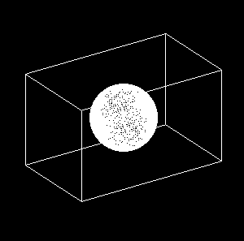
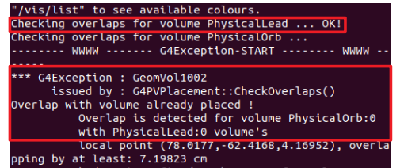
Understanding Physical placement in the Geometry Hierarchy
Both Box and Orb are placed with respect to world reference frame

Slide 17
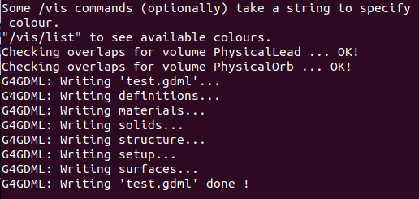
Box is placed with respect to world reference frame
Orb is place with respect to box reference frame

Slide 18
Geometry Hierarchy Tree
Complete hierarchy contains 5 shapes
But you had created only 3 shapes.
World, Box and Orb
Mother box contains Orb daughter
Multiple placement of mother box contains all the daugter volumes
World
Box_1
Box_2
Orb
Orb

Slide 19
Exporting Geometry
If the same geometry setup needs to be used in multiple simulations or needs to be used by different people
Geant supported geometry export format
GDML (Graphics Description Markup language)
A portable format, similar to XML.
Can be read by standalone application
Various XML reading libraries are present.
Xerces-C is used by Geant4

Slide 20
Moving ahead
Till now, whatever we understood
Defining shapes, logical volume and their physical placement
Define material and attaching them to the shapes to convert them to logical volumes
{
C++
Alternative way to achieve the same thing.
Instead of doing a the detector construction at compile that (as done above),
Idea is to generate it at run time.
Reading a text file (XML)
Benefits : Allows to quickly recreate the full detector construction with very few lines of code

Slide 21
GDML : Graphics Description Markup Language
XML formatted text file.
It implements hierarcy of volumes in a detector setup as the tree of geometries.
Allows to define the material, and place the volumes.
Makes the detector construction portable, and independent of the remaining simulation code.

Slide 22
Benefits of using GDML
Language independent
Containing user defined tags.
Can be processed by any library that can process XML.
Provides hierarchal structure, and mother daughter relationship can be easily maintained.
Hierarchical structure make its suitable for object oriented programming.

Slide 23
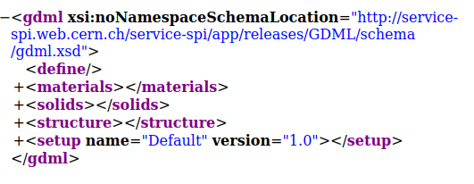
Overview of GDML : Various Components
The flow of a default GDML file follows:
1) Definitions
2) Materials
3) Solids
4) Structures
5) Setup
NOTE : Your internet browser is a very useful tool to have a look at the XML file.

Slide 24
Various GDML Solids
GDML supports all the solids provided by Geant4
Box
Orb
Sphere
Cone
Tube
Parboloid
Ellipsoid
Polyhedro
Polycone
Torus
Trapezoid
Cut Tube
Segment of a Tube
Twisted tube
Extruded Solids
Tesellated Solids
Tetrahedrons
Twisted Generic Trapezoid
Twisted Box

Slide 25
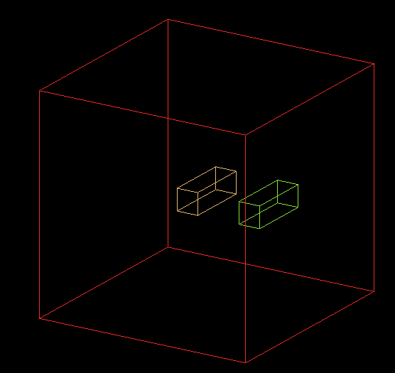
All the pieces of GDML

Slide 26

All the pieces of GDML
<solids> tag of GDML

Slide 27
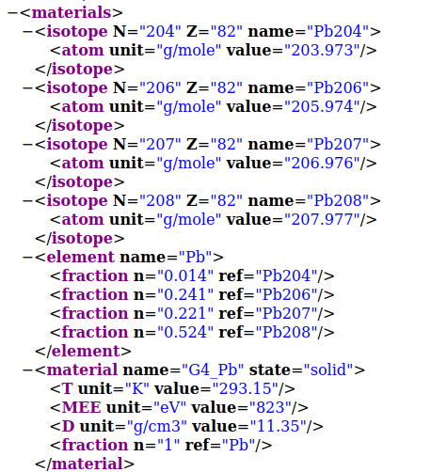
<materials> tag of GDML

Slide 28
<structure> tag of GDML
Structure tag actually defines how different components of detector setup are arranged.
(Actually shows the mother-daughter relatioship)
Both logical and physical volumes are defined in one structure
It show the hierarchy of detector components.
It consist of sequence of volumes tags, that define your logical volumes.
Each volume tag, keeps a pointer to the associated solid and the material.
Structure actually correponds to the your physical detector

Slide 29
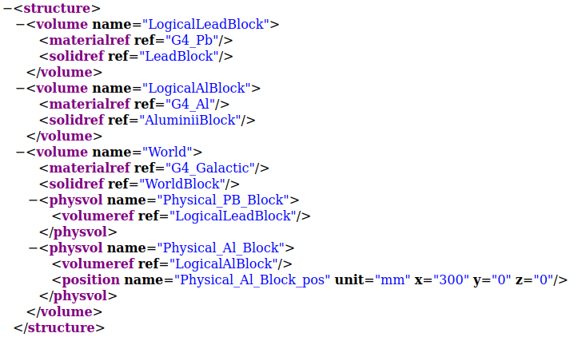
Structures cont...

Slide 30

Finally the <setup> tab
Setup contains the pointer to you world volume.
While creating a detector setup using gdml as an input file, we need to return a pointer to world volume from the “Construct” function of DetectorConstruction file.
It is possible to define multiple geometry setup, and chosing different volumes as world volume.
Moreover, we can actually split this geometry description in multiple file, which allows more granularity, and ease of maintainance.

Slide 31
Exporting/ Importing GDML into Geant4
The GDML files can be imported directly into Geant4, in the detector construction class
Required class : G4GDMLParser : (#include <G4GDMLParser.hh>)
As usual this class contains various functions :
We will focus on Write and Read
An object of “G4GDMLParseR” class is required.
G4GDMLParser myGDMLParser;
To export a full detector construction written in C++
myGDMLParser.Write(“geom.gdml”,pointerToPhyWorld);
To import a full detector setup, just do
myGDMLParser.Read(“geom.gdml);
Finally return the pointer to physical world volume to Geant.
return MyGDMLParser.GetWorldVolume()

Slide 32
What about CAD geometries
What if I want to include the CAD drawing of my detector setup available me, and I would like to use that directly in Geant instead of writing C++ code for the same.
Practically possible, but there are few problems.
We need three things : 1) Solid 2) Material 3) Placement
Difference in the tolerances required for machining and tolerance required to do particle transport.
Need a common format understandable by both (CAD and GEANT)
Some output format provided by various CAD programs are STEP and STL
Problem with these is that some of these does not contain material information.
Do not export the individual primitive geometries and there parameter, rather
export the CAD drawing as a sequence of triangles and their normal, know as the tesellations of the geometries.
How do we go
about ??

Slide 33
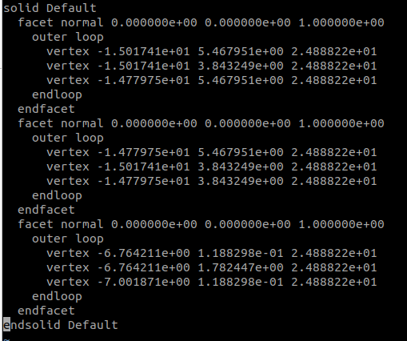
Solution for CAD Geometries
As we have discussed, Geant4 can import GDML files
Converting STEP/STL file to GDML is a potential solution.
Needs some third party tools
Various converters are available like:
FastRad
FreeCAD
CADMesh
None of them is perfect.
But still they can be used to import CAD geometries, along with some manual intervention.
Acceptable from visualization point of view, but may contain some mismatches, which may results in some stuck tracks in Geant4 navigation.

Slide 34

Using CADMesh to import STL file
CADMesh is a Header only package.
Can be downloaded from
https://github.com/christopherpoole/cadmesh
Copy the CADMesh.hh file in the include directory of you simulation code.
Whole mesh can be imported using following lines of code.
auto mesh = CADMesh::TessellatedMesh::FromSTL("eiffel.stl");
std::vector<G4VSolid*> solids = mesh->GetSolids();
Since the .stl does not contain the material information, Hence, one has to create the logical volume on his own.

Slide 35
Thank You for your attention
Any doubts ???

