Slide 1
Building Complete GEANT application
-- Basic Structure of Geant4 Code
-- Where to write what

Slide 2
Things to be discussed
Geant4 Analogy of real experiment
Basic structure of the simulation code.
Writing a basic simulation code
Mandatory classes for your simulation code.
-- Implementation of these mandatory classes
Getting the required information out of you simulation
-- Optional classes
-- Implementation of these optional classes

Slide 3
Geant4 Analogy of the real experiment setup
Beam On : As in real experiment the Geant4 run starts with “Beam On”
A run is basically a collection of event.
As in experiment once the run start, user cannot change anything
--> Geometry Setup
--> Physics processes to study
Before starting the run, following things need to be initialized
--> Detector setup (geometry is optimized)
--> Physics List (cross-section tables are calculated, depending upon the materials used in the geometry creation)

Slide 4
Important user classes : Geant4 Program structure
Define your entry point : main() : There is no starting point provided by Geant4.
It is the place where you actually registers different component of you application.
Initialization classes : Classes whose objects needs to initiated before you simulation starts.
Detector : G4VUserDetectorConstruction
Physics : G4VUserPhysicsList / Existing or Implemented
UserActions : G4VUserActionInitialization
Action classes :
instantiated in the G4VUserActionInitialization
The action classes are invoked during the event loop : ie. When you simulation is running.
G4VUserPrimaryGeneratorAction
G4UserRunAction
G4UserEventAction
G4UserStackingAction
G4UserTrackingAction
G4UserSteppingAction
The classes starting with G4V are abstract classes.
Their objects can’t be created.
They are there to provide a skeleton required by Geant4
User needs to inherit these classes, and to implement few functions which are mandatory.

Slide 5
Creation of your DetectorConstruction : G4VUserDetectorConstruction
class G4VUserDetectorConstruction
{
public:
G4VUserDetectorConstruction();
virtual ~G4VUserDetectorConstruction();
virtual G4VPhysicalVolume* Construct() = 0;
};
class Sim01_DetectorConstruction : public G4VUserDetectorConstruction
{
public:
Sim01_DetectorConstruction(){}
~Sim01_DetectorConstruction(){}
G4VPhysicalVolume* Construct(){
//Write your stuff here
//construct all your materials
//construct all your volumes
//declare you volume as sensitive
}
};
(Pure virtual function)
The Construct method should return the pointer to the world physical volume, which represents your entire geometry setup.

Slide 6
Define your Physics
There is no default particles and physics process that comes automatically in your simulation code.
Not even particle transport.
Derive your own concrete class from G4VUserPhysicsList abstract base class.
– Define all necessary particles
– Define all necessary processes and assign them to proper particles
– Define all the required cut-off ranges
OR use the various physics lists that are already available in GEANT4.
FPFP_BERT (add few more list)

Slide 7
Primary Generator : G4VUserPrimaryGeneratorAction
The second mandatory user class : Controls the generation of primary particles.
--> This is again a abstract class
--> You cannot instantiate it : Will not do anything on its own
class G4VUserPrimaryGeneratorAction
{
G4VUserPrimaryGeneratorAction();
virtual ~G4VUserPrimaryGeneratorAction();
virtual void GeneratePrimaries(G4Event* anEvent) = 0;
};
class Sim01_PrimaryGeneratorAction : public G4VUserPrimaryGeneratorAction
{
G4ParticleGun *fParticleGun;
Sim01_PrimaryGeneratorAction(){}
~Sim01_PrimaryGeneratorAction(){}
void GeneratePrimaries(G4Event*){
fParticleGun->GeneratePrimaryVertex();
}
};
The generate primaries method is called at the beginning of every event.
Your primary generator will not generate any primary particle, until you call GeneratePrimaryVertex() function

Slide 8
Sim01_PrimaryGeneratorAction::Sim01_PrimaryGeneratorAction() {
int numOfParticle = 1;
fParticleGun = new G4ParticleGun(numOfParticle);
G4ParticleTable *particleTable = G4ParticleTable::GetParticleTable();
G4ParticleDefinition *particle = particleTable->FindParticle("mu-");
fParticleGun->SetParticleDefinition(particle);
fParticleGun->SetParticleMomentumDirection(G4ThreeVector(0.,0.,-1.));
fParticleGun->SetParticleEnergy(3.*GeV);
fParticleGun->SetParticlePosition(G4ThreeVector(0.,0.,30.*cm));
}
Called only once
void Sim01_PrimaryGeneratorAction::GeneratePrimaries(G4Event *event) {
fParticleGun->SetParticleMomentumDirection(G4RandomDirection());
fParticleGun->GeneratePrimaryVertex(event);
}
Called in the beginning of every event

Slide 9
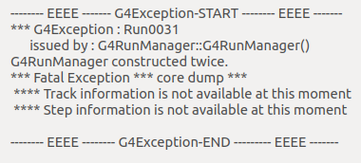
Run Manager : G4RunManager
One of the manager class in Geant4 .
Helps in linking various objects and modules required during the initialization and run.
The program cannot run without the Run Manager.
User can inherit in their derived class to customize the behaviour
G4RunManager or its Derived class must be singleton
--> Only one object should exist in the program’s memory.
Singleton instance helps in accessing the same RunManager object in different locations in the code.

Slide 10
Action Initialization : G4VUserActionInitialization
Basically used to instantiate various classes required during event loop
class Sim01_ActionInitialization : public G4VUserActionInitialization
{
public:
Sim01_ActionInitialization(){}
virtual ~Sim01_ActionInitialization(){}
virtual void BuildForMaster() const{}
virtual void Build() const{
// Link the objects of classes invoked
during the event loop
// EventAction, SteppingAction
}
};
class G4VUserActionInitialization
{
G4VUserActionInitialization();
virtual ~G4VUserActionInitialization();
virtual void Build() const = 0;
}

Slide 11
Revisit : Geant4 Program structure
Define your entry point : main() : There is no starting point provided by Geant4.
It is the place where you actually registers different component of you application.
Initialization classes : Classes whose objects needs to initiated before you simulation starts.
Detector : G4VUserDetectorConstruction
Physics : G4VUserPhysicsList / Existing or Implemented
UserActions : G4VUserActionInitialization
Action classes :
instantiated in the G4VUserActionInitialization
The action classes are invoked during the event loop : ie. When you simulation is running.
G4VUserPrimaryGeneratorAction
G4UserRunAction
G4UserEventAction
G4UserStackingAction
G4UserTrackingAction
G4UserSteppingAction
The classes starting with G4V are abstract classes.
Their objects can’t be created.
They are there to provide a skeleton required by Geant4
User needs to inherit these classes, and to implement few functions which are mandatory.

Slide 12
Structure of main() function
Define your entry point : main() :The place where you actually registers different components of your application.
Things TODO:
1) Instantiate your RunManager
2) Instantiate your DetectorConstruction
3) Instantiate your PhysicsList
4) Instantiate your ActionInitialization
5) Run your code
Optional
6) Instantiate your Visualization Manager
Int main(){
G4RunManager *runManager = new G4RunManager;
DetectorConstruction *det = new DetectorConstruction();
G4VModularPhysicsList *physicsList = new FTFP_BERT;
ActionInitialization *actIni = new ActionInitialization();
runManager->SetUserInitialization(det);
runManager->SetUserInitialization(physicsList);
runManager->SetUserInitialization(actIni);
G4UImanager *UImanager = G4UImanager::GetUIpointer();
Uimanager->ApplyCommand(“/control/execute Run.mac”);
}
Run.mac
/run/initialize
/run/beamOn 100

Slide 13
Structure of main() function
Define your entry point : main() :The place where you actually registers different components of your application.
Int main(){
G4RunManager *runManager = new G4RunManager;
DetectorConstruction *det = new DetectorConstruction();
G4VModularPhysicsList *physicsList = new FTFP_BERT;
ActionInitialization *actIni = new ActionInitialization();
runManager->SetUserInitialization(det);
runManager->SetUserInitialization(physicsList);
runManager->SetUserInitialization(actIni);
G4UImanager *UImanager = G4UImanager::GetUIpointer();
Uimanager->ApplyCommand(“/control/execute Run.mac”);
}
Run.mac
/run/initialize
/run/beamOn 100

Slide 14
Our program is running : Where is the output ??
Geant4 runs the full simulation silently.
The required information needs to extracted.
Just to see what going on :
--> use UI commands : /tracking/verbose 1
This will basically start printing all the tracking information.
--> Particle information (location, direction etc.)
--> Step information
--> Energy loss
--> Associated volume
--> TrackId

Slide 15
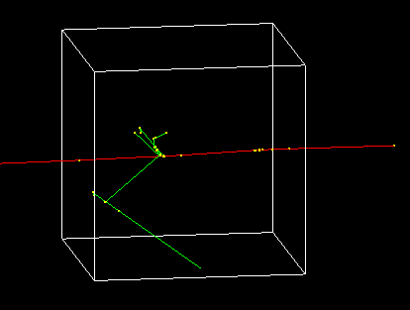
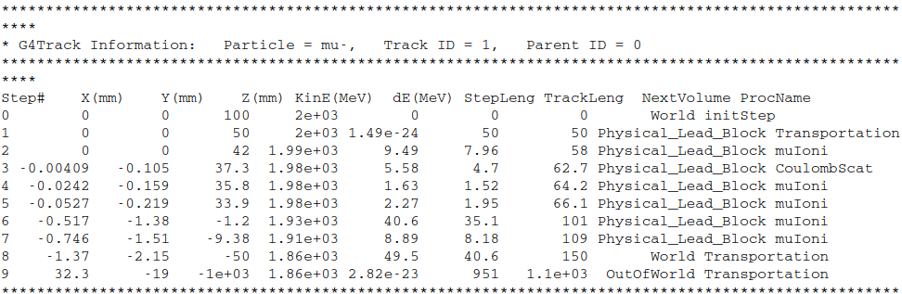

Slide 16
Geant4 Classes to get the information from the simulations
Information can be fetched at different levels, depending upon the requirements.
--> Run level information (G4UserRunAction)
--> Event level information (G4UserEventAction)
--> Step level information (G4UserSteppingAction)
--> Few more are also there.

Slide 17
Getting information from RunAction
class Sim01_RunAction : public G4UserRunAction{
public:
Sim01_RunAction();
~Sim01_RunAction();
public:
void BeginOfRunAction(const G4Run*){
//Write your stuff here
//Open some file for writing
//Initialize your required datastructure
//ROOT Tree, histogram
}
void EndOfRunAction(const G4Run*){
//Write your stuff here
//Print summary of Run
//Close all the open resources
}
};
class G4UserRunAction
{
public:
G4UserRunAction();
virtual ~G4UserRunAction();
public:
virtual G4Run* GenerateRun();
virtual void BeginOfRunAction(const G4Run* aRun);
virtual void EndOfRunAction(const G4Run* aRun);
}
Now just register the object of your RunAction in the Build function of your ActionInitialization
SetUserAction(new Sim01_RunAction);

Slide 18
Getting information from EventAction
class Sim01_EventAction : public G4UserEventAction{
Sim01_EventAction();
~Sim01_EventAction();
Doubel eDep;
void BeginOfEventAction(const G4Event* anEvent){
//Write your stuff here
//Initialize all event related parameter
eDep=0;
}
void EndOfEventAction(const G4Event* anEvent){
//Write your stuff here
//Print total energy deposited
//Use G4RunManager::GetRunManager()
}
}
;
class G4UserEventAction
{
G4UserEventAction();
virtual ~G4UserEventAction();
virtual void BeginOfEventAction(const G4Event* anEvent);
virtual void EndOfEventAction(const G4Event* anEvent);
}
Now just register the object of your EventAction in the Build function of your ActionInitialization
SetUserAction(new Sim01_EventAction);

Slide 19
Getting information from SteppingAction
class G4UserSteppingAction
{
G4UserSteppingAction();
virtual ~G4UserSteppingAction();
virtual void UserSteppingAction(const G4Step*){;}
};
class Sim01_SteppingAction : public G4UserSteppingAction{
Sim01_SteppingAction();
~Sim01_SteppingAction();
void UserSteppingAction(const G4Step *step){
//Write your stuff here like
//Use G4RunManager::GetRunManager()
std::cout << step->GetLength() << std::endl;
std::cout << step->GetTotalEnergyDeposit() << std::endl;
}
};
Now just register the object of your SteppingAction in the Build function of your ActionInitialization
SetUserAction(new Sim01_SteppingAction);

Slide 20
Efficient scoring : Making your detector sensitive
Stepping action class process every step, irrespective of the volume
But what if you want to analyze steps which belongs to particular volume
Can be done by check the volume name before doing the processing on the step
This introduce extra burden on the simulation.
Geant4 provides a concept of sensitive detector, where the required processing is
Done only if the volume is declared as sensitive
Lets have a look at the Sensitive detector class.

Slide 21
Sensitive Detector : G4VSensitiveDetector
class MySD : public G4VSensitiveDetector
{
//constructors
//destructors
virtual G4bool ProcessHits(
G4Step *,
G4TouchableHistory *){
//Write your stuff here
}
void Initialize(G4HCofThisEvent*){
//Initialize required data members
}
void EndOfEvent(G4HCofThisEvent*){
//Things to do at the end of event
}
};
class G4VSensitiveDetector
{
//Constructors
//Destructors
G4bool ProcessHits(
G4Step*aStep,
G4TouchableHistory*ROhist) = 0;
void Initialize(G4HCofThisEvent*);
void EndOfEvent(G4HCofThisEvent*);
}

Slide 22
Making a Logical Volume Sensitive
We have created a sensitive detector class, but not yet link it to our detector volume
Now we need and Sensitive Detector Manager class : G4SDManager
G4VPhysicalVolume* Construct(){
G4LogicalVolume myVol; //Logical volume that we want to make sensitive
G4SDManager *sdman = G4SDManager::GetSDMpointer(); //pointer to SDManager
MySD *mySD = new MySD("MySensitiveDetector"); //object of Sensitive Detector class
sdman->AddNewDetector(mySD); // registering the Sensitive Detector with manager
myVol->SetSensitiveDetector(mySD); //finally making the logical volume sensitive
}

Slide 23
Thanks for your attention

Slide 24
Classes invoked during the event loop
G4RunManager / G4VUserActionInitialization
G4RunManager
void SetUserAction(G4UserRunAction* userAction);
void SetUserAction(G4VUserPrimaryGeneratorAction* userAction);
void SetUserAction(G4UserEventAction* userAction);
void SetUserAction(G4UserStackingAction* userAction);
void SetUserAction(G4UserTrackingAction* userAction);
void SetUserAction(G4UserSteppingAction* userAction);
G4VUserActionInitialization
void SetUserAction(G4VUserPrimaryGeneratorAction*) const;
void SetUserAction(G4UserRunAction*) const;
void SetUserAction(G4UserEventAction*) const;
void SetUserAction(G4UserStackingAction*) const;
void SetUserAction(G4UserTrackingAction*) const;
void SetUserAction(G4UserSteppingAction*) const;

Slide 25
Sample programs
The program discussed during the presentation is available at following link.
https://github.com/rsehgal/IUCCA_tutorials
Particularly Sim09, contains everything, and you can switch ON/OFF various classes at the compile time using the flags available in CMAKE
If you have cmake-curses-gui installed, then you can use
ccmake . (provided you had compiled the code in the current directory)
to see various flags.

