Slide 1
What is a Physics List
Setting up the physics environment:
Particles and the associated physics processes
An object of a C++ class, which is responsible of defining following:
Particles used in simulation
Physics process associated with each particle
Is it really required ??
Yes, as it is one the 3 mandatory object that needs to be registered with RunManager
Eventually its just an interface to define physics of your application.
User is supposed to have a good idea of the physics behind the application
Removal of particles and process may lead to incomplete or unpredictable simulation results

Slide 2
Why not all the physics is included by default by Geant4
Will that be a good idea : Yes / No ? NO
There are different model that defines the same interaction.
Some are approximation and some are extremely precise.
Effect on computation time
You actually DON’T need all the particles
Eg. : Study of energy deposition by gamma radiation in NaI
One may not need optical photon and the associated process,
Unless you need to do its photon yield study
or PMT response study.
For these reasons Geant4 does not following integral physics approach rather it follows application based physics approach.

Slide 3
Application based physics approach
Provides :
Independent Particles to be used
Independent physics components : Physics process
These components (processes) may be select in the custom physics list defined by user.
One important process that should always be there : Transportation
This must be assigned to all the stable particles
Depending upon the requirement one needs to chose different components.
Results in efficient simulation run.
Sometimes you may afford less accurate calculation, so you may get faster model for a particular interaction

Slide 4
Creating a Physics List
There are three ways
UserPhysicsList : Create from scratch using components (processes) and particles
available in Geant4
ModularPhysicsList : Again going to use existing components and particles but it provides an easy to use interface.
Prepacked (Reference) Physics List : Use the PhysicsList already existing in Geant4
(A good start point)
Ease of use
Flexibility

Slide 5
UserPhysicsList : Inheritance mechanism of C++ : G4VUserPhysicsList
Utilizes the Inheritance mechanism of C++
Base class : G4VUserPhysicsList
The most basic interface
User needs to specify all the particles that may be used or generated during the lifetime of a run.
For each of these particles specify all the associated process
Transportation needs to be attached to all the stable particles.
Not suitable for less experience users
But provides great flexibility.
Hence recommended for advance users.

Slide 6
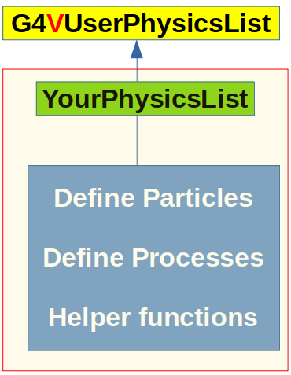
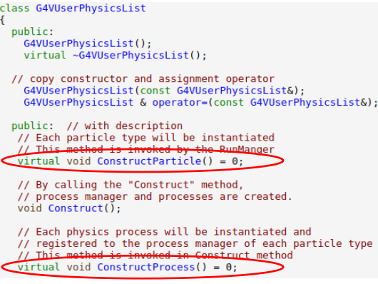
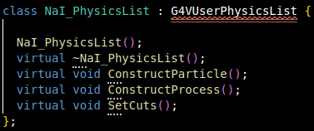
UserPhysicsList : Interface to define Physics List
G4VUserPhysicsList : Defines the interface for Geant4 Physics List.
Recipe to implement you physics list
Inherit the G4VUserPhysicsList in your physics list
Implement the 2 mandatory functions
(Pure virtual functions in G4VPhysicsList)
ConstructParticle()
responsible for creating all the
particles required during simulation
ConstructProcess()
responsible for assigning the required processes associated with each particle type

Slide 7
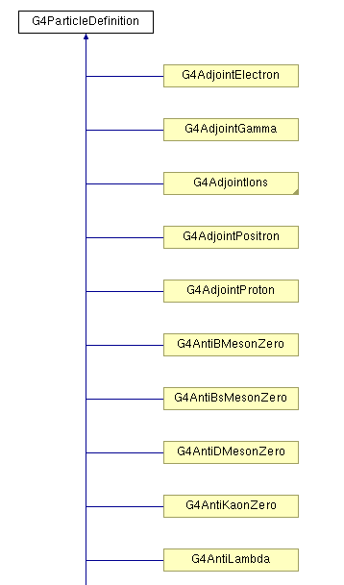
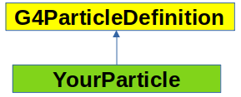
UserDefined Physics List : Particles
In Geant4, everything is a C++ class.
Each of the particle is defined by its class
A Particle can be created using following ways
1) Using ParticleTable : G4ParticleTable::GetParticleTable()
2) Using ParticleClass : G4<ParticleName>::Definition()
Eg. Getting a muon- and gamma
G4ParticleDefinition *muMinus =
G4ParticleTable::GetParticleTable()->FindParticle(“mu-”)
G4ParticleDefinition *muMinus = G4MuonMinus::Definition();
G4ParticleDefinition *gamma =
G4ParticleTable::GetParticleTable()->FindParticle(“gamma”)
G4ParticleDefinition *gamma = G4Gamma::Definition();

Slide 8
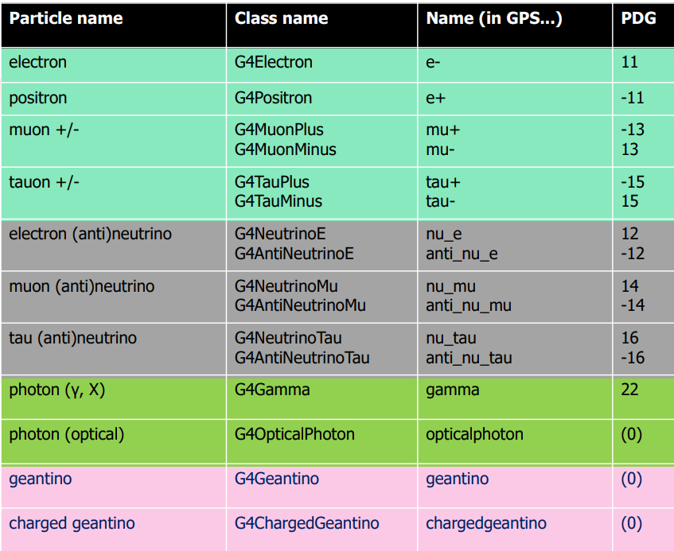
UserDefined Physics List : Particles

Slide 9
UserDefined Physics List : Processes
Each process assiociated with each particle is implemented in a separate class.
All these classes are placed at geant4-v11.3.0/source/processes/
Eg. : Electromagnetic Processes related to gamma can be obtained by creating object of
following classes
G4PhotoElectricEffect
G4ComptonScattering
G4GammaConversion
G4RayleighScattering
Whatever process you want to create is available but you need to know its class name

Slide 10
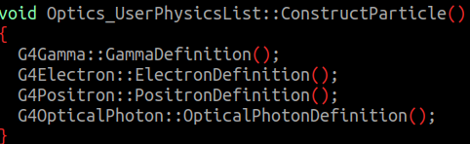
UserDefined Physics List : Final Step
Once you have identified particles and process used in the simulation, populated them at the proper place.

Slide 11
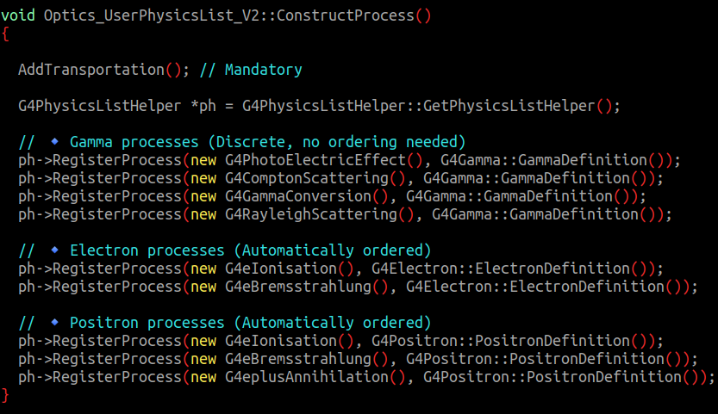
UserDefined Physics List : Process Registration
Particles are created.
Processes are created.
Finally they need to be linked.
Multiple ways of linking.
The cleanest is by using PhysicsListHelper class.
The linking is done by coupling the processes and particle using the RegisterProcess function of
PhysicsListHelper Class.
** Congratulation you had succesfully created a UserDefined Physics list **

Slide 12
Summary UserDefined Physics List
Determine all the Physics of the problem at hand.
Find all the particles associated with that Physics
Find all the processes associated with each particles for that Physics
Create the required objects of particles and Physics processes.
Register them with PhysicsListHelpers
Needs detailed information
Not very trivial to implement
But provide complete control
Modular Physics List is an alternative that provides higher level implementation.

Slide 13
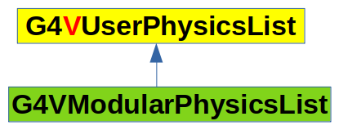
ModularPhysicsList : Inheritance mechanism of C++ : G4VModularPhysicsList
Utilizes the Inheritance mechanism of C++
Base class : G4VModularPhysicsList
G4VModularPhysicsList Class is inherited from G4VUserPhysics List
Different Processes related to particular physics are already attached to respective particles
Electromagnetic Physics: Attached all the particles which undergoes electromagnetic interactions to the corresponding process.
User don’t have to worry for individual particles and the associated processes.
Provide more convenient way to create user define physics lists.
Automatically attached Transportation to all the constructed particles.
User may add more helper functions for debugging or to get additional information about the physics process and the associated particles.

Slide 14
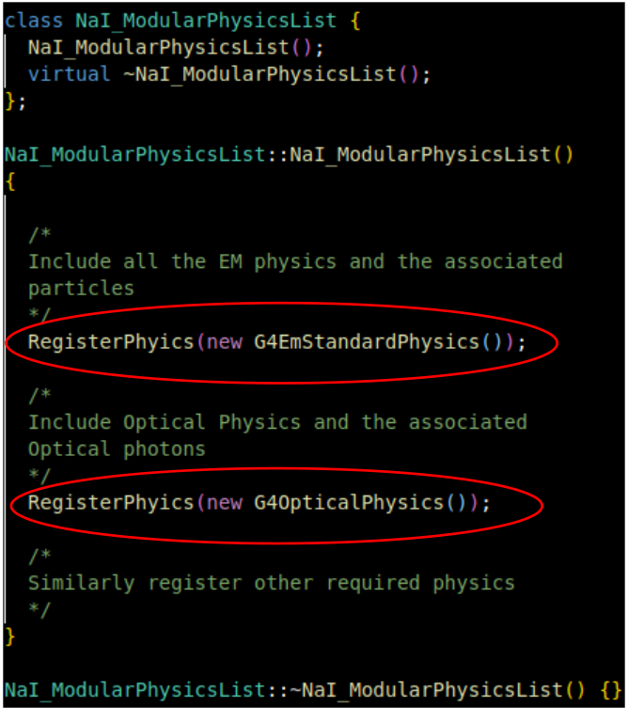
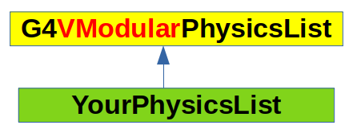
Defining a user defined physics list using G4VModularPhysicsList
G4VModularPhysicsList : Defines the higher level interface for Geant4 Physics List.
Recipe to implement you physics list
Inherit the G4VModularPhysicsList in your physics list
Register the desired physics in the constructor of your physics list.

Slide 15
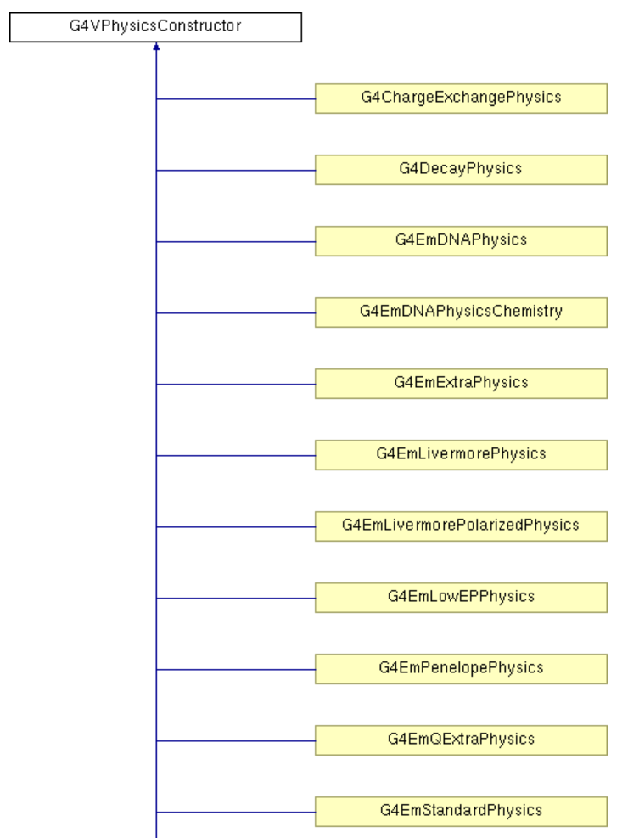
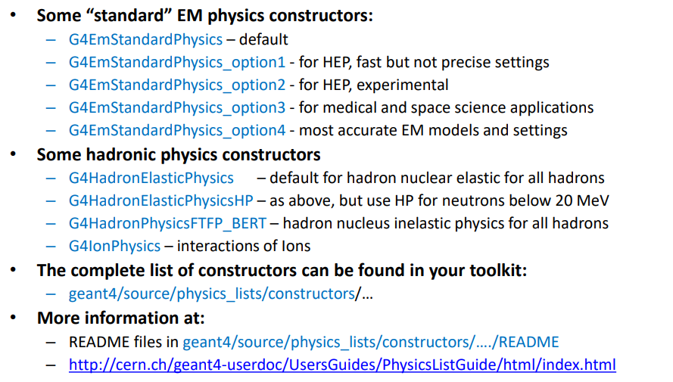
Existing Physics constructor required use ModularPhysicsList interface
What all Physics constructor are already defined.
https://apc.u-paris.fr/~franco/g4doxy/html/classG4VPhysicsConstructor.html

Slide 16
Summary Modular Physics List
Need to create your own class inherited from G4VModularPhysicsList class
Most of the work that was manually done in UserDefined physics list is already implemented in terms of Physics constructor.
No need to worry about each particle and associated process.
Just Need to know the correct physics constructor name.
In the constructor of you class just need to register the Physics constructor, rest everything will be taken care by Geant4 itself.
Now instantiate the object of your class in your main program and register that with RunManager.

Slide 17
Pre-Packaged (Reference) PhysicsList : Use them directly (Inheritance NOT required)
Pre-packaged physics list provides several advantages
Ready to use physics list : Just create an object of the existing pre-packaged class and inform the RunManager
Avoids complexity of manually selecting physics processes.
Extremely easy to use, even for beginners.
Created and maintained by experts, chances of error are extremely less.
Warning : Responsibility lies with the user. One has see carefully chose the physics list based on the his application.
Also the user is responsible to validate the chosen physics list for his application.
Examples: FTFP_BERT, QGSP_BERT, QGSP_FTFP_BERT, etc.

Slide 18
Naming Conventions of Reference Physics Lists
QGSP_BERT: Quark-Gluon String Model + Bertini Cascade.
FTFP_BERT: Fritiof String Model + Bertini Cascade.
QGSP_FTFP_BERT: Hybrid model using QGS, FTF, and BERT.
QGSP_BIC: Binary Cascade instead of Bertini.
Shielding: Optimized for radiation shielding applications.

Slide 19
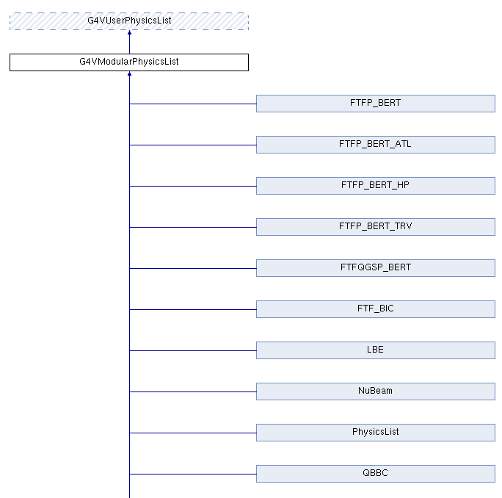
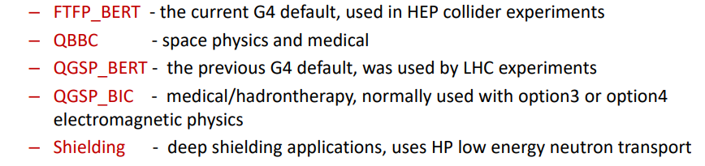
Pre-Packaged PhysicsList cont..
All the pre-packaged physics list are very well documented, and is used by large group of people.
https://apc.u-paris.fr/~franco/g4doxy4.11/html/classG4VModularPhysicsList.html
They need to be used in the same way as user defined ModularPhysicsList.
Details : https://geant4.web.cern.ch/documentation/dev/plg_html/PhysicsListGuide/reference_PL/index.html

Slide 20
Pros and Cons of Reference Physics Lists
Pros:
Prevalidated and well-tested
Optimized for different applications
Easy to implement
Regularly updated with new Geant4 releases
Cons
Not always optimized for every experiment.
May require tuning for specific applications.
Custom physics lists may be necessary for specialized studies.

Slide 21
How to Use a Reference Physics List in Geant4?
Include the physics list in Main program:
#include "FTFP_BERT.hh"
Instantiate the physics list in G4RunManager: runManager->SetUserInitialization(new FTFP_BERT);
No need to manually define particle interactions.

Slide 22
Summary of Reference Physics List
Reference physics lists simplify simulation setup.
Choose based on your application needs.
Geant4 continuously improves these lists.
Good starting point for beginners.
Can be extended depending upon user requirements.

Slide 23
Electromagnetic Models in Reference Lists
Geant4 includes multiple EM models optimized for different energy ranges.
Common EM models used in reference lists:
- G4EmStandardPhysics: Default for general applications.
- G4EmStandardPhysics_option4: Provides high precision for medical applications.
- G4EmLivermorePhysics: Optimized for low-energy electromagnetic interactions.
- G4EmPenelopePhysics: Used for very low-energy simulations.

Slide 24
Extended Reference Physics Lists
Some reference lists extend standard models for specific applications:
- Shielding: Optimized for radiation protection studies.
- QGSP_BIC_HP: High-precision neutron transport.
- LIV: Uses Livermore EM physics for precise low-energy simulations.
- PENELOPE: Uses Penelope EM physics for very low-energy interactions.

Slide 25
How to Customize Reference Physics Lists?
Geant4 allows modifying reference physics lists for specific needs.
Steps to customize:
1. Start with a base physics list (e.g., FTFP_BERT).
2. Add or replace components (e.g., use Livermore EM physics instead of standard EM).
3. Register additional processes (e.g., optical photon physics).

Slide 26
Customize Reference Physics Lists
Example: Replace the Standard Electromagnetic model with Livermore model
G4VModularPhysicsList* physicsList = new FTFP_BERT;
physicsList->ReplacePhysics(new G4EmLivermorePhysics());
runManager->SetUserInitialization(physicsList);

Slide 27
Conclusion
Physics list is one of the mandatory class used in Geant4 Simulation
To do a logical simulation all the required particles and process needs to be registered within the physics list.
Various interface exists to define you physics list
G4VUserPhysics : Provides the maximum level of flexibility but needs expertisze, hence \can safely be used for simple experiment setup
G4VModularPhysicsList : Provides a convenient way to define you physics list, and is generally used for more complex physics problem.
Reference (pre-packaged) physics lists makes the life easier and is a good starting point for beginners.
Physics lists must be selected with extreme care to get the meaningful results from the simulations.

Slide 28
Assignment
You have to write the simulation code to simulate the interaction of 662 keV gammas with NaI crystal.
Specification of NaI Crystal : Cylinder of 2 inch diameter, 2 inch height
Energy resolution : 40 keV
Particle source : gammas of 662 keV
Physics List creation : (a) Pre-packaged
(b) ModularPhysicsList
(c) User Physics List.
Final outcome : Should get a gaussian peak at 662 keV.
spectras from all the three types of physics lists should match

Slide 29
Thank you and All the best for the assignment

Slide 30
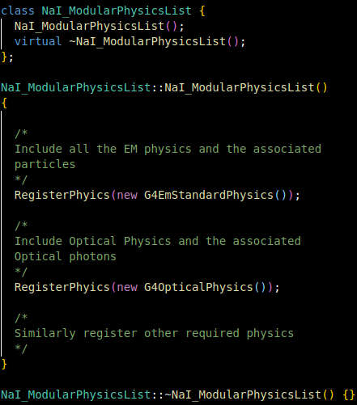
Heading
Content

Slide 31
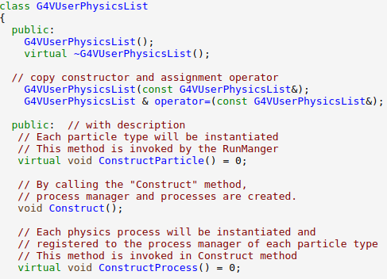
Heading
G4VUserPhysicsList
Content
YourPhysicsList
Define Particles
Define Processes
Helper functions
G4VModularPhysicsList
YourPhysicsList
G4ParticleDefinition
YourParticle

Slide 32
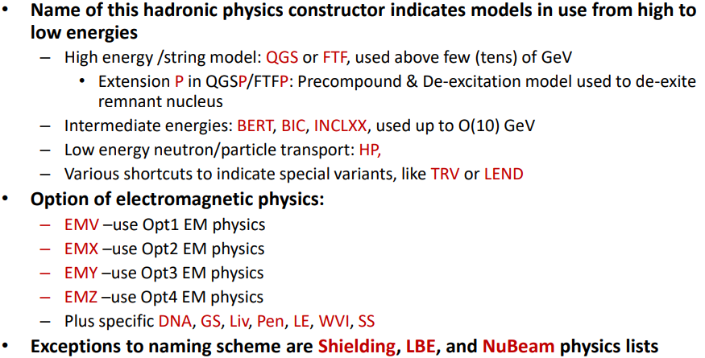
Naming conventions of various Pre-packaged Production Physics lists
Most of the physics lists follows name of Physics Constructor

Slide 33
Physics List in Geant4
What is a Physics List (Is it really required ?? )
Various Physics List Interface (usecase depends on the expertise)
UserPhysicsList (Level1 : Write from scratch)
ModularPhysicsList (Level 2 : More convenient to implement)
Prepacked Physics List (Level 3 : Provided by Geant4 Toolkit)
Reference Physics List
How to extend them

Slide 34
Heading
Content

