Slide 1
Scoring using Senstive Detector

Slide 2
Introduction
Now we know following:
(a) Creation of detector geometry
(b) Creation of Physics List
(c) Running Simulation
In this lecture we will learn about :
Extracting information from the simulation using Sensitive detector

Slide 3
Why Sensitive Detector ?
Geant4 does full simulation silently.
To get the meaningful information out, we need to interfer.
Can be done by writing option user hooks.
One such hook is writing a UserSteppingAction.
This gives us access to each and every step.
Is it really required ?? Not always.........
What if I wanted to get the information only if the particle is in a particular volume.
Here Sensitive detector comes into the picture.

Slide 4
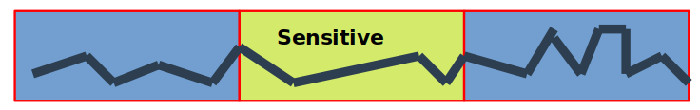
Sensitive Detector
Act like a readout system of your detector
Allows user to focus on the desired volume, by making them sensitive to particles and their interactions.
No need to check for volume in which you are (as you already know)
Gives complete information like energy deposited, step size, position, timing information etc., everything what one can get from SteppingAction.
Allows user to accumulate all the hits within a sensitive volume.

Slide 5
Recipe and components to create a Sensitive detector based application
Create the detector geometry (done)
Create Physics List (done)
Create Primary Generator (done)
Create Sensitive Detector class
Create Hit Class
Create Hit Collection
Fill the hit collections in the Sensitive Detector
Register the hit collection from each sensitive detector to container of hit collection for the entire event
Create an object of Sensitive Detector class and register it with Sensitive detector manager
Declare the required logical volume as Sensitive by attaching it to the object of Sensitive detector class

Slide 6
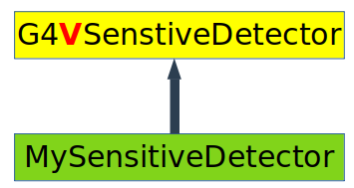
Steps to create a Sensitive Detector
1. Write a class to implement your Sensitive Detector
2. Attach an object of this class to your Logical Volume
3. Register this object with Sensitive Detector Manager
Sensitive Detector interface : G4VSensitiveDetector
Inherit your Sensitive Detector class from G4VSensitiveDetector

Slide 7
Important point
Once a logical volume is made sensitive, all its placement will become sensitive.
To distinguish between different placements use copy number or the name assigned to physicsl volume
It not necessary to have a different SD class for different Logical Volume.
Different logical volume can share same SD object.
More than one SD objects can be made from same SD class, but each object should have different name.

Slide 8
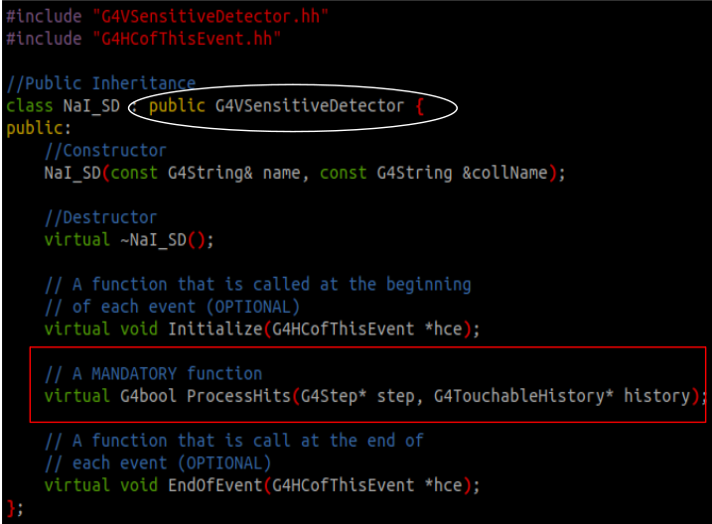
Implementing a Sensitive Detector class
Inherit the G4VSensitiveDetector class
Add the desire optional function, useful for logging and debugging information
Implement the mandatory function, ProcessHits
ProcessHits function is called for each step within you sensitive volume.

Slide 9
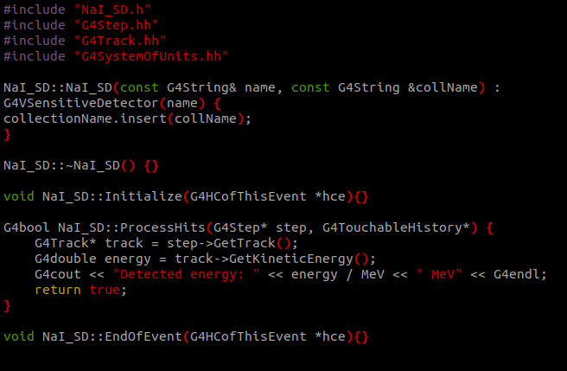
Getting information from Sensitive Detector
ProcessHits function will be called for each step.
A Gateway to get the information out from steps
Now we are able to get this information
What all information needs to be stored, depends on the user & application.
All this information can be stored in HitCollections

Slide 10
Getting information from Sensitive Detector
ProcessHits function give you information corresponding to current hit.
An Event consist of hundreds of hits (may be more).
The idea is to accumulate information from all hits (in and event) in a sensitive volume.
A Mechanism is required:
(a) User defined mechanism (use c++ array, vector, map, pair etc.) : Possible,
but responsibility of memory allocation and deallocation will be on the user.
If not handled properly may result in memory corruption and abnormal program termination
(b) Geant4 defined Hit collection mechanism : User has to just follow the mechanism, other thing will be taken care by Geant4

Slide 11
Geant4 HitCollection Mechanism
Touching the first templatized class of Geant4
G4THitsCollection : It’s basically a container class which can maintain the collection of Geant4 Hits
Eg. std::vector<T> -- std::vector<int>, std::vector<double>, std::vector<std::string>
Now What is Geant4 Hits ???
The definition of Hits is not provided by Geant4 but depends on the user
The set of information you want to get from you sensitive detector constitutes a Hit
This set of information is encapsulated in C++ class which is known as Hit Class

Slide 12
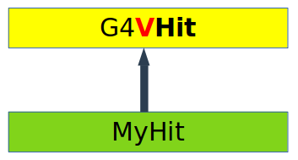
Hit Class for SensitiveDetector
User has to write a Hit class which must be inherited from G4VHit Class of geant
Here you can store various types of information like:
Position
Momentum and energy of track
Geometrical information
Timing information etc..
Object of Hit class must be stored in the HitCollection
The complete collection is associated to G4Event object via G4HCofThisEvent
These Hit collection are accessible through
(a) G4Event object In the EndOfEvent functions
(b) G4SDManager

Slide 13
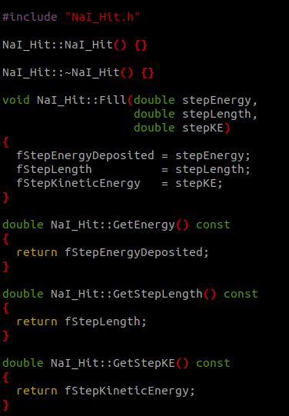
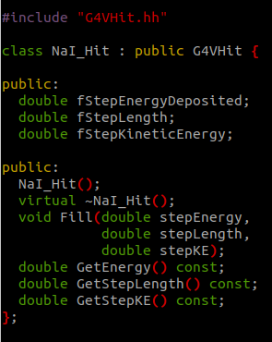
Implementation of a Hit Class
A simple implementation of Hit class name NaI_Hit
Lets create a HitCollection using alias in C++
Better idea would be defined this in separate header file, so that it can be used anywhere.
//HitsCollection.h
using NaiHitCollection = G4THitsCollection<Nai_Hit>

Slide 14
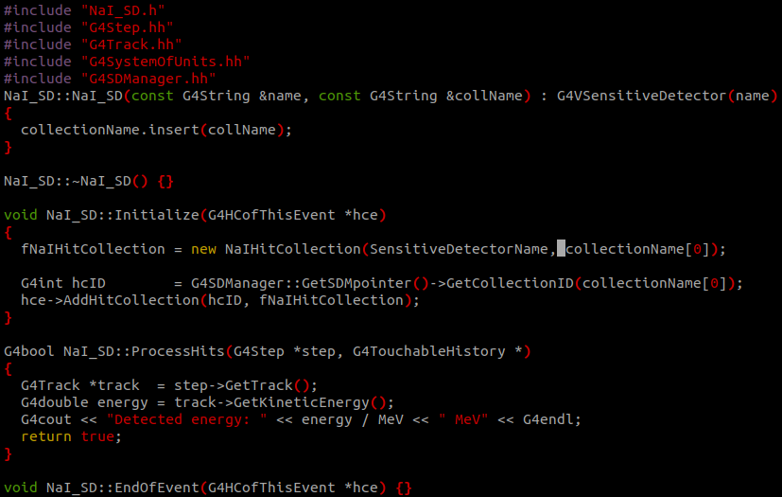
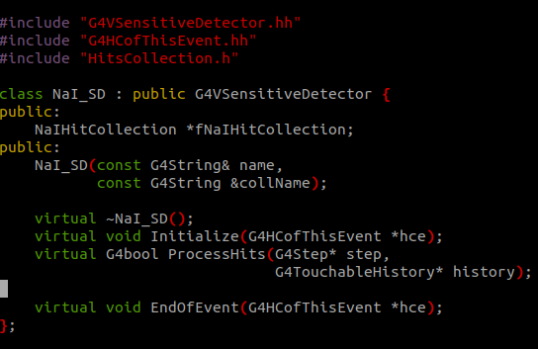
Enabling HitCollection in SensitiveDetector
Every HC has 2 parameter: SD name and colleName. This combination is unique for each HC
Geant4 also assigns a unique identified to each collection

Slide 15
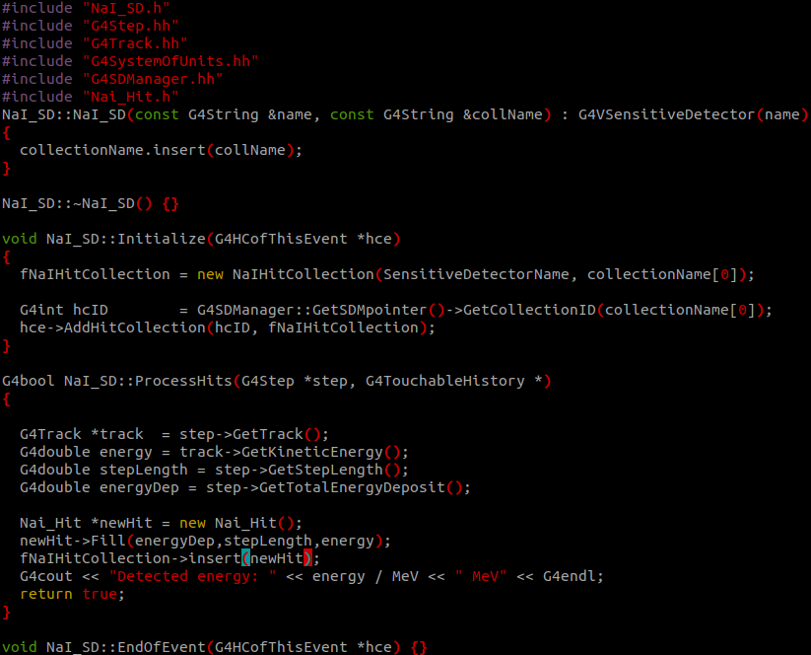
Filling a Hit in the HitCollection
Create an object of Hit class and fill its required data members.
Insert this hit object to the hit collection.

Slide 16
Processing HitCollection of the complete event
In a simulation we may have multiple hitCollections defined in different sensitive detectors.
Each sensitive detector fill its HitCollection and add it to container of HitsCollection (object of G4HCofThisEvent)
All these hit collections are available in the G4UserEventAction hook, where they can be accessed in the EndOfEventAction function via the object G4Event class.
Use case of multiple hitCollection:
Particularly useful when you want to have coincidence between different detector components.
To get the coincidence data, check that the hit collection from these components must have non-zero size, which implies that hit is detected by required detector components.

Slide 17
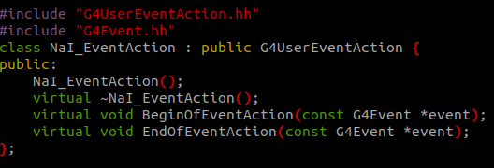
Processing HitCollection of the complete event

Slide 18
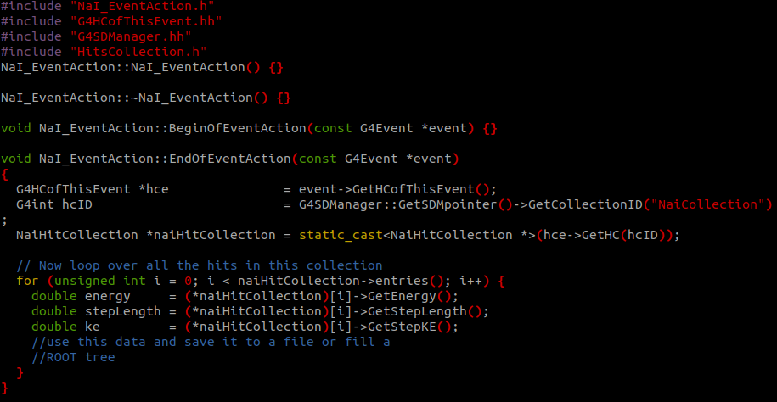
Processing HitCollection of the complete event
Make sure to use the Same collection name that you had assigned in the Initialize function of sensitive detector.

Slide 19
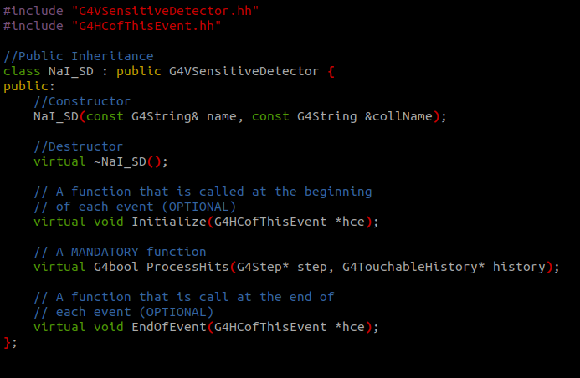
G4VSenstiveDetector
MySensitiveDetector
G4VHit
Sensitive
MyHit

