Slide 1
Muon tracks analysis updates

Slide 2
Simple Schematic
9
8
Top Layers
7
Oblong
Cross
Slab for scatterer
4
3
2
Bottom Layers
1
0

Slide 3
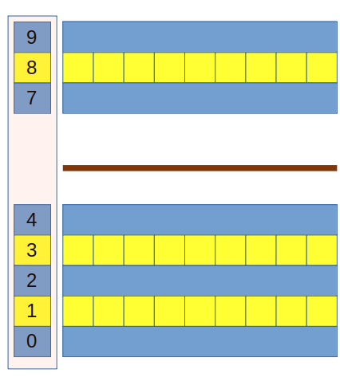
Idea : To improve the Hit point estimation in different layers
Previous attempt :
Get the hit coordinate along the axis of scintillator using parameterization.
Hit coordinate in the orthogonal direction was obtained using the layer above and below the inspected layer.
We were able to obtained the nice hit patter along the scintillators in layer 8.
Were not able to get the similar pattern in layer 7 and 9.
Using Machine Learning
Get the hit coordinate along the axis of scintillator using parameterization.
Hit coordinate in the orthogonal direction is obtained by using a machine learning model, built using the simulated data.
Separated Model for each layer.
On simulated data the prediction were pretty good.
We are now able to see similar pattern in layer 7 & 9

Slide 4
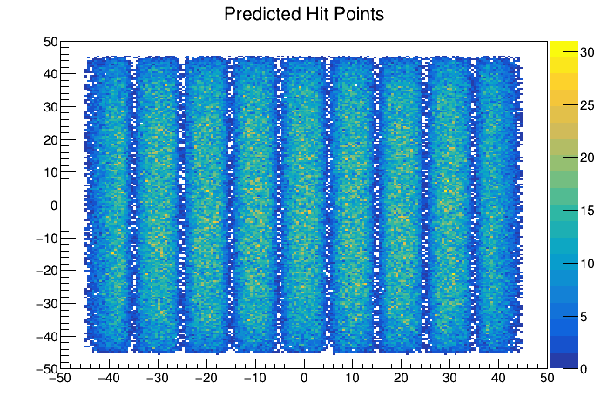
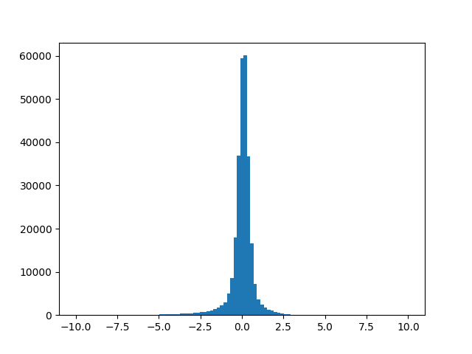
Layer 8
Reconstructed Hit Points and Residual Plot using simulated data
Hit Pattern in Cross Layer
Histogram of Residuals

Slide 5
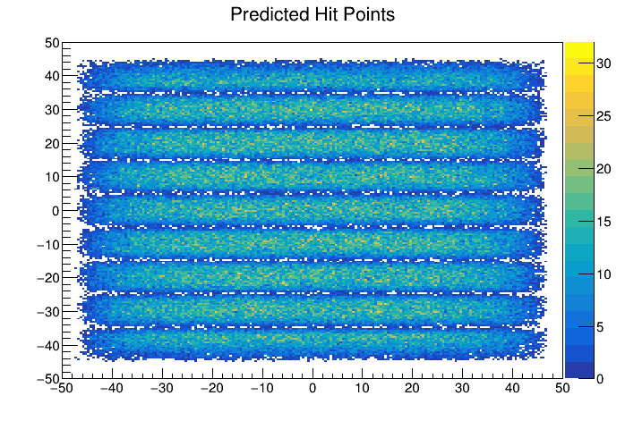
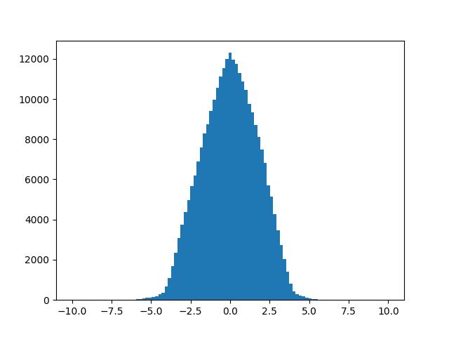
Layer 9
Reconstructed Hit Points and Residual Plot using simulated data
Hit Pattern in Oblong Layer
Histogram of Residuals

Slide 6
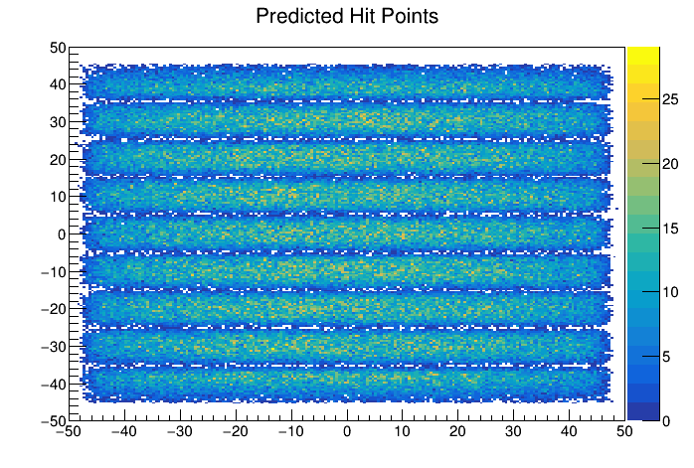
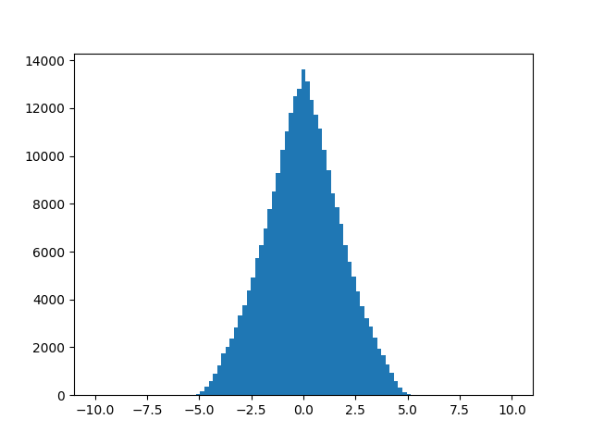
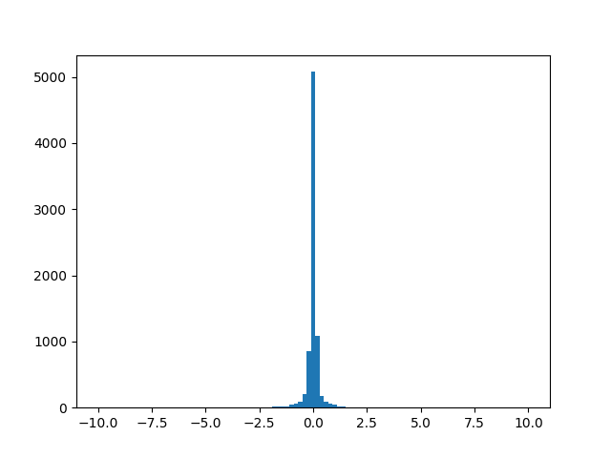
Layer 7
Reconstructed Hit Points and Residual Plot using simulated data
Histogram of Residuals using layer
8 & 3
Histogram of Residuals using layer
9 & 8
Hit Pattern in Oblong Layer

Slide 7
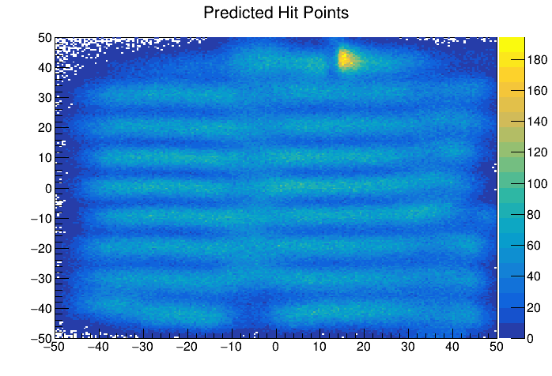
Layer 9
Reconstructed Hit Points using experimental data
Hit Pattern in Oblong Layer

Slide 8
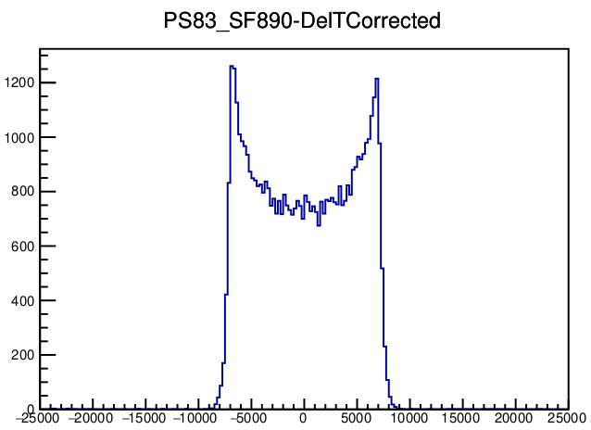
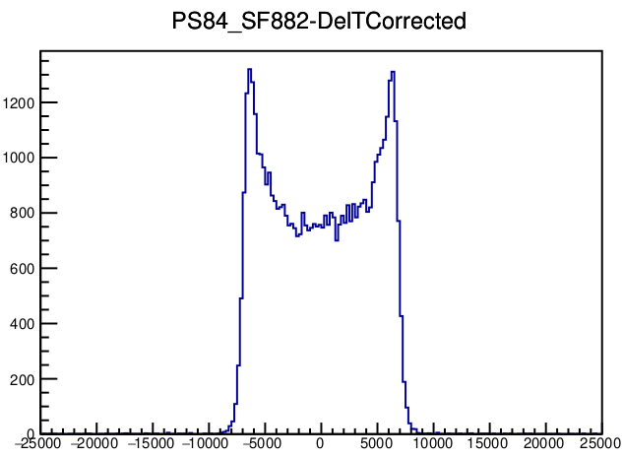
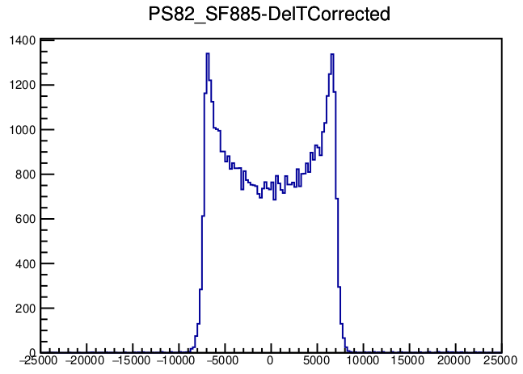
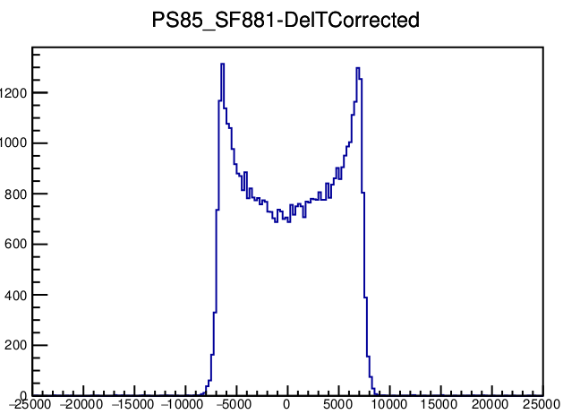
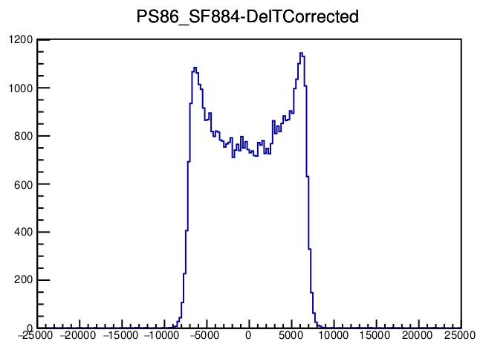
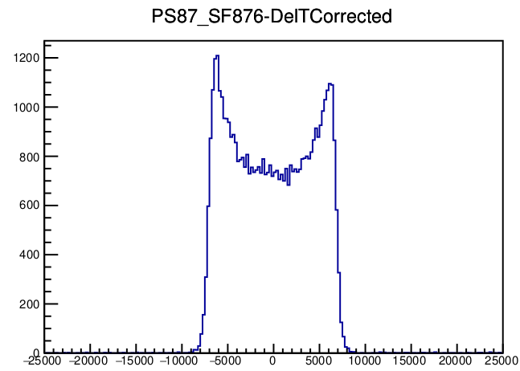
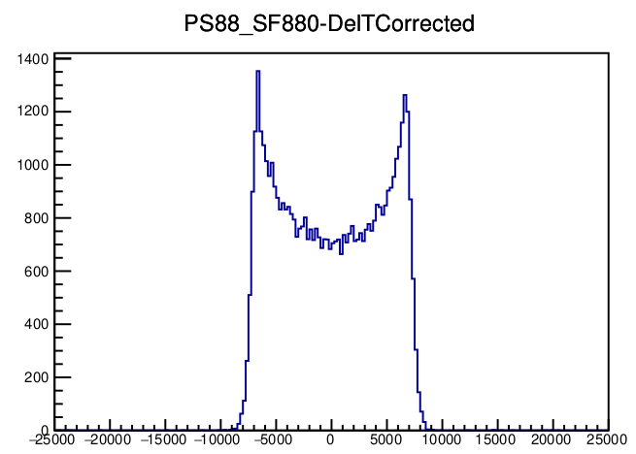
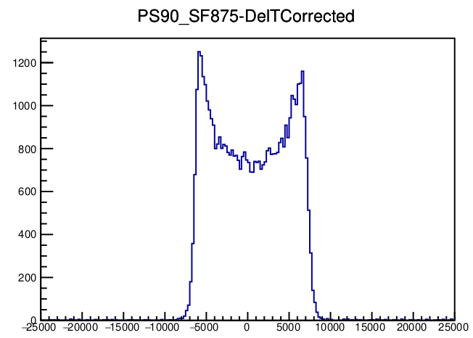

Slide 9
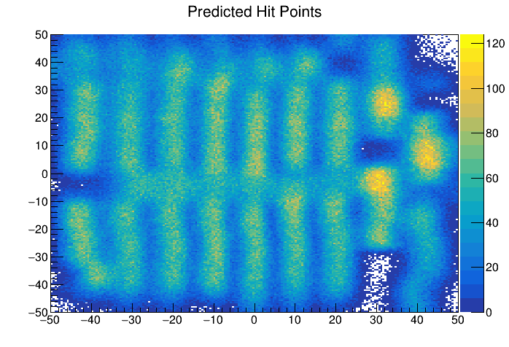
Layer 8
Reconstructed Hit Points using experimental data
Hit Pattern in Cross Layer

Slide 10
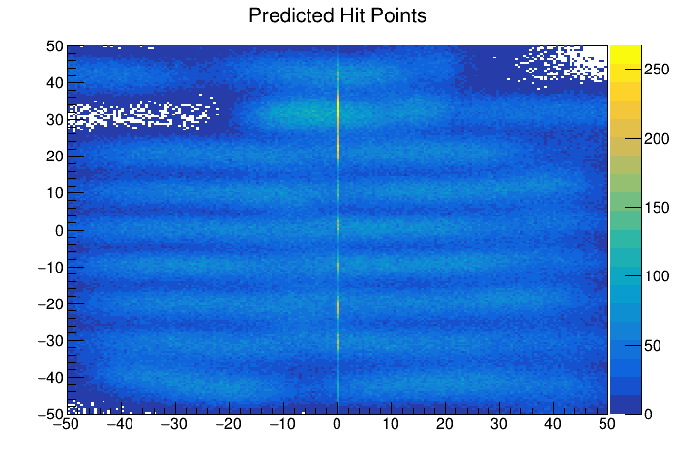
Layer 7
Reconstructed Hit Points using experimental data
Hit Pattern in Oblong Layer

Slide 11
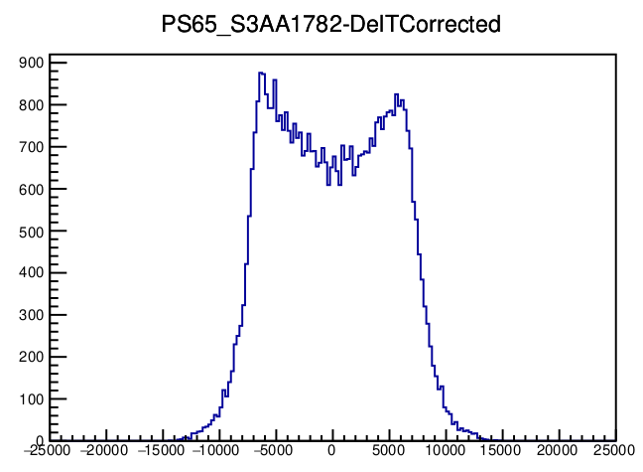
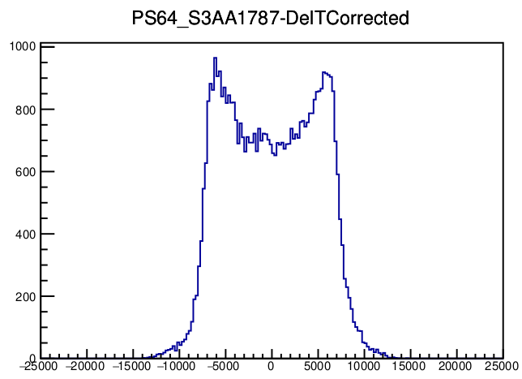
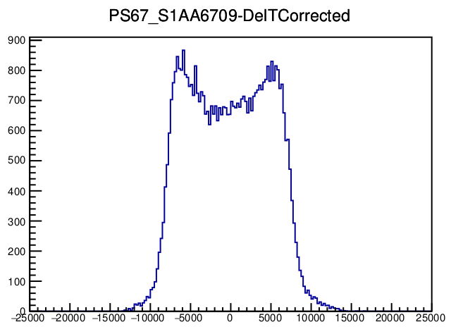
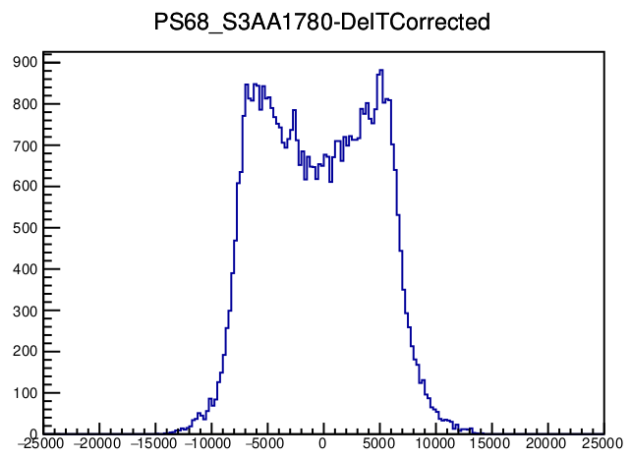
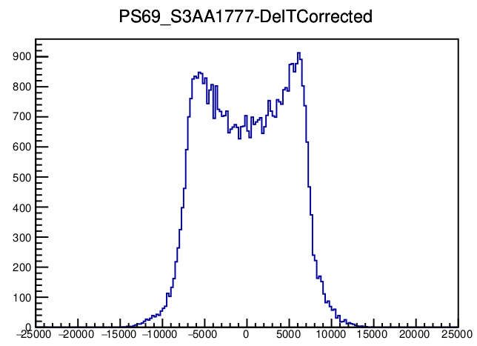
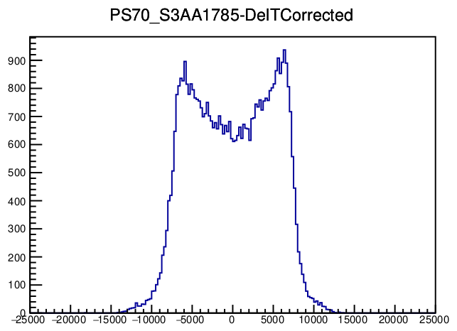
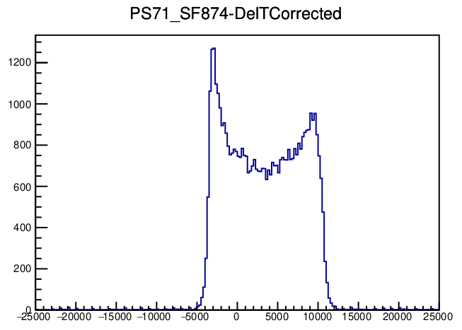
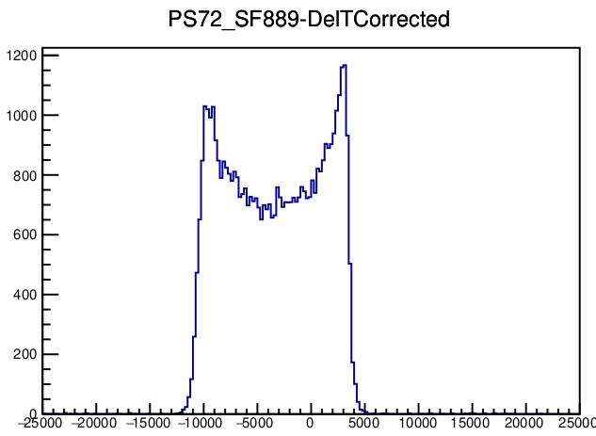

Slide 12
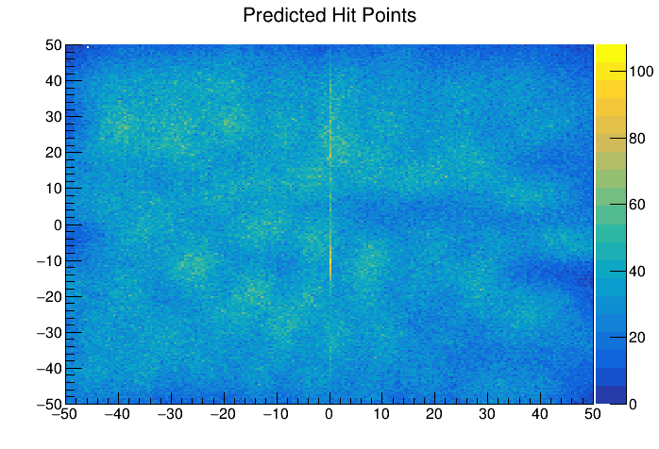
Layer 1
Reconstructed Hit Points using experimental data
Hit Pattern in Cross Layer

Slide 13
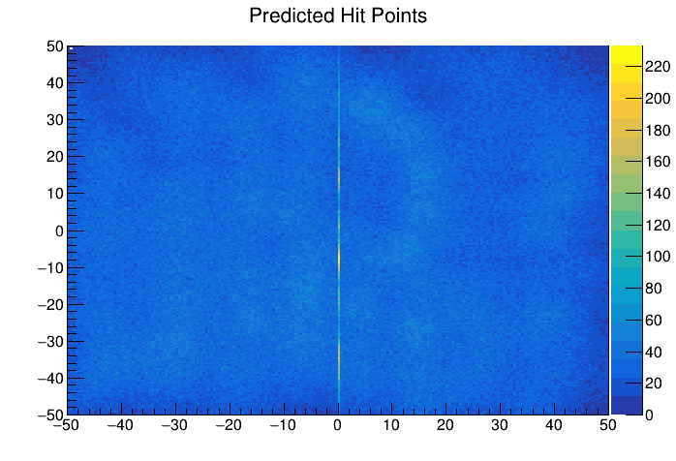
Layer 2
Reconstructed Hit Points using experimental data
Hit Pattern in Oblong Layer

Slide 14
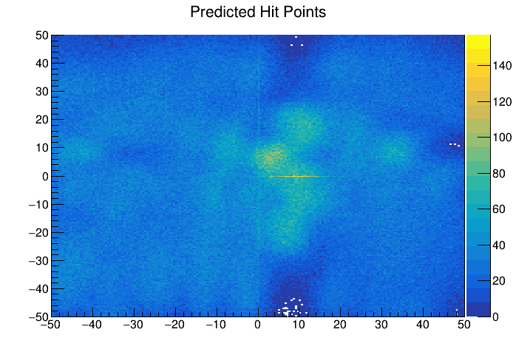
Layer 3
Reconstructed Hit Points using experimental data
Hit Pattern in Cross Layer

Slide 15
Idea : Can we even improve the hit coordinate along the axis itself using ML
Using Machine Learning
Using simulation, build separate model for each scintillator.
Learning features :
DeltaT
Energy depostion
Hit coordinate along axis from simulation
Prediction :
Hit coordinate along axis, using DeltaT and energy deposition.
For this to be done, we need to inject the detector behaviour in the simulations.
(Suggestions ??)

