Slide 1
Geant4 Simulation Of
Muon Tomography
Raman Sehgal
BARC

Slide 2
Outline
PART-1
Introduction to Geant4 (Simulation)
Some information about useful classes.
Building a simple geometry (a Cube) using Geant4
Extending the geometry to create a very simple Muon Tomography setup
Data Analysis using ROOT
PART-2
Handons Session
Prerequisites :
Basic knowledge of Linux operating system
Little bit C++
Introduction of basic linux command that will be required during handson practice
(Tutorial Sheet provided)
Instruction to Run the Simulation Program (Tutorial Sheet provided)
Instruction to do the data analysis (Tutorial Sheet provided)

Slide 3
Why do we need Simulation
To design the experimental setup
To compare the experimental results to make sure that there is no error in analysis.
To test the required algorithms
To optimize the detector geometry.
What is Geant4
GEANT4 is a toolkit for the simulation of the passage of particles through matter.
Written in C++ (But don’t worry)
Used in nuclear physics, high energy physics, accelerator physics,medical as well as space applications.
Nothing is Free of Cost (Geant does not provide simulation programs)
User has to build their simulation program for specific application.

Slide 4
Features
Provides a complete set of geometries that allow the used to create geometry of any type of detector.
Provides a rich set of predefined materials, Particles etc.
User can track the particle as it passes through matter and EM fields.
Allow to visualize the full detector, and also the events in real time.
Class Structure in Geant4
Mandatory classes
G4VUserDetectorConstruction
Define detector geometries and materials
G4VUserPhysicsList
Define Physics and Processes involved
G4VUserPrimaryGeneratorAction
Generation of Primary event
Action classes (Optional)
G4UserRunAction
G4UserEventAction
G4UserTrackingAction
G4UserSteppingAction

Slide 5
Defining Materials and Geometries
Defining Material
G4NistManager* nist = G4NistManager::Instance();
G4Material* world_mat = nist->FindOrBuildMaterial("G4_AIR");
There are three steps to define a geometry in Geant4
1) Geometrical Shapes (G4VSolid) : Specify the Shape and its dimensions
2) LogicalVolume (G4LogicalVolume) : Attach the material to the shape
3) PhysicalVolume (G4VPhysicalVolume) : Placement of Logical Shape in the setup
G4Box* solidWorld = new G4Box("World", //Name
50*cm, //Half length along X
50*cm, //Half length along Y
50*cm //Half length along Z);
G4LogicalVolume* logicWorld = new G4LogicalVolume(solidWorld, //its solid
world_mat, //its material
"World"); //its name
G4VPhysicalVolume* physWorld = new G4PVPlacement(0, //no rotation
G4ThreeVector(), //at (0,0,0)
logicWorld, //its logical volume
"World", //its name
0, //its mother volume
false, //no boolean operation
0, //copy number
checkOverlaps); //overlaps checking
Class Structure in Geant4

Slide 6
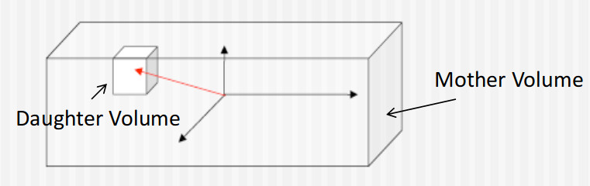
Physical Placements (Mother/Daughter relationship)
While building the detector geometry, one has to place different geometry one inside the another, and this placement follows Mother/Daughter relationship.
A volume is placed inside its mother volume.
Position and rotation of daughter volume is with respect to mother’s coordinate system.
Daughter volumes cannot protude from the mother volume.
Multiple daughter volumes cannot overlap
Class Structure in Geant4

Slide 7
Generating Primary Event (G4VUserPrimaryGeneratorAction )
This class is responsible for generating primary event
Its allow user to define following
1) Type of Particle gun
2) Location of Particle gun
3) Particle Energy
int n_particle = 10;
fParticleGun = new G4ParticleGun(n_particle);
fParticleGun->SetParticleDefinition(G4Electron::ElectronDefinition());
// Set the kinetic energy to 2 GeV
// and tell the gun to emit them along the negative z-axis
fParticleGun->SetParticleEnergy(50. * keV);
fParticleGun->SetParticlePosition(G4ThreeVector(0., 0., 120 * cm ));
fParticleGun->SetParticleMomentumDirection(G4ThreeVector(0., 0., -1.));
Using Physics process in simulation (G4VUserPhysicsList)
Geant4 provides a wide variety of physics components for use in Simulation, which are coded as Processes
Process class tells the particle, how to interact with Detector material
User can also write his own process class

Slide 8
Geant4 Work flow
Run
In Geant4, a run is a collection ofevents which share the same detector and physics conditions.
•A run consists of one eventloop.
•At the beginning of a run, geometry is optimizedand cross-section tables are calculated according to materials appear in the geometry and thecut-off valuesdefined.
•A run starts withBeamOn()method ofG4RunManager.
Event
An event is the basic unit of simulation in Geant4.•
G4Event class represents an event.
•It has following objects at the end ofits successful processing.
-List of primary vertices and particles(as input)
-Hits and Trajectory collections (as output)
Track
Track is a snapshot of a particle.
•G4TrackingManager manages processing a track,
A track is represented by G4Track class.

Slide 9
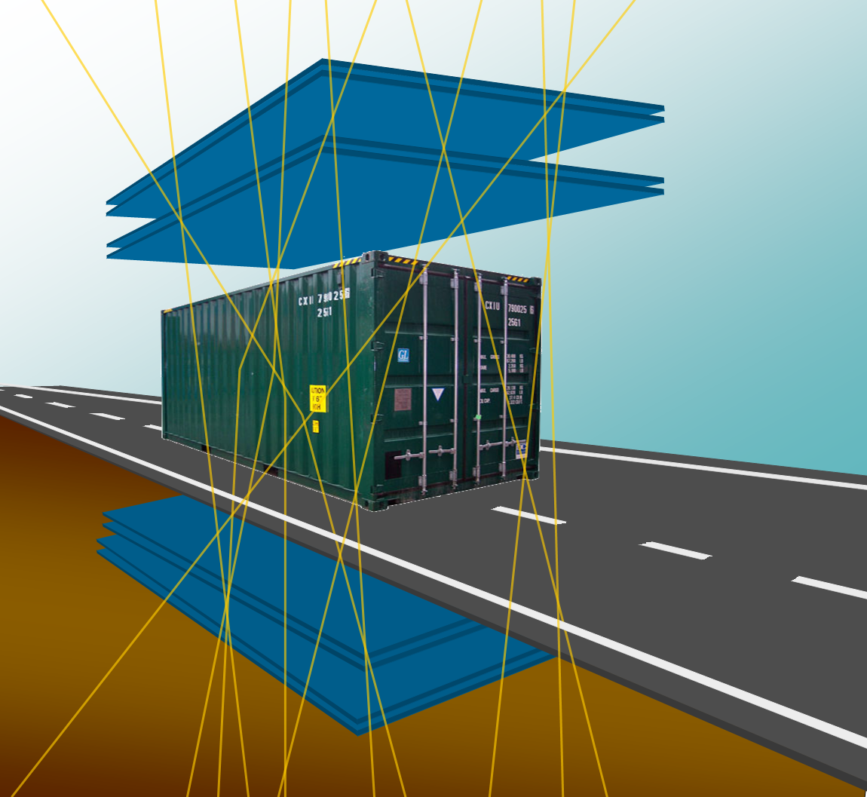
Application : Muon Tomography
Muon tomography is a technique that uses cosmic ray muons to generate three-dimensional images of volumes using information contained in the Coulomb scattering of the muons.
Secondary cosmic muons: highly penetrating radiations (even more than X-rays)
Average energy : 3 to 4 GeV
(Free of Cost) “Natural” radiation
Muonic interactions well understood, the main physics process under study is Multiple Coulomb Scattering
Muon scattering strongly dependent on the Z of the material
Dr. L. M. Pant & Raman Sehgal 1/12

Slide 10
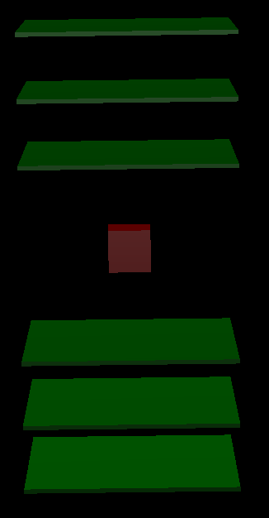
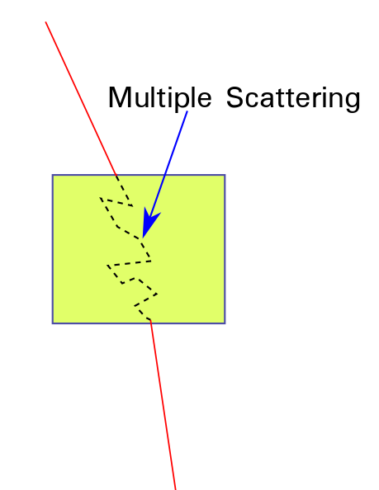
Geant4 Simulation setup for Muon Tomography
The physics process under study is Multiple scattering
Geometry Setup
Physics list used FTFP_BERT
Particle gun : Muon
Size of Detector : 1m X 1m
Number of Detectors : 6
Size of Scatterer : 20cm X 20cm X 20cm
Muon Energy and angular distribution
3 GeV (ie. Monoenergetic muon)
Firing from a given point vertically down
Firing in all random direction
In reality cosmic muons follow COS²θ
Scatterer used : Al, Fe, Pb
Shape of Scatterer : Cube
Target : To produce the scattering histogram, to distinguish between different material

Slide 11
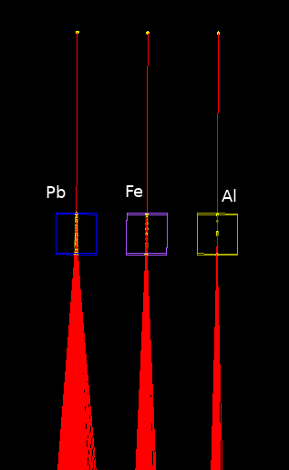
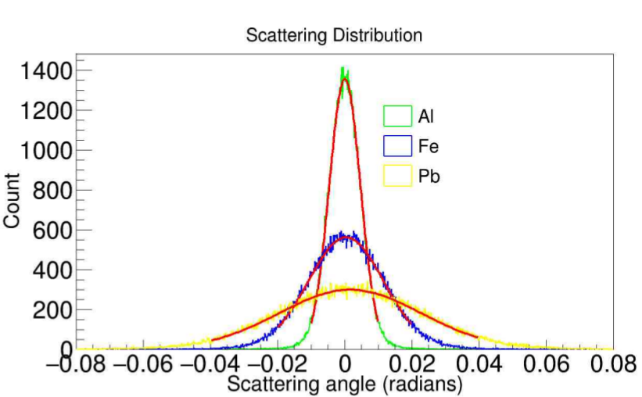
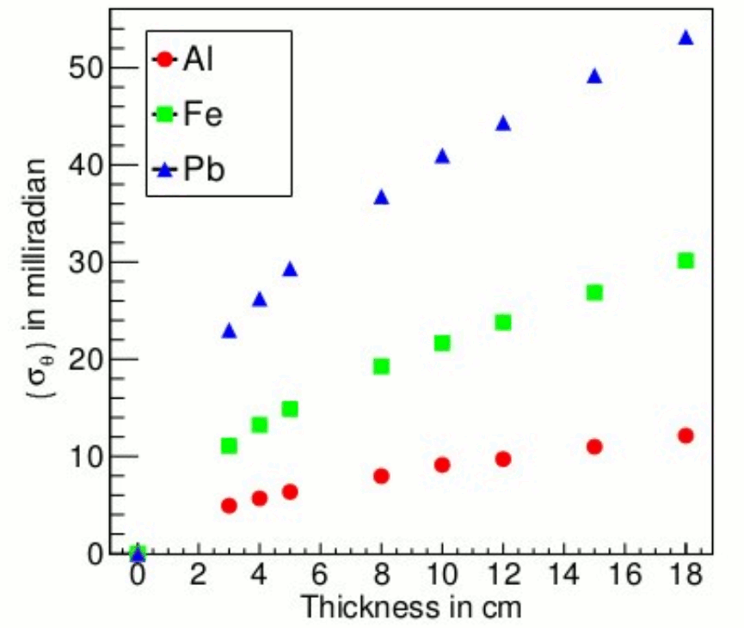
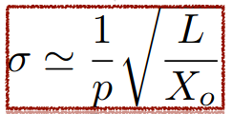
Muon Tomography : Material Discrimination and Identification
Materials can be discriminated by calculating the standard deviation of the measurement of scattering of N muons passing through the object.
This can tell that one material is having more Z relative to other, but cannot tell what actually is the material.
Two material of different thicknesses may give same scattering angle distribution.
To detect the correct material one has to estimate some material property.
Radiation Length can be one such good property
Try to calculate the radiation length of
Al, Fe and Pb, and compare them with theoritical values
Materaial | Radiation Length
Al | 8.897 cms
Fe | 1.797 cms
Pb | 0.561 cms

Slide 12
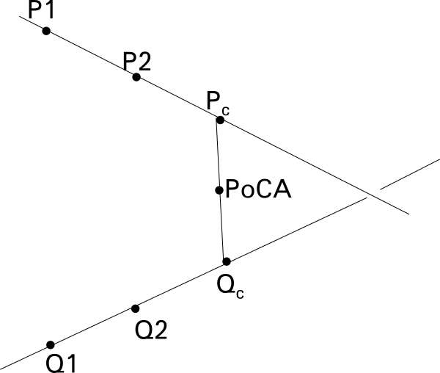
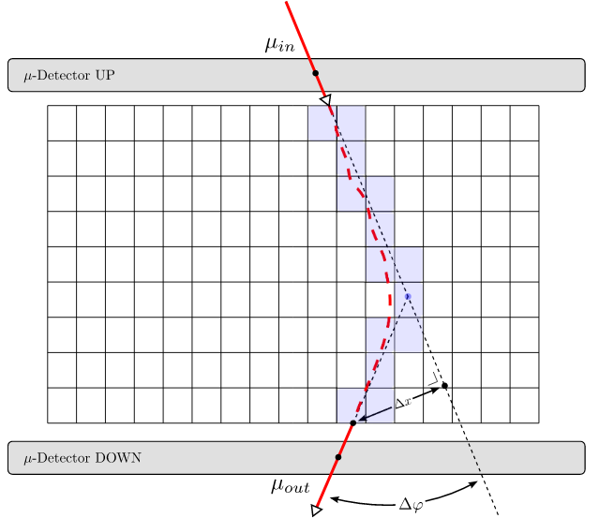
Lets do some reconstruction
The two most famous reconstruction algorithms for muon tomography are
1) Point of Closest Approach (PoCA)
2) Maximum Likelihood Expectation Maximization (MLEM)
PoCA is simplest and purely geometrical algorithm
Pros : Its very fast and and quickly gives you the location of object.
Cons : It does not takes any multiple scattering physics into consideration, as a result of this assigns the full scattering to single PoCA point.
Also gives a alot of false positives, and hence some postprocessing filteration algorithm are required
MLEM is an iterative algorithm, and works by dividing the volume of interest into Voxels
Pros : Makes use of Multiple scattering physics and assign scattering
value to the voxel that comes along the Muon Path.
Cons : Needs more computation power and time to converge.

Slide 13
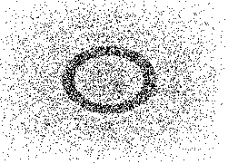
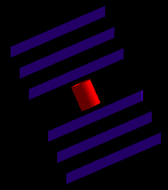
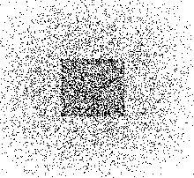
PoCA Reconstruction Results
Top View of Hollow tube
Top View of Cube

