Slide 1

Python: Coding Guidelines, Tooling, Testing and Packaging

Slide 2
JAN SCHAFFRANEK

Slide 3
Who am I
M.Sc. Applied Computer Science (Machine Learning)
Working as an algorithm engineer at ZF for autonomous driving
Instructor on Udemy since December 2017

Slide 4
Python: Coding Guidelines, Tooling, Testing and Packaging

Slide 5
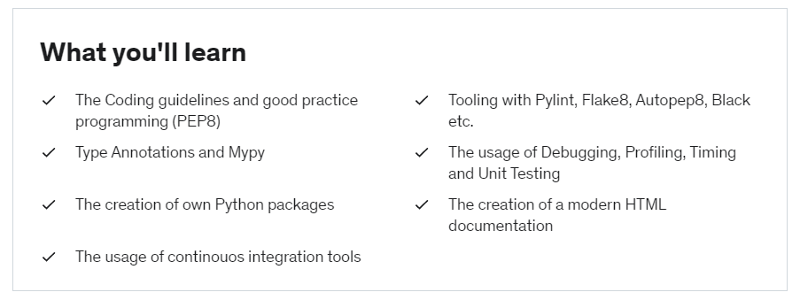
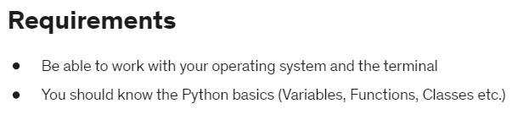
The course

