Slide 1
[LGC] Understanding the importance of model-free approach + an example implementation
eCAL
Raja Selvakumar
08/13/18

Slide 2

Dynamic programming: overview
Summary
Minimize cost/maximize benefit using discretized time steps
Sequentially finding optimal solutions to subproblems of the larger problem: value/policy iteration
Creates large state and decision spaces subject to the curses of dimensionality
Bellman principle of optimality: For all k=0,1,…,N-1:
Common applications
Task scheduling, trajectory planning, stochastic control problems
Background
Example
Next Steps
Notes:
We find optimal solutions to the subproblems using a value or policy iteration in order to find an optimal solution to the larger problem. DP is subject to the curses of dimensionality: mainly the size of the state, action, and outcome space causing significant increases in complexity.
Notation: c_{k} is the cost function while V_{k} is the value function. X_{k} is the state vector while u_{k} is the input vector.

Slide 3
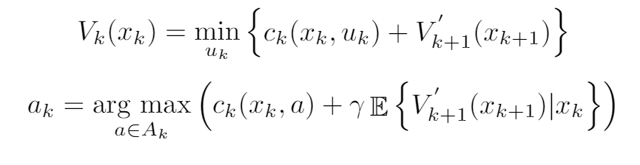
The actor-critic algorithm: model-based RL
Summary
Adding a “critic” to assess the reward (value) associated with each action (policy)
Approximate dynamic programming (ADP) is a form of this real-time optimal decision-making: critic is the function approximator
Key Equation(s)
Background
Example
Next Steps

Slide 4
Overall comparison of different RL techniques
 | Simulation | DP | ADP | RL
Temporal dependence | Forward time-stepping | Backward time-stepping | Infinite time horizon; requires state transition information | Infinite time horizon
Required input(s) | Parameters, model dynamics | Parameters, discretized state + control space, model dynamics, reward function | Parameters, initial weights, reward function, control objective | Parameters, control objective
Calculated output(s) | State and output profiles | Output profiles | Output profiles and function approximations | Output profiles
Predicted solution time¹ | 1 | - | - | ?
Predicted accuracy | 1 | 0.99 | 0.92 | ?
¹Normalized to simulation time, predictions based on preliminary tests/literature estimates
Background
Example
Next Steps
Notes:
Please see References slide for selected literature on the topic

Slide 5
Actor-critic: Algorithm Block Diagram
Grad desc
update critic weights
w _{c,k+1}
x_{k}
Critic
Neural Network 1
V_{k}’
Maximize reward
Need r(x_{k},u_{k})
From DFN
u_{k}
DFN
V_{k}’
EXP
x_{k}
Actor
Neural Network 2
Minimize error
e_{c} = V_{k}’-(V_{k-1}’-r_{k})
u_{k}*
From DFN
u_{k}
To experiments
w _{a,k+1}
Grad desc
update actor weights
Notes:
k denotes each individual time step
ADP assess how good the function approximation is close to the desired reward
We provide the state space and initial control from DFN/other echem model results. Find optimal control to use in experimental controller

Slide 6
Actor-critic: Critic Overview
Steps
0. Iterate forward in time
Obtain state information from DFN, construct x_{k} at every time step k
Get control values from Actor, append to x_{k} to construct {x_{1..m},u_{1..n}}_{k}
Use neural network to predict J_{k}^
Repeat 1-3 with w_{c,k+1} calculated from gradient descent algorithm from Reward subroutine
From reward update
w _{c,k+1}
x_{k}
Critic
Neural Network 1
J_{k}^
From DFN
To reward
u_{k}
From Actor
Notes:
k denotes each individual time step
ADP assess how good the function approximation is close to the desired reward
We provide the state space and initial control from DFN/other echem model results. Find optimal control to use in experimental controller

Slide 7
Actor-critic: Critic Visual Representation
x₁
.
.
.
x_{m}
u₁
.
.
.
u_{n}

Slide 8
ADP: Reward subroutine overview
Steps
0. Iterate forward in time
Obtain J_{k}^ from critic
Combine with reward and previous fn approximation to create e_{c}
Minimize 0.5 e_{c}² over all weights w_{c}
Yield w_{c}, send to Critic
From previous fn approximation
J_{k-1}^
J_{k}^
Maximize reward
w _{c,k+1}
From Critic
To Critic
r(x_{k},u_{k})
Reward function
Notes:
k denotes each individual time step
ADP assess how good the function approximation is close to the desired reward
We provide the state space and initial control from DFN/other echem model results. Find optimal control to use in experimental controller

Slide 9
Actor-critic: Actor overview
Steps
Obtain state information from DFN, construct x_{k} at every time step k
Initialize weights: w_{a}⁽¹⁾ and w_{a}⁽²⁾
Use neural network to predict J_{k}^
Repeat 1-3 with w_{c,k+1} calculated from gradient descent algorithm from Reward subroutine
From reward update
w _{a,k+1}
x_{k}
Actor
Neural Network 1
u_{k}
From state space
To reward
J_{k}^
From Critic
Notes:
k denotes each individual time step
ADP assess how good the function approximation is close to the desired reward
We provide the state space and initial control from DFN/other echem model results. Find optimal control to use in experimental controller

Slide 10
References
[1] Wahl et. al, 2014. IEEE ISVP. doi: 10.1109/IVS.2014.6856459
[2] Nascimento et. al, 2007. IEEE ISADPRL. doi: 10.1109/ADPRL.2007.368169
[3] Scott et. al, Operations Research. Accessed online.
[4] Dong et. al, 2011. ICAR. Accessed online.
[5] Zhang et. al, 2017. IEEE TSG. doi: 10.1109/TSG.2015.2505298
[6] van der Herten et. al, 2016. arXiv preprint arXiv:1608.04550
[7] Li et. al, 2018. IEEE TITS. Advance Online Publication.
[8] Xu et. al, 2018. AiMES. Submitted abstract online.

Slide 11
Backup

Slide 12
Dynamic programming: algorithm
Step 1: Load parameters and discretized state space
Step 2: Iterate backwards in discretized time
Step 3: Create ‘for’ loops for each state
Step 4: Set bounds on control space based on min/max formulation
e.g.
Step 5: Solve Bellman equation at each time point
e.g.
Step 6: Repeat
Step 7: Simulate over control matrix given initial state values
Background
Example
Next Steps

Slide 13
Approximate dynamic programming: sample algorithm
Step 1: Load parameters and initial weights/other ADP parameters
Step 2: Iterate forward in discretized time
Step 3: Create ‘for’ loop for function approximation subroutine
Step 4: Initialize Actor/Critic to obtain a) J^ and b) u*
Step 5: Compute state transition given prior model dynamic information
Step 6: Repeat
Advantage: Reduce time required to compute value function at each time step
Disadvantage: Reduction in model accuracy and still requiring knowledge of system
Background
Example
Next Steps

Slide 14
Model based RL: Actor overview- parameter list
Expression | Size | Coming from? | Going to?
x_{k}: State vector | [m,1] | Input neurons | σ_{a}
w_{a}⁽¹⁾: 1st weighting matrix | [N_{ah},m] | Input neurons | σ_{a}
σ_{a}: Σw_{ai,k}⁽¹⁾x_{ik} | [N_{ah},1] | Input neurons | q_{a}
q_{a}: Φ(σ_{a}) -> tanh(0.5σ_{a}) | [N_{ah},1] | σ_{a} | Hidden neurons
w_{a}⁽²⁾: 2nd weighting matrix | [n,N_{ah}] | Hidden neurons | μ_{a}
μ_{a}: Σw_{az,k}⁽²⁾q_{az} | [n,1] | Hidden neurons | u_{n}
u_{n}: Φ(μ_{a}) -> tanh(0.5μ_{a}) | [n,1] | μ_{a} | Output neurons
J_{k}^: Function approximation
Notes:
k denotes each individual time step
ADP assess how good the function approximation is close to the desired reward
We provide the state space and initial control from DFN/other echem model results. Find optimal control to use in experimental controller

Slide 15
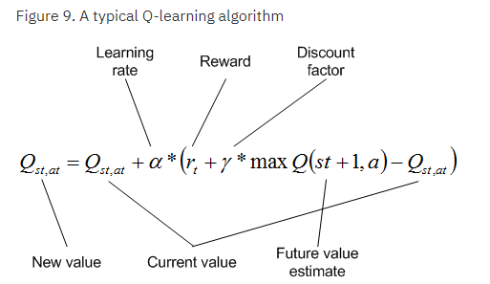
Model-free reinforcement learning: overview
Summary
Model-free framework to obtain optimal control decisions
Actor interacts with environment, adapts based on stimulus reaction
Tradeoff of removing model dynamics vs accuracy in final solution
Useful when analytical methods become infeasible, e.g. finite Markov Decision Problems (MDP), multi-armed bandit problem
Examples
Q-learning, temporal difference
Source: IBM
Background
Example
Next Steps
Notes:
Model-free framework is used where an actor obtains a reward from external stimulus with the environment. It subsequently adapts the decision-making process to maximize/minimize the reward.

