Slide 1
Literature findings: “ADP” “battery” “RL”
Raja Selvakumar
7/5/18
eCAL

Slide 2
Agenda
Discussion of overall project progress
Key literature findings

Slide 3
Overall project progress: Raja Selvakumar
Week of 6/4 | Week of 6/11 | Week of 6/18 | Week of 6/25 | Week of 7/2
SPM/ADP Literature Review
ADP + optimal control literature review
OCV-R implementation: Python
Week of 7/9 | Week of 7/16 | Week of 7/23 | Week of 7/30 | Week of 8/6-14
TBD
Full max charge ECM: Python

Slide 4
Overall project progress
Completed:
Preliminary literature review
SPM, ECT: limitations of such models
In progress:
ADP/battery literature review
Complete ECM: DP formulation/writeup
Implement ECT (equivalent circuit + thermal model) into python

Slide 5
Literature review: overview
Motivation: As we are converting the maximum charge/minimum time problem to a dynamic programming (DP) problem, we need to identify an appropriate objective function and determine feasibility of given electrochemical model used
Literature: Survey literature topics covering the intersection of reinforcement learning (RL) techniques used to model parameters in battery charging
Method: Search Google Scholar, characterize: 1) high level objective 2) formulation/approach + findings and 3) how it relates to the LG Chem project
Result: x new articles discovered, findings documented in link

Slide 6
Literature review: key results
Objective: Survey literature topics covering the intersection of reinforcement learning (RL) techniques used to model parameters in battery charging. As we are converting the maximum charge/minimum time problem to a dynamic programming (DP) problem, we need to identify an appropriate objective function and characterize
Result: x new articles discovered, findings documented in link

Slide 7
Backup

Slide 8
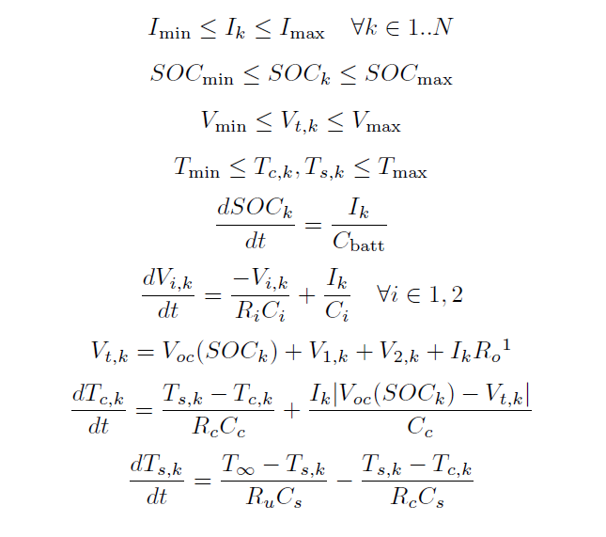
OCV-R DP Formulation

