Slide 1
Garnering a deeper understanding of the actor-critic algorithm
Raja Selvakumar
7/19/18
eCAL

Slide 2
Agenda
Technical summary/definitions
Key literature findings
Next steps

Slide 3

Dynamic programming: overview
Summary
Minimize cost/maximize benefit using discretized time steps
Sequentially finding optimal solutions to subproblems of the larger problem: value/policy iteration
Creates large state and decision spaces subject to the curses of dimensionality
Sample implementation
Bellman principle of optimality: For all k=0,1,…,N-1:
Common applications
Task scheduling, trajectory planning, stochastic control problems
Background
Literature
Next Steps
Notes:
We find optimal solutions to the subproblems using a value or policy iteration in order to find an optimal solution to the larger problem. DP is subject to the curses of dimensionality: mainly the size of the state, action, and outcome space causing significant increases in complexity.
Notation: c_{k} is the cost function while V_{k} is the value function. X_{k} is the state vector while u_{k} is the input vector.

Slide 4
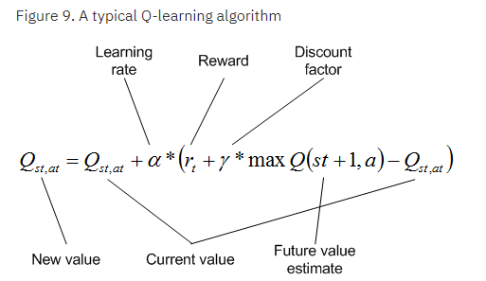
Model-free reinforcement learning: overview
Summary
Model-free framework to obtain optimal control decisions
Actor interacts with environment, adapts based on stimulus reaction
Useful when analytical methods become infeasible, e.g. finite Markov Decision Problems (MDP), multi-armed bandit problem
Source: IBM
Background
Literature
Next Steps
Notes:
Model-free framework is used where an actor obtains a reward from external stimulus with the environment. It subsequently adapts the decision-making process to maximize/minimize the reward.

Slide 5
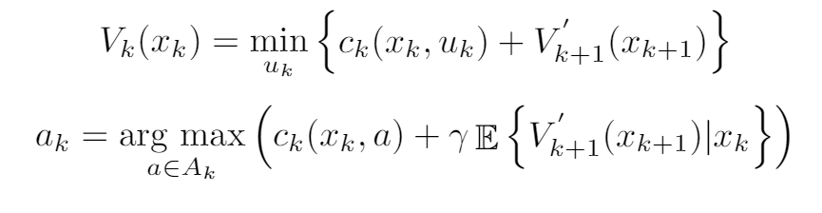
The actor-critic algorithm: model-based RL
Adding a “critic” to assess the reward (value) associated with each action (policy)
Approximate dynamic programming (ADP) is a form of this real-time optimal decision-making: critic is the function approximator
Key Equation(s)
Background
Literature
Next Steps

Slide 6
Literature review: relevant papers
Title | Method | Application | Objective Function | Unique ECT vars | Key Findings
Wahl et. al 2014 | ADP | Far trajectory planning | HDP: min LSQ on critic error ¹ | - | Precise w/in 7% Big comp decrease
Powell 2012 | ADP | Grid energy storage | Min LSQ (HDP), KGCP ² | - | Direct policy > min LSQ
Dong et. al 2011 | DP | BESS peak shaving | Min variance of load + BESS output | #Discharge cycles, DOD constraints | N/A
Zhang 2015 | ADP | EV charging stations | TSADP: (1) LP (2) Monte Carlo ADP | - | 2.5% better than ADP on average
Li 2018 | ADP | ACC in HEV | Min LSQ (HDP), gradient descent | - | ACC reduces fuel consumption by 4.11%
^{Spreadsheet link}
¹Please refer to the backup slides for a detailed explanation on this algorithm
²Knowledge gradient for continuous parameters. Finds optimal policy for continuous state space sampling the past and current decisions
Background
Literature
Next Steps

Slide 7






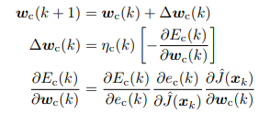
Sample implementation of ADP
Construct initial state and control space:
Determine σ₀:
Determine q₁:
Approximate value function J₁:
Compute error:
Minimize error over all weights w₁,w₂:
Update weights with grad descent:
Repeat
Background
Literature
Next Steps

Slide 8
Next steps
Construct reward function to test with Bellman error minimization
Research direct policy algorithm
Specifically: applications with large state spaces. Complex system dynamics. PDEs
Background
Literature
Next Steps

Slide 9
References
[1] Wahl et. al, 2014. IEEE ISVP. doi: 10.1109/IVS.2014.6856459
[2] Nascimento et. al, 2007. IEEE ISADPRL. doi: 10.1109/ADPRL.2007.368169
[3] Scott et. al, Operations Research. Accessed online.
[4] Dong et. al, 2011. ICAR. Accessed online.
[5] Zhang et. al, 2017. IEEE TSG. doi: 10.1109/TSG.2015.2505298
[6] van der Herten et. al, 2016. arXiv preprint arXiv:1608.04550
[7] Li et. al, 2018. IEEE TITS. Advance Online Publication.
[8] Xu et. al, 2018. AiMES. Submitted abstract online.

Slide 10
Backup

Slide 11
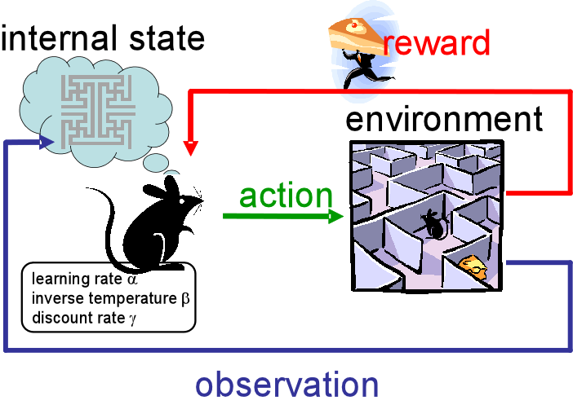
RL Schematic
Source: Medium

Slide 12
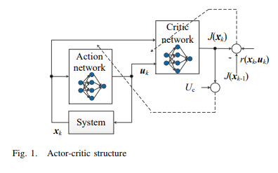
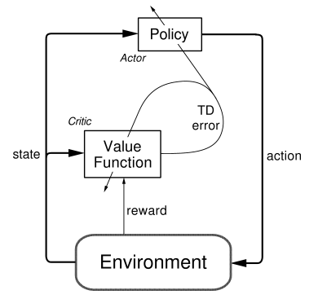
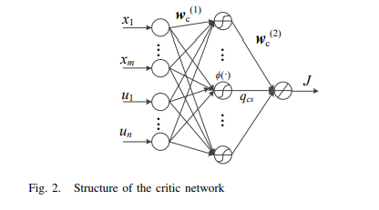
Actor-critic schematic
Source: Li, G 2018.
Source: SlideShare

Slide 13
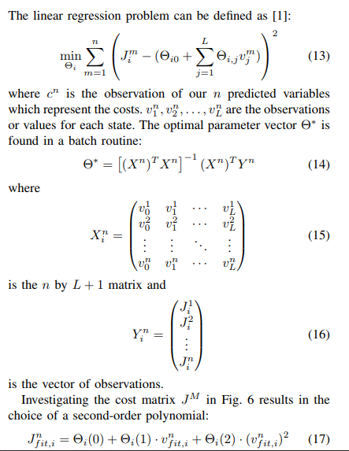

Critic error algorithm
Source: Wahl et. al, 2014

Slide 14
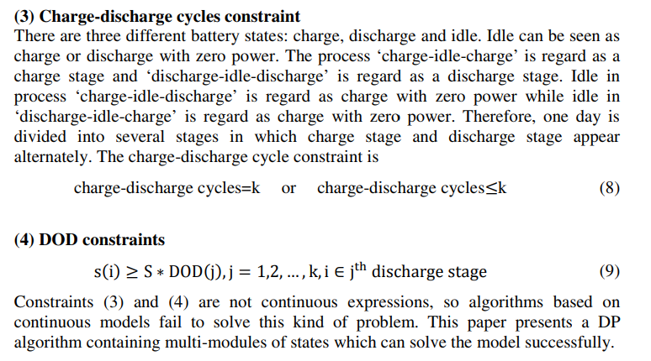
X. Dong constraints
Source: Dong et. al 2011

Slide 15
Overall project progress: Raja Selvakumar
Week of 6/4 | Week of 6/11 | Week of 6/18 | Week of 6/25 | Week of 7/2
SPM/ADP Literature Review
ADP + optimal control literature review
OCV-R implementation: Python
Week of 7/9 | Week of 7/16 | Week of 7/23 | Week of 7/30 | Week of 8/6-14
TBD
Full max charge ECM: Python

Slide 16
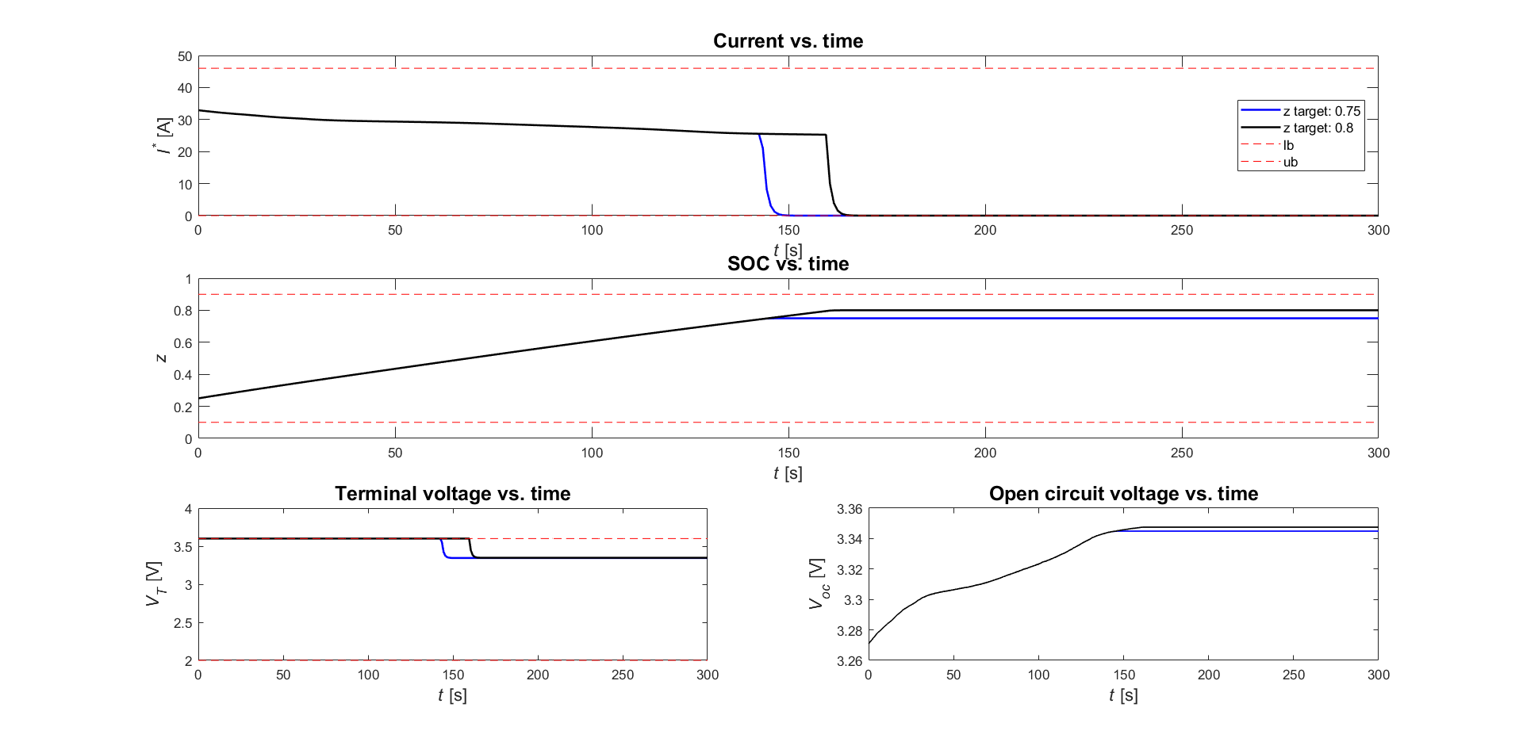
OCV-R DP Formulation

