Slide 1
Weekly Meeting Update
Raja Selvakumar
6/12/18

Slide 2
Agenda
Address literature review questions
Develop plan moving forward

Slide 3
Questions
What is LGR quadrature? How does one transform a nonlinear set of equations into a PDAE optimization problem? ¹
What are the current constraints being used in the DFN implementation? ²
DFN control problem: what is the objective function? Are we looking to use a similar LMRG approach?
¹Perez et. al 2017. “Optimal Charging of Li-Ion Batteries via a Single Particle Model with Electrolyte and Thermal Dynamics”
²Perez et. al. 2015. “Enhanced Performance of Li-Ion Batteries via Modified Reference Governors and Electrochemical Models”
*Solid active material and electrolyte concentration, temperature, overpotential. Unclear what the control objective is in the original paper

Slide 4
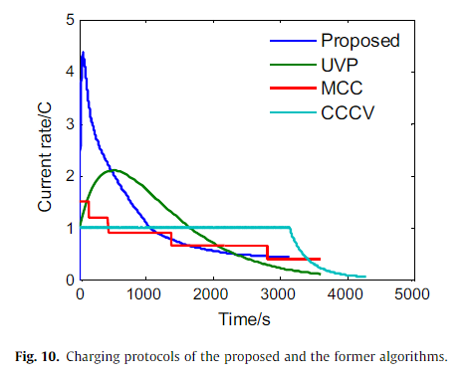
Questions (ctd)
How important is it to operate as close to the constraint limits as possible?
Difference between open and close loop charging control strategies?
Fig. 10: explaining difference between AOOL/CCML and CCCV?
¹Chu et. al 2017. “Non-destructive fast charging algorithm of lithium-ion batteries based on the control-oriented electrochemical model”
*AOOL: anode over potential observation loop, CCML: charging current modification loop

Slide 5
Next steps
RL
LG Chem Params
SPMeT
MPC

