Slide 1
Literature findings
Raja Selvakumar
LG Chem: Internal Biweekly Update
eCAL
6/21/2018

Slide 2
Papers to discuss today
Paper | Keywords | Application | Novelty? | Key results
Wahl et. al 2014 | ADP, OSMPC | Trajectory opt | ADP approximates dynamic cost-to-go term | 0.97% cost deviation, 99% reduction in memory
Nascimento et. al 2007 | Concave opt, ADP, SPAR | Multistage stochastic control | ADP application to concave single asset acquisition | Scales to high dimension problems as well
Johannesson et. al 2007 | OSMPC | Trajectory opt | Explains development of the one-step model predictive control | 0.3% higher fuel consumption, realtime implementation
Sun et. al 2015 | RL, Free Time Horizon | Trajectory opt

Slide 3

Cost-to-go function framework
State (x_{k}) | Inputs (u_{k})
SOC | Engine, break, motor torque
 | Gear
 | Decoupling clutch
Algorithm
Start at N-1
Calculate μ_{k}*
Update cost matrix J_{k}^{M} (x_{k})
Calculate x_{k}*
Wahl et. al 2014

Slide 4
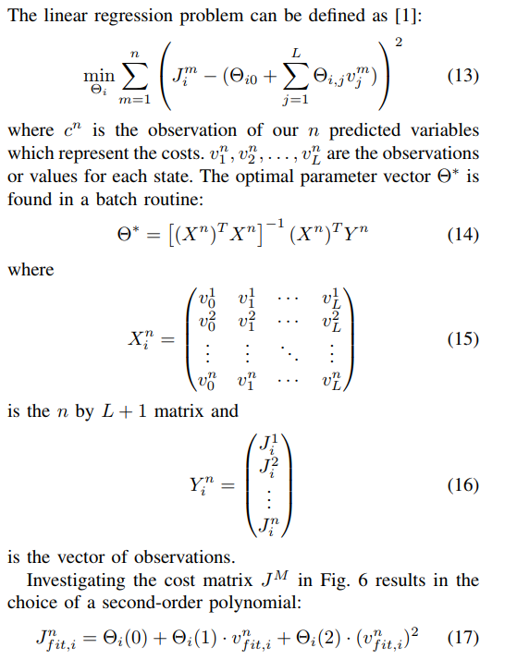
ADP used to approximate cost-to-go function for one-step model predictive control (OSMPC) framework
Algorithm
LSQ
2nd order polynomial fit
Wahl et. al 2014

Slide 5
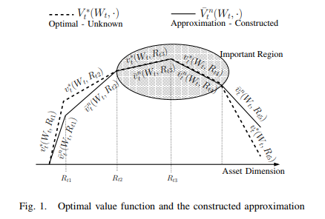
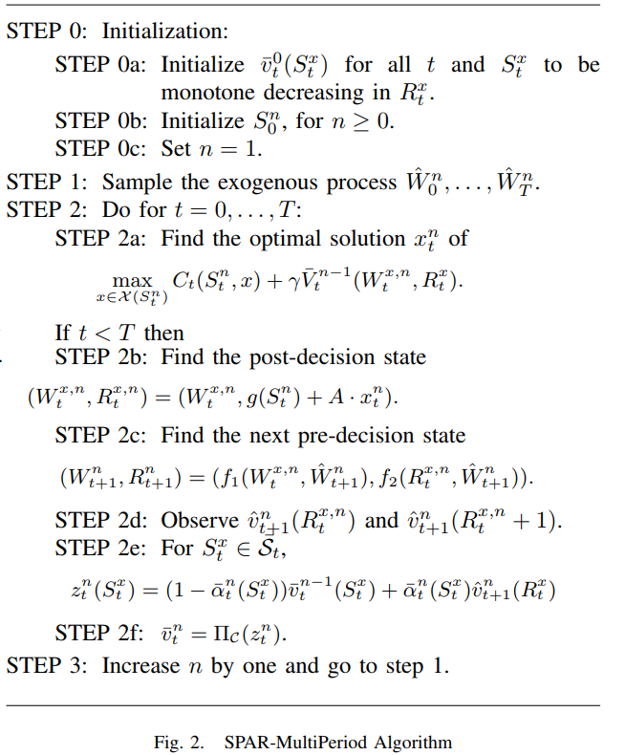
Concave optimal value functions
Nascimento et. al 2007

Slide 6
References
H. G. Wahl, M. Holzäpfel and F. Gauterin, "Approximate dynamic programming methods applied to far trajectory planning in optimal control," 2014 IEEE Intelligent Vehicles Symposium Proceedings, Dearborn, MI, 2014, pp. 1085-1090. doi: 10.1109/IVS.2014.6856459
L. Johannesson, M. Asbogard and B. Egardt, "Assessing the Potential of Predictive Control for Hybrid Vehicle Powertrains Using Stochastic Dynamic Programming," in IEEE Transactions on Intelligent Transportation Systems, vol. 8, no. 1, pp. 71-83, March 2007. doi: 10.1109/TITS.2006.884887
J. Nascimento and W. Powell, "An Optimal ADP Algorithm for a High-Dimensional Stochastic Control Problem," 2007 IEEE International Symposium on Approximate Dynamic Programming and Reinforcement Learning, Honolulu, HI, 2007, pp. 52-59. doi: 10.1109/ADPRL.2007.368169

Slide 7
Appendix

Slide 8

Free time horizon optimization
Sun et. al 2015

Slide 9
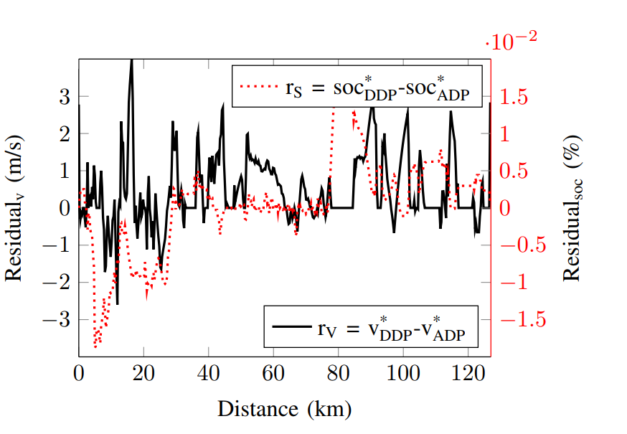
ADP-OSMPC results
Wahl et. al 2014

