Slide 1
Garnering a deeper understanding of the actor-critic algorithm
Raja Selvakumar
7/17/18
eCAL

Slide 2
Agenda
Technical summary/definitions
Key literature findings
Proposal for future

Slide 3

Dynamic programming: overview
Summary
Minimize cost/maximize benefit using discretized time steps
Sequentially finding optimal solutions to subproblems of the larger problem: value/policy iteration
Creates large state and decision spaces subject to the curse of dimensionality
Sample implementation
Bellman principle of optimality: For all k=0,1,…,N-1:
Common applications
Task scheduling, trajectory planning, stochastic control problems
Background
Literature
Next Steps

Slide 4
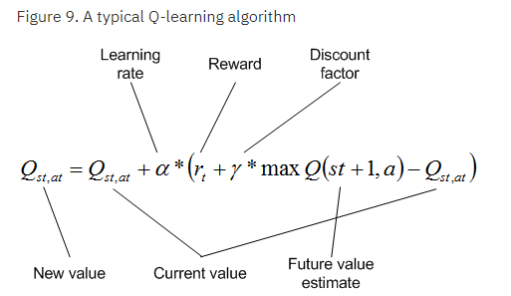
Reinforcement learning: overview
Summary
Model-free framework to obtain optimal control decisions
Actor interacts with environment, adapts based on stimulus reaction
Useful when analytical methods become infeasible, e.g. large state spaces, finite Markov Decision Problems (MDP), multi-armed bandit problem
Source: IBM
Background
Literature
Next Steps

Slide 5
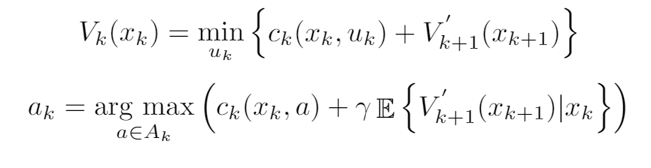
Introducing the actor-critic algorithm
Adding a “critic” to assess the reward (value) associated with each action (policy)
Approximate dynamic programming (ADP) is a form of this real-time optimal decision-making: critic is the function approximator
Key Equation(s)
Background
Literature
Next Steps

Slide 6
Literature review: relevant papers
Title | Method | Application | Objective Function | Unique ECT vars | Key Findings
Wahl et. al 2014 | ADP | Far trajectory planning | HDP: min LSQ on critic error ¹ | - | Precise w/in 7% Big comp decrease
Powell 2012 | ADP | Grid energy storage | Min LSQ (HDP), KGCP ² | - | Direct policy > min LSQ
Dong et. al 2011 | DP | BESS peak shaving | Min variance of load + BESS output | #Discharge cycles, DOD constraints | N/A
Zhang 2015 | ADP | EV charging stations | TSADP: (1) LP (2) Monte Carlo ADP | - | 2.5% better than ADP on average
Li 2018 | ADP | ACC in HEV | Min LSQ (HDP), gradient descent | - | ACC reduces fuel consumption by 4.11%
¹Please refer to the backup slides for a detailed explanation on this algorithm
²Knowledge gradient for continuous parameters. Finds optimal policy for continuous state space sampling the past and current decisions
Background
Literature
Next Steps

Slide 7






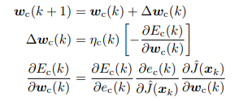
Sample implementation of DFN with ADP
Construct initial state and control space:
Determine σ₀:
Determine q₁:
Approximate value function J₁:
Compute error:
Minimize error over all weights w₁,w₂:
Update weights with grad descent:
Repeat
Background
Literature
Next Steps

Slide 8
Next steps
Construct reward function to test with Bellman error minimization
Research direct policy algorithm
Specifically: applications with large state spaces. Complex system dynamics. PDEs
Background
Literature
Next Steps

Slide 9
References
H. G. Wahl, M. Holzäpfel and F. Gauterin, "Approximate dynamic programming methods applied to far trajectory planning in optimal control," 2014 IEEE Intelligent Vehicles Symposium Proceedings, Dearborn, MI, 2014, pp. 1085-1090. doi: 10.1109/IVS.2014.6856459
J. Nascimento and W. Powell, "An Optimal ADP Algorithm for a High-Dimensional Stochastic Control Problem," 2007 IEEE International Symposium on Approximate Dynamic Programming and Reinforcement Learning, Honolulu, HI, 2007, pp. 52-59. doi: 10.1109/ADPRL.2007.368169
W.R. Scott and W.B. Powell, “Approximate Dynamic Programming for Energy Storage with New Results on Instrumental Variables and Projected Bellman Errors,” Operations Research, Princeton, NJ.
Dong X., Bao G., Lu Z., Yuan Z., Lu C. (2011) Optimal Battery Energy Storage System Charge Scheduling for Peak Shaving Application Considering Battery Lifetime. In: Yang D. (eds) Informatics in Control, Automation and Robotics. Lecture Notes in Electrical Engineering, vol 133. Springer, Berlin, Heidelberg
L. Zhang and Y. Li, "Optimal Management for Parking-Lot Electric Vehicle Charging by Two-Stage Approximate Dynamic Programming," in IEEE Transactions on Smart Grid, vol. 8, no. 4, pp. 1722-1730, July 2017. doi: 10.1109/TSG.2015.2505298
Joachim van der Herten, Ivo Couckuyt, Dirk Deschrijver, and Tom Dhaene. Fast Calculation of the Knowledge Gradient for Optimization of Deterministic Engineering Simulations. arXiv preprint arXiv:1608.04550, 2016.
G. Li and D. Gorges, “Ecological Adaptive Cruise Control and Energy Management Strategy for Hybrid Electric Vehicles based on Heuristic Dynamic Programming,” 2018 IEEE Transactions on Intelligent Transportation Systems. Advance Online Publication.

Slide 10
Backup

Slide 11
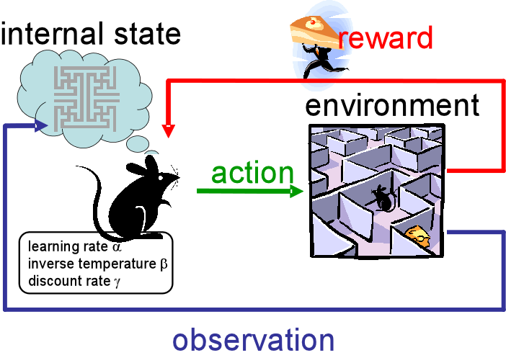
RL Schematic
Source: Medium

Slide 12
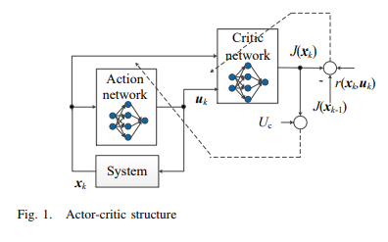
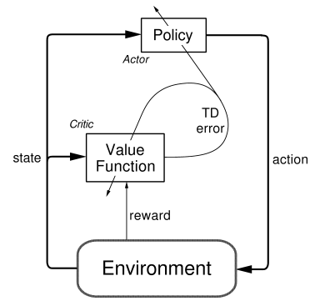
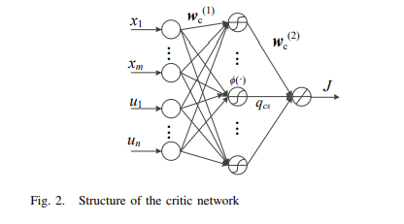
Actor-critic schematic
Source: Li, G 2018.
Source: SlideShare

Slide 13
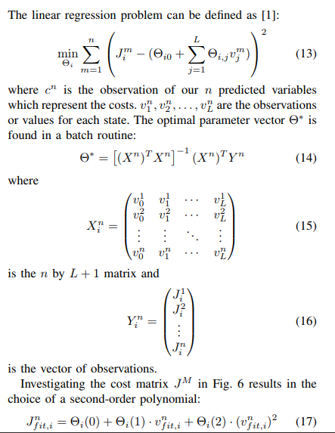

Critic error algorithm
Source: Wahl et. al, 2014

Slide 14
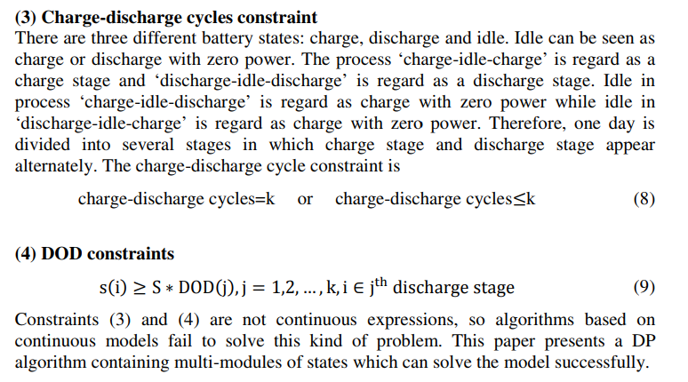
X. Dong constraints
Source: Dong et. al 2011

Slide 15
Overall project progress: Raja Selvakumar
Week of 6/4 | Week of 6/11 | Week of 6/18 | Week of 6/25 | Week of 7/2
SPM/ADP Literature Review
ADP + optimal control literature review
OCV-R implementation: Python
Week of 7/9 | Week of 7/16 | Week of 7/23 | Week of 7/30 | Week of 8/6-14
TBD
Full max charge ECM: Python

Slide 16
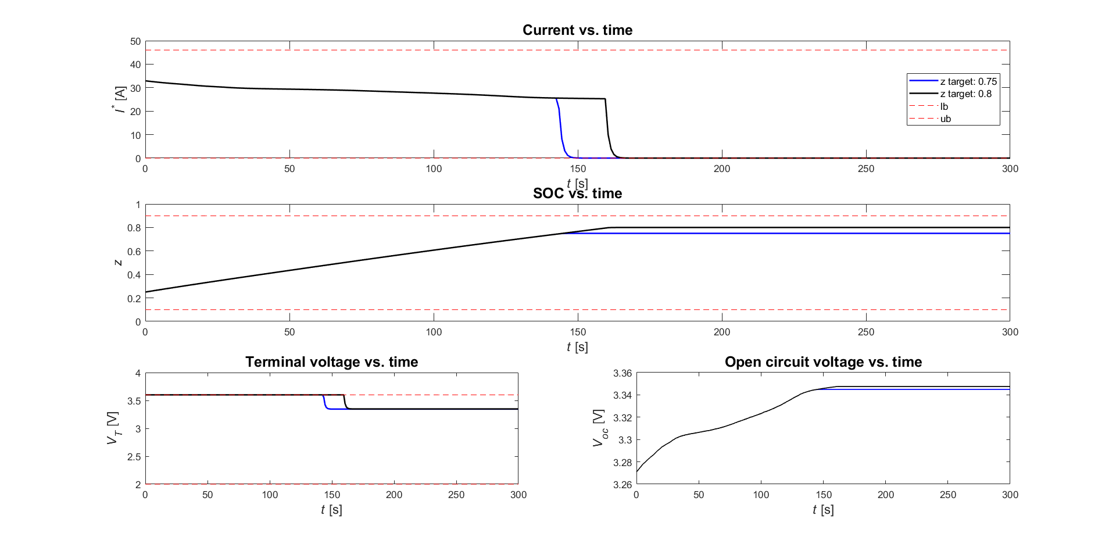
OCV-R DP Formulation

