Slide 1
DP: MATLAB/Python Update
Raja Selvakumar
7/19/18
eCAL

Slide 2
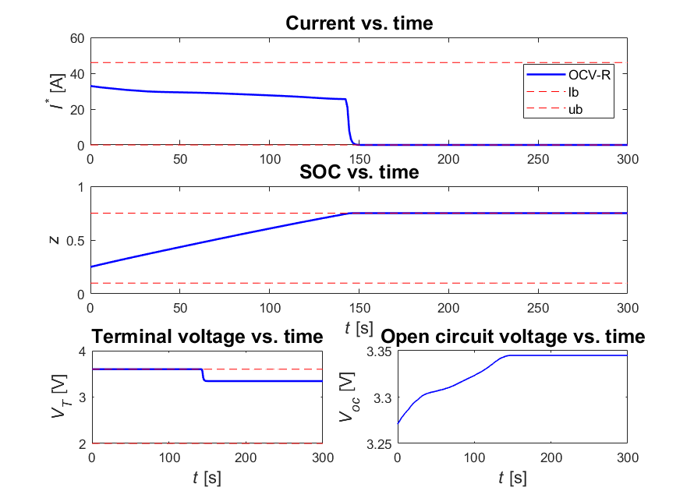
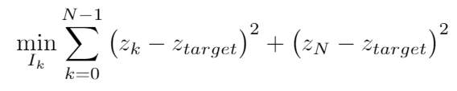
OCV-R: MATLAB
Specifications
z_{target} = 0.75
lb:
ub:
State(s): {z}
Control(s): {I}
Objective fn:
Remarks
Changing objective function has no impact on optimal control
DP time: 4.5-6.5 sec

Slide 3
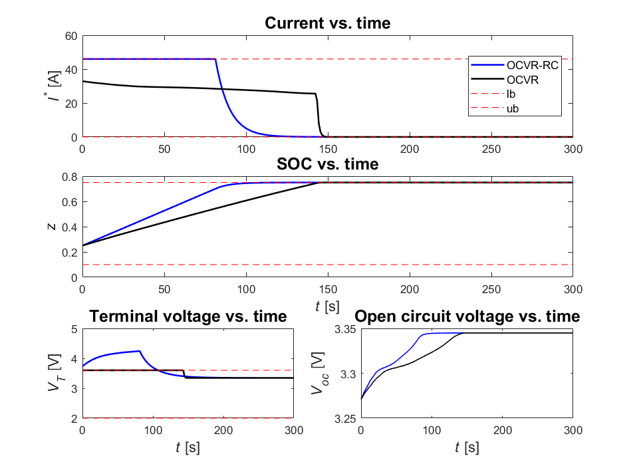
OCV-R-RC: MATLAB
Specifications
z_{target} = 0.75
lb:
ub:
State(s): {z}
Control(s): {I}
Objective fn:
MATLAB
DP time: 39-41 sec
Notes:
Main issue: finding appropriate limits to iterate over for V1

