Slide 1
[LGC] Biweekly Internal Meeting
eCAL
Raja Selvakumar
08/02/18

Slide 2
Overview
Status report on DP implementation of OCVR/OCVRRC models
MATLAB
Python
Breaking down actor-critic algorithm
Workflow
Pseudocode

Slide 3
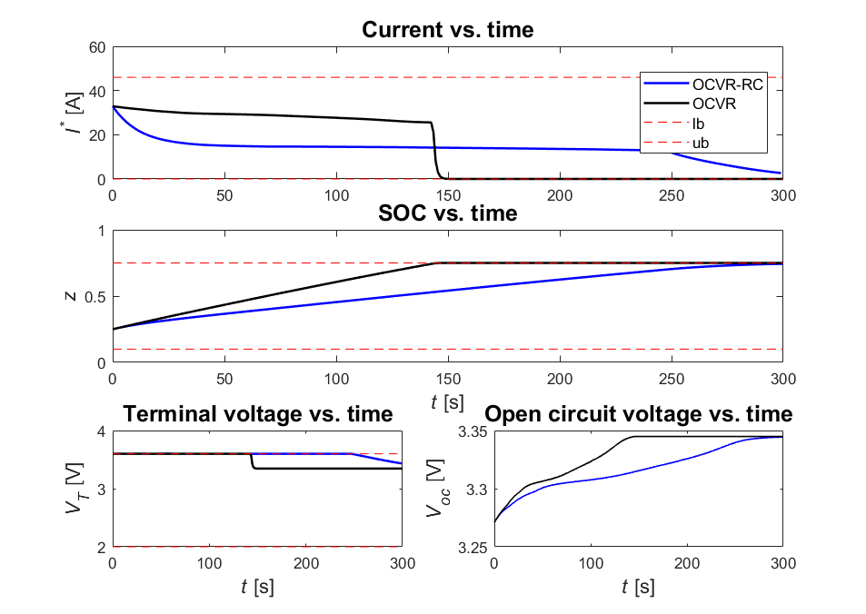
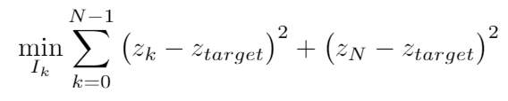
[MATLAB] OCVRRC Findings
Specifications
z_{target} = 0.75
lb:
ub:
State(s): {z}
Control(s): {I}
Objective fn:

Slide 4
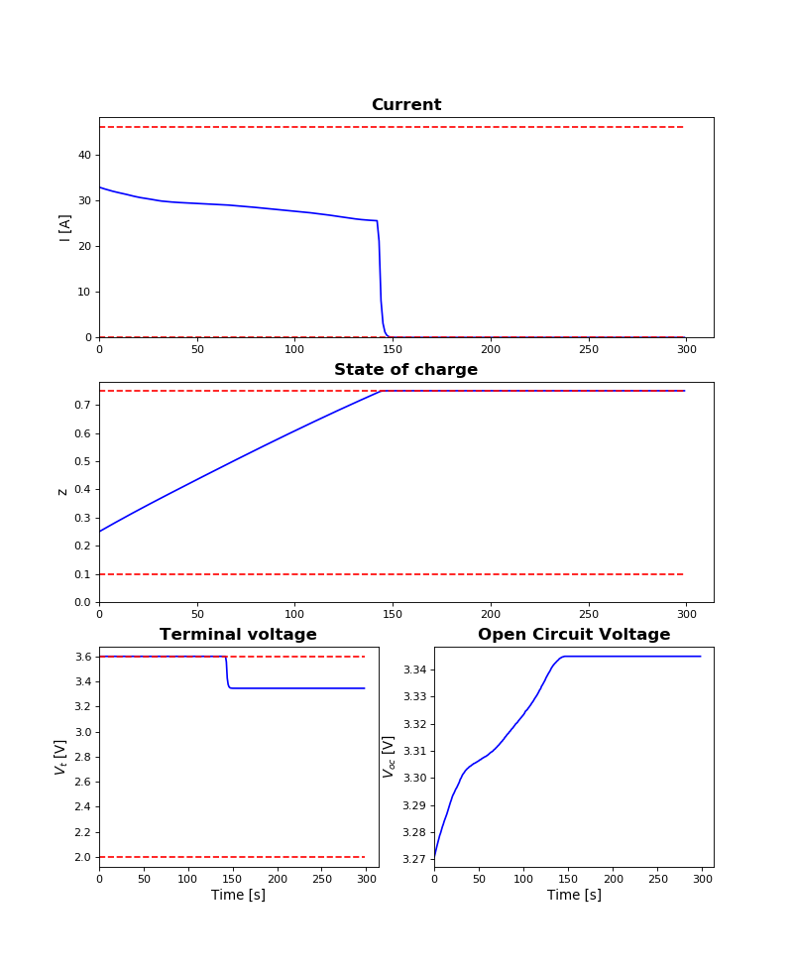
[Python] OCVR Findings
Specifications
z_{target} = 0.75
lb:
ub:
State(s): {z}
Control(s): {I}
Objective fn:
Remarks
Matching results from MATLAB
Much slower than MATLAB: 4s -> ~5 min
Notes:
OCVRRC: 2d interpolation issues

Slide 5
Approximate Dynamic Programming: Algorithm Block Diagram
Grad desc
update critic weights
w _{c,k+1}
x_{k}
Critic
Neural Network 1
J_{k}^
Maximize reward
Need r(x_{k},u_{k})
From DFN
u_{k}
DFN
J_{k}^
EXP
x_{k}
Actor
Neural Network 2
Minimize J_{k}^
u_{k}*
From DFN
u_{k}
To experiments
w _{a,k+1}
Grad desc
update actor weights
Notes:
k denotes each individual time step
ADP assess how good the function approximation is close to the desired reward
We provide the state space and initial control from DFN/other echem model results. Find optimal control to use in experimental controller

Slide 6
ADP: Critic Overview
Steps
0. Iterate forward in time
Obtain state information from DFN, construct x_{k} at every time step k
Get control values from Actor, append to x_{k} to construct {x_{1..m},u_{1..n}}_{k}
Use neural network to predict J_{k}^
Repeat 1-3 with w_{c,k+1} calculated from gradient descent algorithm from Reward subroutine
From reward update
w _{c,k+1}
x_{k}
Critic
Neural Network 1
J_{k}^
From DFN
To reward
u_{k}
From Actor
Notes:
k denotes each individual time step
ADP assess how good the function approximation is close to the desired reward
We provide the state space and initial control from DFN/other echem model results. Find optimal control to use in experimental controller

Slide 7
ADP: Reward subroutine overview
Steps
0. Iterate forward in time
Obtain J_{k}^ from critic
Combine with reward and previous fn approximation to create e_{c}
Minimize 0.5 e_{c}² over all weights w_{c}
Yield w_{c}, send to Critic
From previous fn approximation
J_{k-1}^
J_{k}^
Maximize reward
w _{c,k+1}
From Critic
To Critic
r(x_{k},u_{k})
Reward function
Notes:
k denotes each individual time step
ADP assess how good the function approximation is close to the desired reward
We provide the state space and initial control from DFN/other echem model results. Find optimal control to use in experimental controller

Slide 8
Backup

Slide 9
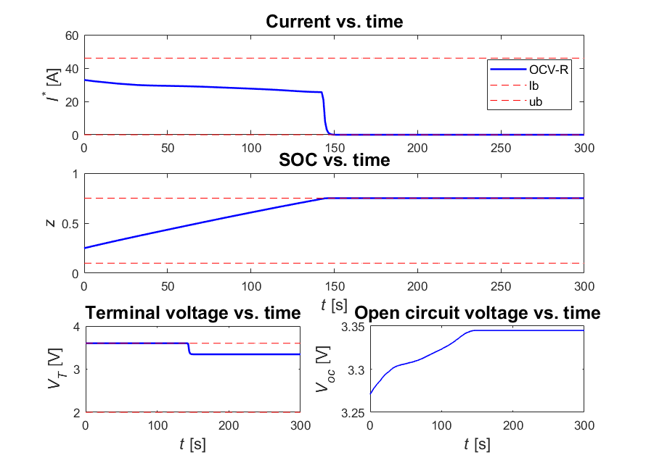
OCV-R: MATLAB
Specifications
z_{target} = 0.75
lb:
ub:
State(s): {z}
Control(s): {I}
Objective fn:
Remarks
Changing objective function has no impact on optimal control
DP time: 4.5-6.5 sec

