Slide 1


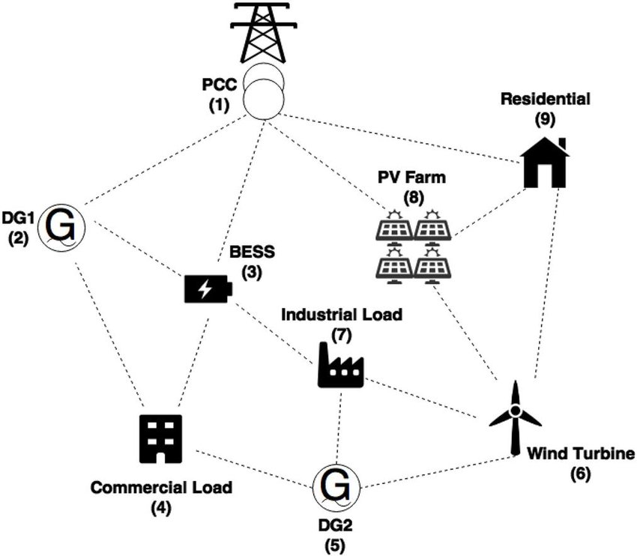




G
Equivalent circuit model (ECM)
PV Farm (8)
Wind (6)
DG (2,5)
I_{B}
G(k)
±
V_{oc}
R_{B}
P_{0i}
i=1
i=2
i=3
BESS (3)
d(k)
Commercial (4)
Industrial (7)
Residential (9)

Slide 2
E₁(N-1)
.
.
.
E₁(1)
E₁(0)
W_{h,1}(0)
W_{h,1}(1)
.
.
.
W_{h,1}(N-1)
i=1
i=2
i=I

