Slide 1
Pima Dataset
Raul Sena

Slide 2
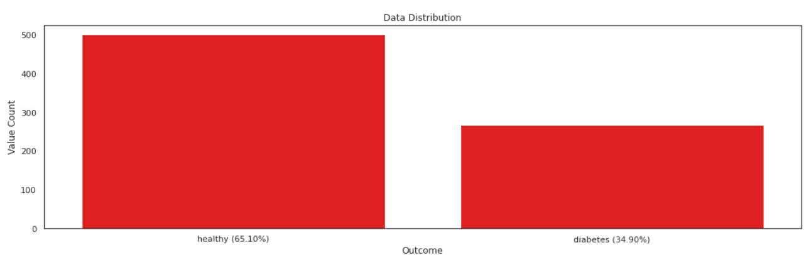
Imbalance Distribution

Slide 3
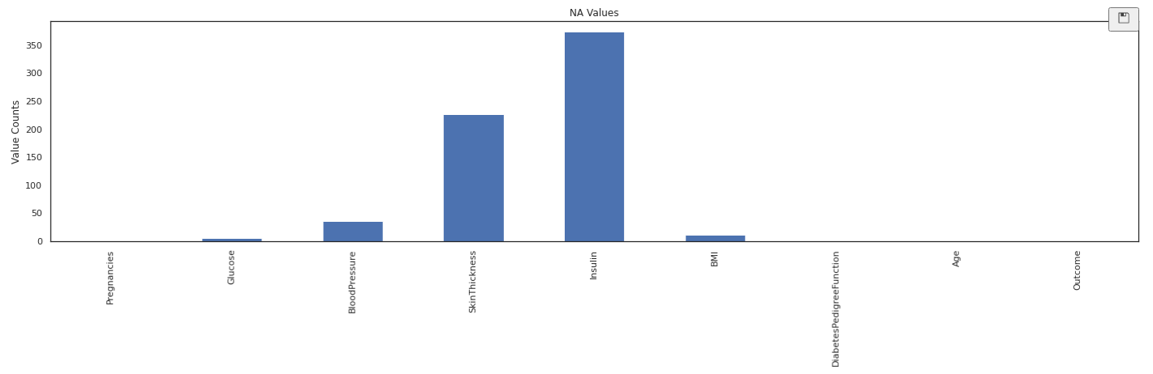
NA values
The only preprocessing done was an educated guess in the NA values (taking the median) and use an Standard Scaler transformer.

Slide 4
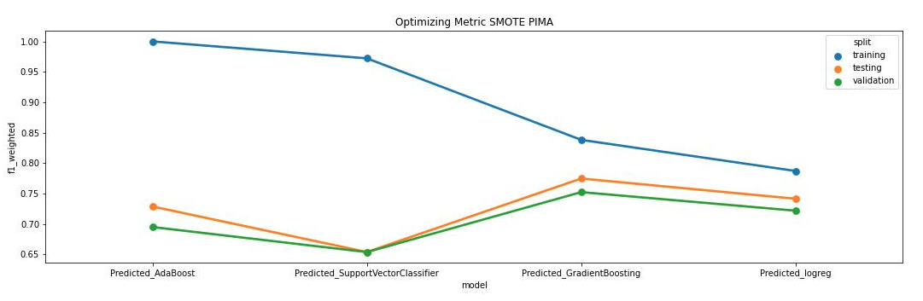
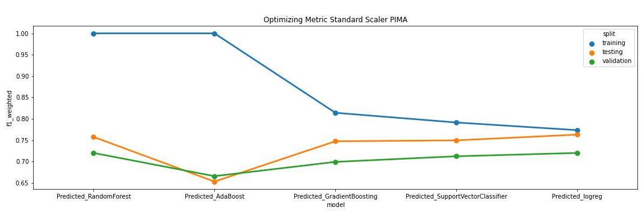
Optimizing Metric

Slide 5
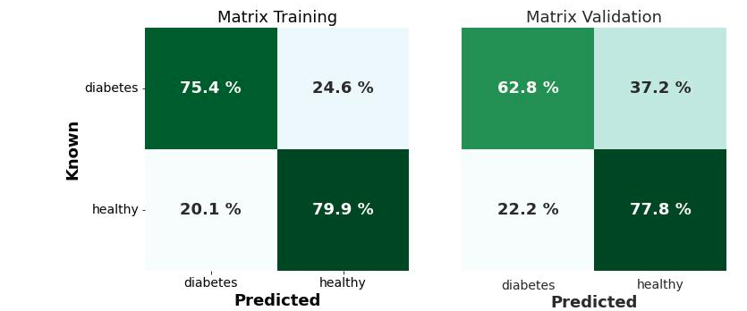
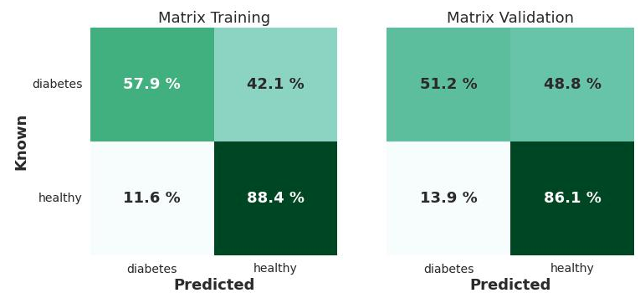
Logistic Regression
SMOTE
Standard Scaler

Slide 6
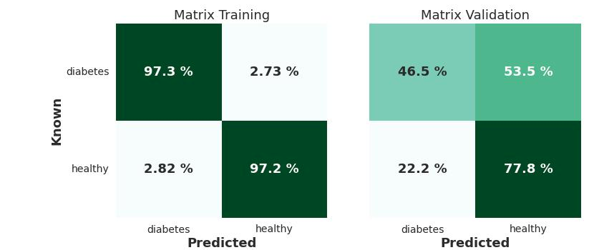
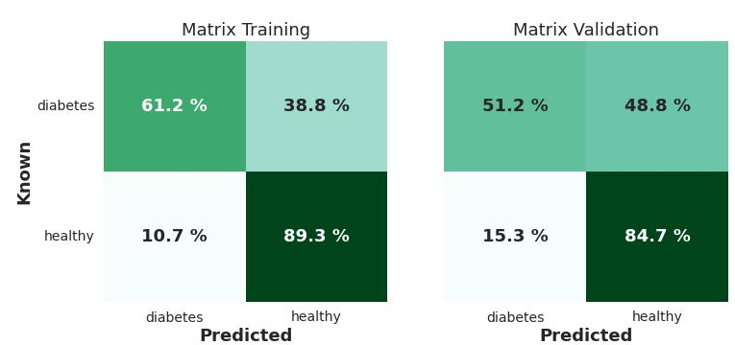
Support Vector Classifier
SMOTE
Standard Scaler

Slide 7
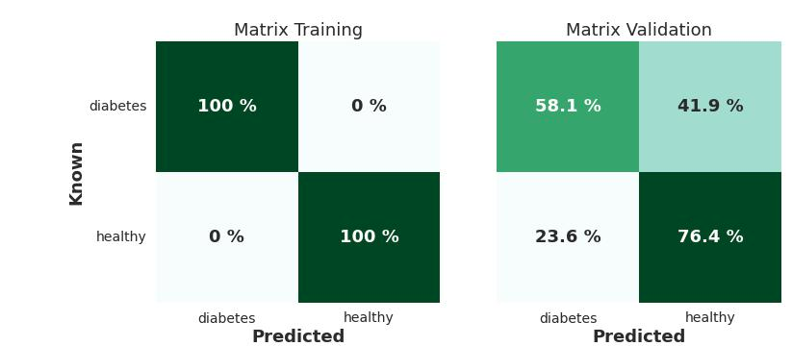
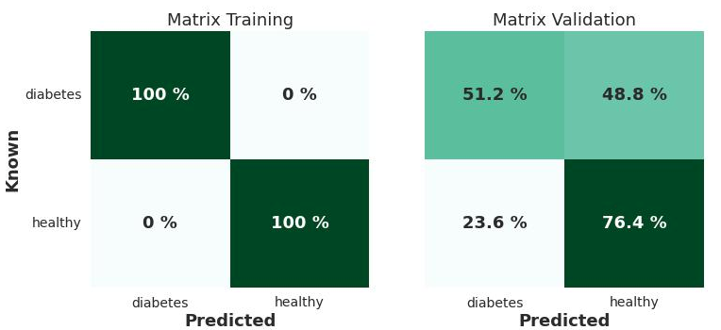
AdaBoost
SMOTE
Standard Scaler

Slide 8
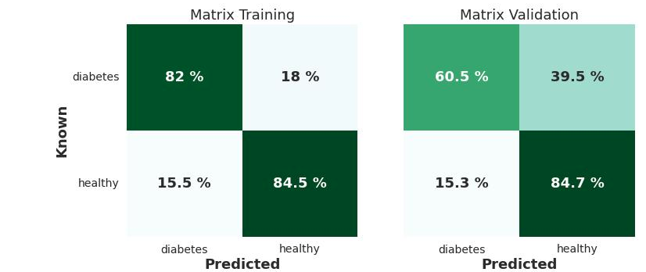
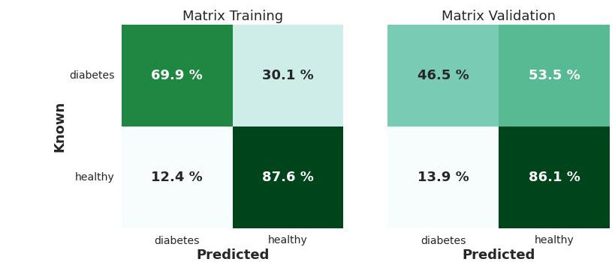
Gradient Boosting
SMOTE
Standard Scaler

Slide 9
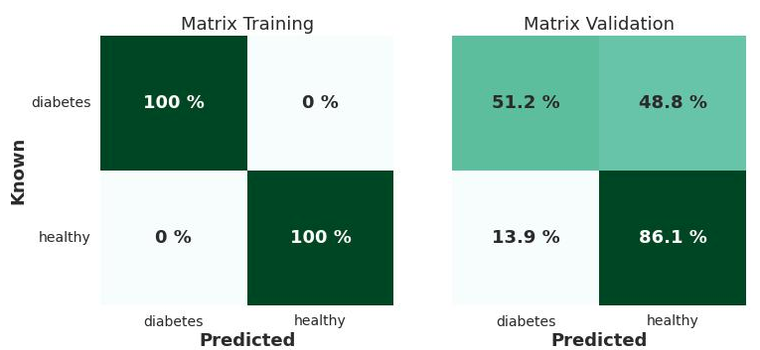
Random Forest
SMOTE
Standard Scaler

